Slide 1
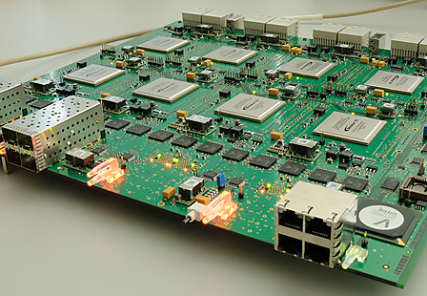
JUC, the JIVE UniBoard Correlator
Arpad Szomoru
for the JUC team:
Jonathan Hargreaves, Harro Verkouter, Des Small

Slide 2
A bit of history
2006: correlator workshop in Groningen
SKA looming on the horizon
But, more immediate need for massive computing power, I/O:
EVN correlator, APERTIF
Software on commodity hardware – not yet
Blue Gene – too expensive…
iBOB/ROACH – too small
ASICs – too long and expensive to develop
GPUs – I/O limitations
FPGAs to the rescue?

Slide 3
Project setup
UniBoard: Joint Research Activity in RadioNet FP7
Kick-off January 2009
7 partners at first, 2 joined in later
JIVE, ASTRON, INAF, Bordeaux, Orleans, UMAN, KASI
Followed by Oxford and ShAO
Board development + four separate applications
VLBI correlator
digital backend
pulsar binning machine
RFI mitigation for pulsar binning
Followed by
APERTIF beamformer
all-dipole LOFAR correlator
Filterbank for Effelsberg pulsar machine

Slide 4
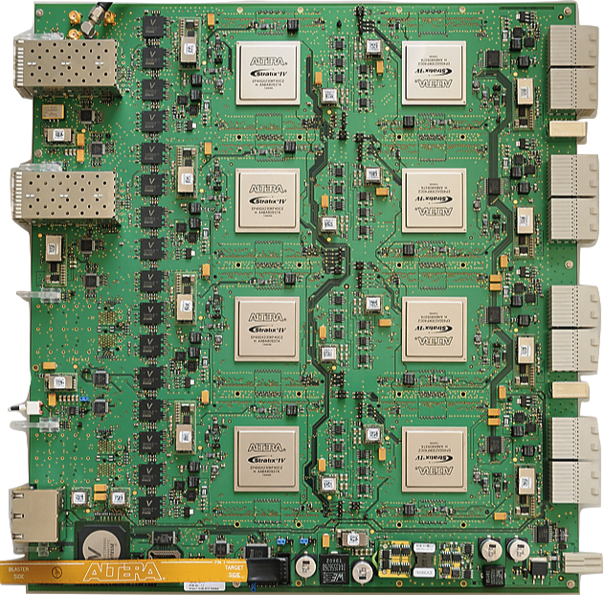

Slide 5
UniBoard
FN0
Stratix IV FPGA
2x 4GB DDR3
BN0
Stratix IV FPGA
2x 4GB DDR3
Backplane /Breakout
3x CX4
SFP+ Cage
3x 10GbE ports
FN1
Stratix IV FPGA
2x 4GB DDR3
BN1
Stratix IV FPGA
2x 4GB DDR3
Backplane /Breakout
3x CX4
SFP+ Cage
3x 10GbE ports
FN2
Stratix IV FPGA
2x 4GB DDR3
BN2
Stratix IV FPGA
2x 4GB DDR3
Backplane /Breakout
3x CX4
SFP+ Cage
3x 10GbE ports
FN3
Stratix IV FPGA
2x 4GB DDR3
BN3
Stratix IV FPGA
2x 4GB DDR3
SFP+ Cage
3x 10GbE ports
Backplane /Breakout
3x CX4
Notes:
8 field programmable gate arrays
Fns and bns
Fns do station based processing and channelisation. Bns receive ¼ of the bandwidth. Coloured line represent chunks of frequency bins

Slide 6
JUC Signal Flow
FNs do station based processing:
Delay and Phase correction, channelization
BNs contain the correlator engines
Notes:
8 field programmable gate arrays
Fns and bns
Fns do station based processing and channelisation. Bns receive ¼ of the bandwidth. Coloured line represent chunks of frequency bins

Slide 7
FPGAs like a simple life
Leave complex tasks to the control software
Run-time options consume real resources
Operating modes can be supported by changing the firmware
Notes:
Ask about implementation details

Slide 8
FPGAs like a simple life
Leave complex tasks to the control software
Run-time options consume real resources
Operating modes can be supported by changing the firmware
Aim is to support the most common modes for continuum processing
Notes:
Ask about implementation details

Slide 9
Correlator Engine
One BN correlator engine calculates 2112 products from 64 input streams
The processing bandwidth is 16MHz per BN
0
32 dual polarization stations
1024 frequency bins
15.625kHz spectral resolution
16MHz
2112 products
31
0
31

Slide 10
BN Correlator Engine
All 2112 products are always computed – the control computer selects which ones to export
0
32 dual polarization stations
Exported Products
16MHz
2112 products
31
0
31
Control computer sets a table of products to export

Slide 11
BN Correlator Engine
One UniBoard has four BN correlator engines
Total processing bandwidth is 64MHz => 32 stations at 512Mbps
Simply add more UniBoards to increase the processing bandwidth
0
32 dual polarization stations
Exported Products
16MHz
2112 products
31
0
31

Slide 12
BN Correlator Engine
Control software can configure a 16 station, 1Gbps correlator
0
32 dual polarization stations
Exported Products
16MHz
2112 products
31
0
31

Slide 13
BN Correlator Engine
… or an 8 station 2Gbps correlator
0
32 dual polarization stations
Exported Products
16MHz
2112 products
31
0
31

Slide 14
Channelization
Polyphase filterbank weights can be re-loaded at run-time.
Default is Blackman Harris
First implemented: four 16MHz input sub-bands per station
Channelized frequency bin size is 15.625kHz
Sub-band a
2048 point FFT
1024 bins of a
BN0
6 taps pre-filter
Sub-band b
2048 point FFT
1024 bins of b
BN1
6 taps pre-filter
Sub-band c
0
2048 point FFT
1024 bins of c
BN2
6 taps pre-filter
Sub-band d
2048 point FFT
1024 bins of d
BN3
6 taps pre-filter

Slide 15
Sub-bands wider than 16MHz
… the FN firmware image has to change (but not the BN)
Operational version:
Two 32MHz input sub-bands per station
Channelized frequency bin size remains15.625kHz
Lower1024 bins of a
BN0
Sub-band a
4096 point FFT
6 taps pre-filter
Upper1024 bins of a
BN1
0
Lower1024 bins of b
BN2
Sub-band b
6 taps pre-filter
4096 point FFT
Upper1024 bins of b
BN3

Slide 16
Sub-bands wider than 16MHz
… the FN firmware image has to change
Under test:
Channelized frequency bin size remains15.625kHz
One 64MHz input sub-bands per station
1024 bins
BN0
1024 bins
BN1
Sub-band a
8192 point FFT
6 taps pre-filter
0
1024 bins
BN2
1024 bins
BN3

Slide 17
Sub-bands narrower than 16MHz
Lower bandwidths can be processed without changing the firmware
The spectral resolution increases
Pre-recorded data can be processed faster than real-time
Sub-band width | Processing speed-up | Spectral Resolution
16MHz | x1 | 15.650 kHz
8MHz | x2 | 7.8125 kHz
4MHz | x4 | 3.90623 kHz
Notes:
Ask about implementation details

Slide 18
Mixed Modes
Possible by configuring the four FNs with different firmware
abcd
4 x 16MHz
FN0
abcd
4 x 16MHz
FN1
Frequency bins to the back node correlator engines
ab
FN2
2 x 32MHz
a
FN3
1 x 64MHz

Slide 19
Integration Time
Set at run-time in units of FFTs
One FFT is 64us
Range is approx. 0.022-1 s
Upper limit is due to memory available for corner-turning in the BN
Lower limit is due to the volume of output
Notes:
Ask about implementation details

Slide 20
Spectral Resolution
Native spectral resolution is 15.625kHz
Not needed for most continuum experiments
Output data volume is high causing unnecessary load on network, storage and post-processing facilities
Solution was to implement a simple channel aggregation algorithm post-correlation
Combine 2,4,8,16,32 or 64 consecutive frequency bins to reduce spectral resolution by the same factor
Notes:
Ask about implementation details

Slide 21
Input Data Format
VDIF only
Tested with a frame length (payload) of 5000 bytes
Other frame lengths are supported provided:
There is an integer number of frames in one second
The frames are a multiple of 8 bytes
Currently only 2-bit sampling
4 and 8-bit might be added as needed
Lower side bands are ‘converted’ to upper at the input
Notes:
Ask about implementation details

Slide 22
Delay and Phase Correction
The control computer sends a set of quadratic polynomial coefficients for each integration
Delay and phase coefficients are 48-bit and 64-bit integers respectively. This is enough precision to remain valid over the maximum 1 second integration.
The delay polynomial is evaluated at the start of the integration, and thereafter every FFT
The phase polynomial is evaluated every sample
Notes:
Ask about implementation details

Slide 23
Delay and Phase Correction
DDR
ETH Switch
10Gb-Eth
Packet Receiver
Mixer
Pre Filter Structure
FFT
Normalize
Framer
FBI
Mesh
3
1
2
Control Computer
Delay Model
1Gb-Eth
SOPC
Integer delay is used to look up the first sample at the start of integration
Fractional delay (to 1/256th sample) is converted to phase at the band centre and applied after the FFT
Phase model is applied continuously using a quadrature mixer at the filterbank input

Slide 24
Validity bits handle gaps in the data
1 bit per VDIF frame stored in FN
A whole FFT is invalid if any contributing data are invalid
First six FFTs in an integration are invalid because pre-filter structure is filling up
Invalid FFTs are substituted by zeros so do not contribute to the products
One validity bit per FFT is carried across to BN and corner-turned with the data
Thirty-two bit validity accumulators calculate normalization factors for every product.

Slide 25
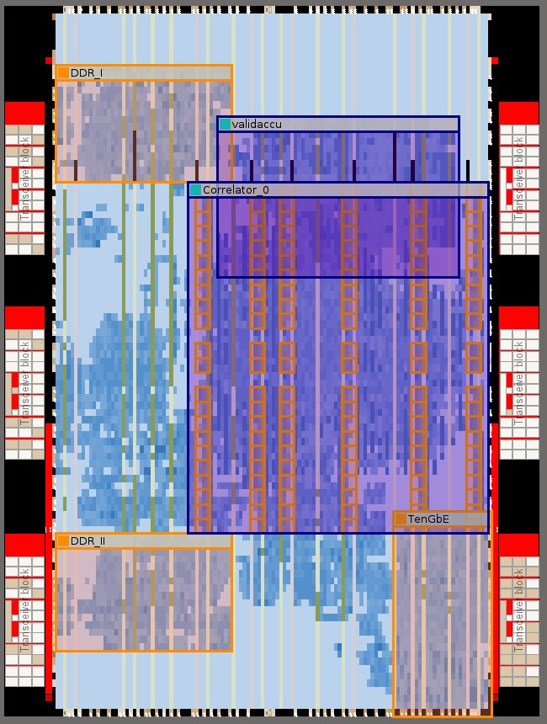
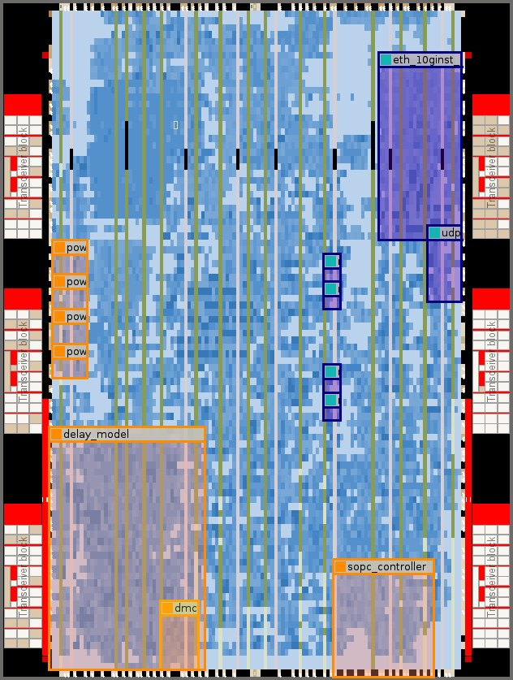
Overkill?
Notes:
Coherent dedispersion

Slide 26
Current Developments
Commissioning
Control system allows operators to run JUC jobs
JUC is run in parallel with SFXC on a series of real experiments
e-VLBI in final tests
2 x 32MHz band mode now default
Has been verified against the 4 x 16MHz firmware using 16MHz data
One band of 64MHz bandwidth
In development stage
Not much 64 MHz data available though…
Per-station frame length
Implemented in 2 x 32MHz firmware

Slide 27
Future Developments
Support 1, 4 and 8 bit sampled data
One bit can be supported by converting to 2 bit at the input
4 and 8 bit to be added when needed
Pulsar Gating
Mixed Modes
Much development needed
Sample Statistics
Firmware written, needs integration and verification
UniBoard²
Arria 10 (20nm) version should double throughput
Stratix 10 (14nm) version up to 8x the throughput

Slide 28
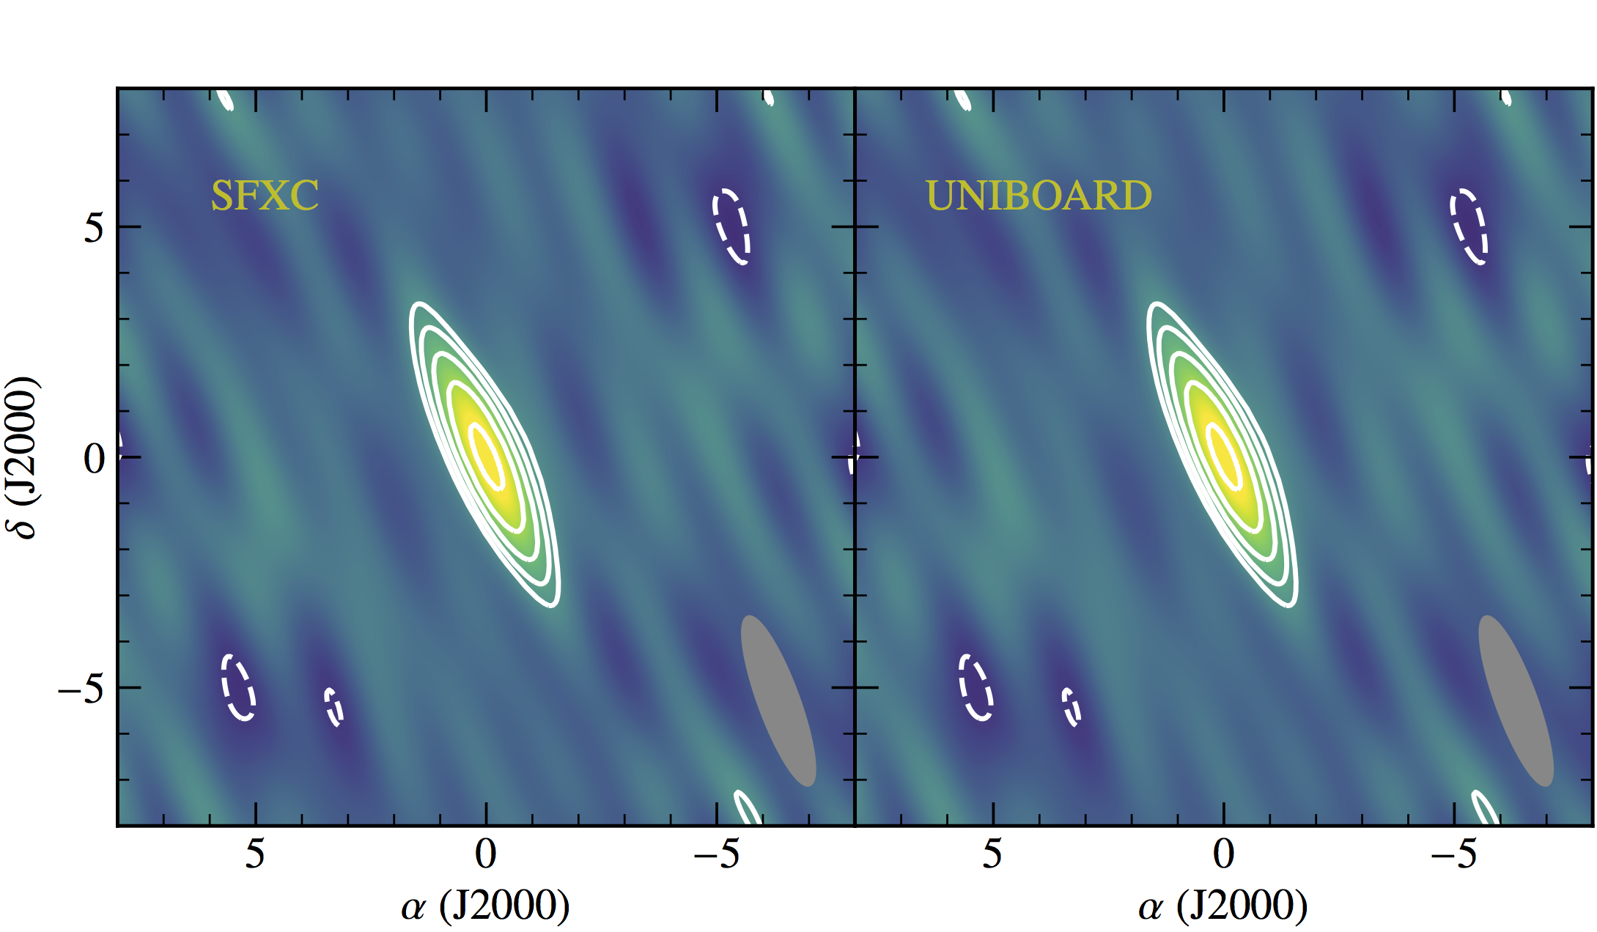
JIVE UniBoard Correlator (JUC)
JUC tested for e-VLBI
Control software re-written, stable
Needs Fila10G in corner turning mode
Which means small packets of 1000B
Maybe 2000
Several real-time tests
Per board:
32 stations at 64 MHz
Dual pol
4 boards: 16 stations at 4 Gbps

Slide 29
Lessons learned
FPGA design tools are ….
Not limited to any particular brand of FPGA
Number of MUXes definitely not equivalent to available computing power
Big chips with lots of multipliers are great, but, to use all of them we would need more of everything else: registers, SRAM, routing resources
Plenty of space left on FPGA, but correlator design at (cutting) edge of what is possible (according to Altera engineers)
Modularization of VHDL code blocks for re-use by other parties is only possible in very limited cases and for very limited functionality
And a waste of time in other cases
But good agreements on level and type of documentation very useful

Slide 30
The future?
Lack of flexibility remains great drawback of FPGA designs
Loooooong development/debugging times
Bandwidth of EVN has not at all increased at expected speed
UniBoard power has never been needed in the past ten years
And by now commodity hardware has caught up
Still useful for “straightforward” correlation
Especially for e-VLBI
Hundreds of boards produced
Experience gained in UniBoard and UniBoard² projects has fed into SKA design

