Slide 1
Construction of the VGOS radio telescope at the Metsähovi Geodetic Research Station
Guifré Molera Calvés

Slide 2
From 0 to 100 in …
The radio telescope is constructed by the Finnish Geospatial Research Institute (FGI), which is part of the National Land Survey of Finland.
From 2005 until now, FGI was just an institute that rented 4 observing times per year the radio telescope of Aalto Metsähovi Radio Observatory (MRO).
In 2019 FGI aims to be a full functioning VLBI Global Observing System (VGOS) station.
Building a VLBI station from scratch with minimal resources.

Slide 3
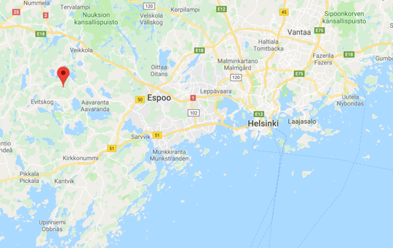
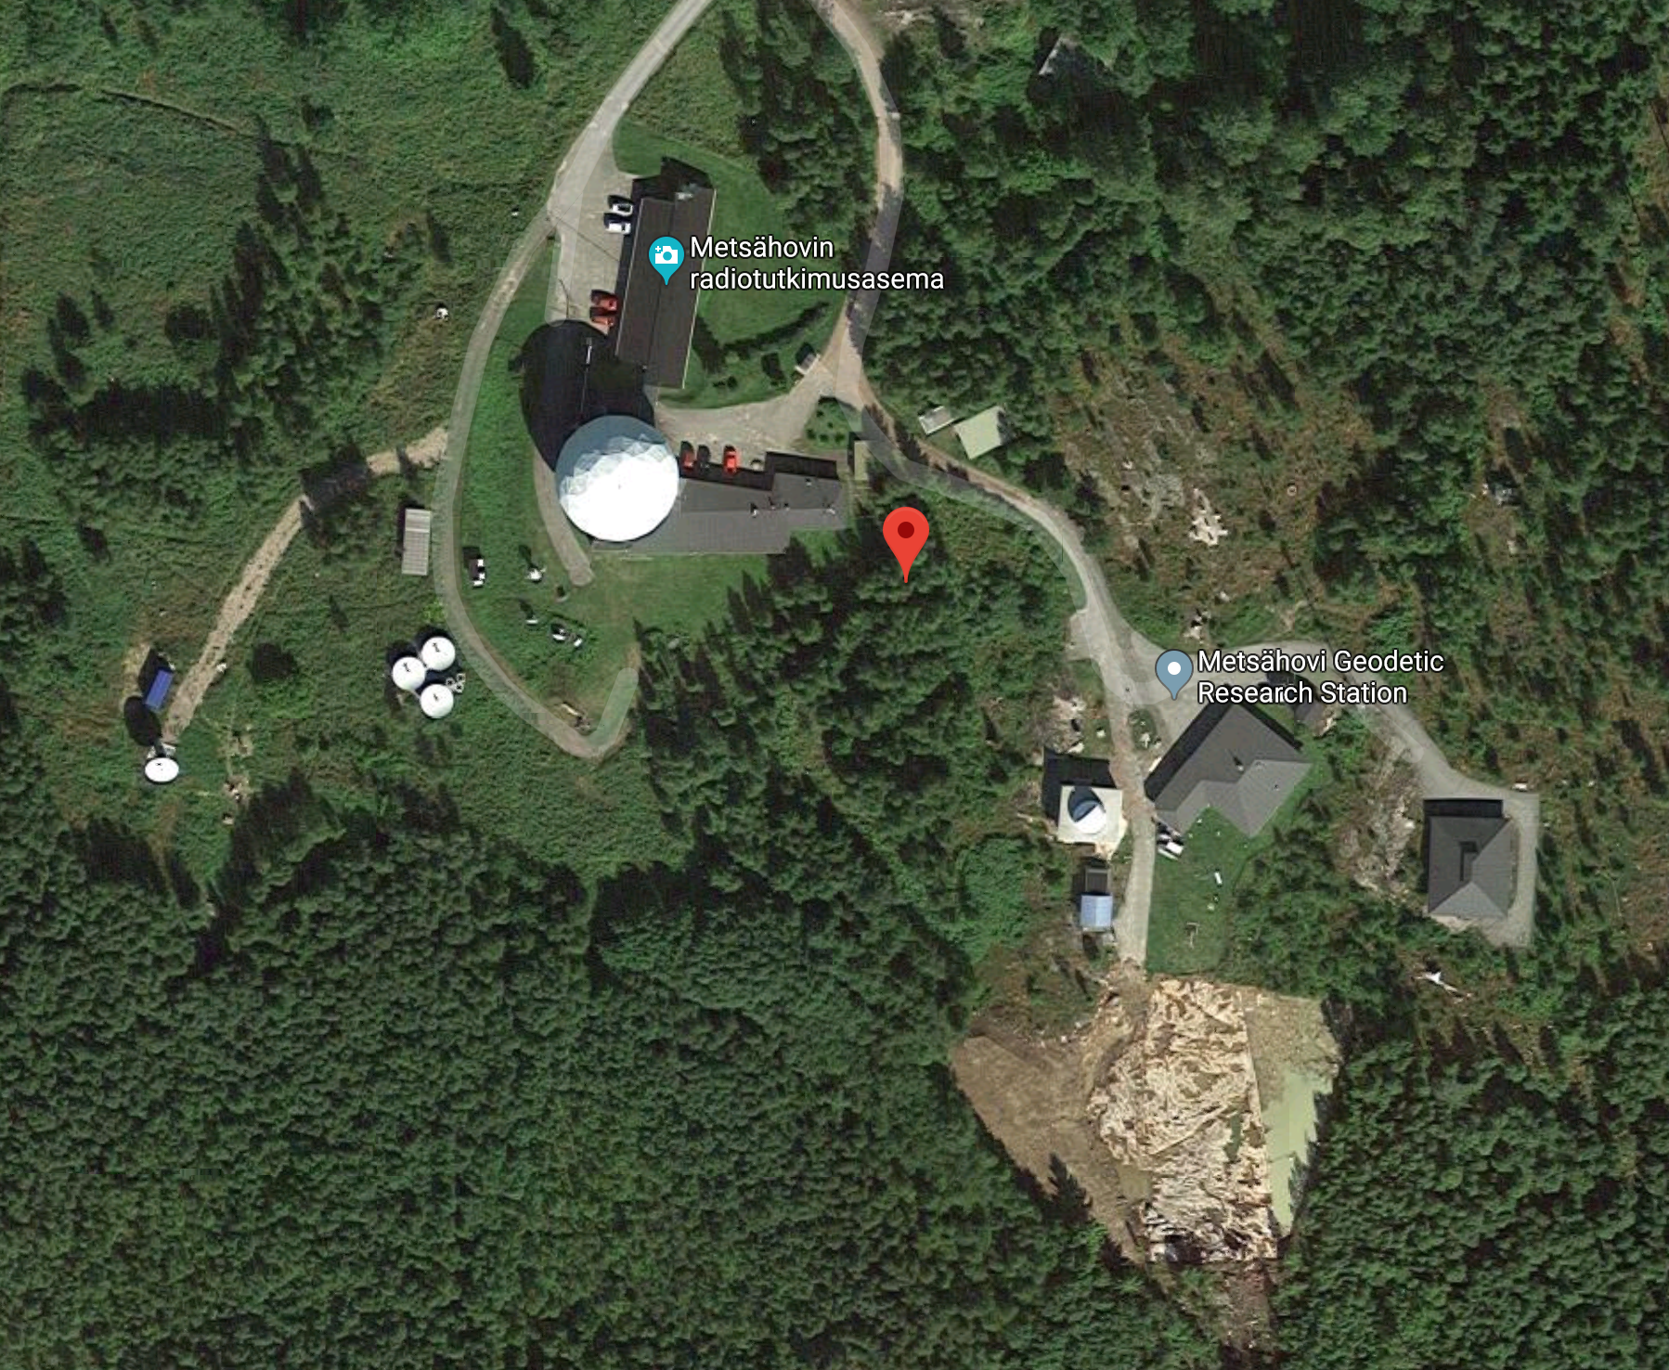
The location
Metsähovi radio quite area
  Helsinki University, Aalto University and FGI

Slide 4
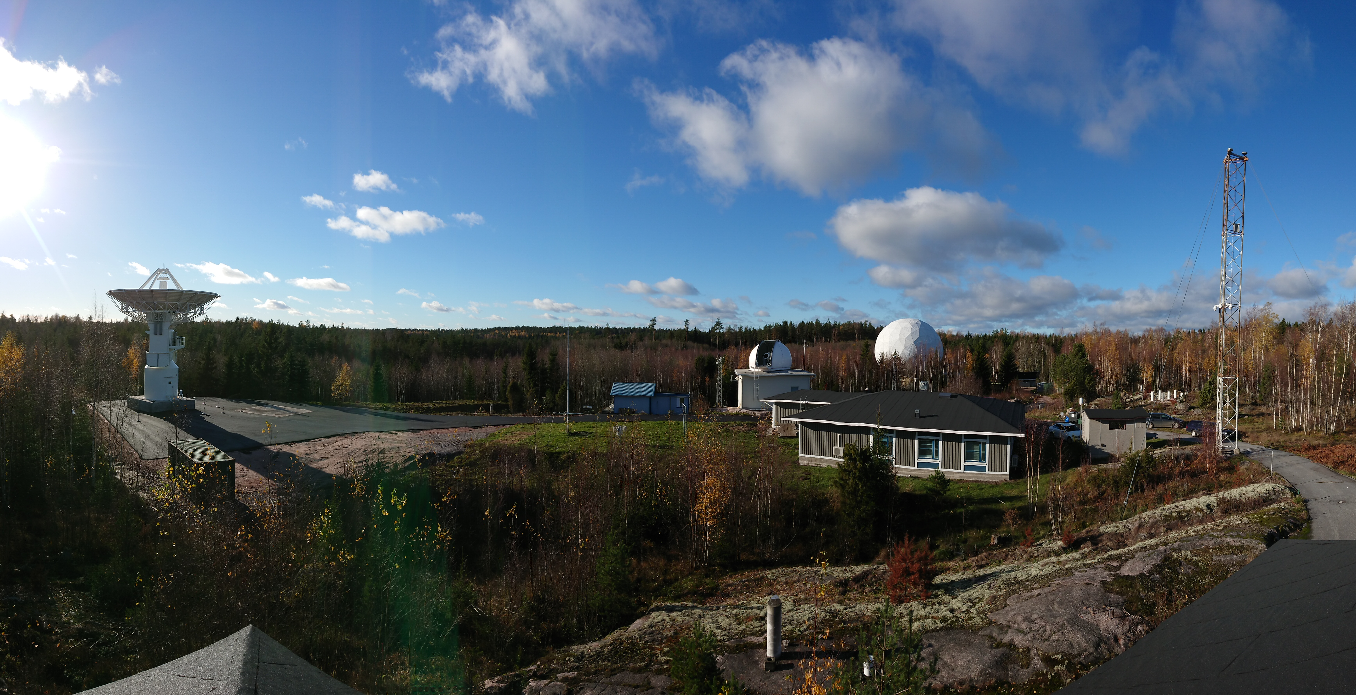
The station
Metsähovi Geodetic Research Institute
  VGOS radio telescope
  Satellite Laser Ranging station (SLR)
  Doppler Orbitography and Radiopositioning Integrated by Satellite (DORIS)
  Receivers for Global Navigational Satellites (GNSS)
  Superconducting and absolute gravimeter (SG+AG)
Notes:
Remind that it is a geodetic station, thus, it accounts for several geodetic instruments.

Slide 5
Timeline
2009 – 2015: Search of funding
  Until 2015: renewal of other Metsähovi instruments.
  November 2015: Proof of funding for the VGOS project by Finnish Ministry of Forestry and Agriculture
January 2016: Start of the project
March - November 2016: tendering of radio telescope
December 2016: MTM is selected as the manufacturer
April 2017 - February 2018: manufacturing of the radio telescope
March – June 2018: Shipment of the parts by boat
June 2018: Arrival of the telescope in Finland

Slide 6
Budget
 | Budget | Timeline
Radio telescope: Construction and Installation | 2.0 M€ | 2017-2018
On-site preparations | 0.5 M€ | 1/2018
Signal Chain | 1.0 M€ | 2/2017-1/2019
Total | 3-3.5 M€ | 2016-2018

Slide 7
The antenna

Slide 8
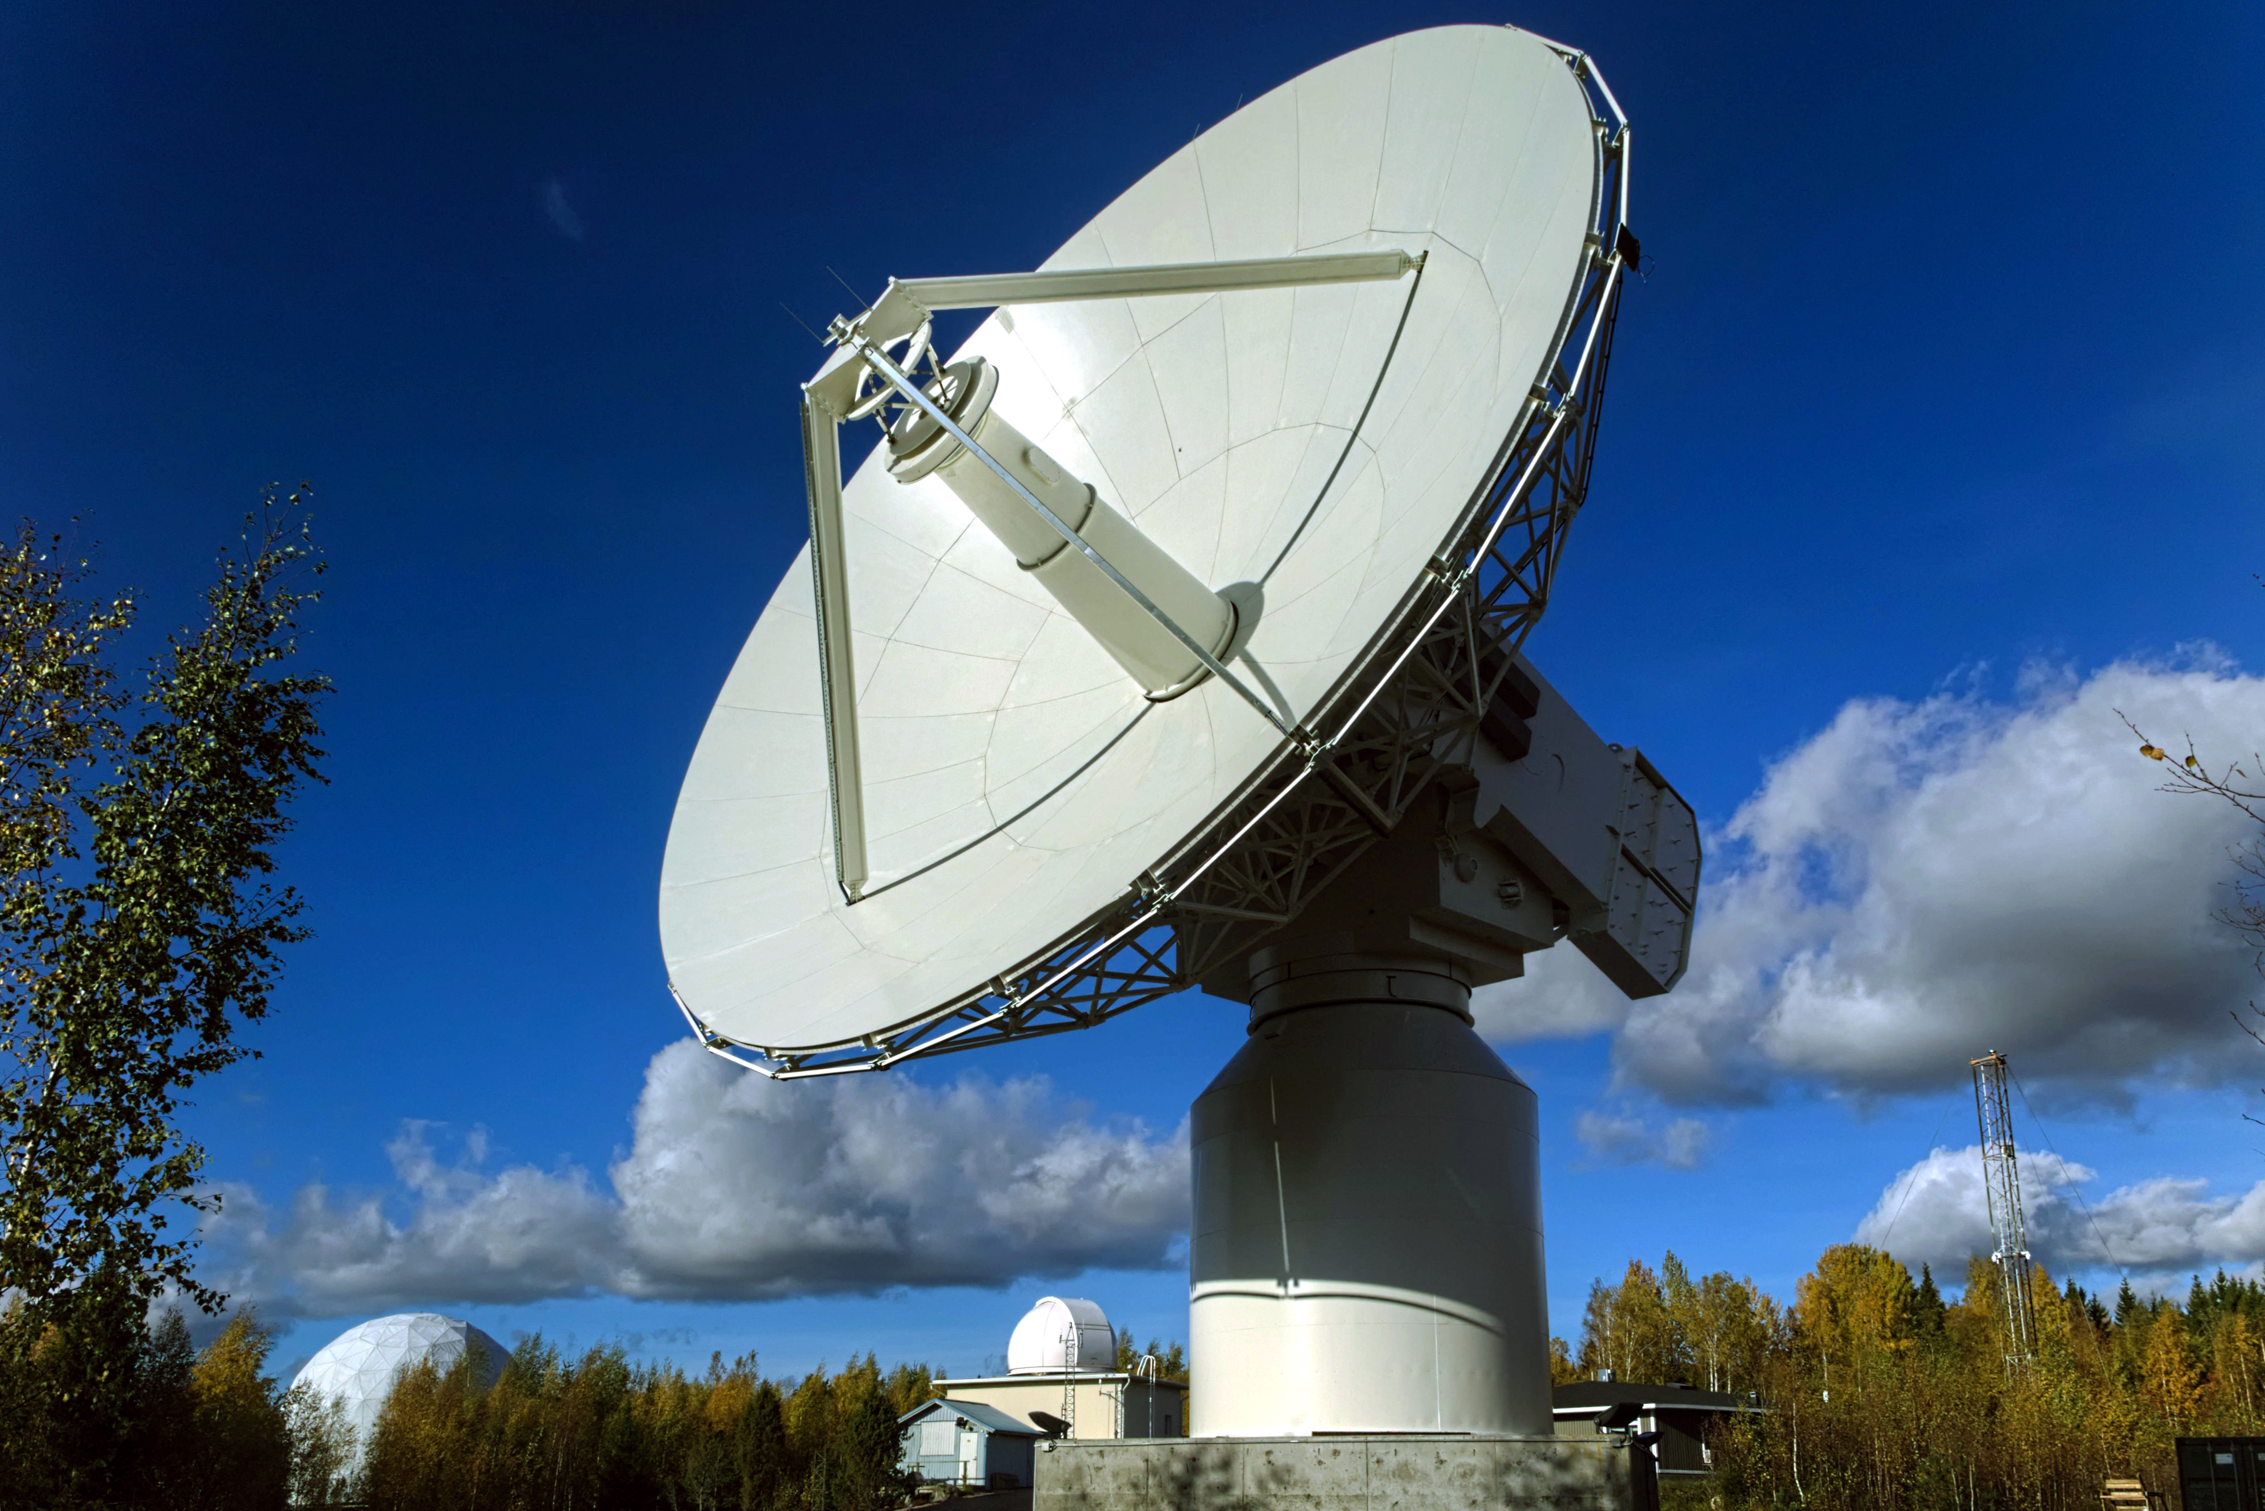
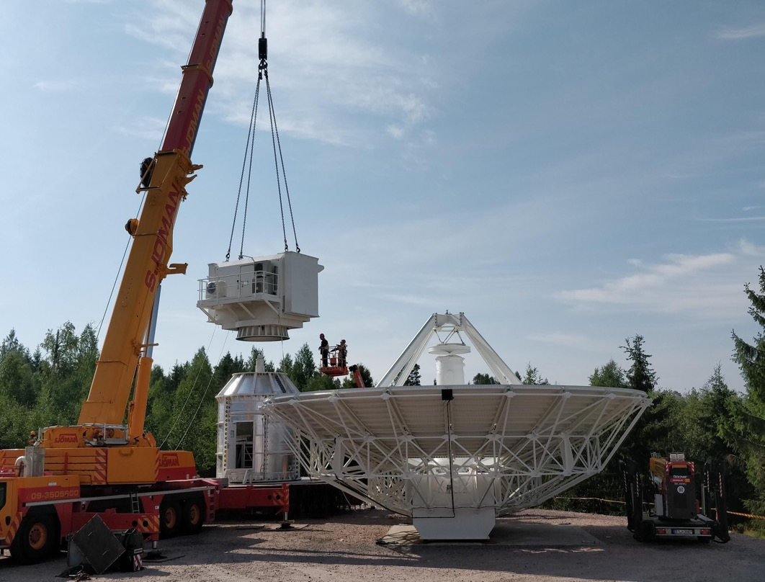
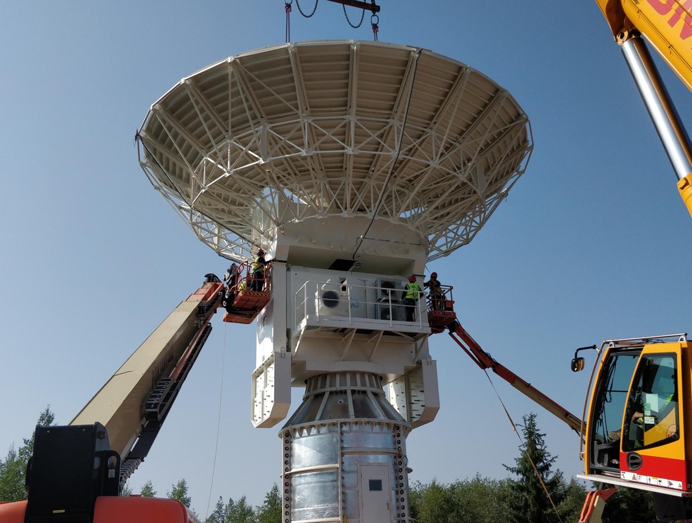
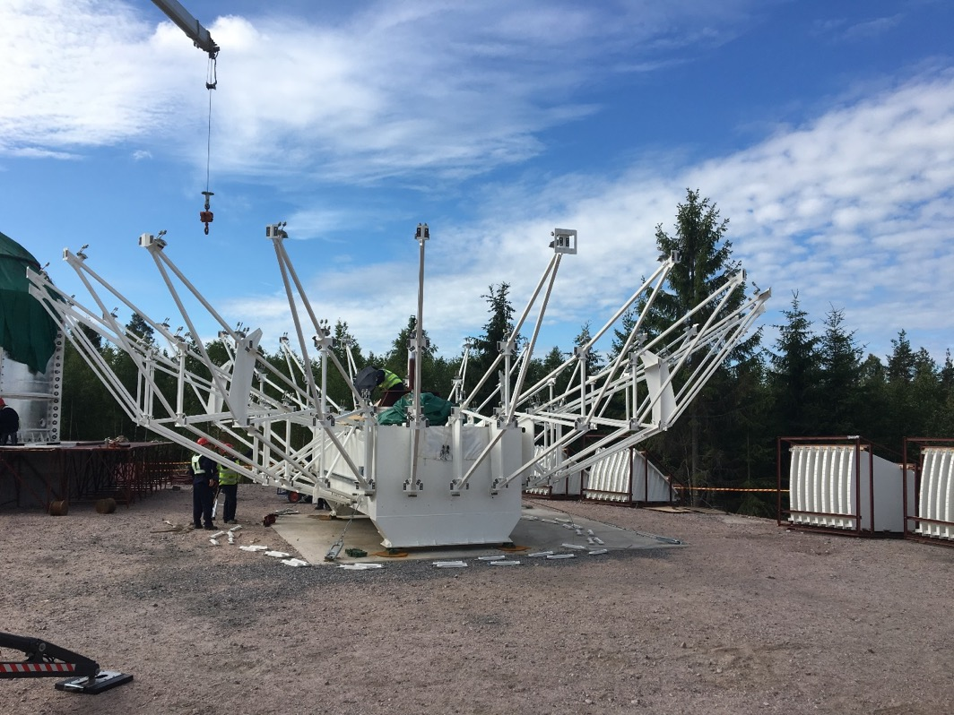
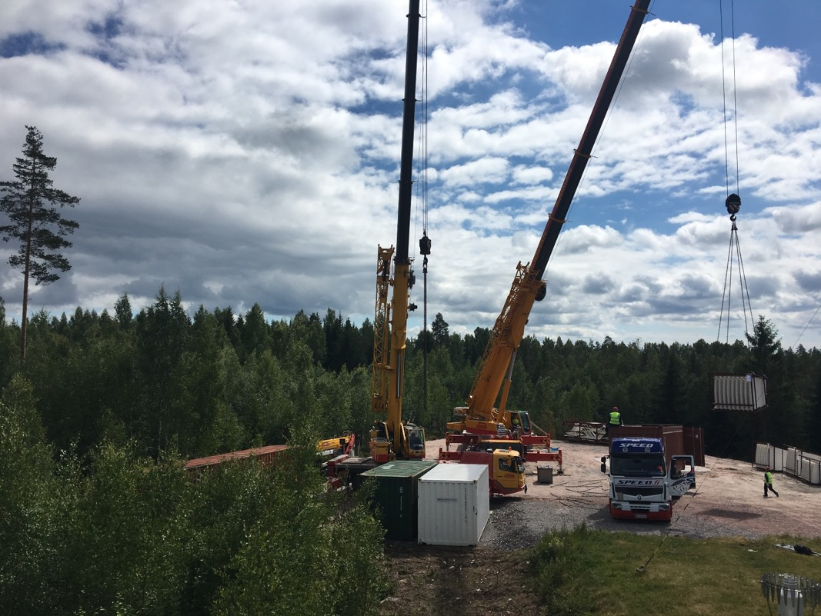
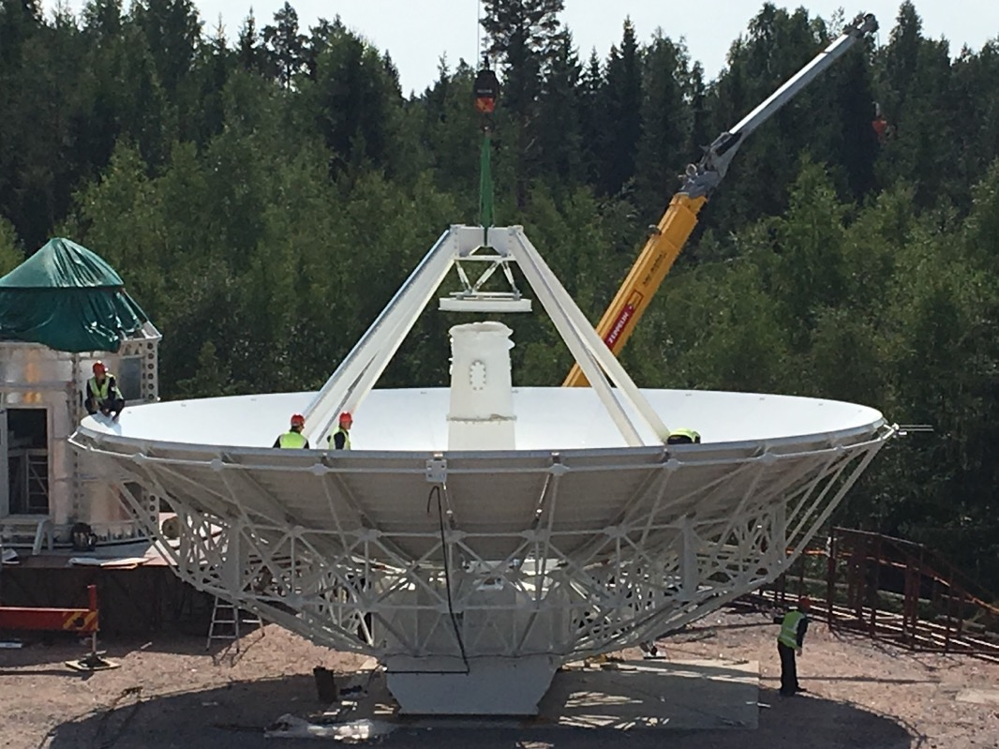
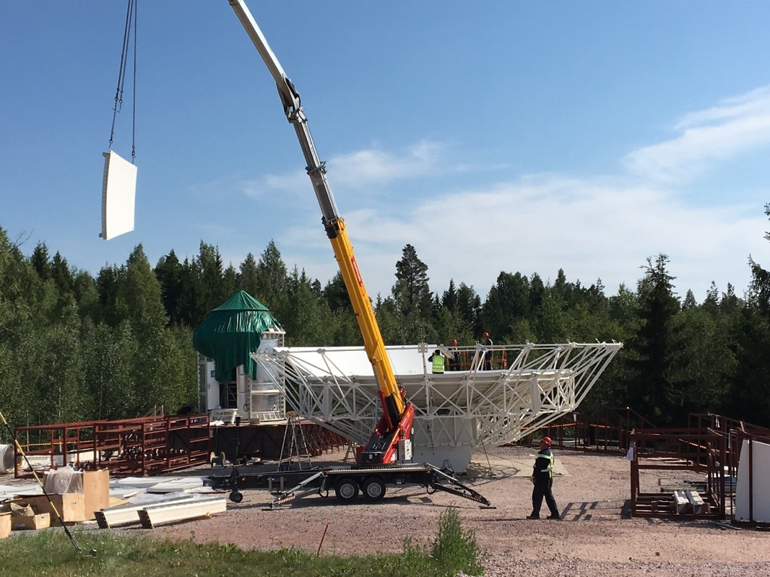
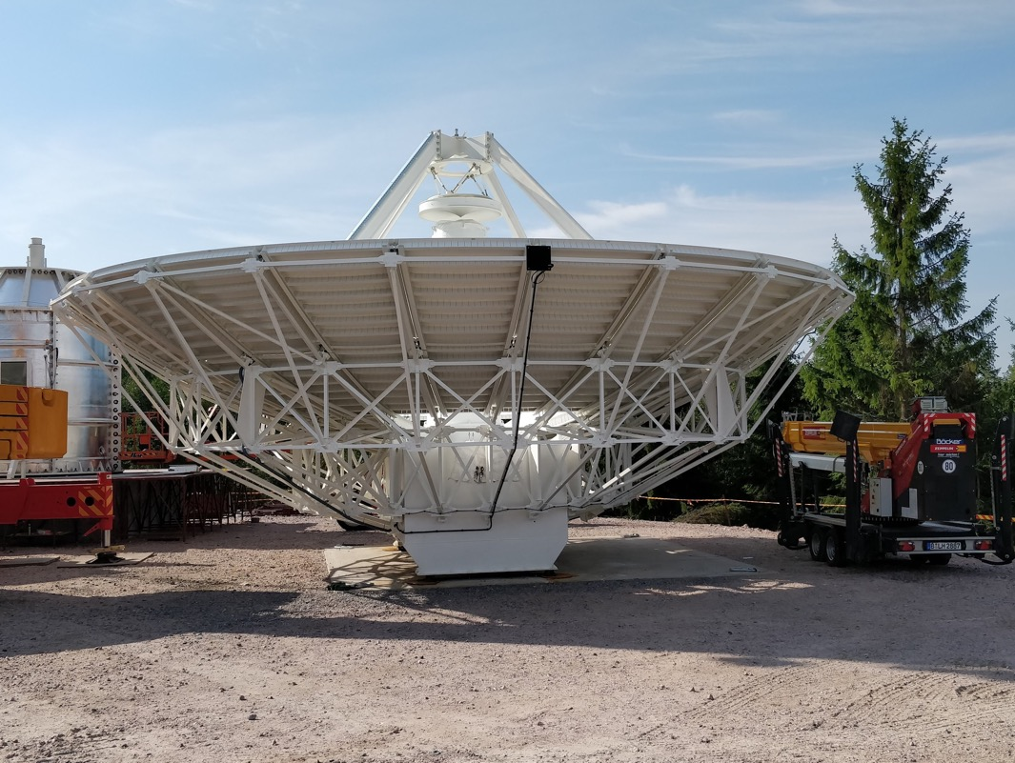
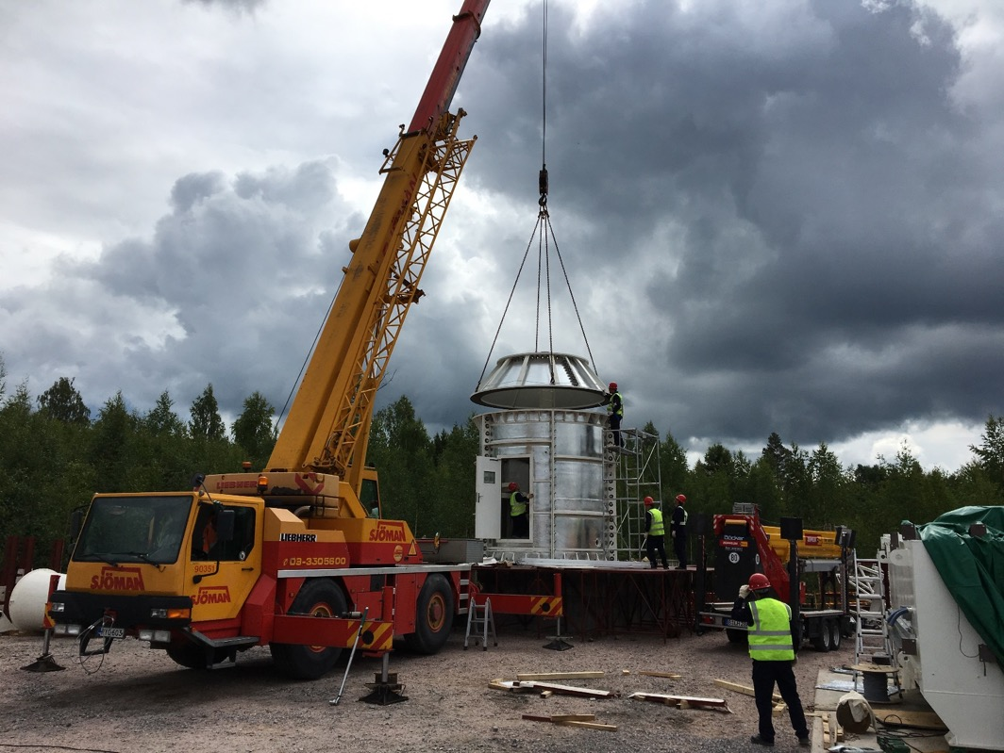
Assembly of the telescope

Slide 9
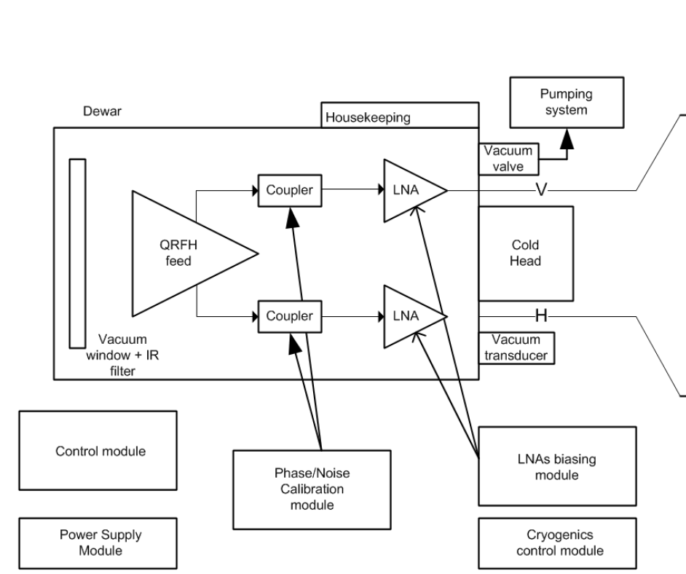
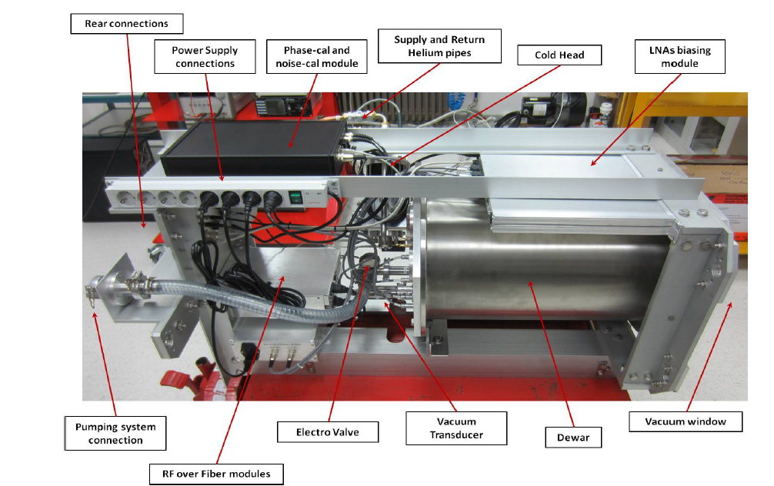
Signal Chain - FE

Slide 10
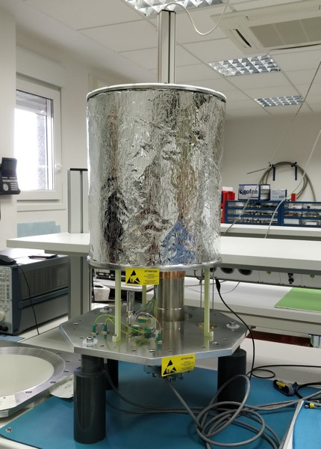
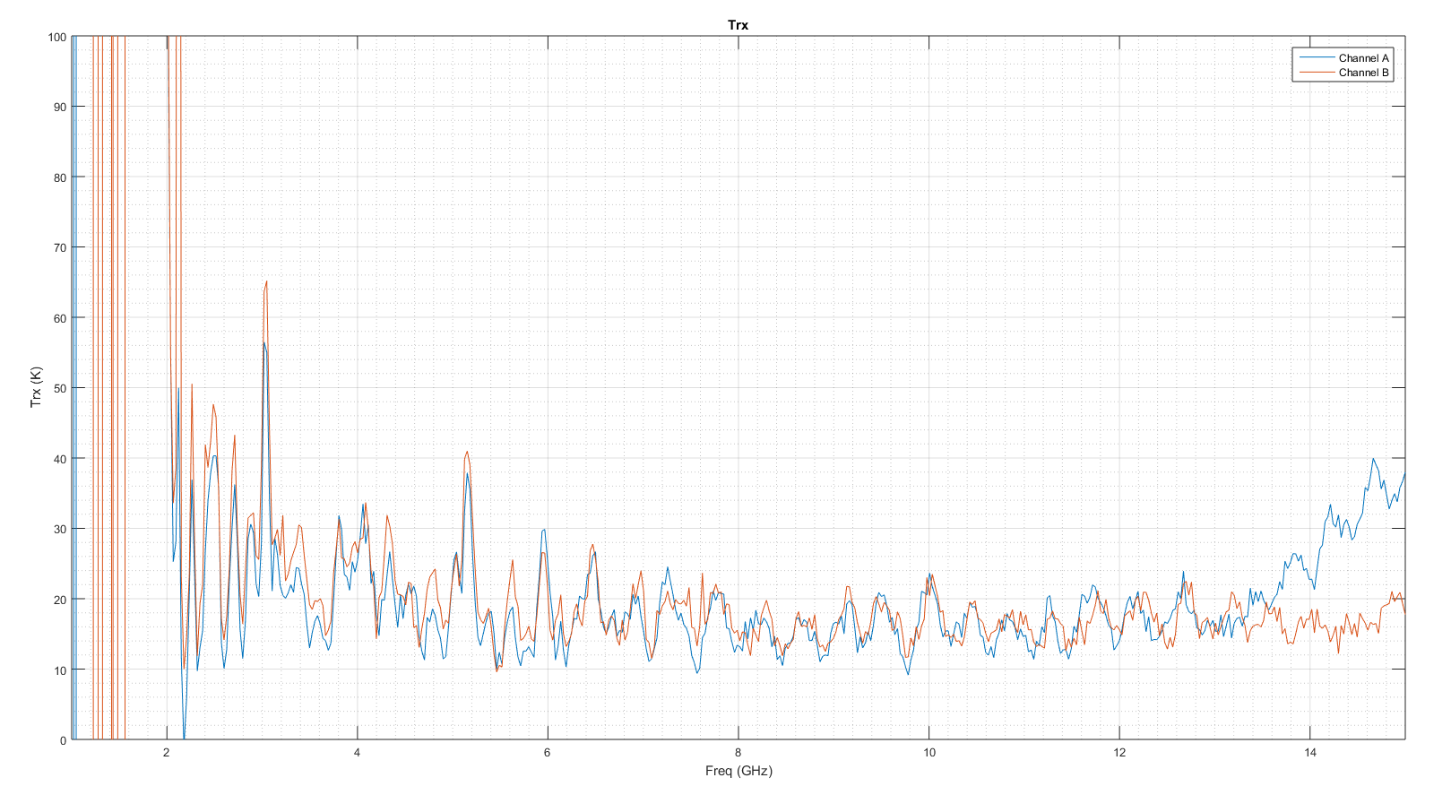
Signal Chain – FE 03.10.2018
Temperature receiver measured at the laboratory in Yebes
Receiver before integrating the dewar.

Slide 11
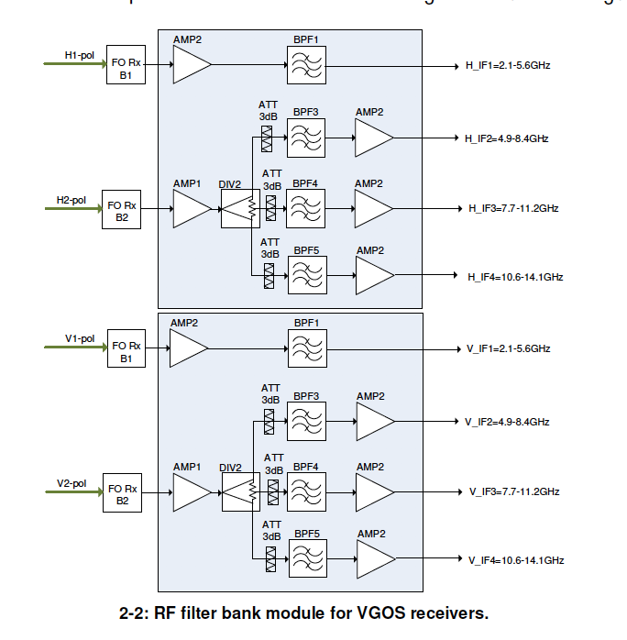
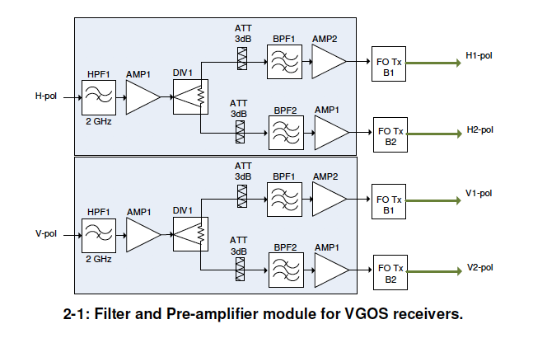
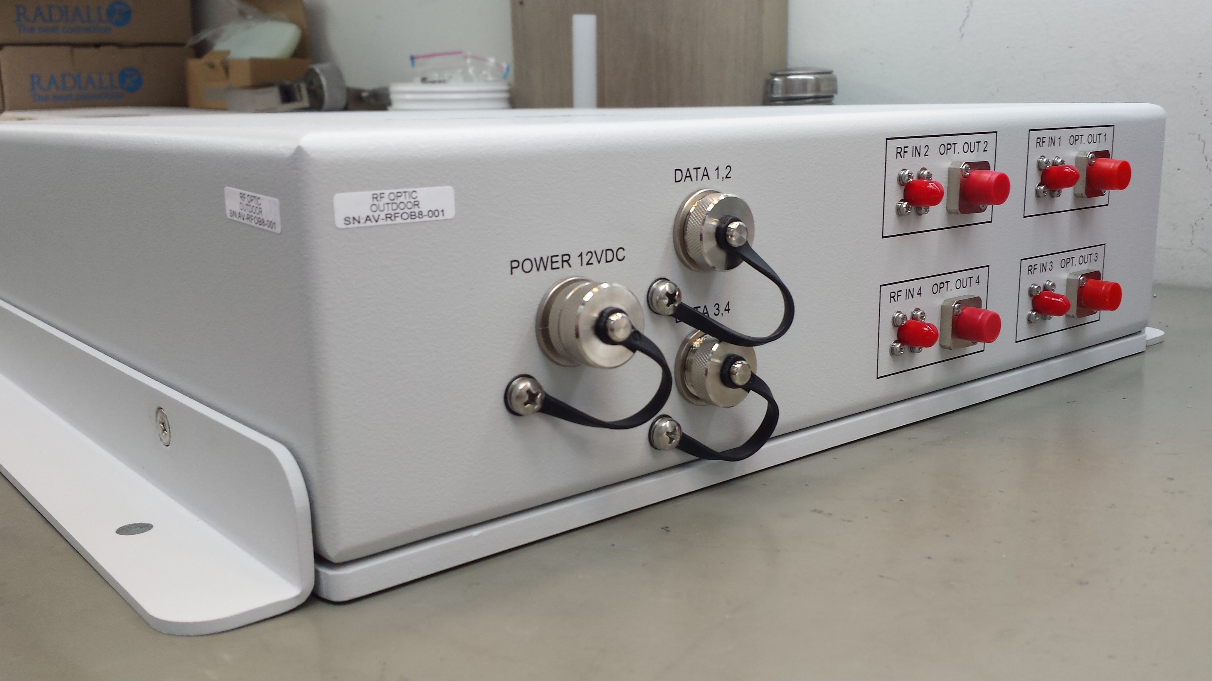
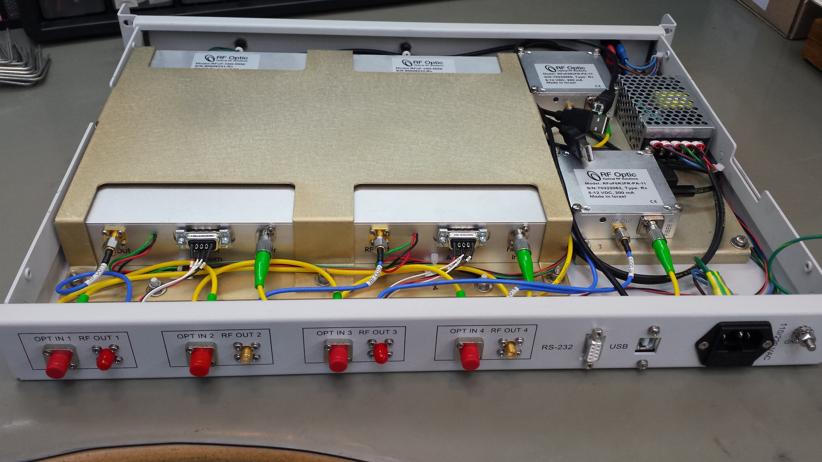
Signal Chain - ME
4 SMF
2x 0-6 GHz
2x 0-18 GHz
Optic fibre
110 metres
Filter and Pre-amplifier module: custom-made (discussions with Yebes).
RFOptics: Tx and Rx units (2 links per polarisation – Low and High freqs.
RF Filter bank module: custom-made (discussions with Yebes).

Slide 12
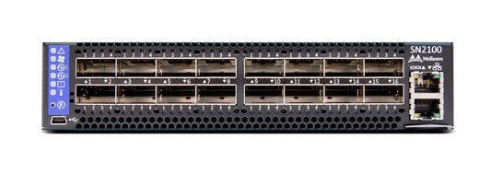
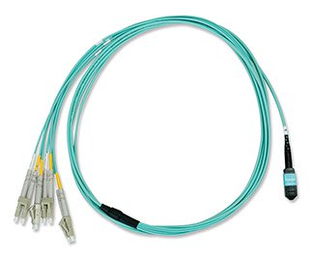
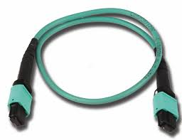
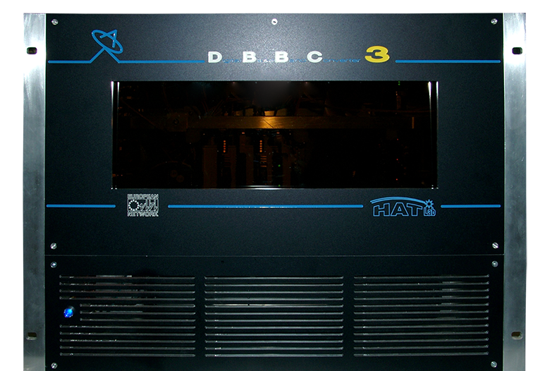
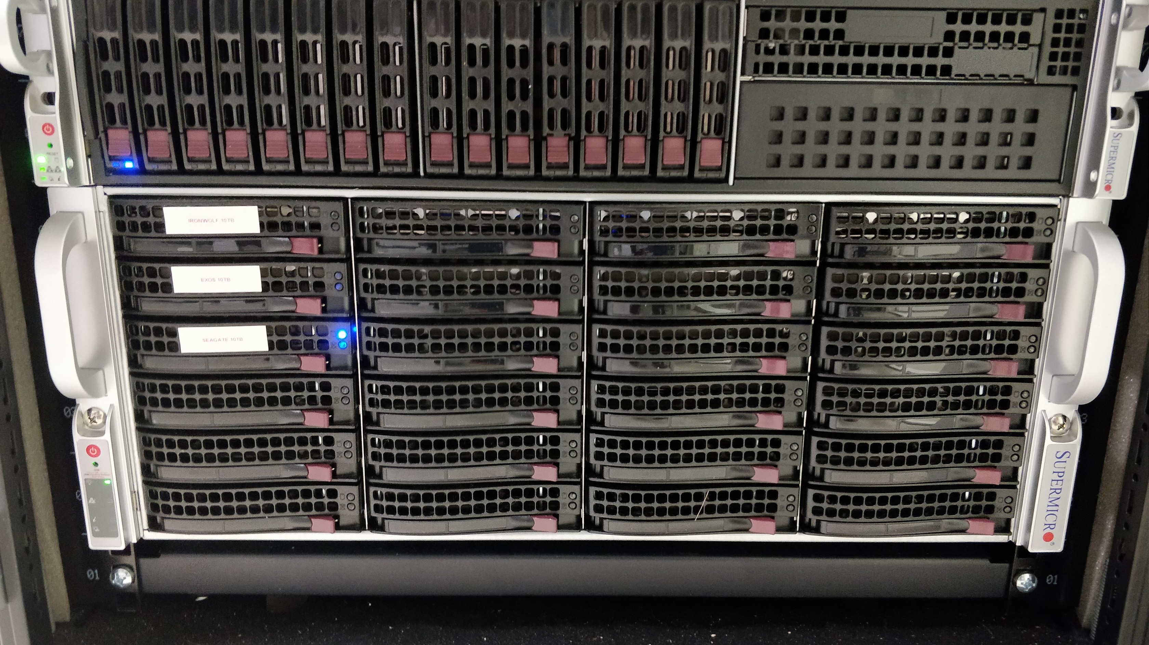
Signal Chain - BE
Internet
MELLANOX SN2100 100 Gbps
8x 40 Gbps SFP+
8x MTP to 4 LC breakout cable
1x 100 Gbps SFP+
1x MTP to MTP 12 Fibers cable

Slide 13
Signal Chain – BE (Flexbuff)
 | Option A | Option B
Motherboard | Supermicro C7X99-OCE | MB-X10DRI-T
Chipset | I7-6950X 10-core 3.0GHz | 2 Xeon E5-2637v4 3500
Number of PCI-E | 4 3.0x16 and 2 2.0x4 | 3 3.0x16 and 3 3.0x8
Memory RAM | 64 GB | 256 GB (16x16 GB)
Chasis | Supermicro 4U | Supermicro 2U + Supermicro 4U
Disks | 36x3.5’’ Ironwolf Seagate 10TB | 18 2.5’’ HDD + 48 3.5’’ HDD
Storage interface | Adaptec HBA 1000-8i8e | LSI SAS 9300-4i4e
Network card | 100 Gbps Mellanox card | 8 AOC-STG-i4S

Slide 14
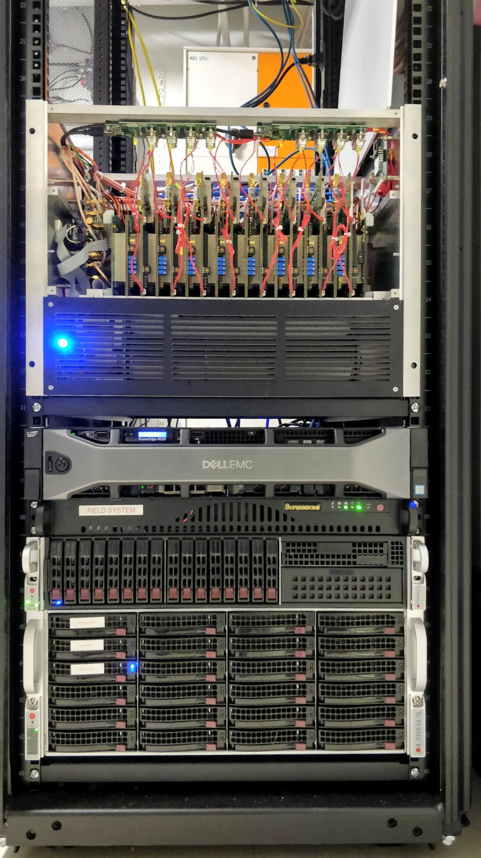

Slide 15
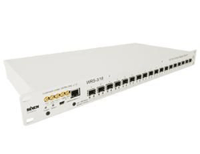
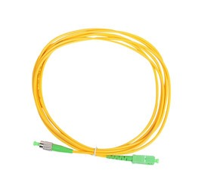
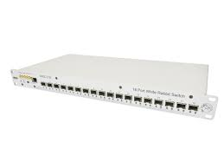
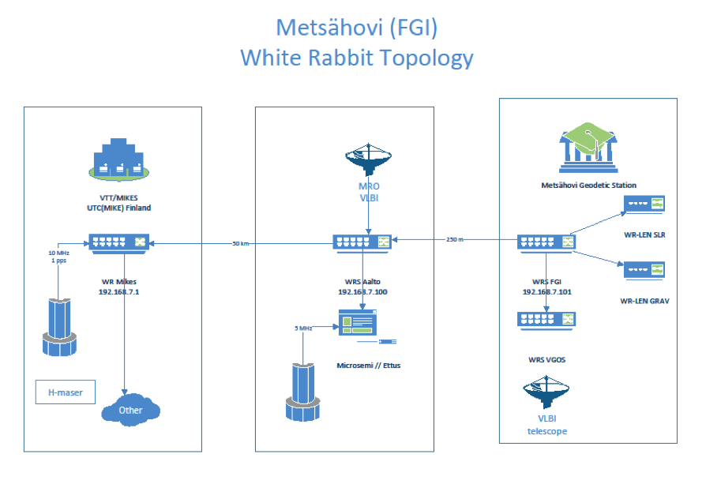
Time & Frequency distribution
FGI will run the station without an Hydrogen maser!
H-maser+
Master
Optic fibre
Slave
1pps/5 MHz

Slide 16
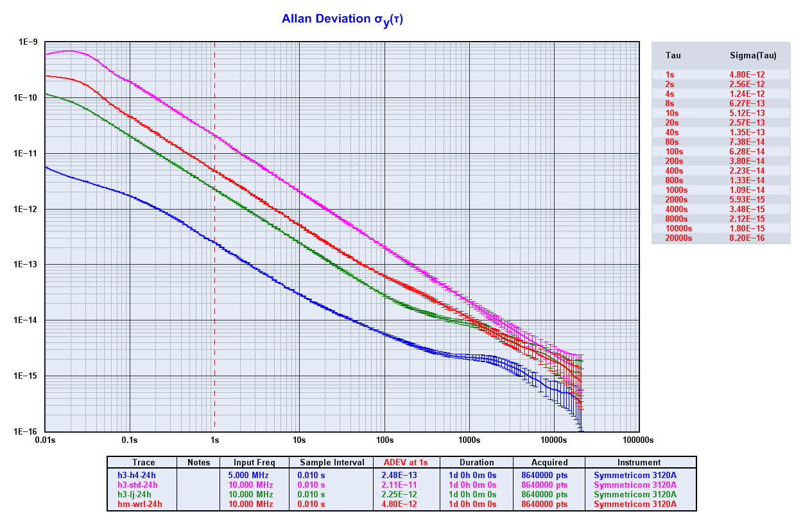
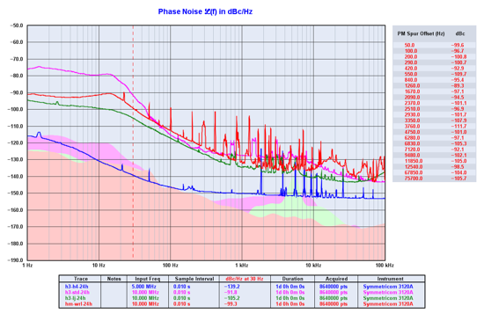
Time & Frequency distribution
Extensive tests have been carried out since the installation of the system in 2017.
Comparing WRS signal vs Aalto’s Metsähovi H-maser.
WRS provides a good 1 pps and 5 MHz signals to fulfill VGOS requirements.

Slide 17
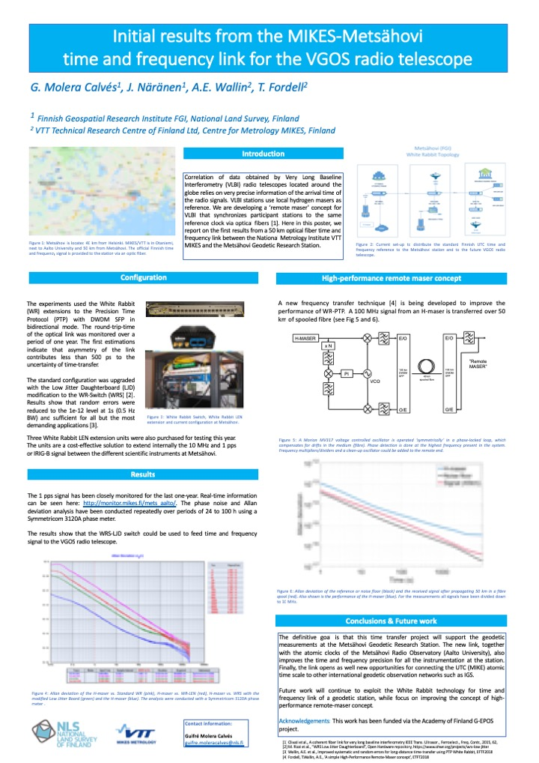
Upgrade TFD – See Poster

Slide 18
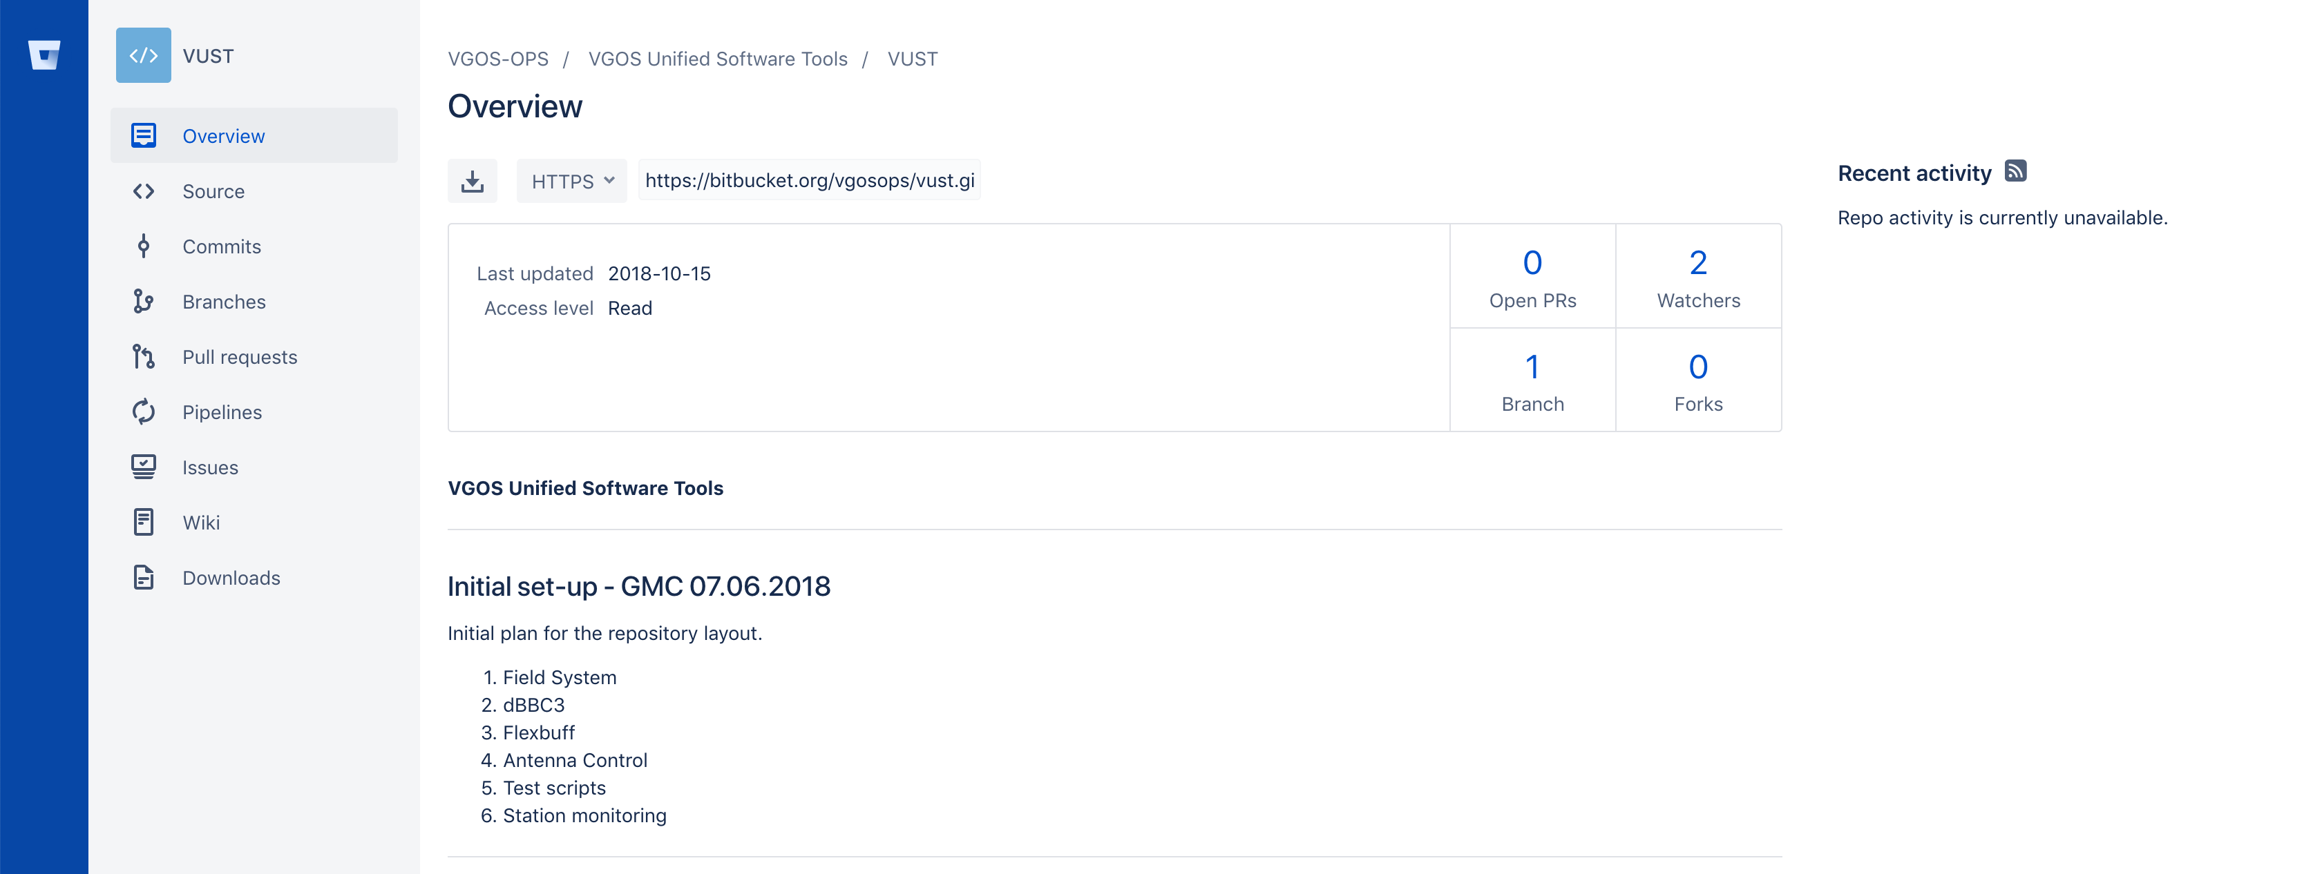
Git Repository

Slide 19
Upcoming timeline
Sep - Oct 2018: Telescope commissioning
Dec 2018: Site acceptance test
Feb - Apr 2019: Installation of the signal chain components
2019: Testing of the complete telescope system
2020: Start regular observations

