Slide 1
Neutrino Physics
2nd ThaisCube Workshop Chiang Mai University
Vedant Basu
On behalf of the IceCube Collaboration

Slide 2
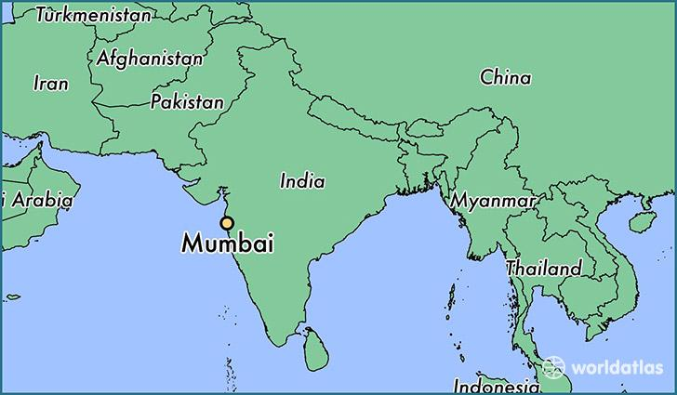
Who am I, and how did I get here?
Undergrad: IIT Bombay, an engineering school in Mumbai, India
Graduate School: University of Wisconsin-Madison

Slide 3
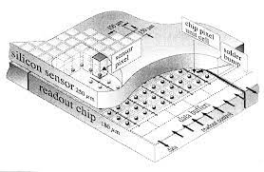
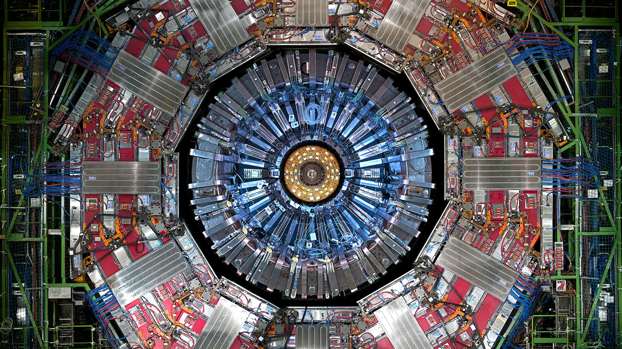
Worked on electrical circuitry for particle physics experiments in Japan to study new reactions
Spent a summer in Germany with a group building detectors at CERN to probe dark matter
Worked with the Compact Muon Solenoid experiment at CERN on new algorithms to accurately measure energy at the Large Hadron Collider
Notes:
Undergrad: IIT Bombay, an engineering school in Mumbai, India
Before that: Bounced around the country from city to city
Why Physics: up late one night watching Big Hero 6 Always enjoyed building stuff and fiddling around in a lab
COMET:https://indico.cern.ch/event/868940/contributions/3815682/attachments/2083310/3499474/ICHEP_COMET_Nishiguchi.pdf Pixel Detector:https://encrypted-tbn0.gstatic.com/images?q=tbn:ANd9GcQWUoP4NsNGdSUruQ3uAxxm4sc9bSkMEKKvRc81BezUbObl6Voy-9Qb1Hh7WIek4DP3DBI&usqp=CAU CMS:https://cms.cern/sites/default/files/2022-06/detector_stripe01-min_0_0.jpeg

Slide 4
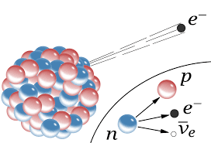
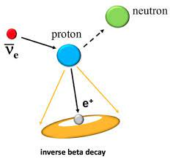
What are neutrinos?
Theorized by Pauli in 1930, to explain spread in e⁻ energies observed in beta-decays
Pauli’s Letter
Discovered by Cowen and Reines in 1956 using the inverse beta-decay process
Further reading

Slide 5
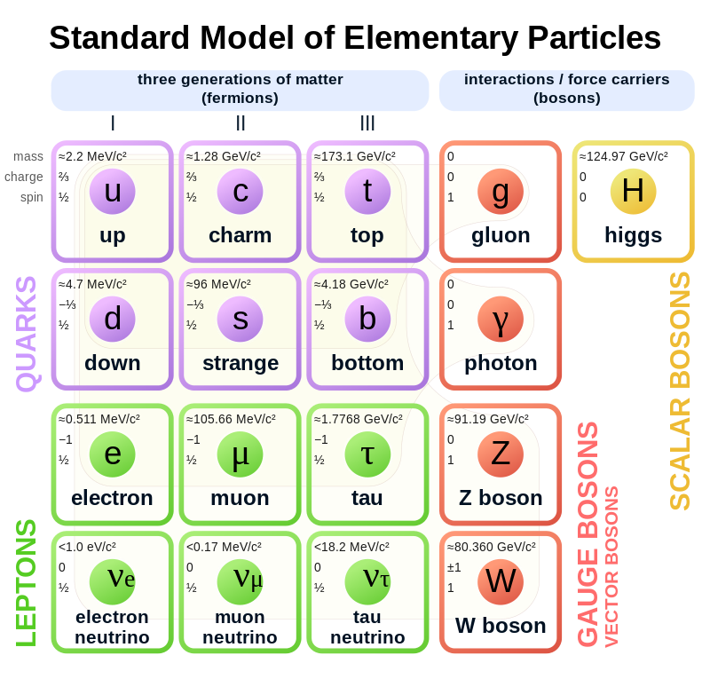
What are neutrinos?
Near-massless, at least a million times lighter than electrons
electrically neutral
lepton-> interact mostly via weak interaction

Slide 6
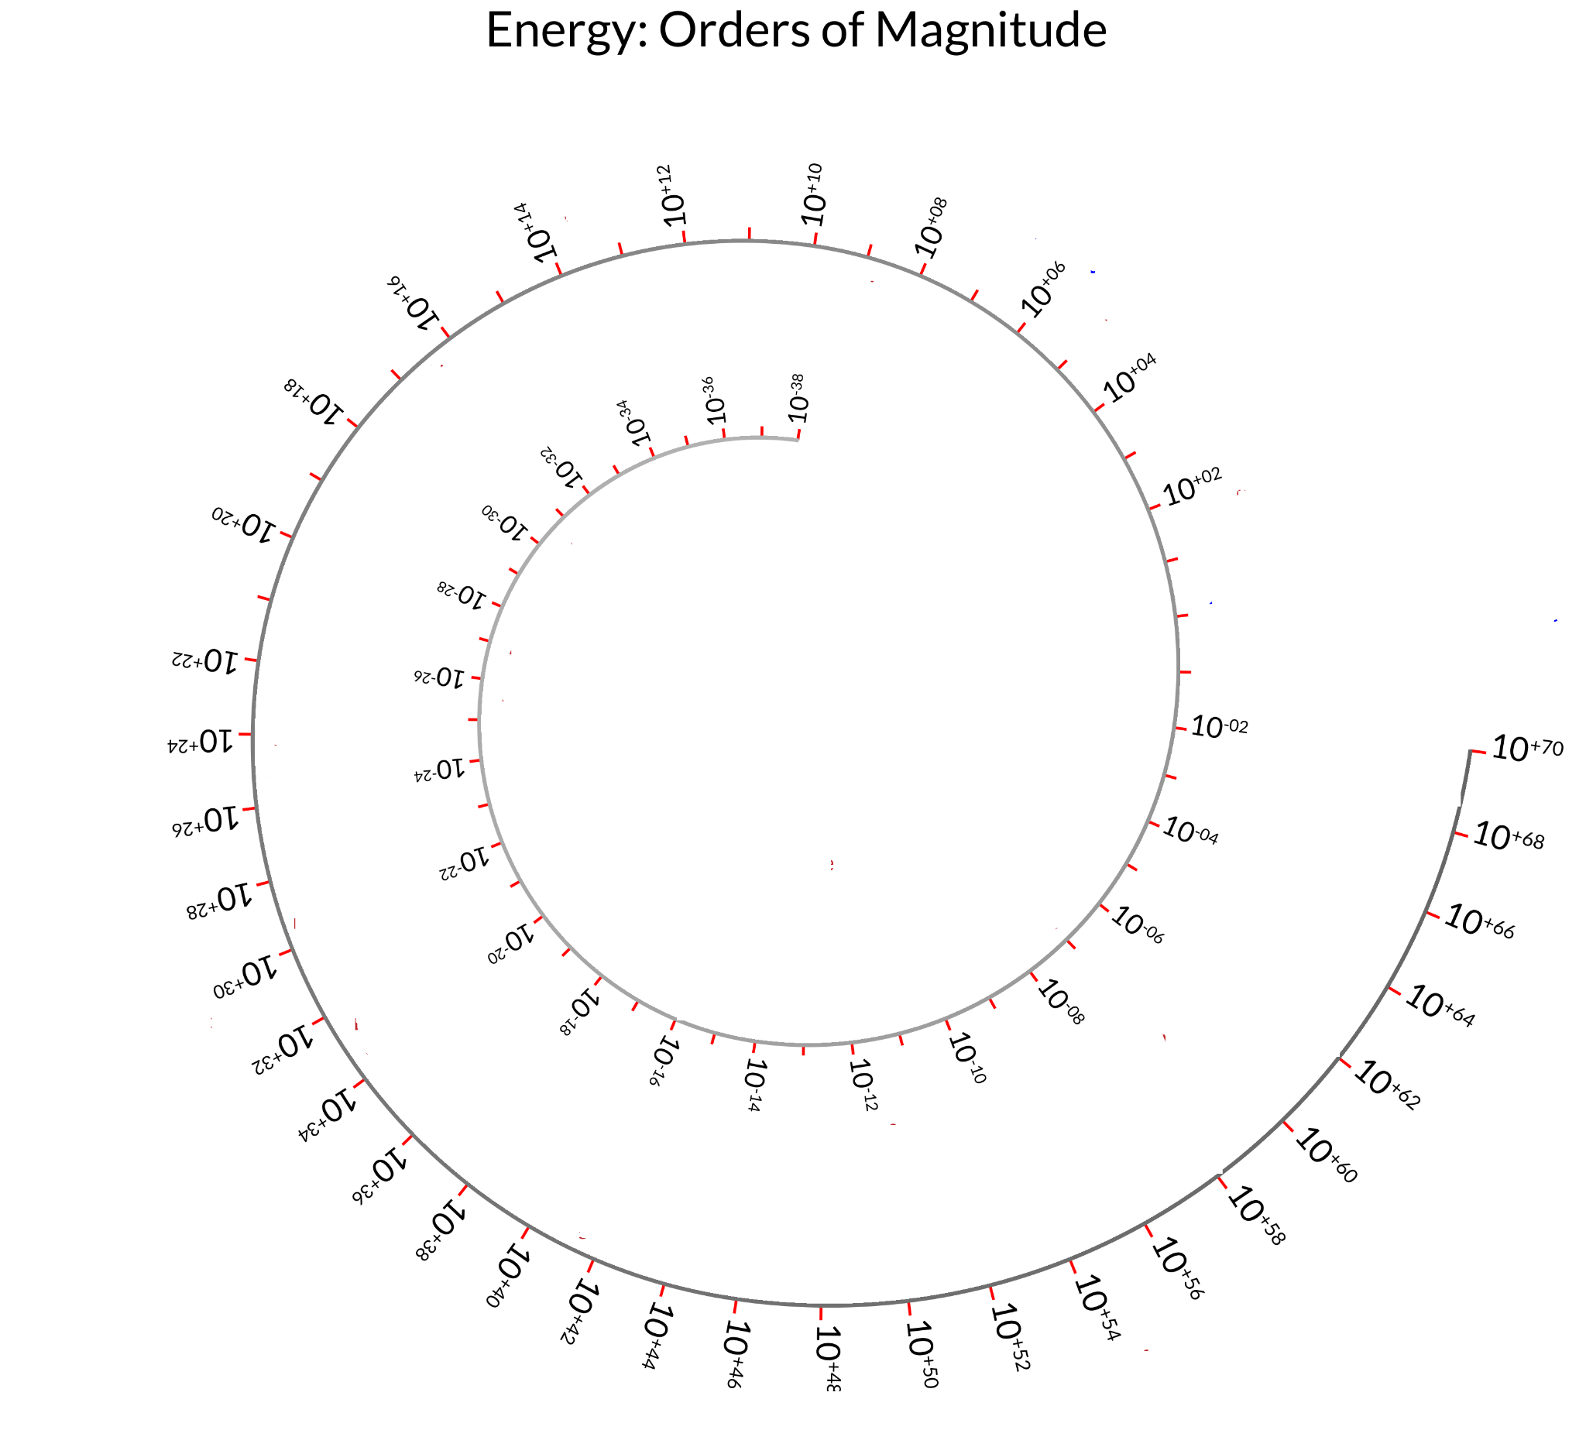
Weak?
First atomic bomb
Tornado
Human body everyday
Hurricane
Tennis serve
Highest energy cosmic ray
Sending a tweet!
Photographic Flash
1 Joule ~ heartbeat
Energy of radio photon
Annual Solar Energy received by Earth
Typical LED for 1 second
Mass energy of observable universe
Dino-killing meteors
Atomic Binding Energies
Flying Mosquito
Rotational energy of the Earth
electronvolt
GeV
Typical gamma ray
Annual output of the Sun
Sun’s output since birth
Mass energy of the visible Milky Way
Mass energy of the Earth
Annual light output of the visible universe
Average Supernova
Annual light output by the Milky Way

Slide 7
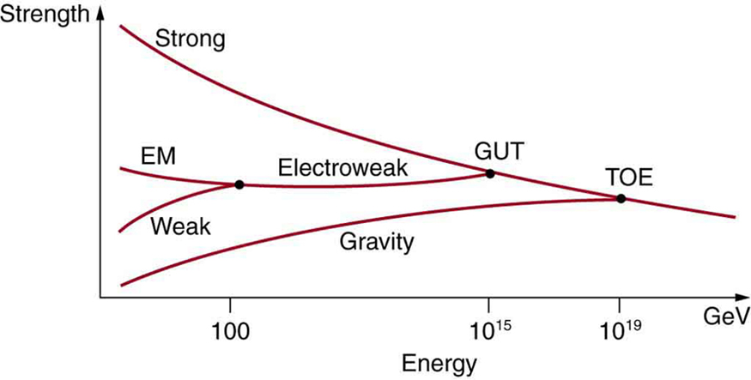
Different Interactions in nature

Slide 8
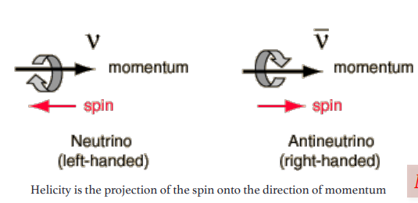
Neutrinos and Antineutrinos
For each neutrino, there also exists a corresponding antiparticle, called an antineutrino.
Each lepton has a lepton number of 1, and each antilepton has a lepton number of -1. The total lepton number is conserved in all particle reactions.
Conservation of lepton number means that whenever a lepton of a certain flavour is created or destroyed in a reaction, a corresponding antilepton from the same flavour must be created or destroyed

Slide 9
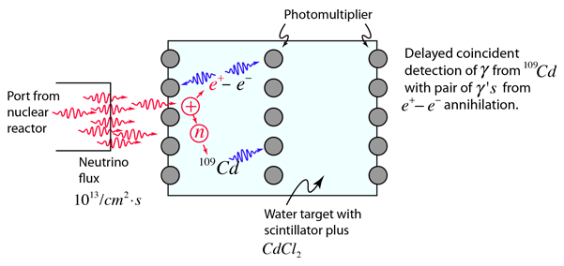
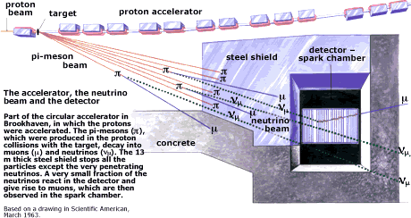
How did we find them?
Electron Neutrinos: Cowan & Reines in 1956
Muon Neutrinos: Lederman, Schwartz and Steinberger in 1962

Slide 10
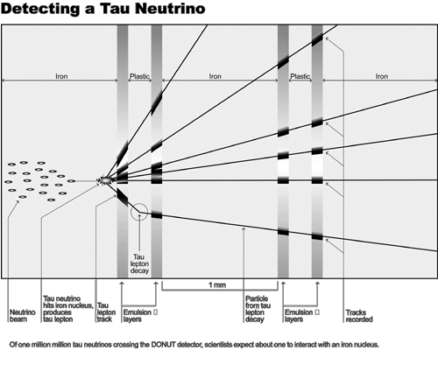
How did we find them?
Tau Neutrinos: DONUT @ Fermilab, 2000

Slide 11
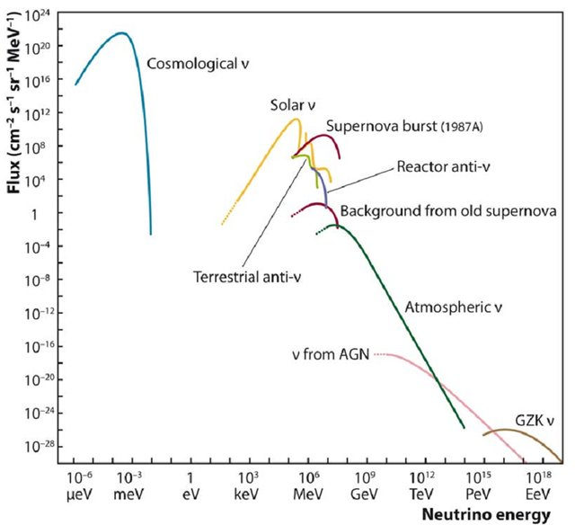
Where do they come from?
Cosmological Neutrinos: From the Big Bang!
Exist nearly everywhere in the universe, (about 300 Big Bang neutrinos in every cubic centimeter!).
Very low-energy→ very hard to find!

Slide 12
Where do they come from?
Solar neutrinos: created during fusion in the Sun
Studying Solar Neutrinos led to one of the most important breakthroughs in neutrino physics! Stay tuned :)

Slide 13
Where do they come from?
Supernova bursts:Most of the energy of a supernova is carried away by a burst of neutrinos in a span of about 10 seconds.
Many detectors are connected through the Supernova Early Warning System, or SNEWS, which will trigger experiments to record data if a sudden influx of neutrinos (indicating a supernova) arrives.

Slide 14
Where do they come from?
Reactor neutrinos are born in beta decays, which happens inside the atomic nucleus.
Possible way to monitor reactor activity!

Slide 15
Where do they come from?
Atmospheric neutrinos produced when cosmic rays interact with Earth’s atmosphere, producing showers of short-lived particles called mesons
These mesons decay into neutrinos, among other particles

Slide 16
Where do they come from?
GZK neutrinos are created at extremely high energies
Produced in interactions between Ultra High Energy Cosmic Rays, and the Universe’s Cosmic Microwave Background

Slide 17
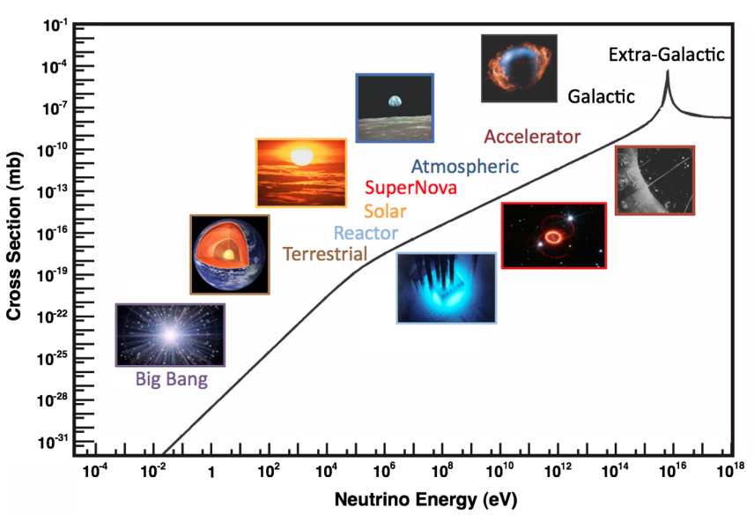
Astrophysical Neutrinos
Interaction cross-section increases with energy, favourable for detection of astro neutrinos >100GeV
Notes:
https://journals.aps.org/rmp/pdf/10.1103/RevModPhys.84.1307

Slide 18
Why study neutrinos?
Fig: J. Aguilar and J. Yang for the IceCube Collaboration
Notes:
Neutral → pointing
Low cross section → not absorbed by intermediate matter Maybe open with this and then go to cosmic rays?

Slide 19
Astrophysical Neutrinos
Cosmic rays accelerated in presence of strong magnetic fields at source
IceCube optimized to observe neutrinos above 100GeV, with DeepCore going down to 1GeV
Notes:
Produced by hadronic interactions → smoking gun for CR sources
simplify the discussion to be about fermi acceleration

Slide 20
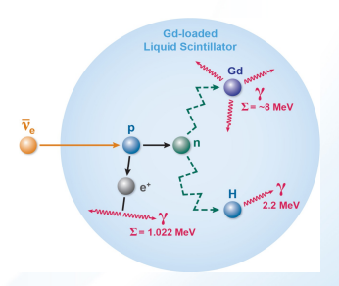
How do we detect neutrinos?
Electrically neutral, with a low interaction probability -> very hard to detect! But not impossible
Scintillators: Study gamma rays produced by neutrino interactions, during annihilation of a positron and an electron
KamLAND: Studies neutrino oscillations, double beta decay
NOνA: Oscillation parameter measurements

Slide 21
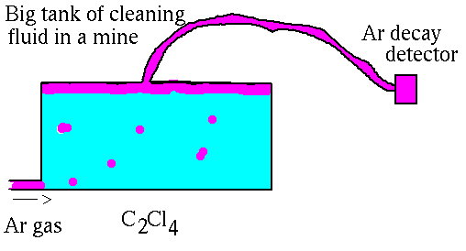
How do we detect neutrinos?
Radiochemical Detectors: Study decay products of excited nuclei created in neutrino charged current interactions with elements like chlorine and gallium
Homestake Experiment:Solar neutrinos
GALLEX: Solar neutrinos

Slide 22
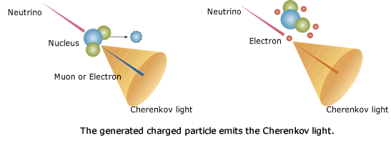
How do we detect neutrinos?
Cherenkov Detectors: High energy charged particles produced in neutrino-nucleon interactions emit Cherenkov radiation in an optical medium
SuperK
IceCube!

Slide 23
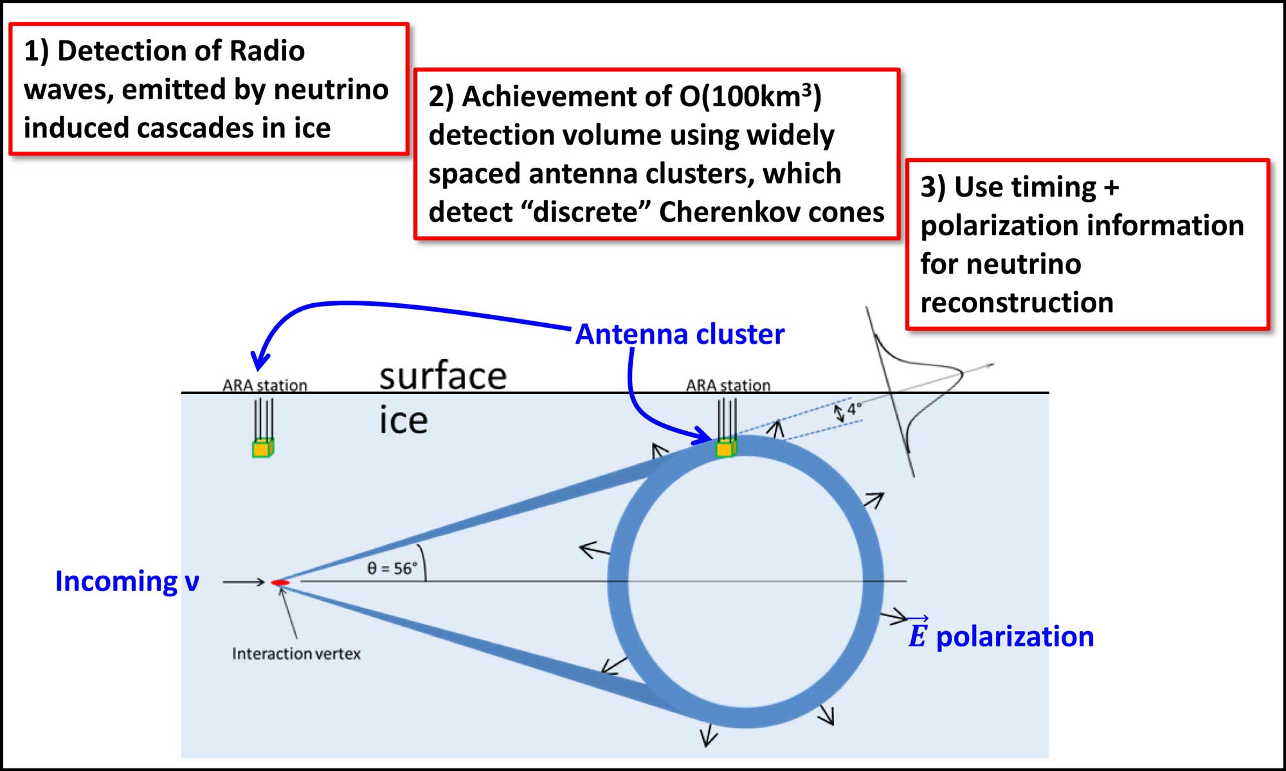
How do we detect neutrinos?
Radio: Showers of charged particles in a medium create an observable radio/microwave signal. Provides a means to detect highest energy astrophysical neutrinos

Slide 24
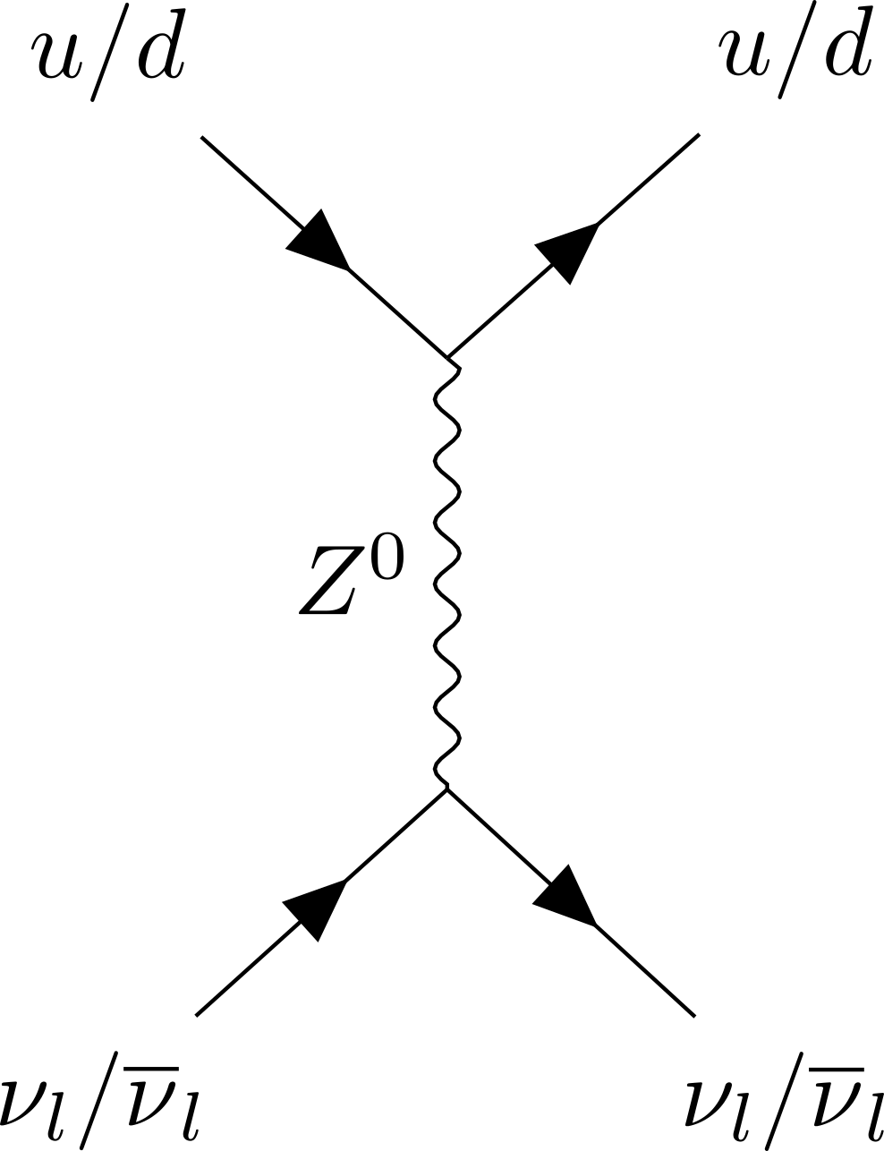
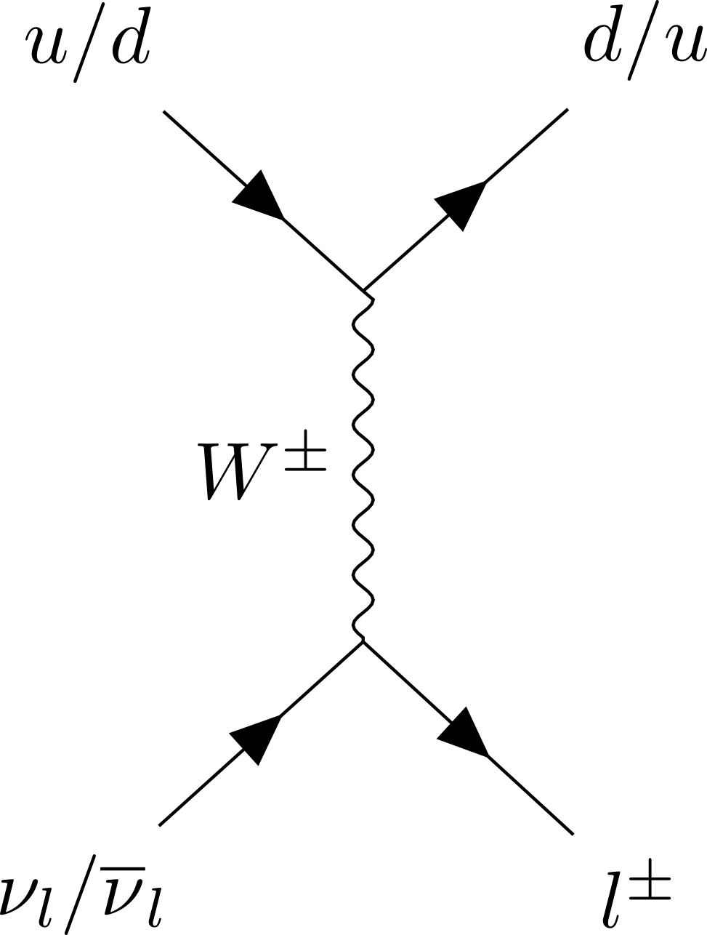
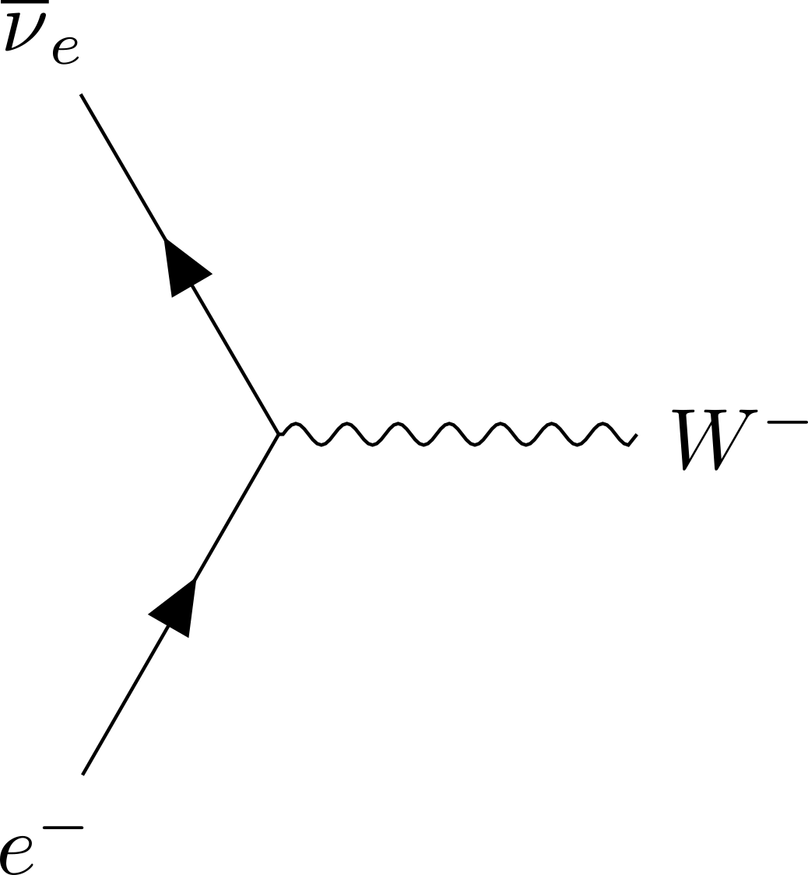
Neutrino Interaction Channels at IceCube
Charged current interactions yield an outgoing charged lepton and a hadronic shower
Neutral current interactions have an outgoing scattered hadron and neutrino
Glashow Resonance interactions yield a W⁻ boson
Notes:
CC and NC Deep Inelastic Scattering Glashow Resonance:https://www.nature.com/articles/s41586-021-03256-1

Slide 25
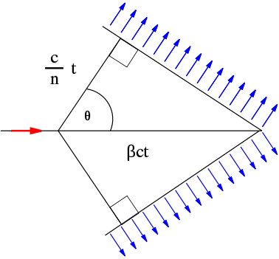
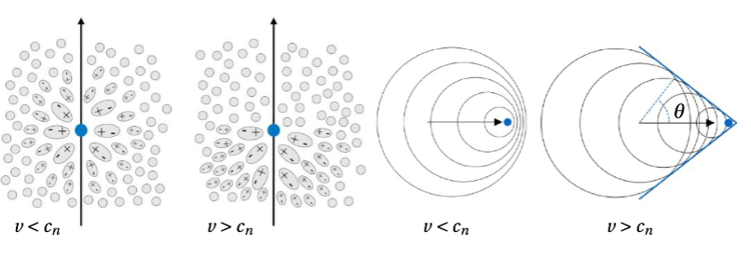
Observing neutrinos through interactions in ice
Charged particles travelling through deposit energy and can polarize a medium
When charged relativistic particles travel faster than the speed of light in a medium, emit radiation (Cherenkov effect)
This produces a cone of Cherenkov light, with its wavefront at a characteristic angle (𝛳c)

Slide 26
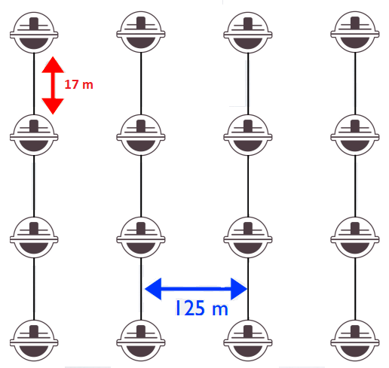
Cherenkov Radiation and IceCube
Number of photons captured ∝ deposited energy. Photon arrival times at DOMs helps reconstruct particle trajectory.
Charged particle trajectory
Notes:
Hits from DOM are classified as HLC/SLC Look for image with waveforms

Slide 27
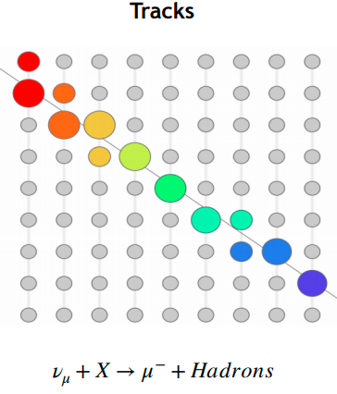
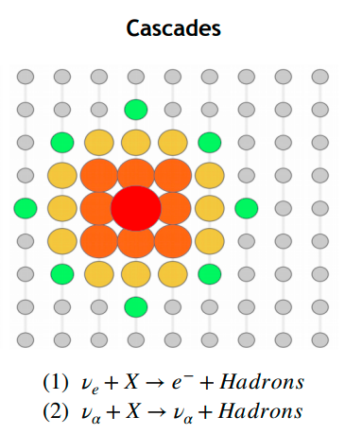
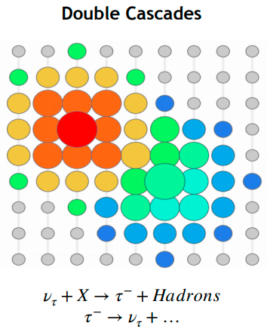
IceCube Event Morphologies
Energy Resolution: ~ factor 2
Angular resolution ~0.3°@100TeV
Energy Resolution: 15%
Angular resolution: ~8°@100TeV
Decay Length: 50m/PeV
Notes:
Size of circle is proportional to charge deposited SPEND MORE TIME Find out how energy resolutions are measured . Be specific about resolutions
Tracks:Due to the relatively long muon lifetime, cherenkov emission along the outgoing muon path shows up as a linear track Cascades: in a NC interaction the out-going products are a neutrino and a recoiling hadron. We don't see the daughter neutrino, and the hadronic recoil is what becomes the cascade, because hadronic products tend to feature short lifetimes and short interaction lengths. They also readily produce electrons in the shower, which don't decay but also have short interaction lengths Double Cascades: Secondary signal from Tau decay product. A second cascade is resolvable starting at Tau energies of around 1 PeV, when the decay length is ~50m (comparable to 0.5*string spacing 125m). Depending on the Tau decay channel, other topologies such as a ‘lollipop’ (where tau decays to a muon) may also occur

Slide 28
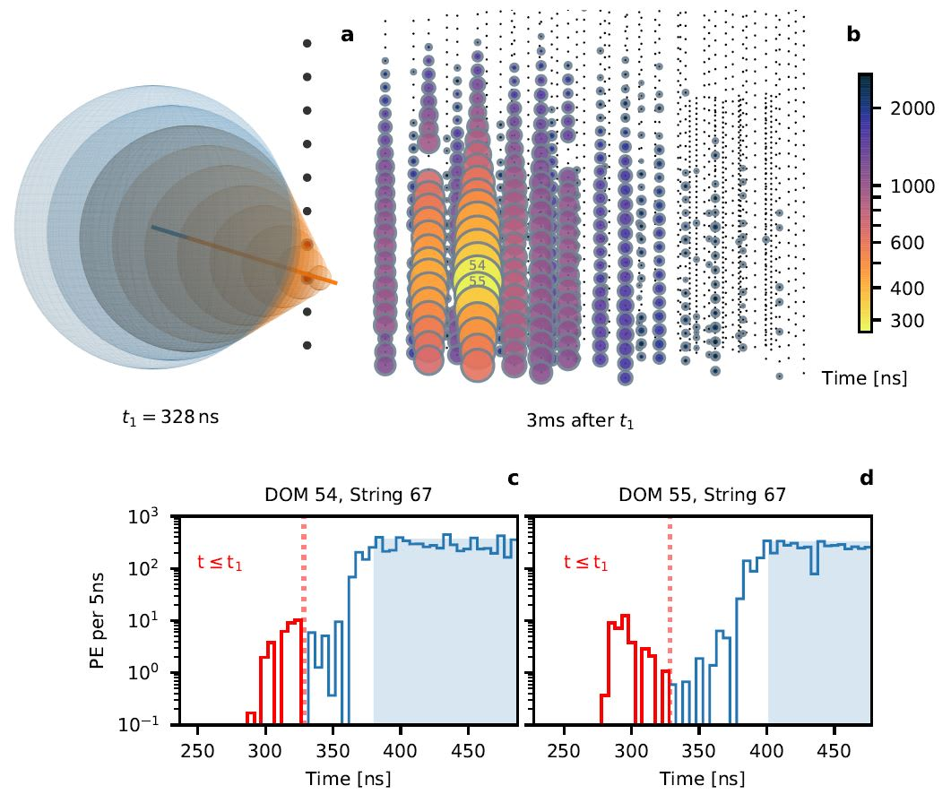
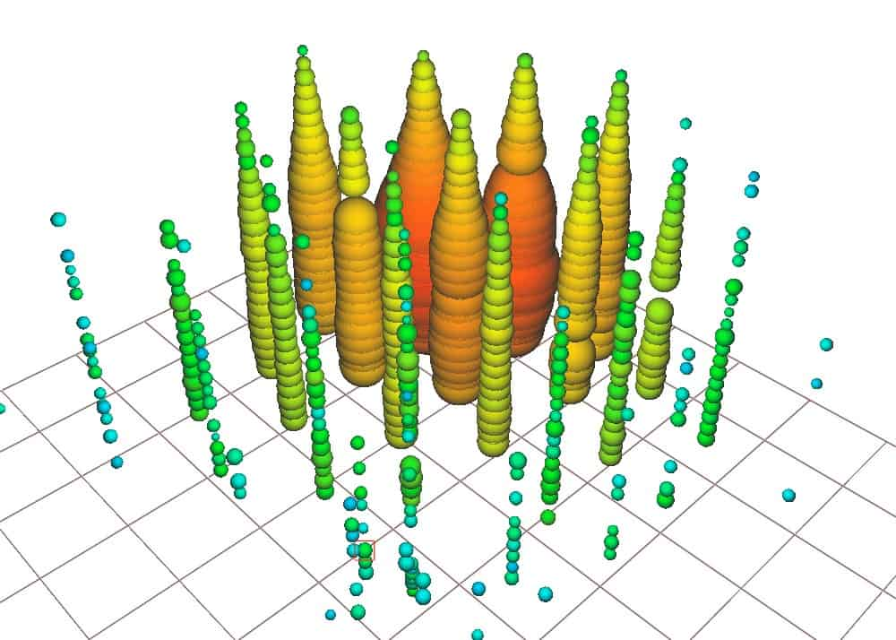
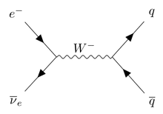
Glashow Resonance
Interaction where an electron antineutrino interacts with an electron
Antineutrino must have very high energy, ,~6.3PeV!
Helps constrain ratios of neutrinos to antineutrinos, which helps model production of astrophysical neutrinos
Nature 591, 220–224 (2021)

Slide 29
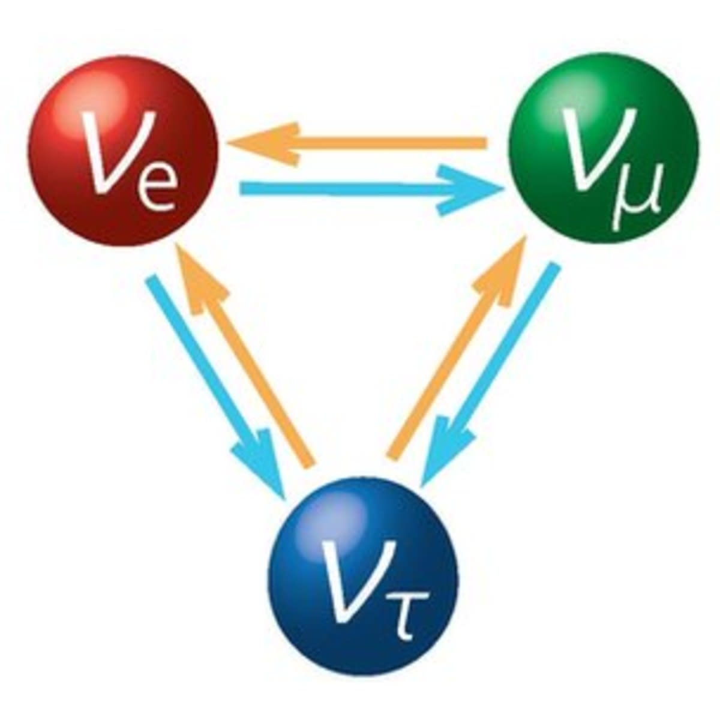
Types of neutrinos
Initially, neutrinos were believed to be created in three flavours -> electron, muon and tau neutrinos
In 1968, the Homestake experiment measured ⅓ of the predicted flux of solar electron neutrinos
Where did the others go?

Slide 30
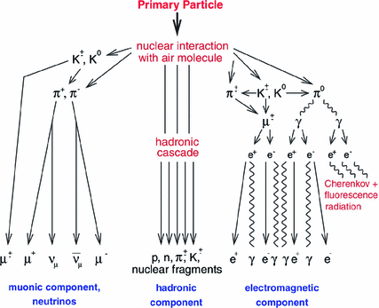
Neutrino Oscillations
Atm. neutrinos are produced by the decay of particles resulting from interactions of primary CRs with the atmosphere.
The observed number of neutrinos is predicted uniformly across zenith. However, Super-K found that the number of upward muon neutrinos (generated on the other side of the Earth) is half of the number of downward going muon neutrinos.
Notes:
Experimental approach
Solar Neutrino Problem:Homestake
Daya Bay result

Slide 31
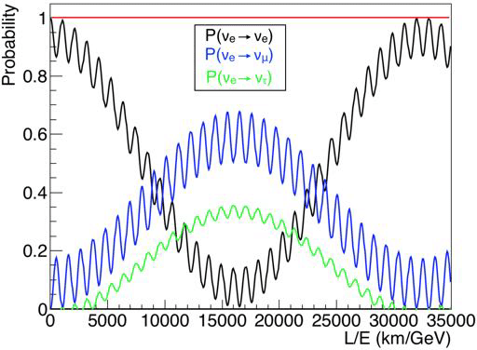
Neutrino Oscillations
Because neutrinos have a finite mass, they can oscillate between flavours!
Oscillations widget
Notes:
Experimental approach
Solar Neutrino Problem:Homestake
Daya Bay result

Slide 32
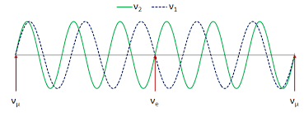
Neutrino Oscillations
Because neutrinos have a finite mass, they can oscillate between flavours!
Notes:
Experimental approach
Solar Neutrino Problem:Homestake
Daya Bay result

Slide 33
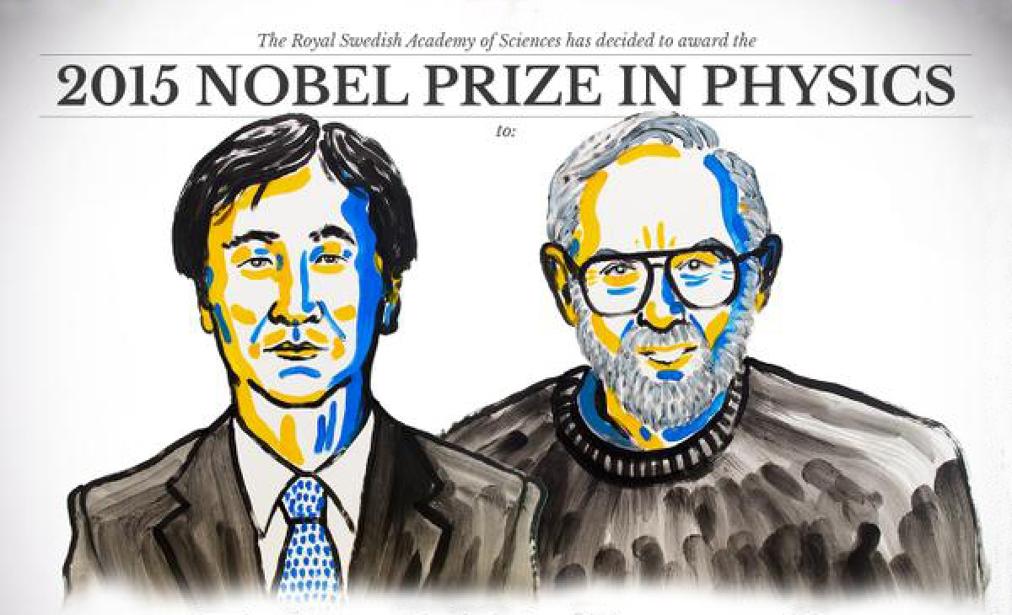
Neutrino Oscillations
Atm. Neutrino problem:
Difference in muon neutrino flux through the earth!
Caused by muon neutrinos oscillating!
Solar neutrino problem:
Only half the electron neutrino flux detected!
Caused by electron neutrinos oscillating into other flavours!
Notes:
Experimental approach
Solar Neutrino Problem:Homestake
Daya Bay result

Slide 34
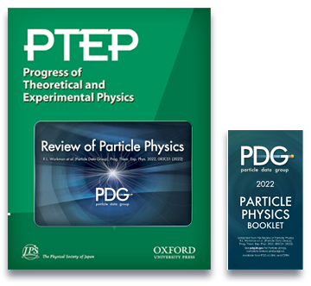
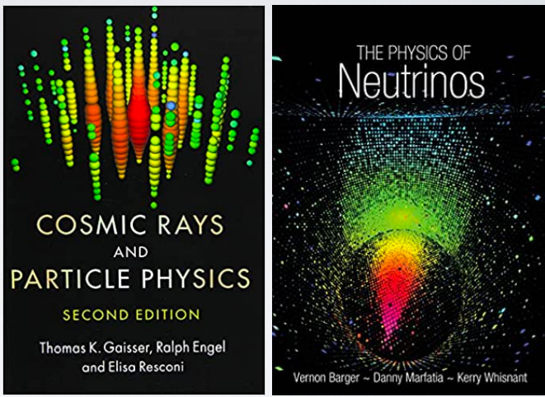
Conclusion
How can I find out more?
Lots of exciting properties to study, many things we don’t understand yet
Next steps: to precisely measure various properties of neutrinos, lots of experiments planned and underway
Notes:
Experimental approach
Solar Neutrino Problem:Homestake
Daya Bay result

Slide 35
BACKUP

Slide 36
Cherenkov Radiation and IceCube
Number of photons captured ∝ deposited energy. Photon arrival times at DOMs helps reconstruct particle trajectory.
Charged particle trajectory
Notes:
Hits from DOM are classified as HLC/SLC Look for image with waveforms

