Slide 1
Country Report on Astronomy Education in Myanmar
Dr Yee Yee Oo*, Dr Khin Than Tint#
*Rector, Kyaukse University
#Professor, Department of Physics, University of Mandalay
12th SEAAN Meeting
Siem Reap, Cambodia
1st February, 2023.

Slide 2
Contents
★Introduction to Universities
★ Review on Astronomy Education of Myanmar from 2017 to 2019
★ Astronomy Education of Myanmar from 2020 to 2022

Slide 3
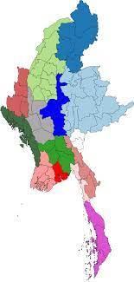
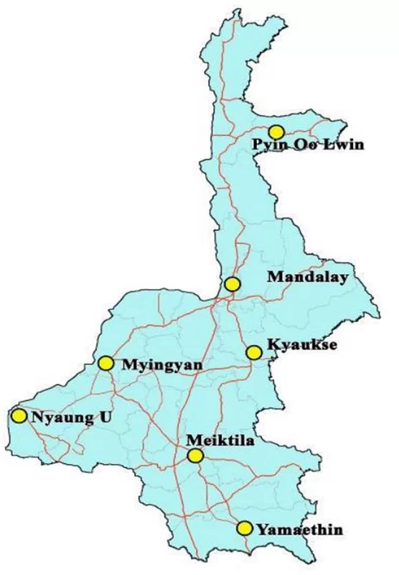
8 Arts and Science Universities in Mandalay Region
27.7 mi
Ministry of Education
49 Arts and Science Universities
Mandalay Region
Myanmar

Slide 4
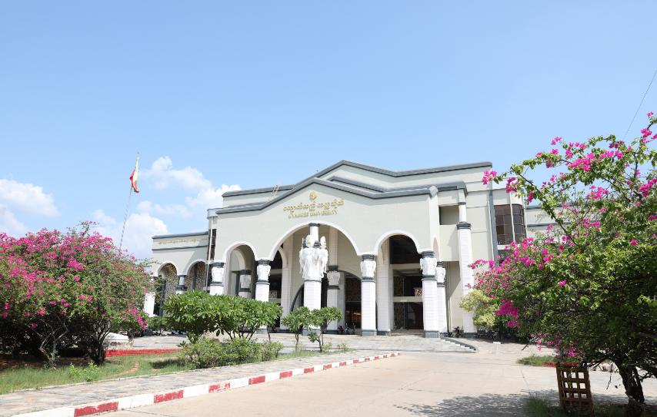
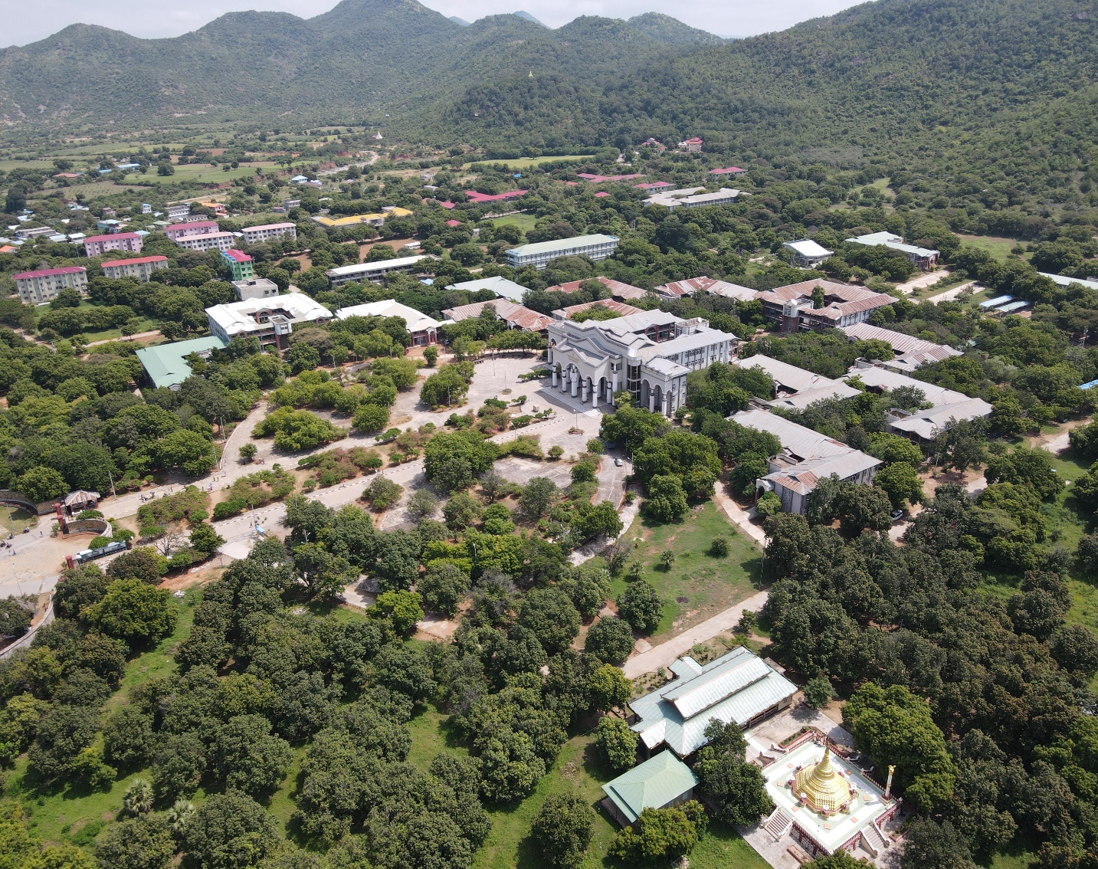
Kyaukse University
(Campus)
Kyaukse University
(Main building)

Slide 5
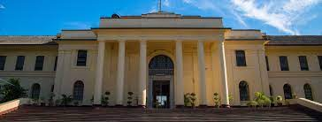
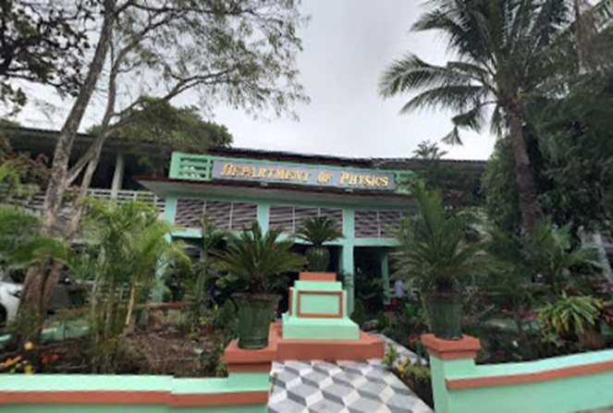
University of Mandalay
(Main building)
Department of Physics

Slide 6
Review on Astronomy Education of Myanmar from 2017 to 2019
★Discussion about Astronomy & Astrophysics curriculum at Chiang Mai University (30th May, 2017)
★ Workshop in University of Mandalay to approve the Astrophysics syllabus and curriculum (28th-29th September 2017)
★“You Are Galileo Workshop”, University of Mandalay (2nd December, 2017)
★ Telescopes were donated by NARIT and NAOJ [Galileo, Vixen, Dobsonian, Celestron]

Slide 7
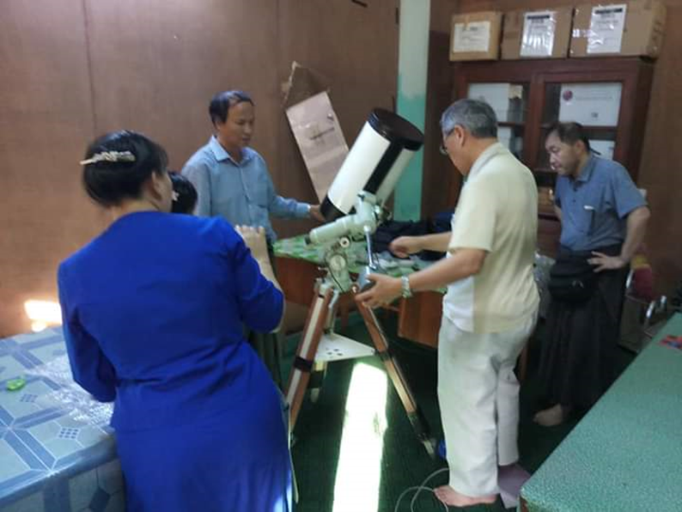
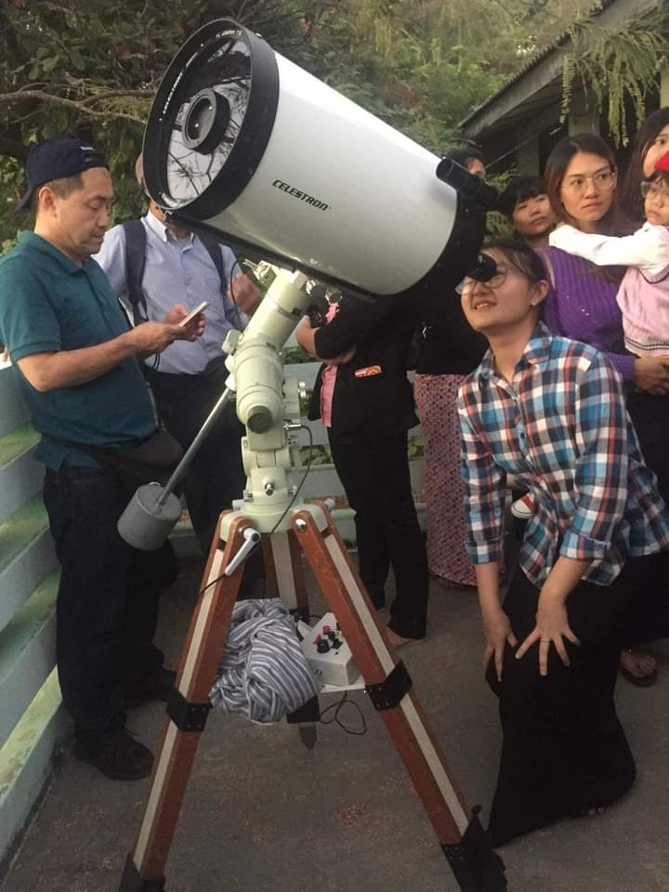
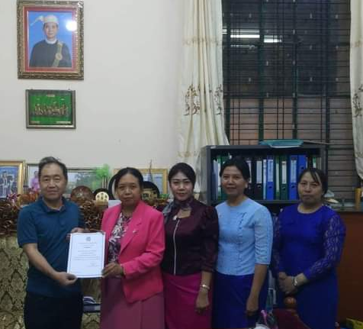
Mr. Akio Nakanishi (Astro Photographer),
Mr. Yasuhiro Toyama (Electronic Engineer) and Mr. Yusuke Habu (Software Engineer)
Viewing moon, Jupiter and Saturn with Celestron Telescope in 9th December, 2019

Slide 8
Outcomes
Board of study of Myanmar Universities approved to insert astronomy as an elective course in undergraduate physics course
Astronomy Talk shows and night sky observations (3 times)
Student Astronomy clubs ｗｅre successfully set up in Mandalay and Yadanabon Universities.

Slide 9
Astronomy Education of Myanmar from 2020 to 2022
Due to the Covid 19 pandemic, schools and Universities were closed from March 2020 to May, 2021.
In May, 2021, the Universities were reopened only final classes of
graduate and post graduate (B.Sc, BSc(Hons:), MSc).
On the other hand, all research fields of PhD candidate were continued
in the University of Yangon and University of Mandalay.
Unfortunately, most of the staff as well as students who working in the astronomy and Astrophysics area from Universities were joined to CDM (Civil Disobedience Movement) in February, 2021.

Slide 10
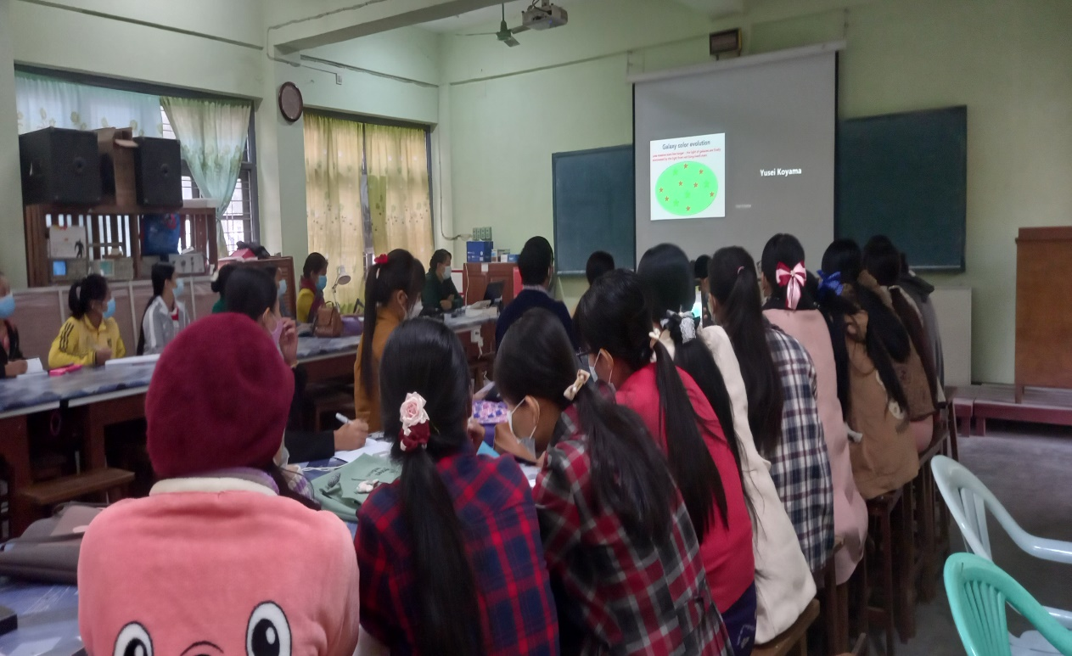
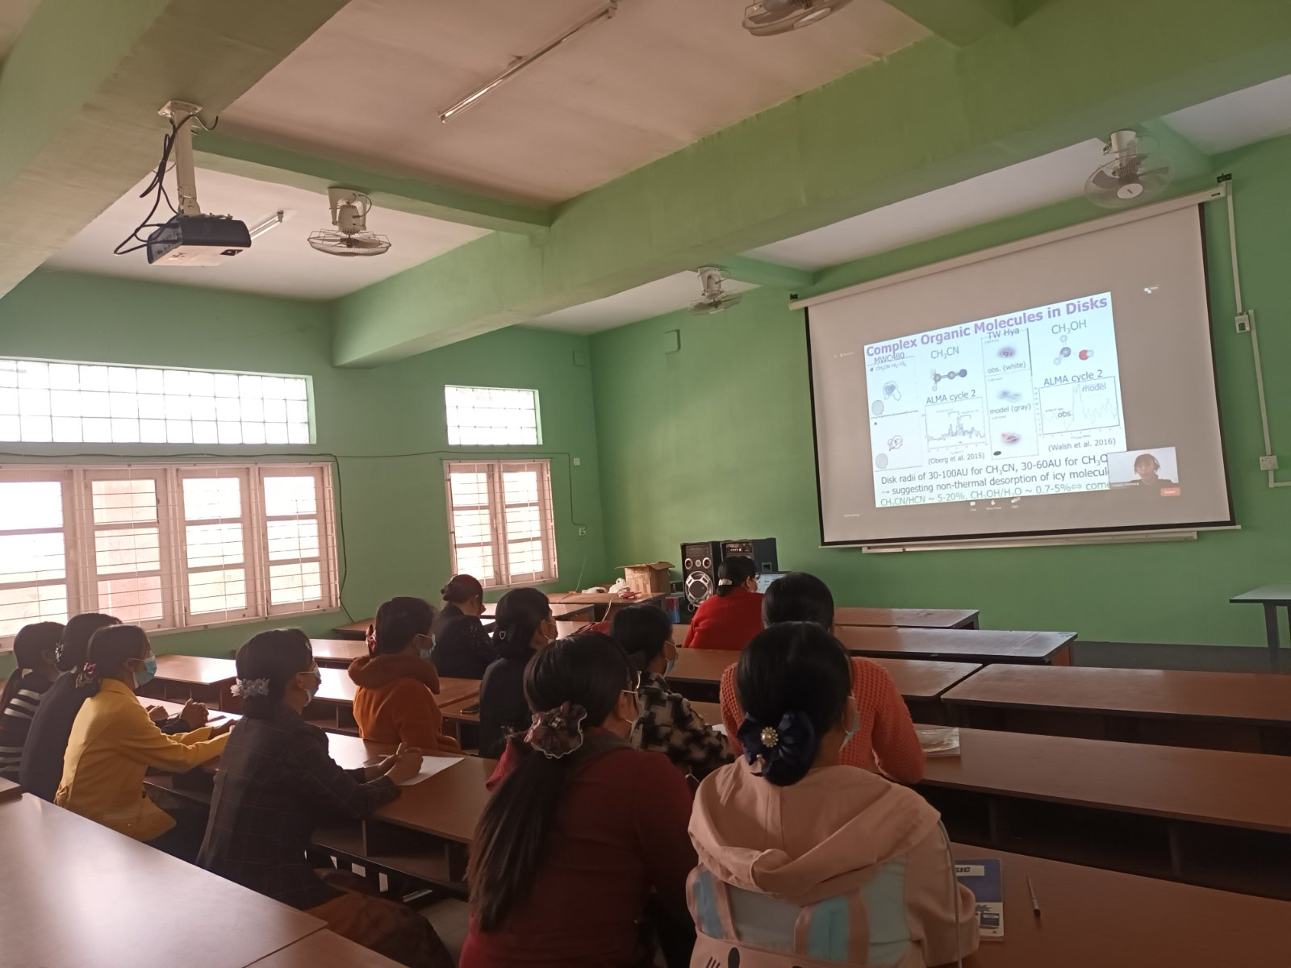
Sokendai Asian Winter School 2021 (3rd to 5th FEBRUARY, 2021)
Sokendai Asian Winter School 2022 (2nd to 4th FEBRUARY, 2022)
Virtual Meeting
Department of Physics,
Monywa University (2022)
Department of Physics,
Kyaukse University (2022)

Slide 11
Present Condition
In November 2022, all under graduate and post graduate classes in all Universities were reopened.
Now, we are reorganizing staff and students to continue to work in Astrophysics area such as teaching, research, astronomy clubs and star gazing.
Request
Please share information e-mail for virtual meeting, school and training concerning with Astronomy and Astrophysics to us for future collaborations.

Slide 12
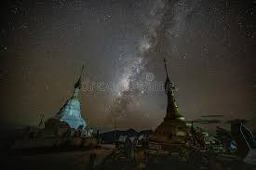
THANK YOU VERY MUCH FOR YOUR KIND ATTENTION!

