Slide 1
12TH SEAAN
SIEM REAP, CAMBODIA
PHILIPPINES COUNTRY REPORT
MA. ROSARIO C. RAMOS
Philippines

Slide 2
OUTLINE
PAGASA Activities
Popularization of Astronomy
Rizal Technological University Activities
Infrastructure Projects

Slide 3
PAGASA
Philippine Atmospheric, Geophysical and
Astronomical Services Administration

Slide 4
ACTIVITIES
Mobile Planetarium on Tour | Various schools from Metro Manila and Mindanao Students/ Teachers/ General Public
Stargazing and Telescoping @ PAGASA Astronomical Observatory | 300 students/ astro enthusiasts during the 8 November 2022 Total Lunar Eclipse
Accommodation of Visitors at the PAGASA Planetarium | 61 Trainees from PAGASA and Phil Coast Guard Trainees
Astronomical Publication | 200 sold 210 complimentary
Press Release Issued ( Astronomical Diary) and Monthly Astronomical Events Video | 12
Astronomical Observations | 300 Sunspots 3 Meteor Shower
Monitored the dissemination of Philippine Standard Time | 11 TV Stations and 7 Radio Stations

Slide 5
2021

Slide 6
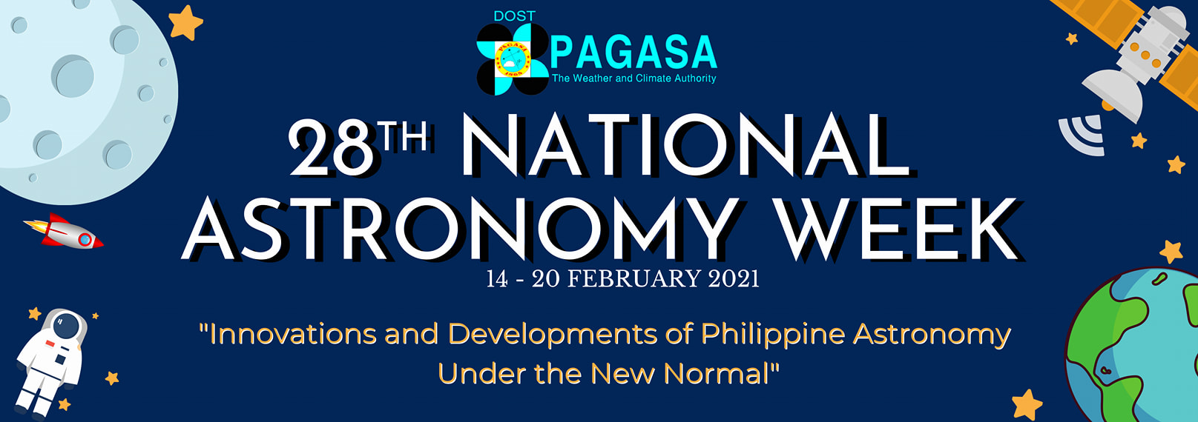
Online Planetarium Show
Basic Astrophotography
Quick Tour in Stellarium Web
5 Beautiful Reasons Why Everyone Loves the Moon
PAGASA Astronomical Services
The Sun and Astronomical Seasons
Special Podcast Episode
Ask An Astronomer: Debunking Myths and Misconceptions in Astronomy

Slide 7
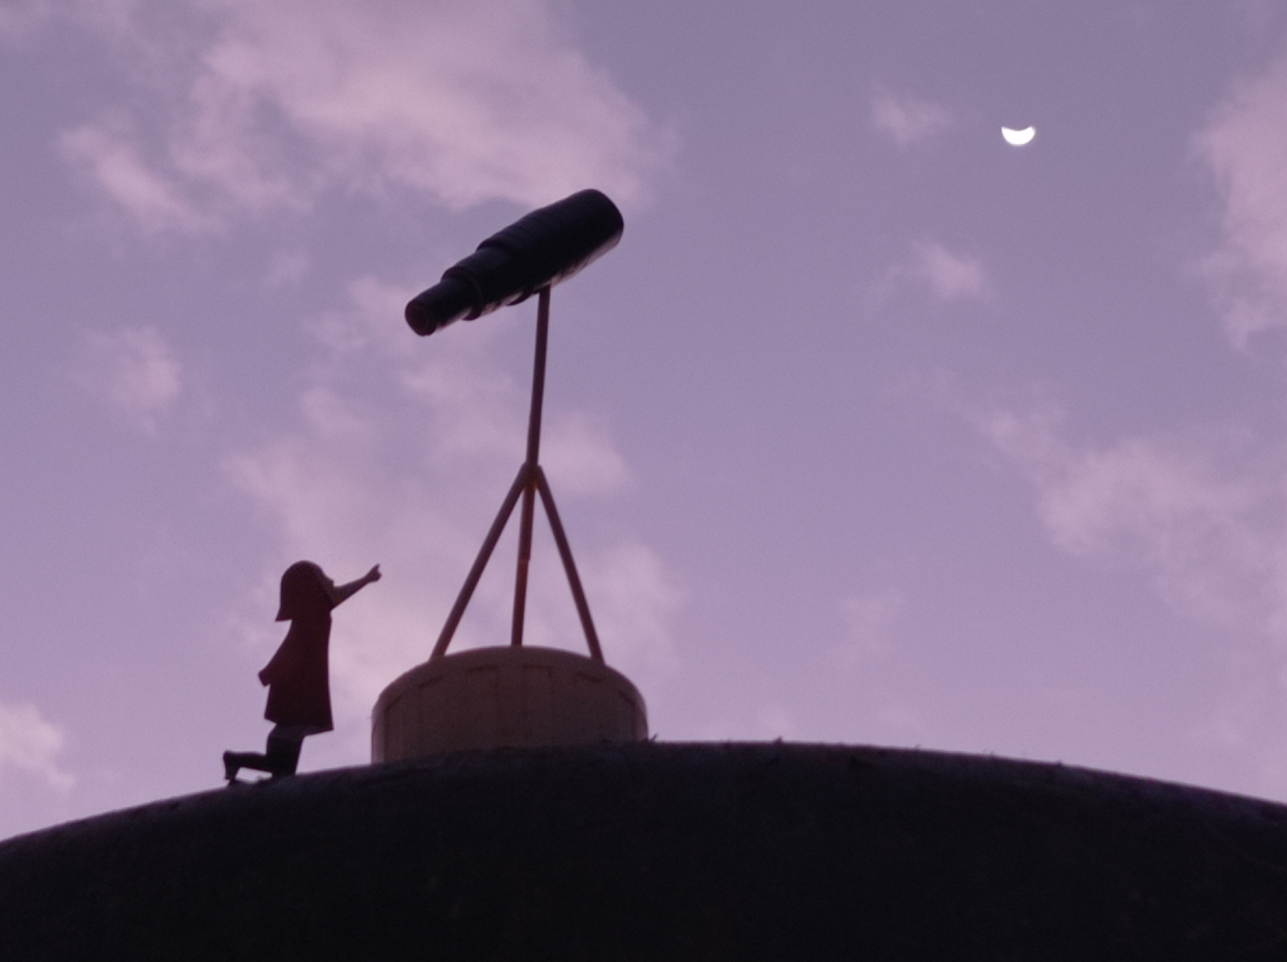
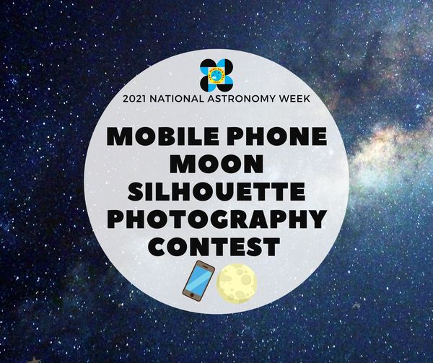

Slide 9
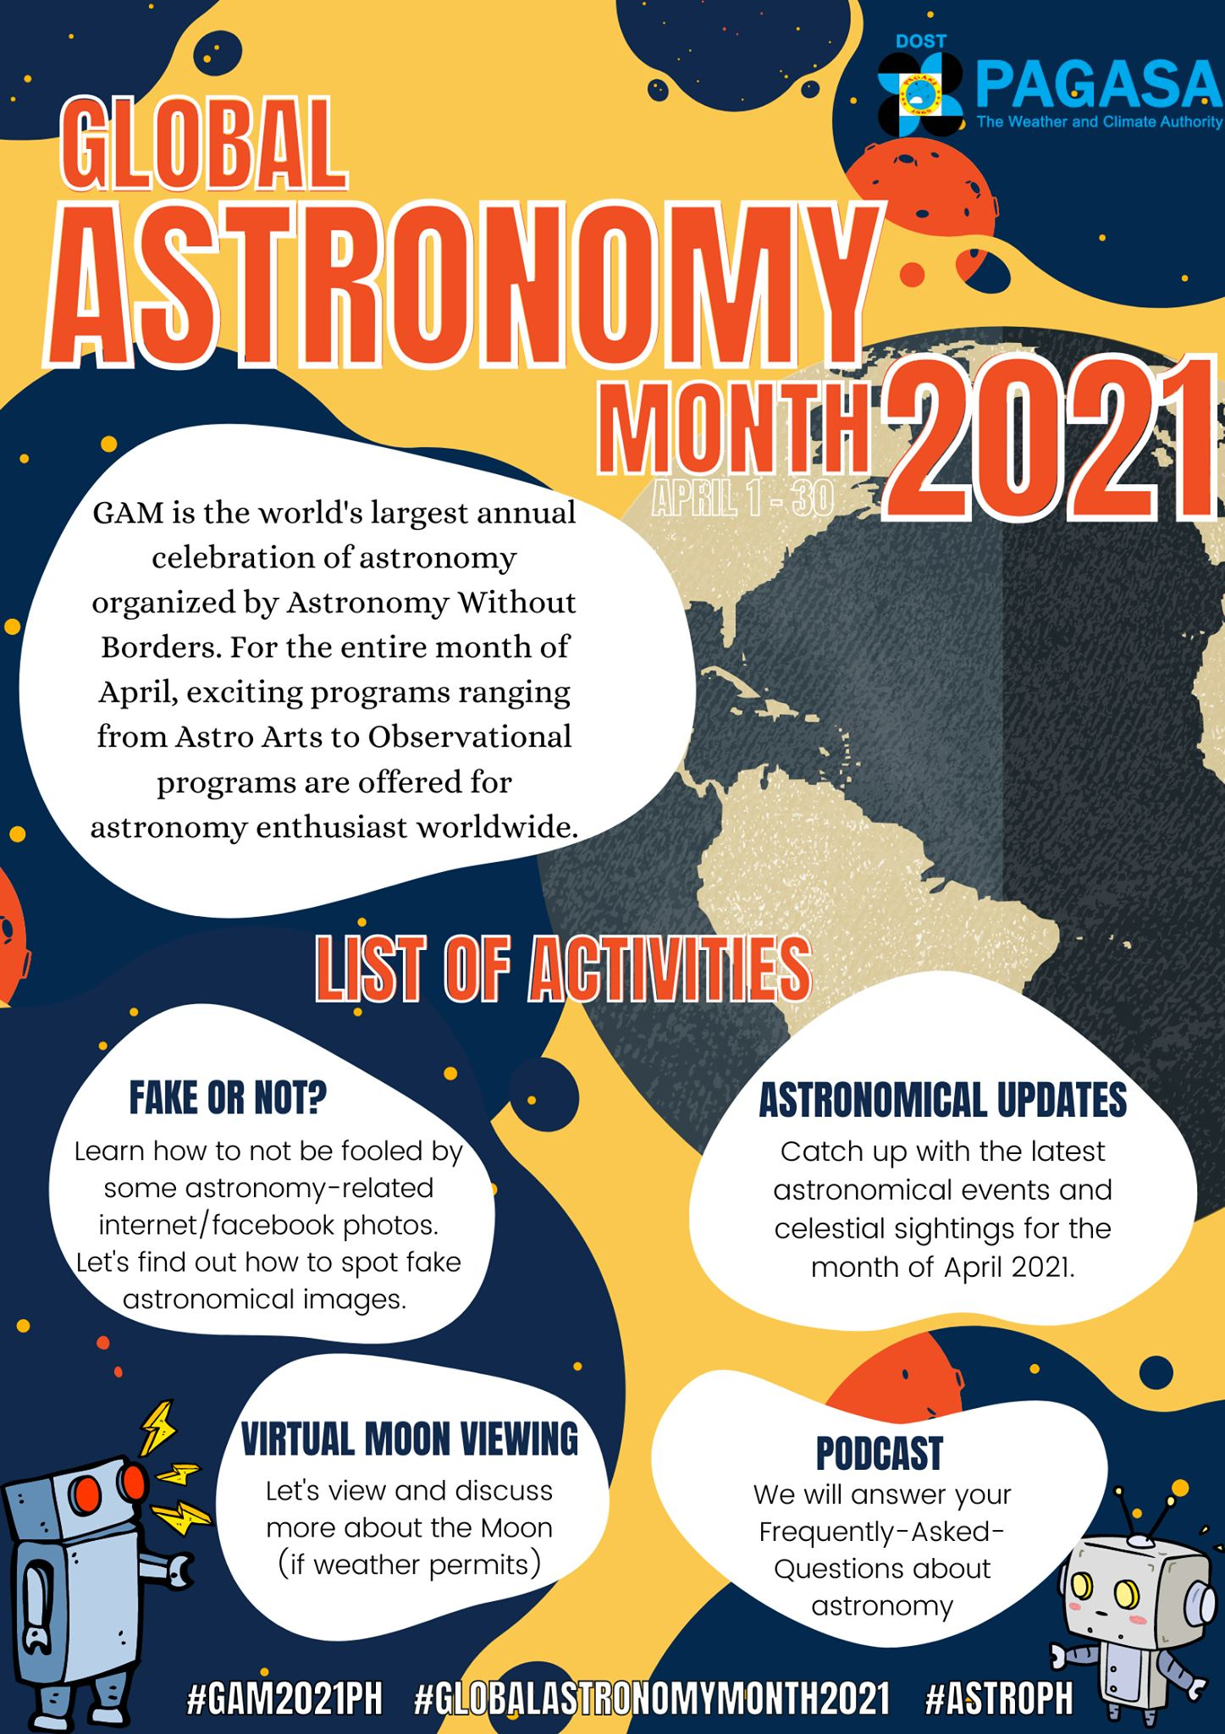
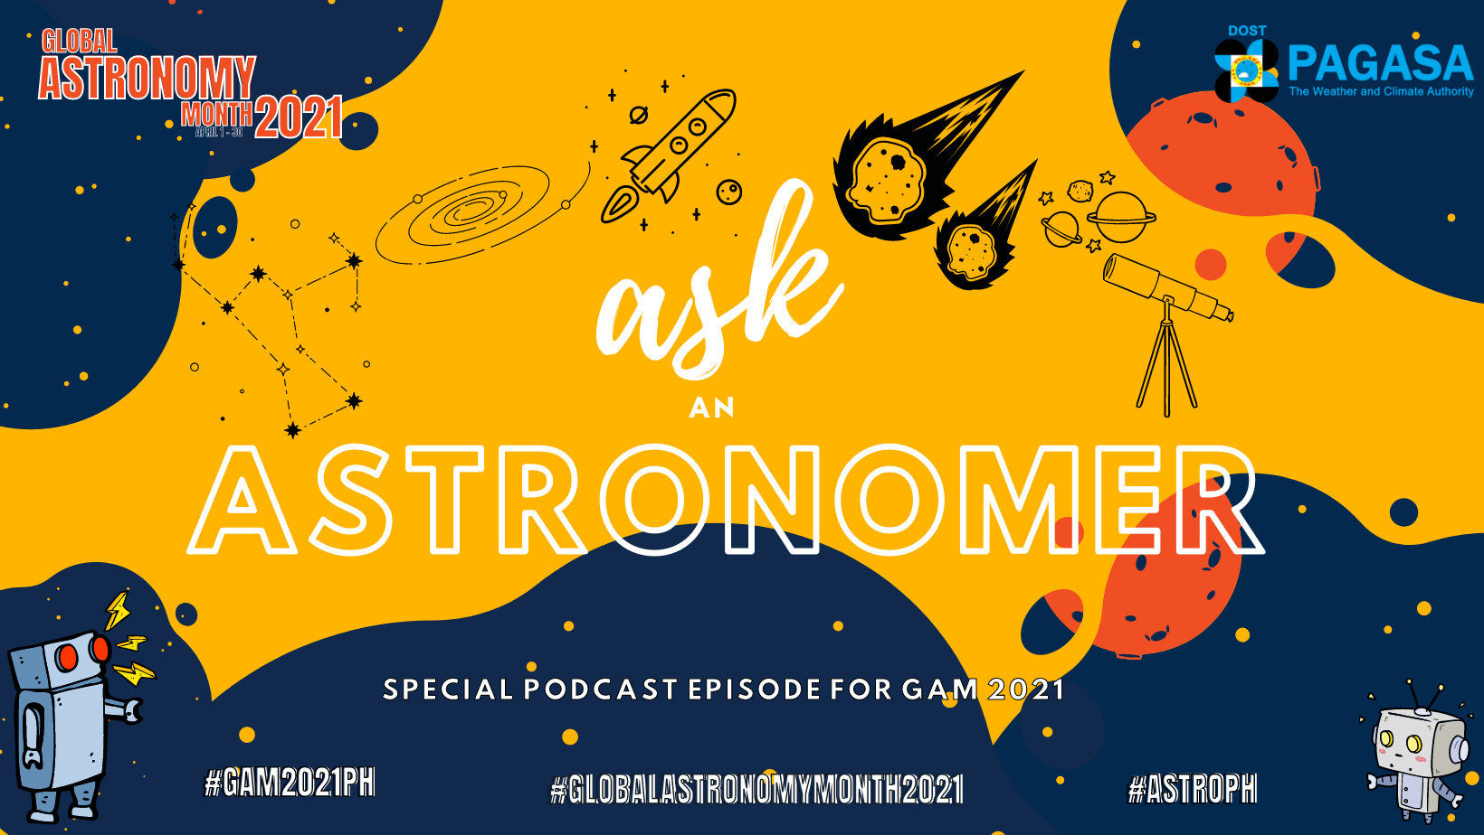

Slide 10
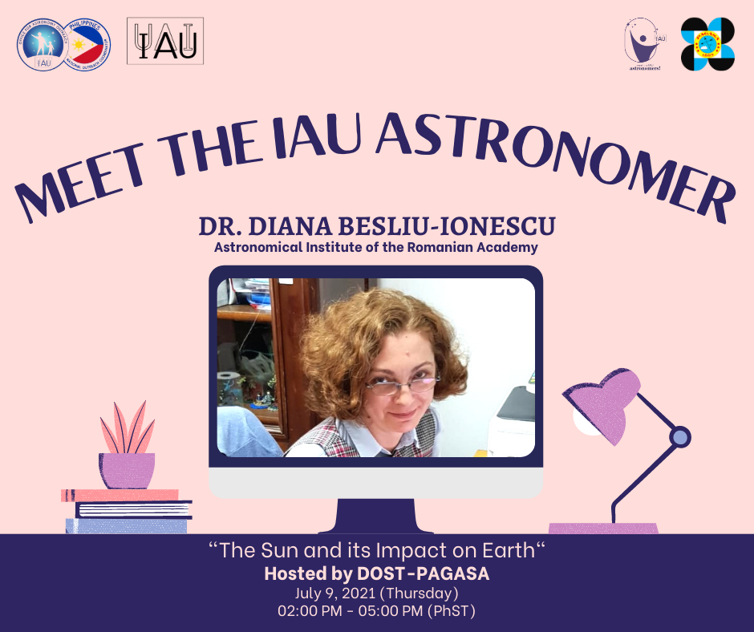
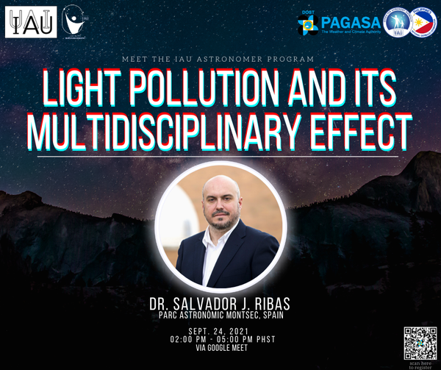

Slide 11
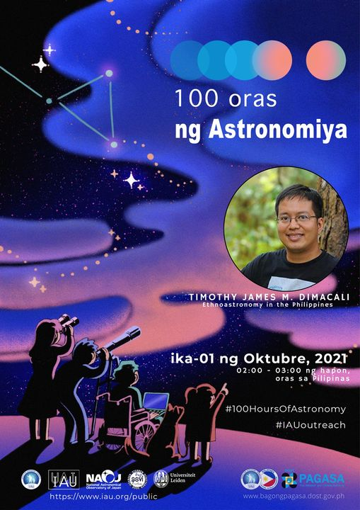
100 HOURS OF ASTRONOMY
WEBINAR TITLE:
ETHNOASTRONOMY IN THE PHILIPPINES

Slide 12
WORLD SPACE WEEK
ON-LINE ASTRONOMY WEBINAR FOR TECHERS
No. Of Participants: 92 Science Teachers form Luzon, Visayas And Mindanao

Slide 13
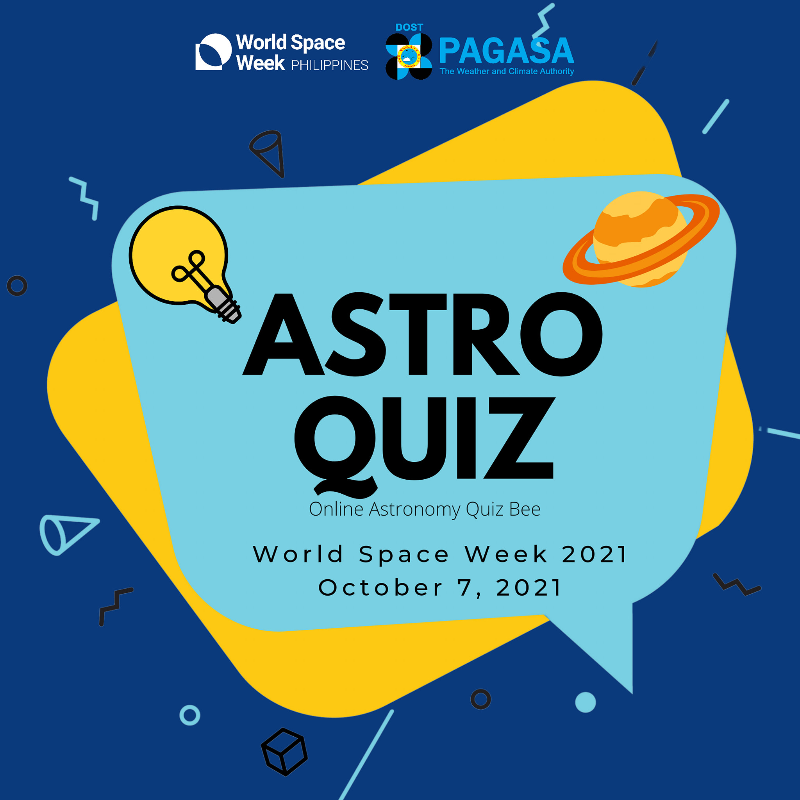
ON-LINE ASTRO QUIZ BEE
No. Of Participants: 36 students from Luzon, Visayas and Mindanao

Slide 14
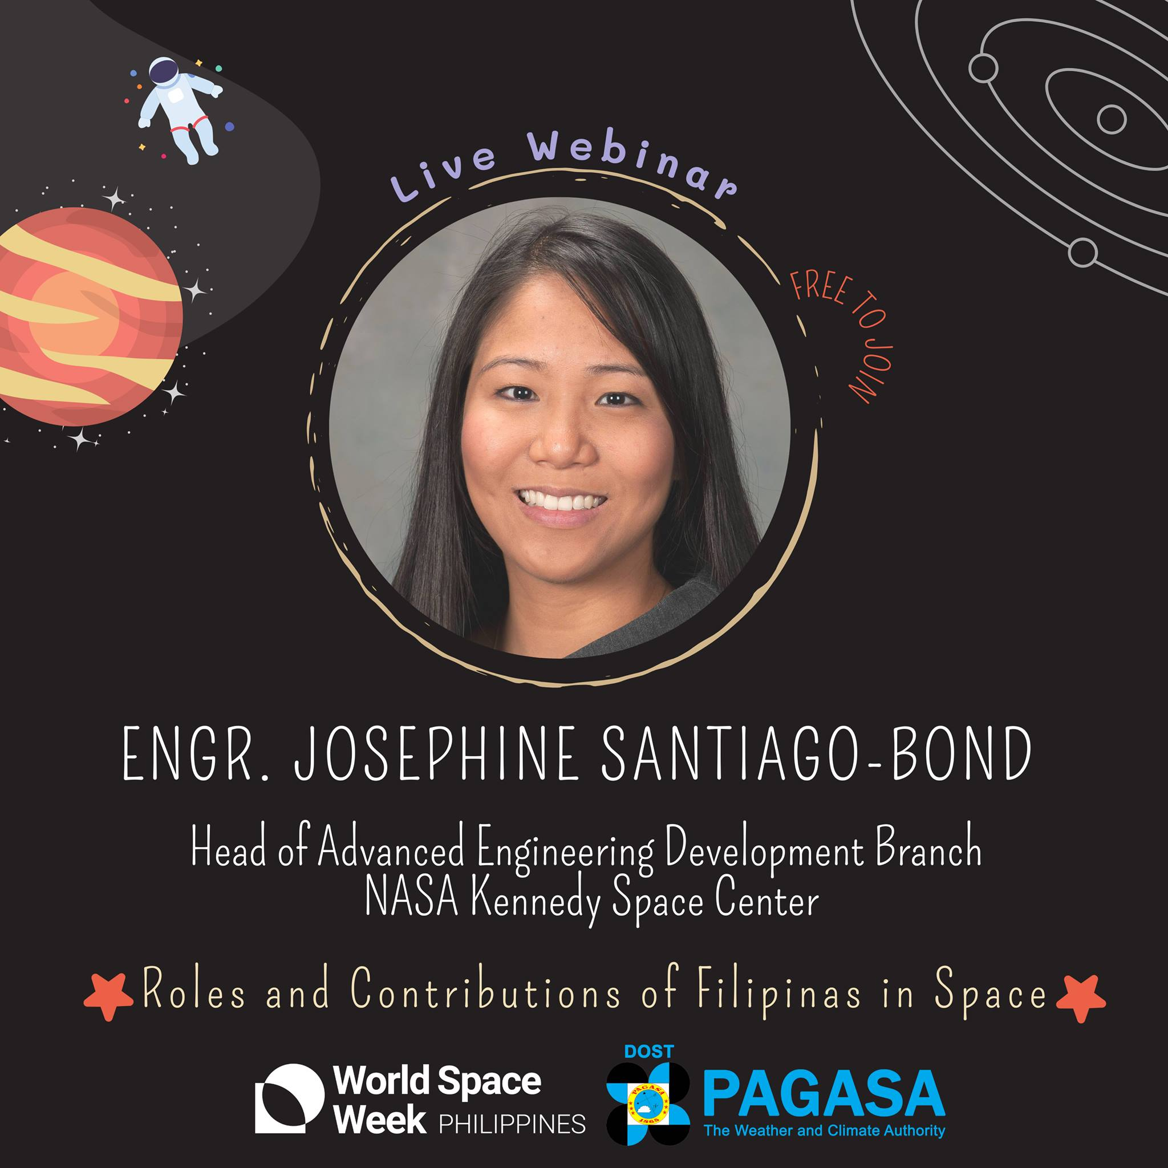
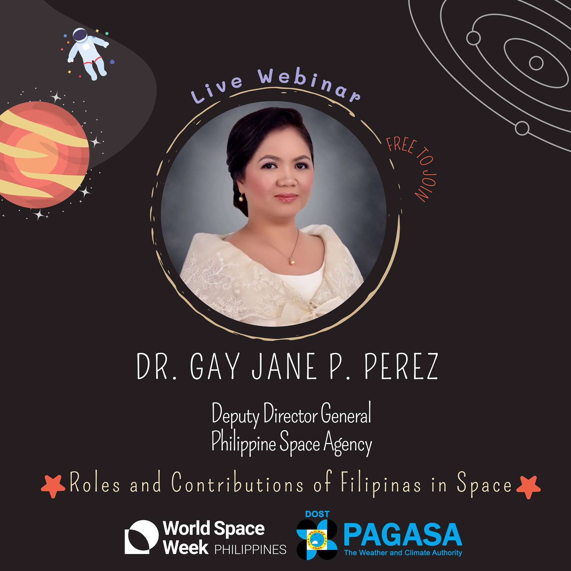
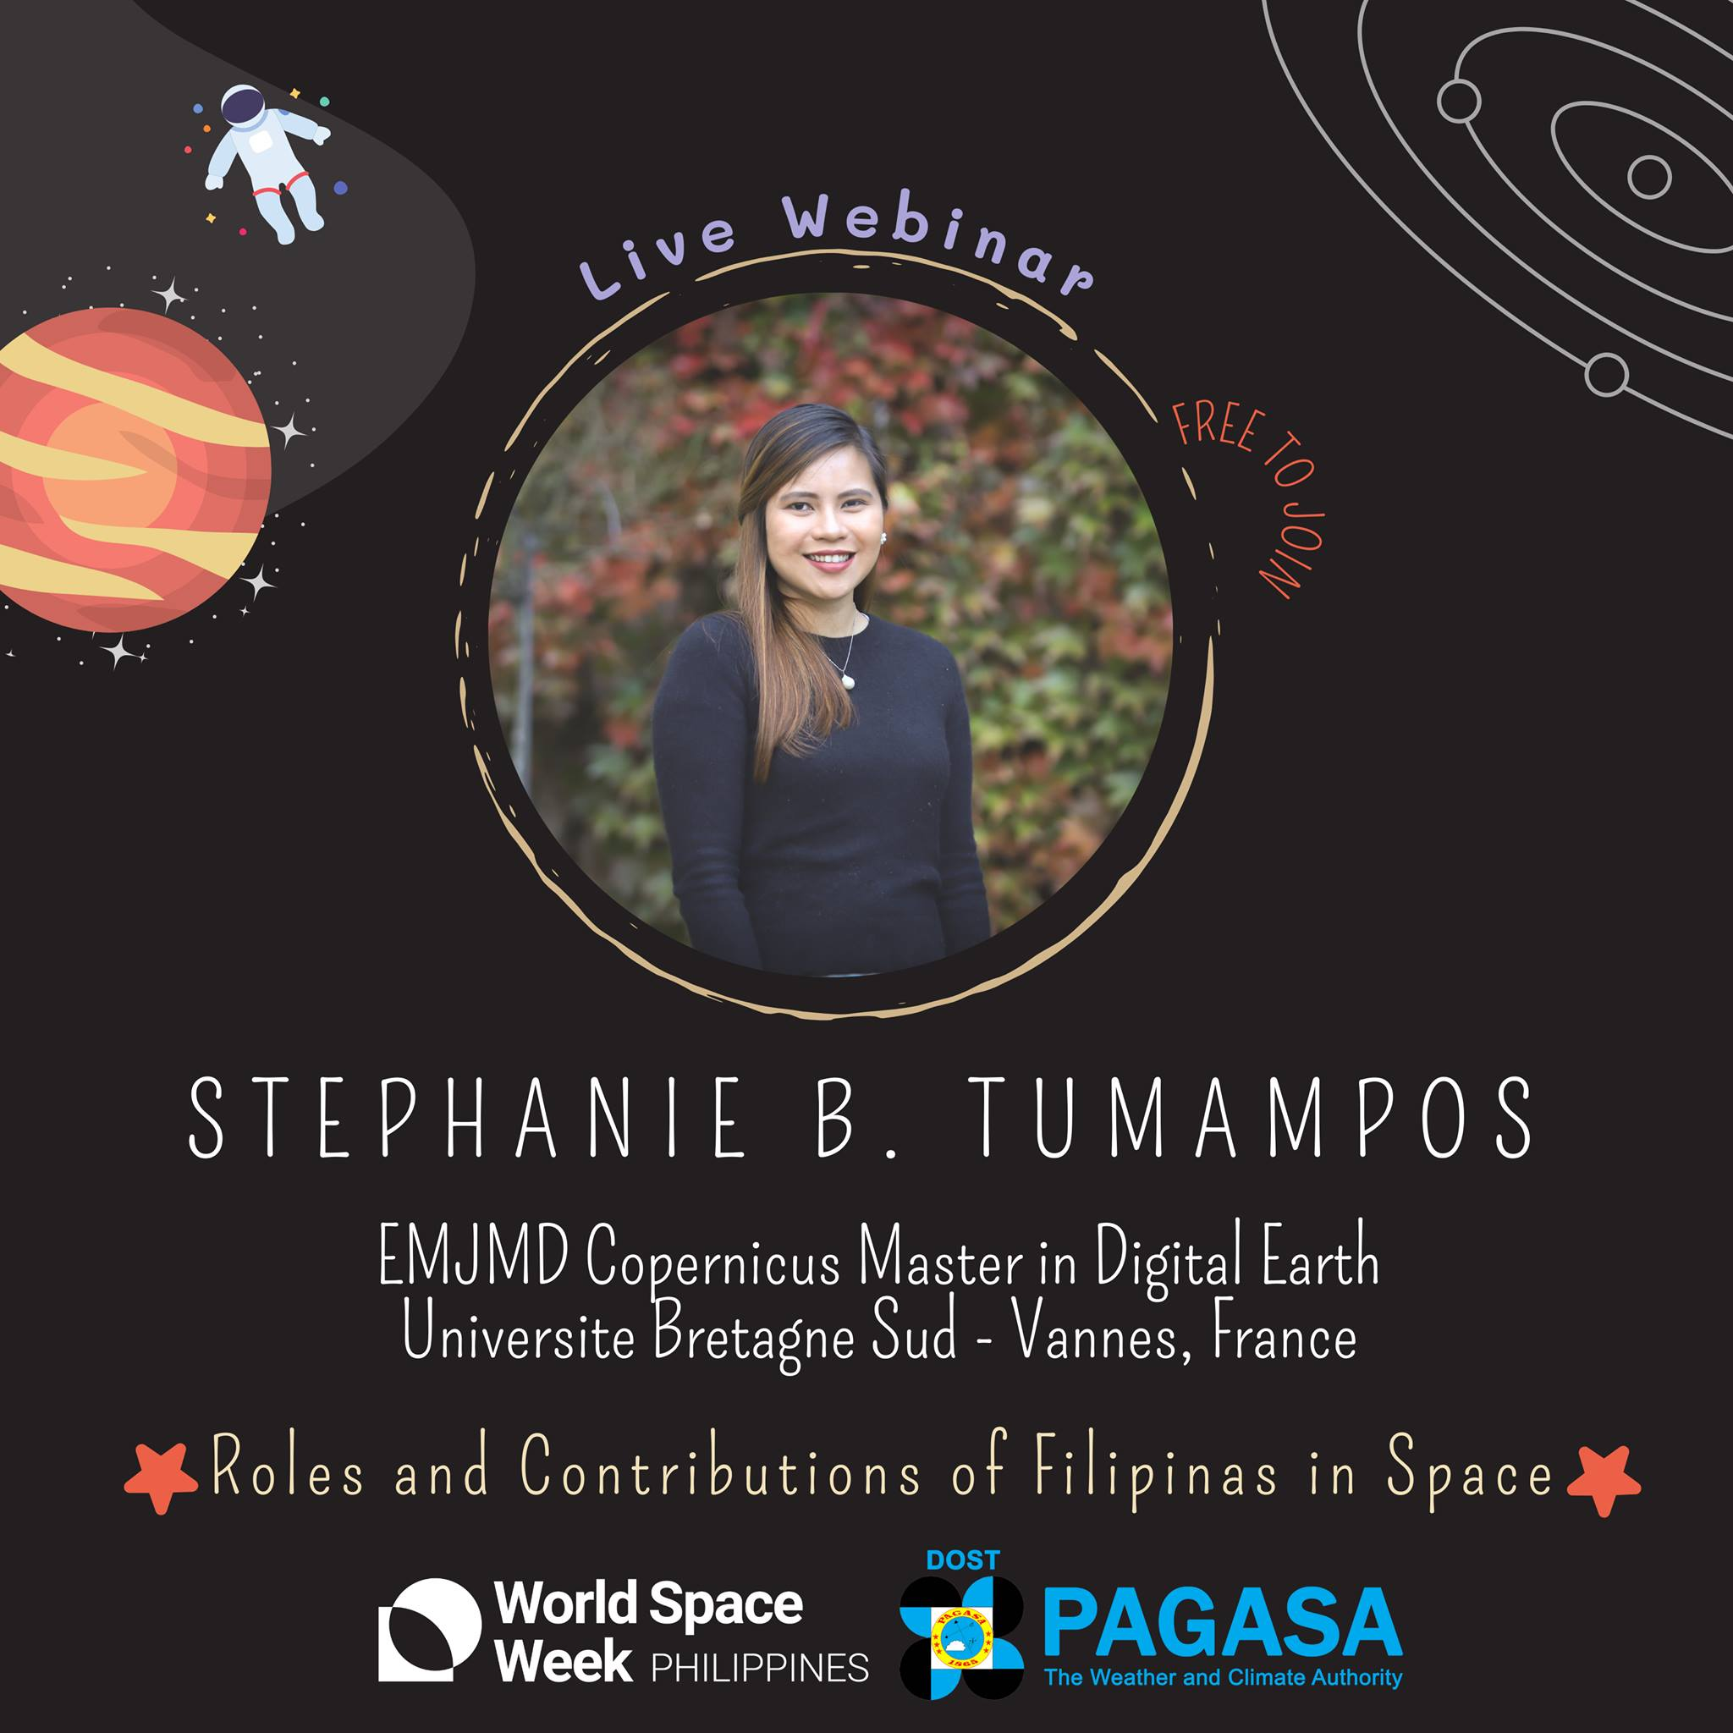
No. of Participants: 156

Slide 15
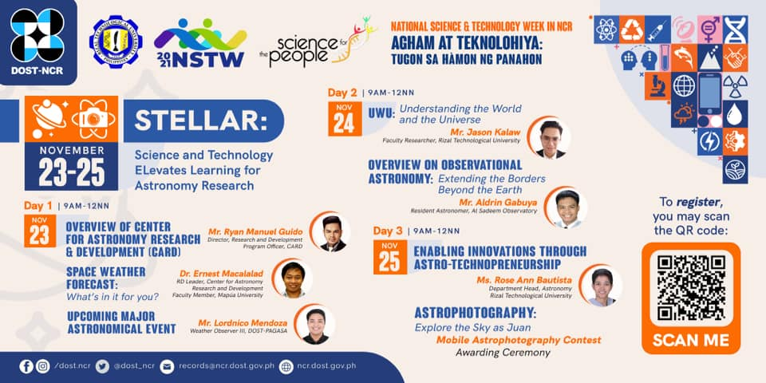

Slide 16
2022

Slide 17
1st PAGASA Astro Vlog Contest
Webinar Series entitles “Revisiting Philippine Ethnoastronomy Amidst the Pandemic”
Understanding the Philippine Ethnoastronomy: A Research Symposium
Virtual Telescope viewing using the 45 cm GOTO Telescope
Virtual Planetarium Show

Slide 19
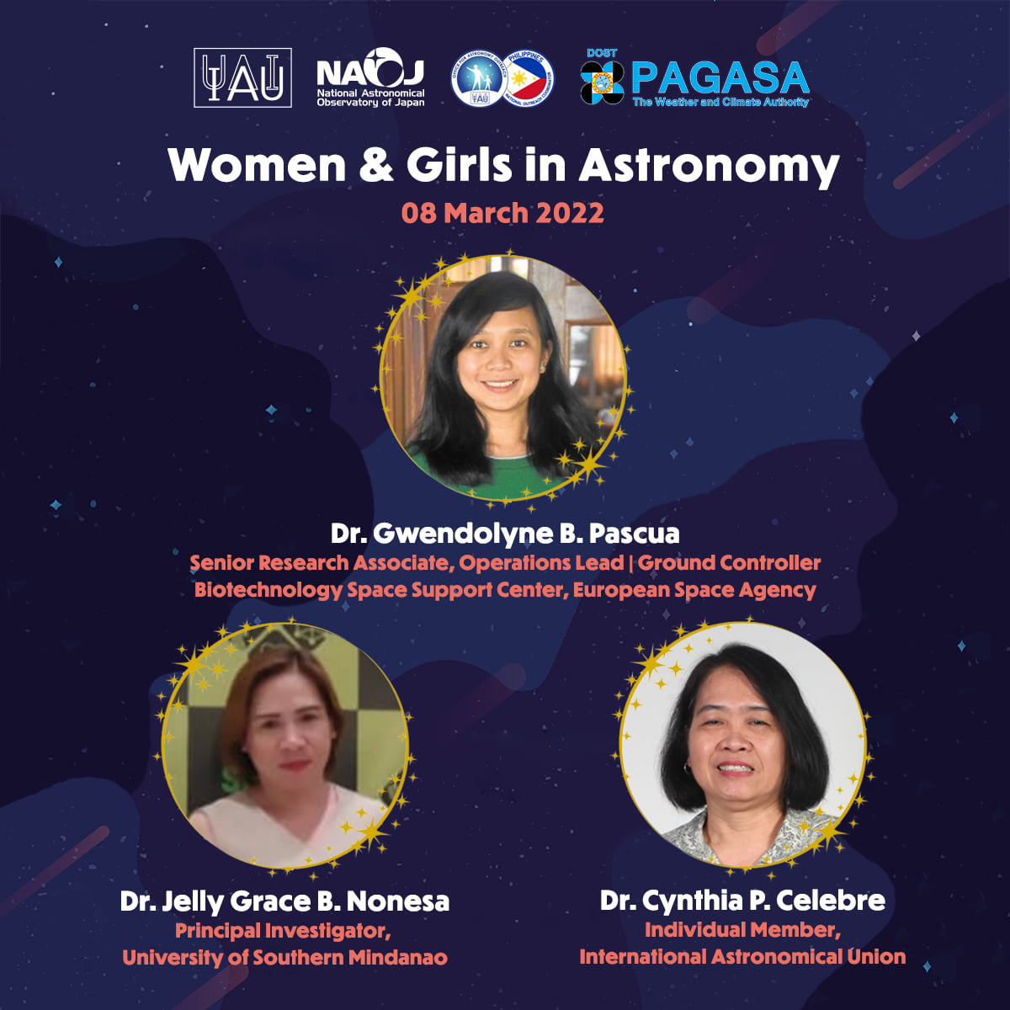
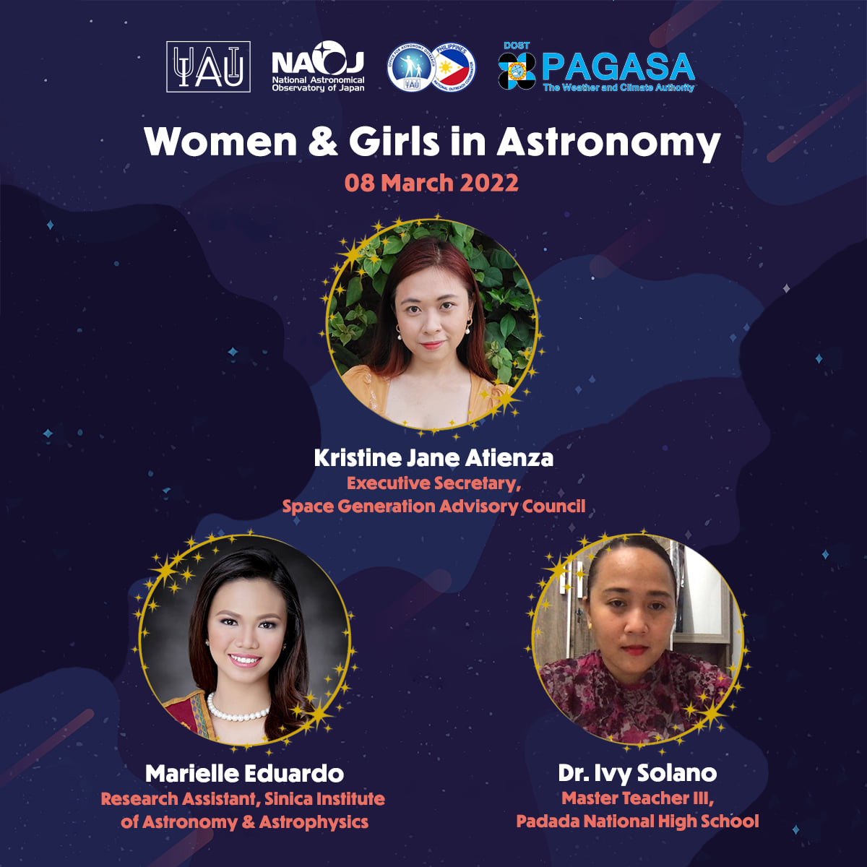
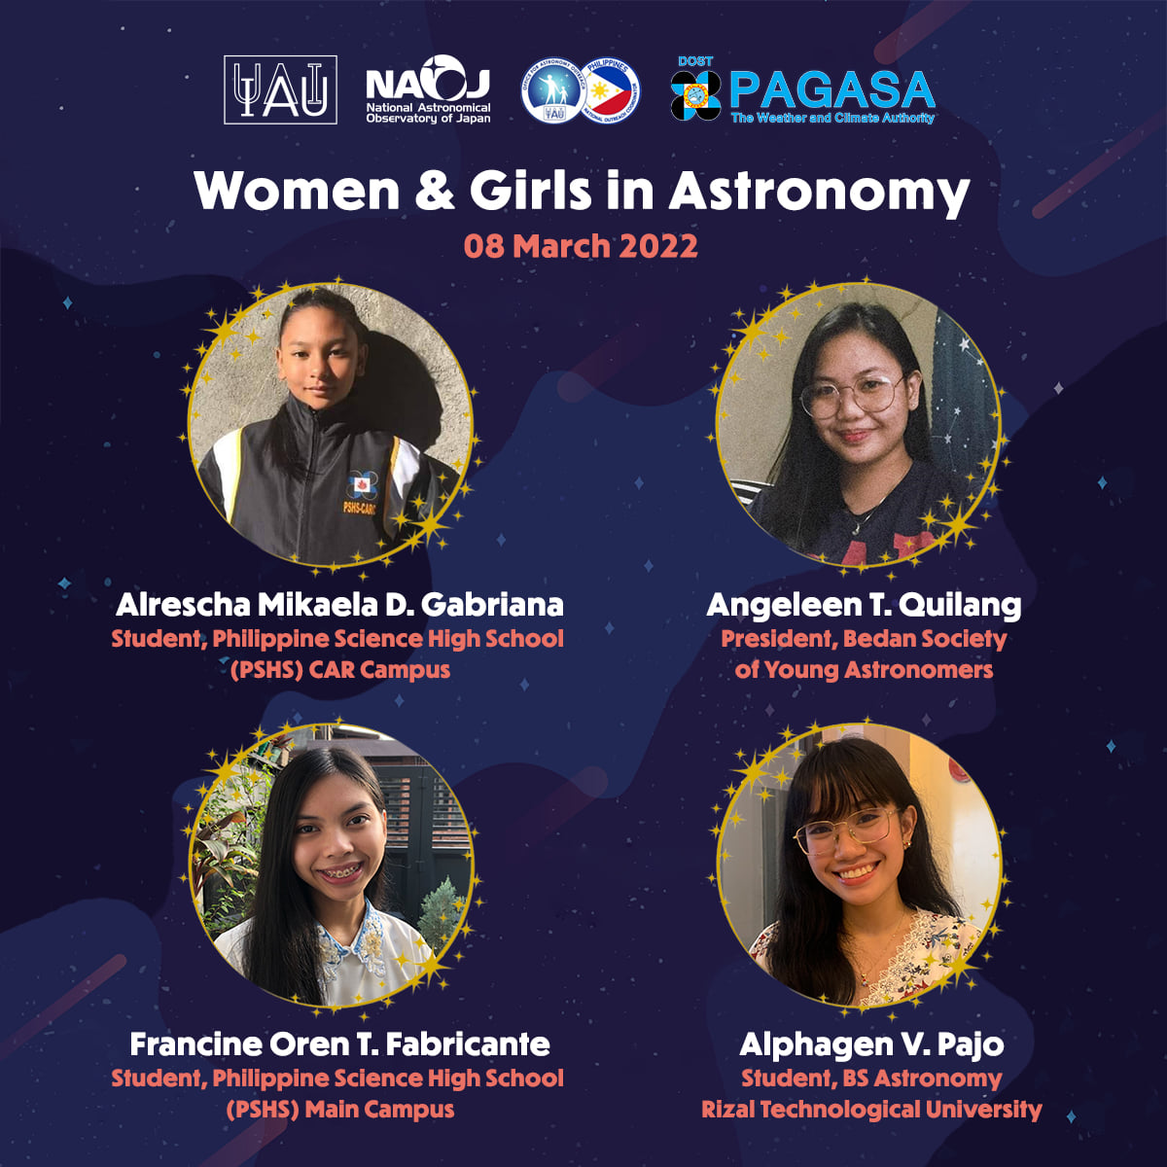

Slide 20
GLOBAL ASTRONOMY MONTH 2022

Slide 21
INTERNATIONAL ASTEROID DAY JUNE 30, 2022

Slide 22
CAP 2022

Slide 23
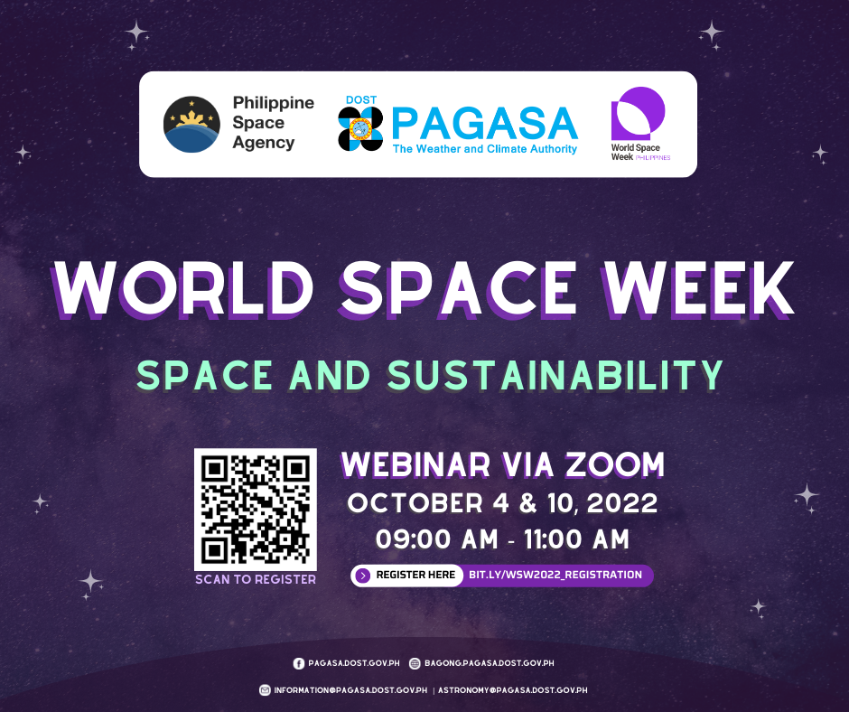

Slide 24
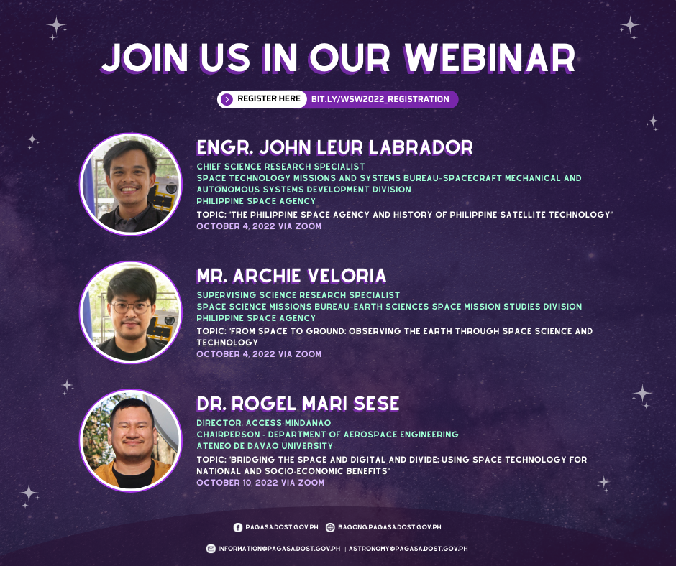

Slide 25
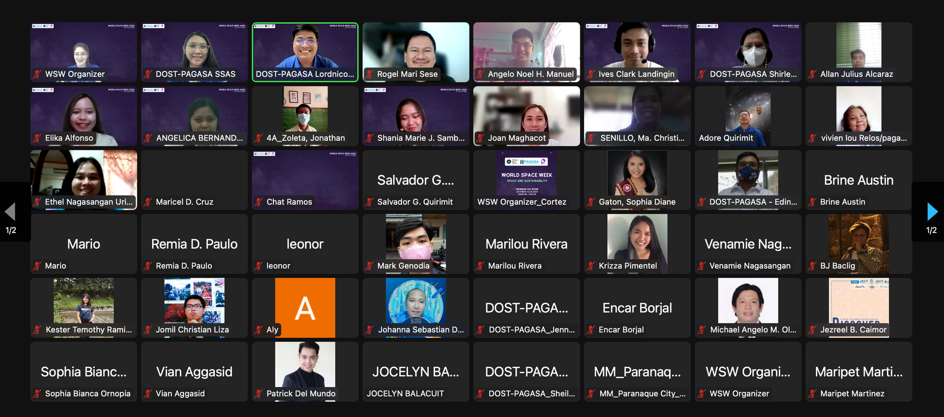

Slide 27
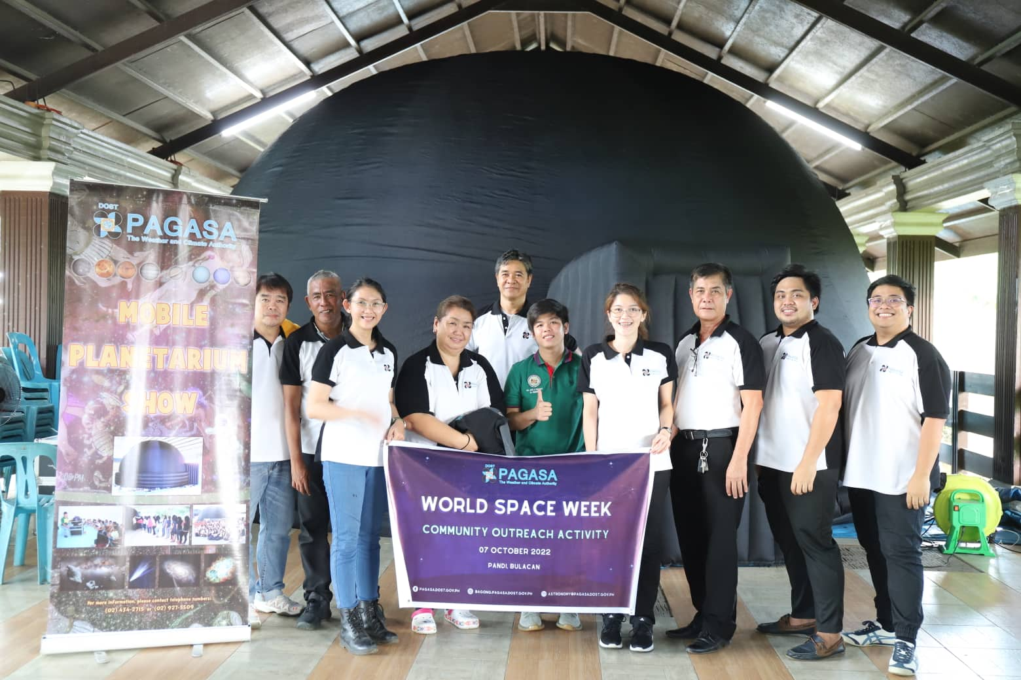

Slide 28
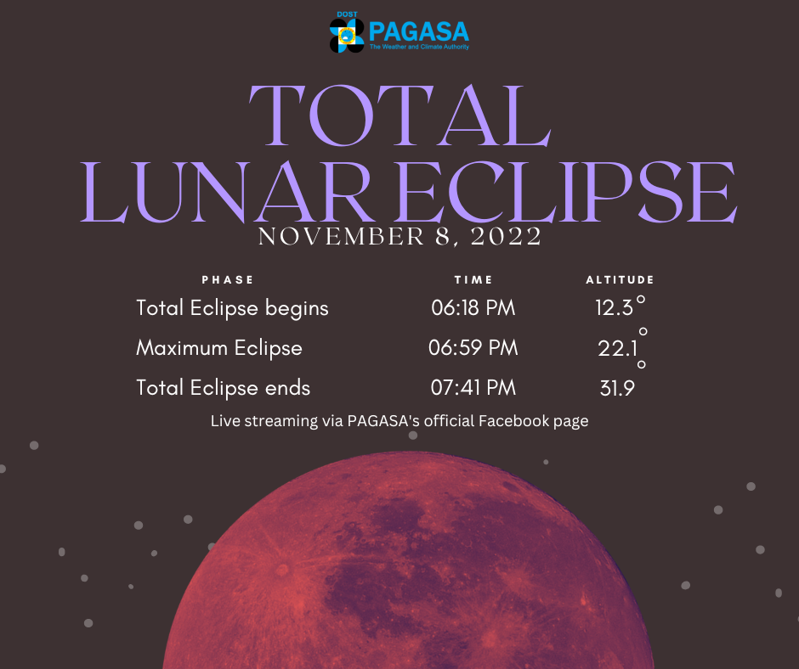

Slide 29
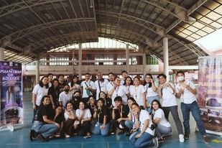
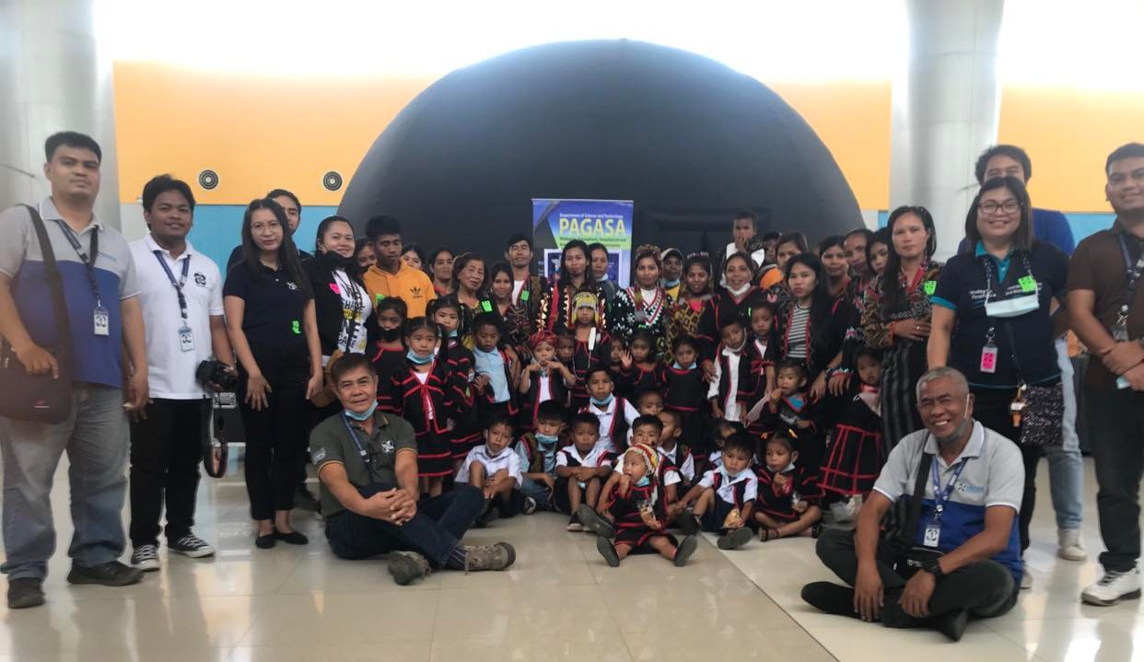
NATIONAL SCIENCE AND TECHNOLOGY WEEK CELEBRATION
MOBILE PLANETARIUM ON TOUR
Manila
Mindanao

Slide 30
Training on the Introduction to Space Weather
Lecturer: Dr. Ernest Macalalad
MAPUA University
Astronomy Research Completed:
The effects of three (3) Solar Cycle on the Intensity of Tropical Cyclones and Meteorological Parameters in the Philippines
Lead Researcher: Ma. Angela Lourdes Lequiron- PAGASA

Slide 31
Current Capacity Building Initiatives:
One (1) Ph D fellow in Korea
Incoming One (1) MSc to Japan

Slide 32
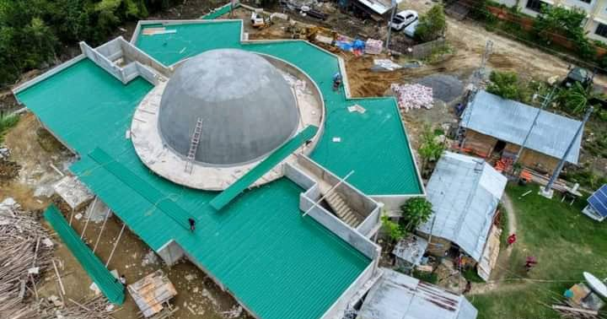
ON-GOING INFRASTRUCTURE PROJECTS
2 Fixed Planetariums (Visayas and Mindanao)
Mindanao

Slide 33
Astronomy Education:
RIZAL TECHNOLOGICAL UNIVERSITY
COURSE | NO. OF RADUATES
BS ASTRONOMY TECHNOLOGY | 142
BS ASTRONOMY | 20
COURSE | NO. OF ENROLLEES
BS ASTRONOMY | 365

Slide 34
RECENT ACHIEVEMENTS:
Establishment of Center for Astronomy Research and Development funded by the Department of Science and Technology
Established memorandum of Understanding with NARIT and Chiang Mai University
Awarded by the IAU Office of Astronomy Outreach as Honorable Mention in the Most Innovative Event
Hosted Balik Scientist Program

Slide 35
RESEARCH ACTIVITIES
RESEARCH PROPOSAL - 135
Completed Research - 61
Published Research - 17
Trained Students - 180
Faculties Collaborated - 15
Communities Served - 21
Institutional Collaborations – 20
Funded research Projects - 2

Slide 36
Astronomical Infrastructure inside the University
Small Astronomical Observatory
Mobile Planetarium

