Slide 1
Introduction of the Substorm in Near-Earth Space
Yukinaga Miyashita
Korea Astronomy and Space Science Institute (KASI)
Korea University of Science and Technology (UST)
Planetary Science and Astrophysics Workshop, Thailand, 30 Jul 2022

Slide 2
■ Self-Introduction
Yukinaga Miyashita
Principal researcher at Korea Astronomy and Space Science Institute (KASI)
Professor at University of Science and Technology (UST)
Doctor, Kyoto University, Japan
Worked at ISEE, Nagoya University, Japan;
ISAS, JAXA, Japan; and UCLA, USA.
Research interests:
  space physics, solar-terrestrial physics,
  space weather, space environment, etc.
  magnetospheric physics
    magnetosphere, magnetotail
    geomagnetic storm, substorm, aurora
    space weather and its prediction

Slide 3

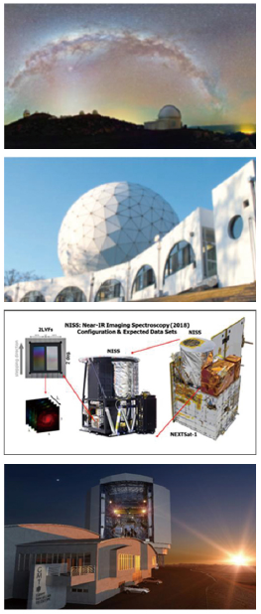
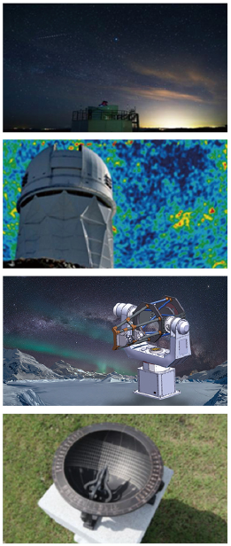
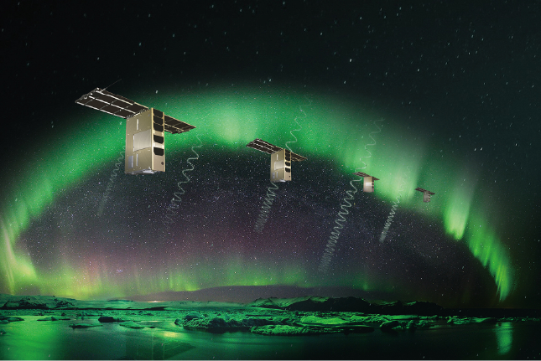
■ KASI
Korea Astronomy and Space Science Institute
https://www.kasi.re.kr/eng/index
Daejeon, South Korea
Space Science
Optical Astronomy
Radio Astronomy
Theoretical Astronomy
Space Situational Awareness
SNIPE

Slide 4

■ UST KASI School
University of Science and Technology
https://ust.ac.kr/eng/
KASI School: Astronomy and Space Science
https://www.kasi.re.kr/eng/pageView/338
Graduate School
  Master course
  PhD course
  Integrated course (Master + PhD)
Campuses: national research institutes in South Korea
Admission: twice a year (spring and fall)
Internship (summer)

Slide 5
■ Contents
Space Science
  Sun-Earth connection
  What is the substorm?
Substorm-associated phenomena
Substorm triggering mechanism (models)
To solve the substorm triggering mechanism

Slide 6
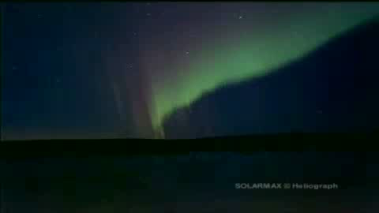
■ Aurora: A Substorm Signature
When substorms occur, active auroras appear
in the polar regions near midnight.
Auroral breakup observed on the ground
(c) NASA

Slide 7
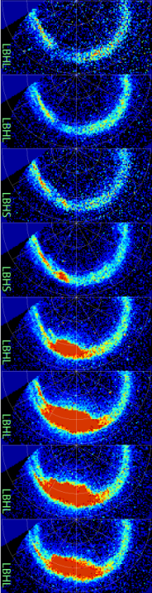
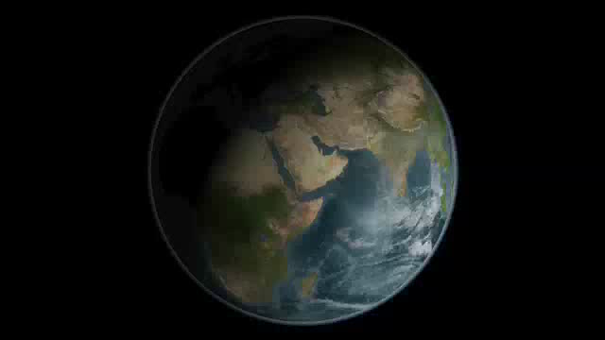
■ Aurora: A Substorm Signature
When substorms occur, active auroras appear
in the polar regions near midnight.
Aurora observed from
a high-altitude satellite
substorm
onset
~10 min
(c) NASA
midnight

Slide 8
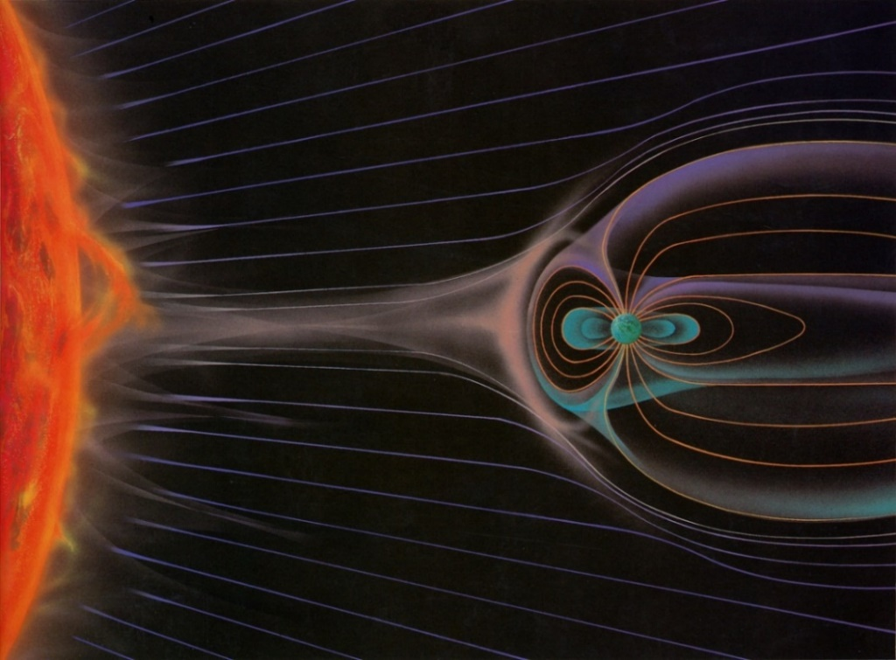
■ Sun-Earth System
Space physics, Solar-terrestrial physics, ...
Plasmas and energy are transported from the Sun
to near-Earth space (magnetosphere and ionosphere).
Severe solar activity can cause severe disturbances
in near-Earth space, such as geomagnetic (space)
storms and substorms (active auroras).
magnetotail
Sun
solar wind
magnetosphere
from Pollock et al. (2003)

Slide 9
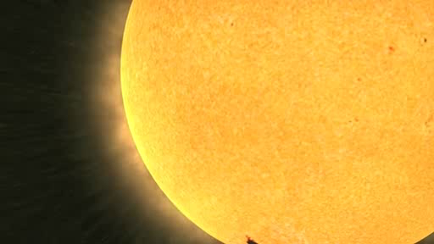
■ Substorm Generation Processes
Energy for substorms comes from the sun.
It is accumulated in the magnetotail and then released. → Substorm and auroral breakup
(c) NASA

Slide 10
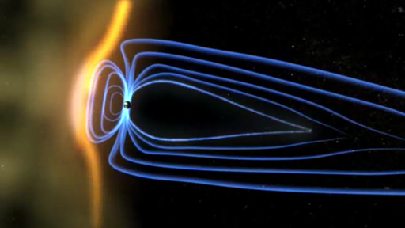
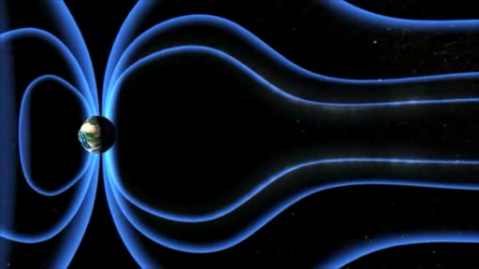
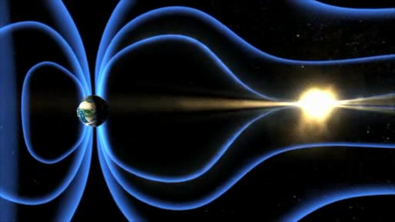
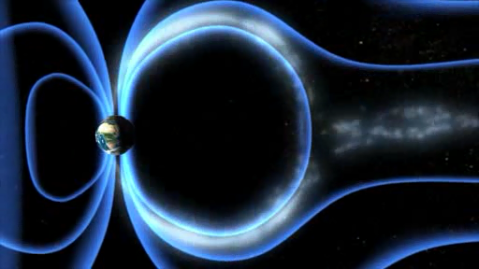
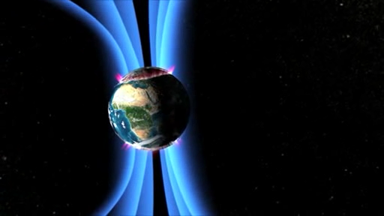
■ Substorm Generation
solar
wind
magnetotail
Interaction between the solar wind
and the magnetosphere leads to
energy accumulation in the magnetotail.
→ When the energy excessively
accumulates, some process causes
severe energy release and dissipation:
substorm.
→ Various changes occur
in the magnetosphere and
the ionosphere and on the ground:
dipolarization, auroral breakup,
geomagnetic disturbances, etc.
What process causes a substorm
or severe energy release?
aurora

Slide 11
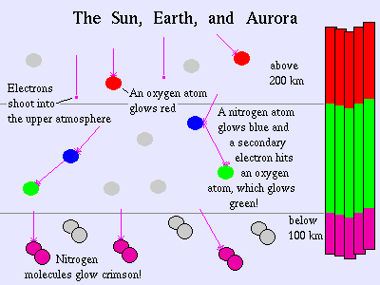
■ Mechanism of Aurora
Auroral images are like television-screen view of magnetospheric processes
Precipitating particles collide with atoms and molecules,
which are excited and emit radiation (aurora).
The color and altitude of auroras depend on the species
and altitudinal profile of the atoms and molecules and
the energy of precipitating particles.
https://aurorawatch.lancs.ac.uk/alerts/
Univ. Alaska, Fairbanks

Slide 12

■ Geomagnetic (Space) Storms
Another major disturbance in near-Earth space.
When a huge amount of energy from the Sun enters
the magnetosphere, the ring current and the radiation
belts in the inner magnetosphere highly develop,
causing much severer disturbances called
geomagnetic (space) storms.
(c) ERG-SC, JAXA/ISEE Nagoya Univ.

Slide 13
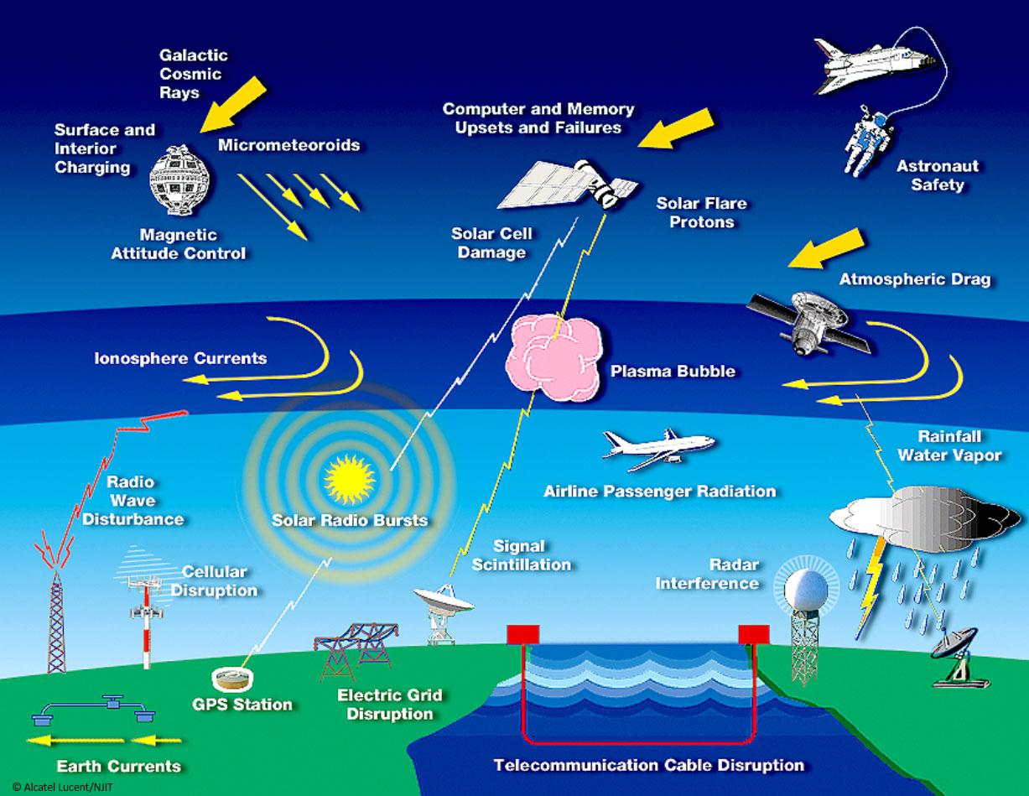
■ Importance of Space Weather Research
Storms and substorms are fundamental in space weather
and space plasma physics.
It has become essential to utilize space for human life,
and human activity is spreading to space more and more.
Severe storms and
substorms can
cause damage to
human activity.
→ Space weather
research and
forecast are
essential to
minimize damage.

Slide 14
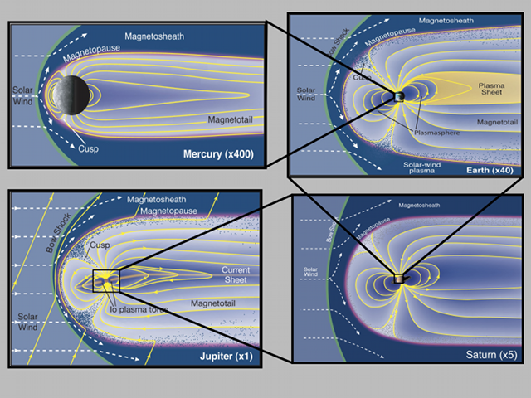
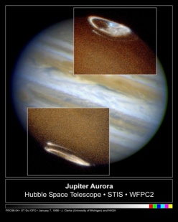
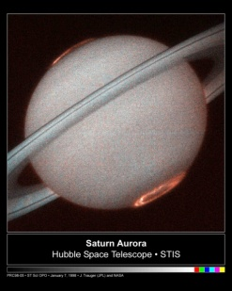
■ Universality of Substorm Phenomena
Substorms are explosive phenomena closely related to
various plasma processes, such as instabilities,
particle acceleration, and magnetic reconnection.
They are common at planets, at the sun,
and in the universe.
planetary aurora
(c) NASA

Slide 15
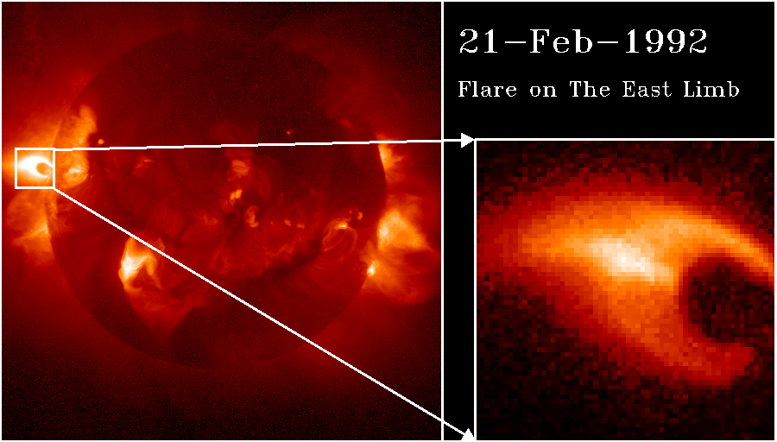
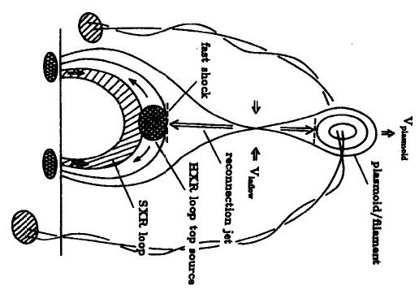
■ Universality of Substorm Phenomena
Solar flare
(c) JAXA, Yohkoh
Understanding of substorms will further promote that of
universal space plasma physics at planets, the sun, and
other celestial objects.
Comparison will deepen not only our understandings
of the near-Earth space environment itself and
its universality and specialty but also those of
other objects.

Slide 16
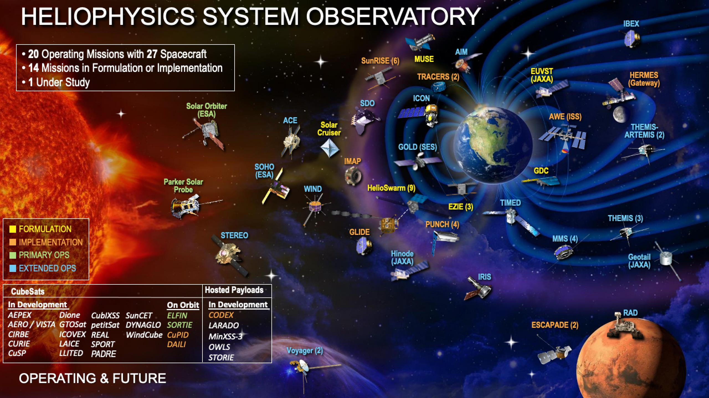

■ Comprehensive Studies of Space Physics
Comprehensive analyses are needed.
Multi-point satellites
ERG, MMS, THEMIS, Cluster, Geotail, GEO, etc.
Ground-based instruments
magnetometers, cameras, radars, etc.
Simulations
global MHD,
local particle
ERG
(c) NASA

Slide 17
■ Substorm-Associated Phenomena
Various phenomena occurs, associated with substorms
(at onset and in the expansion phase).
Ionosphere
  Auroral breakup (poleward expansion)
  Intense westward auroral electrojet
Magnetotail
  Magnetic reconnection, fast flows, plasmoid
Magnetotail and inner magnetosphere
  Dipolarization, energetic particle injection
Others
  Auroral kilometric radiation
  Pi2 and Pi1 pulsations (magnetosphere and ground)
  Geomagnetic and ionospheric changes at middle and low latitudes on the ground

Slide 18
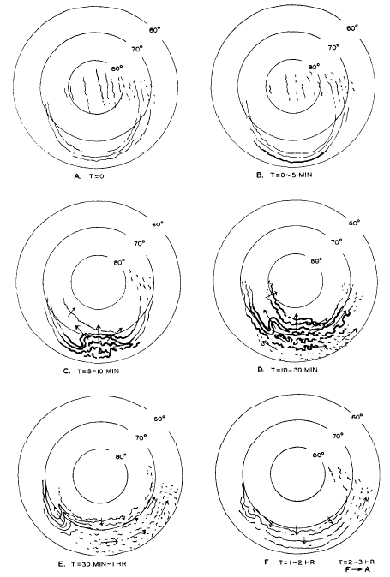
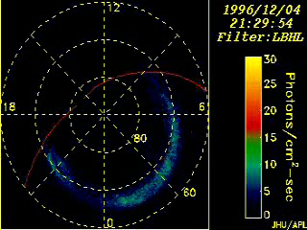
■ Auroral Breakup
Expansion phase
Initial auroral brightening
near the most equatorward
part of the auroral oval
(substorm onset)
poleward expansion
(auroral breakup)
Recovery phase: Subsiding
initial brightening (onset)
B-D: expansion phase
poleward expansion (auroral breakup)
E-F: recovery phase
Akasofu (1964)

Slide 19
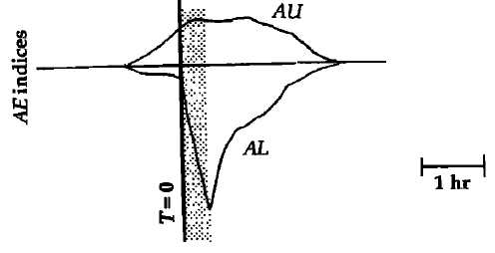
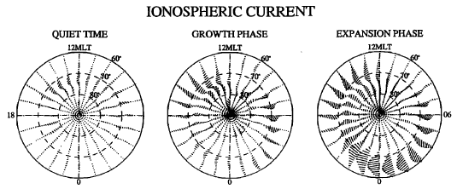
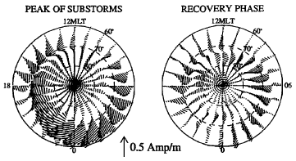
■ High-Latitude Ground & Substorm Phases
Intense westward ionospheric currents near midnight
are associated with auroral breakup (poleward expanding
intense aurora).
AU: maximum eastward electrojet
AL: maximum westward electrojet
(poleward geomagnetic field
perturbation)
sharp
decrease
Ionospheric
currents
Kamide & Kokubun (1996)

Slide 20
■ Substorm Phases
Growth phase
  The energy accumulates in the magnetotail (lobes).
  Begins with southward interplanetary magnetic field.
Onset and expansion phase
  The accumulated energy releases.
  Consequently, various severe changes occur.
Recovery phase
  The activities subside.
  The magnetosphere and the ionosphere return
  to quiet state.

Slide 21
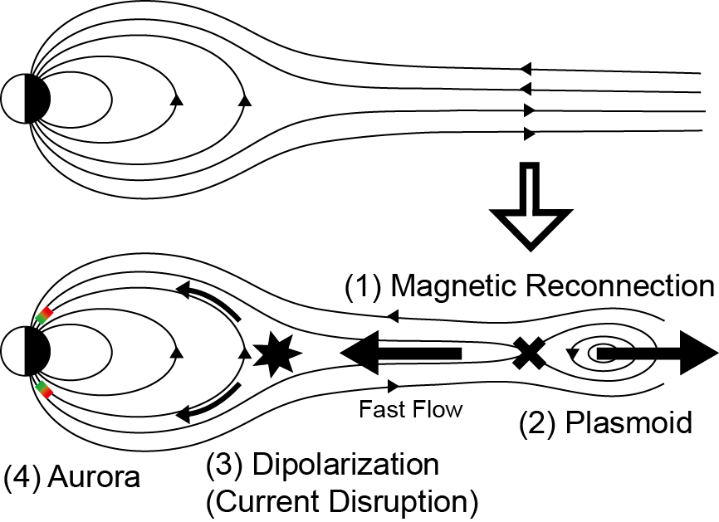
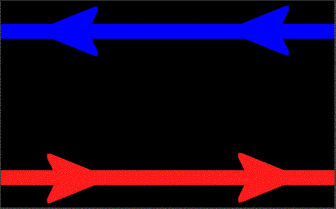
■ Magnetic Reconnection in the Magnetotail
Magnetic reconnection is disconnecting and connecting
oppositely directed magnetic field lines.
It converts magnetic energy into plasma energy
i.e., energy release.

Slide 22
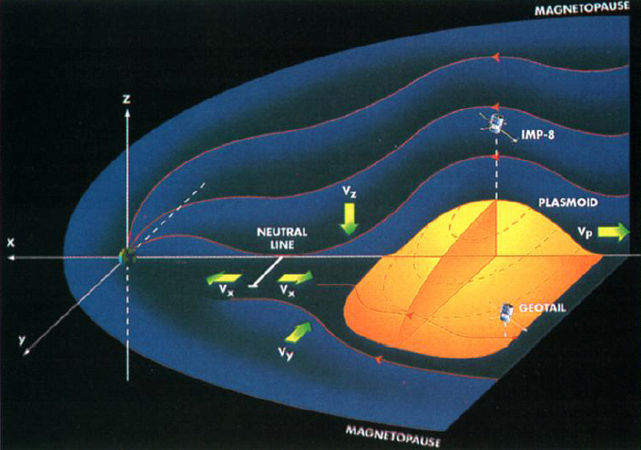
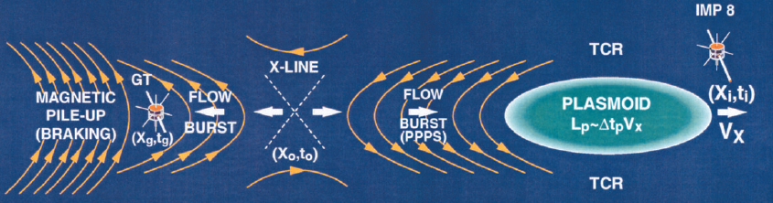
■ Magnetic Reconnection in the Magnetotail
Magnetic reconnection
in the near-Earth magnetotail
→ - fast tailward flow with
southward magnetic field
(plasmoid)
- fast earthward flow with
northward magnetic field
Slavin et al.
(1999)
magnetic
reconnection
northward
magnetic field
southward
magnetic field
fast tailward
flow
fast earthward flow
Slavin et al. (2002)

Slide 23
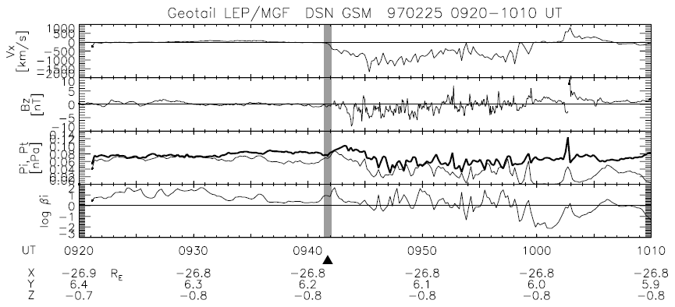
■ Magnetic Reconnection in the Magnetotail
An example of the plasmoid
fast tailward flow (negative Vx)
southward magnetic field (negative Bz)
energy release (pressure decrease)
substorm
onset
Miyashita et al. (2009)

Slide 24
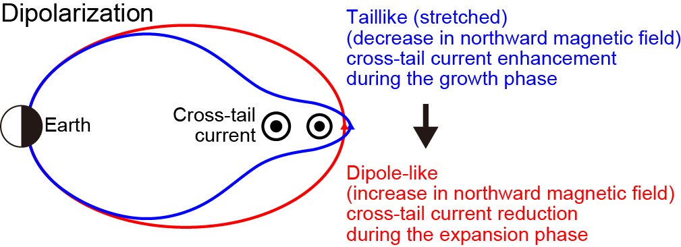
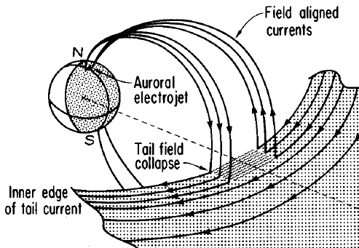
■ Dipolarization in the Magnetotail
During the growth phase, magnetic field lines become taillike (stretched) configuration.
In the expansion phase, they return to dipole-like configuration: dipolarization.
Dipolarization is directly
connected with auroral
poleward expansion.
aurora
dipolarization
McPherron et al. (1973)

Slide 25
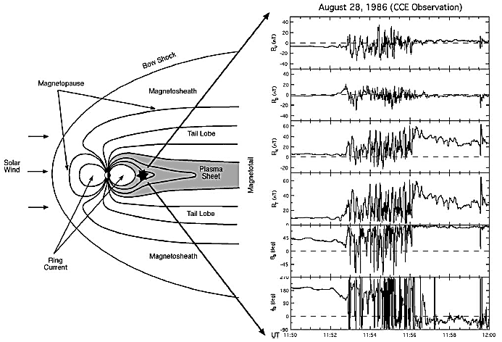
■ Dipolarization in the Magnetotail
Examples
Dipolarization:
Net increase
in northward
magnetic field
Accompanied
by rapid
fluctuation
from Lui [2004]

Slide 26
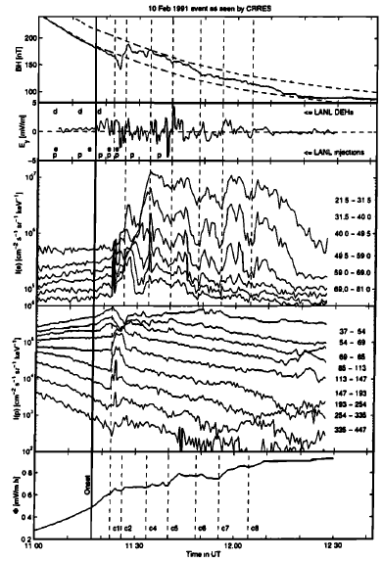
■ Energetic Particle Injection
Energetic particles are
generated, associated
with dipolarization.
Then the particles
drift around Earth.
Increase in energetic
particle fluxes:
“injection”
dipolarization
northward
mag
high-energy
electron
fluxes
high-energy
proton
fluxes
at L~5
Sergeev et al. (1998)

Slide 27
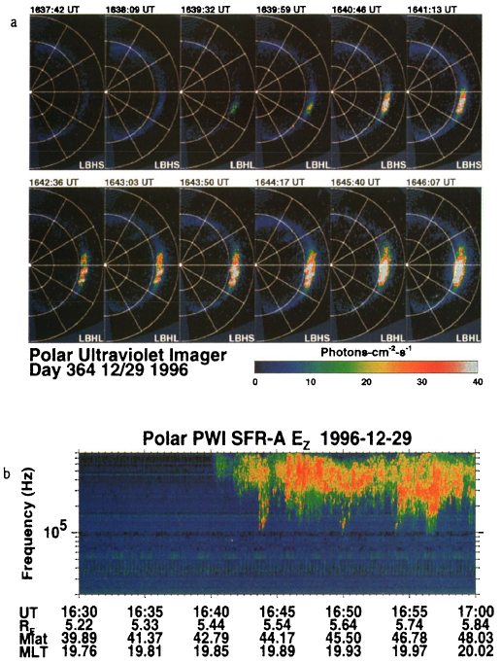
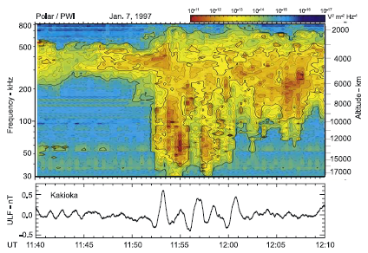
■ Auroral Kilometric Radiation
Related to acceleration of auroral particles
at ~2000-20,000 km altitude.
Observed in a wide area of
near-Earth space
Good correlation with auroral
breakup and geomagnetic waves
auroral breakup
auroral
kilometric
radiation
(AKR)
auroral
kilometric
radiation
(AKR)
ground mag
Morioka et al. (2007)
Liou et al. (2000)

Slide 28
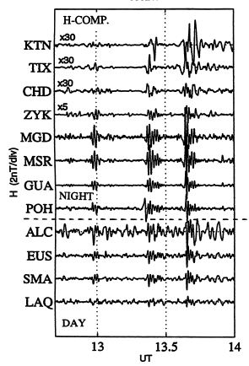
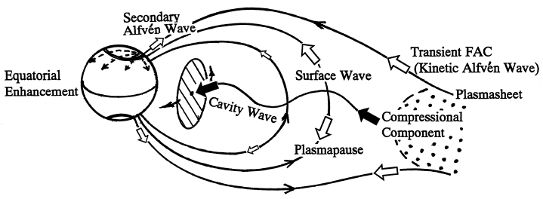
■ Low-Latitudes during Substorm (1)
Pi2 pulsation (period: 40-150 s)
Pi1 pulsation (period: 1-40 s)
- Geomagnetic waves
- Generated in the near-Earth
magnetotail at substorm onsets
- Propagates in the magnetosphere
to the ground
- Amplitude: a few nT (ground)
Positive bay perturbation
- Increase in northward mag
inside the substorm
current wedges
- a few to 10 nT
Yumoto & CPMN (2001)
substorm
current wedge
McPherron et al. (1973)

Slide 29
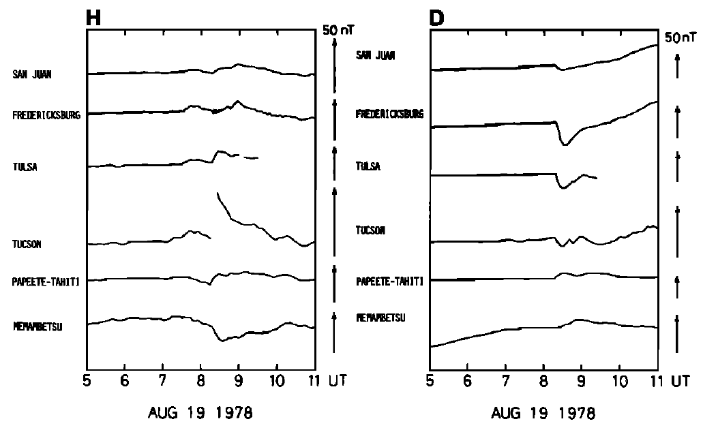
■ Low-Latitudes during Substorm (2)
The substorm current wedge expands longitudinally.
Eastward and westward magnetic fields deflect due to
field-aligned currents of the substorm current wedges.
ground mag from longitudinally-aligned low-latitude stations
(northward)
(eastward)
アメリカ
substorm
current wedge
positive
bay
ポリネシア
女満別
Nagai (1982)
McPherron et al. (1973)

Slide 30
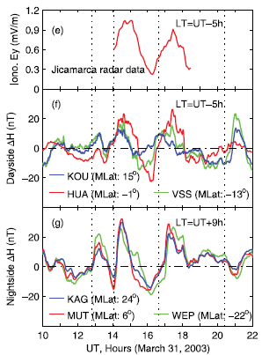
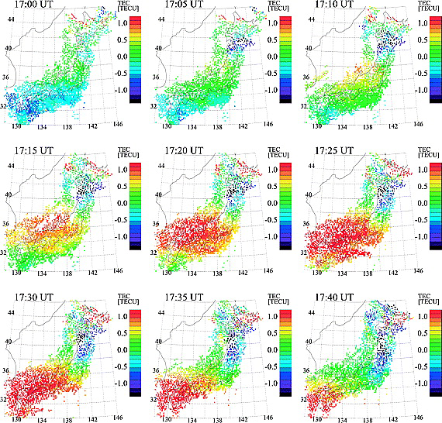
■ Low-Latitudes during Substorm (3)
Substorm phenomena at low-latitudes
Electric field (convection)
enhances even on the dayside.
Large-scale traveling
ionospheric disturbances
  Propagates equatorward
  from the auroral region.
  Cameras, radars, GPS-TEC,
  ionosondes, etc.
radar
ground mag
Huang
(2009)
GPS electron
Shiokawa
et al. (2003)

Slide 31
■ Substorm Triggering Mechanism
The substorm triggering mechanism has been
a major issue for decades.
Various substorm models have been proposed:
  Near-Earth Neutral Line Model (“Outside-In”)
  [e.g., Baker et al., 1996]
  Current Disruption Model (“Inside-Out”) [e.g., Lui, 1996]
  Magnetosphere-Ionosphere Coupling [e.g., Kan et al., 1988]
  Convection Reduction Model [Lyons, 1995]
  Boundary Layer Dynamics Model [Rostoker and Eastman, 1987]
  Thermal Catastrophe Model [Smith et al., 1986]
Catapult Current-Sheet Relaxation Model
(Middle → In & Out) [Machida et al., 2009]
New plasma intrusion (preonset streamer) mode
[Nishimura et al., 2010]
etc.

Slide 32
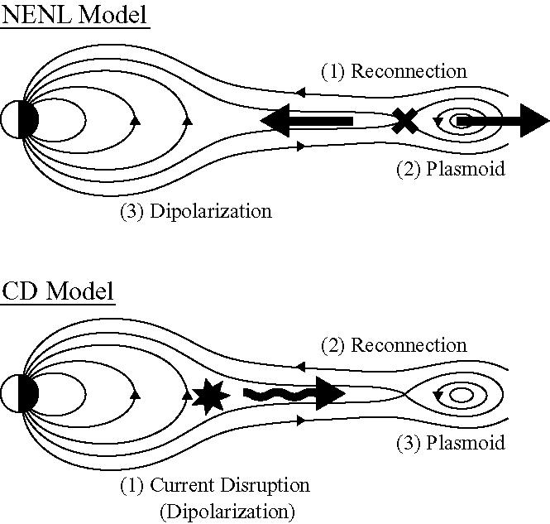
■ Two Leading Substorm Models
Near-Earth
Neutral Line
(NENL) Model
“Outside-In”
Current Disruption (CD) Model
“Inside-out”
The substorm triggering mechanism has been
a major issue for decades.

Slide 33
■ Near-Earth Neutral Line Model
Magnetic reconnection in the magnetotail drives
energy release and a substorm.
Magnetic reconnection:
disconnecting and connecting oppositely directed magnetic
field lines
Converts
magnetic energy into plasma energy.

Slide 34
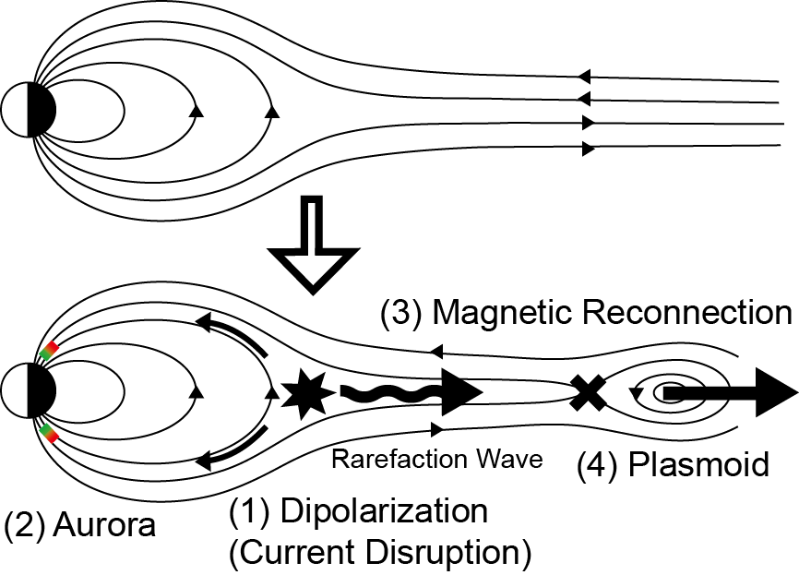
■ Current Disruption Model
The time sequence is different.
Current disruption drives energy release and a substorm.
→ Relative timing and causal relationship between
reconnection and current disruption?

Slide 35
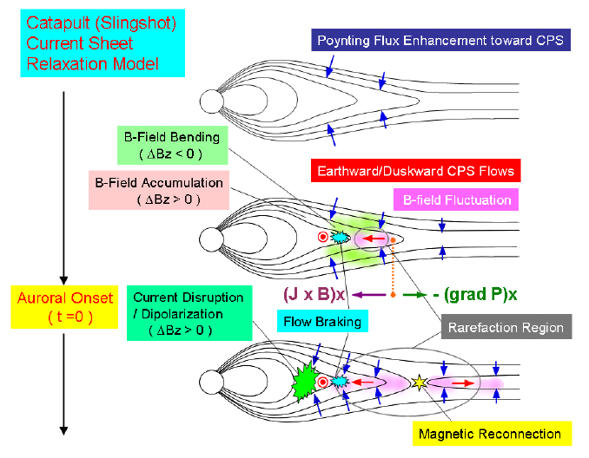
■ Catapult Current-Sheet Relaxation Model
Middle → In & Out
Machida et al. (2009)

Slide 36
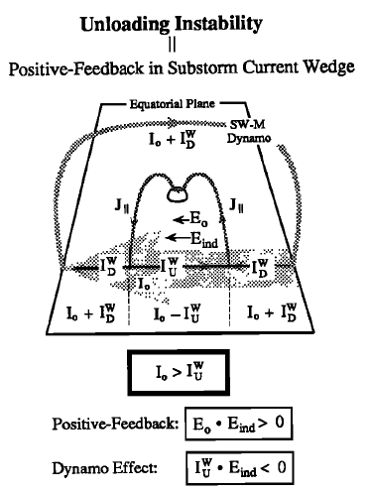
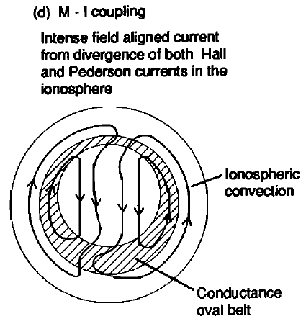
■ Magnetosphere-Ionosphere Coupling Model
  Field-aligned current and convection enhance
  by positive feedback by Alfvén waves.
  (Kan et al., 1988; Kan, 1993; Kan and Sun, 1996; Wang and Lyu, 2021)
from Lui (1991)
Kan (1993)

Slide 37
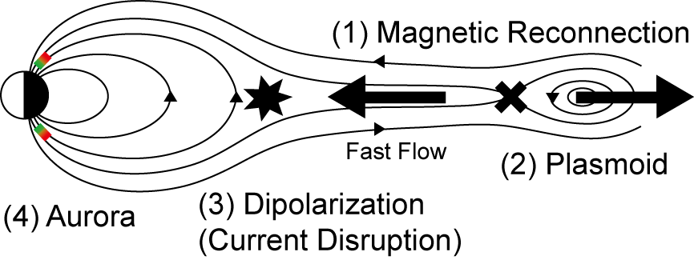
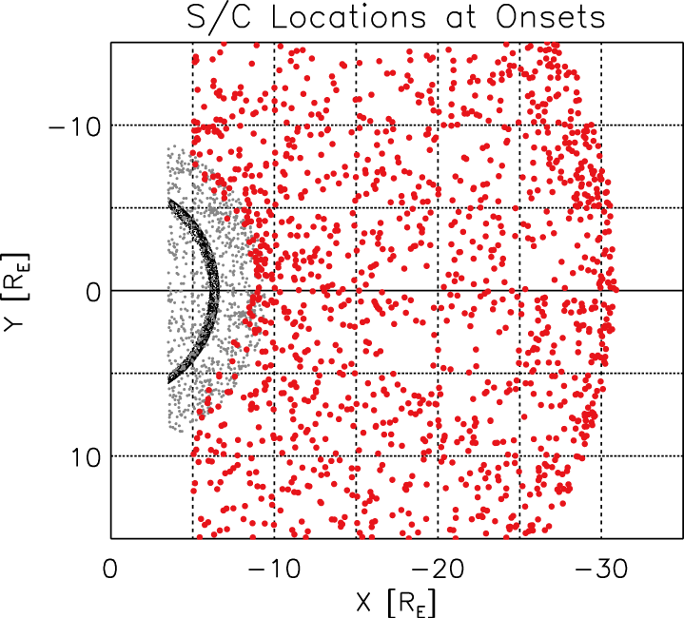
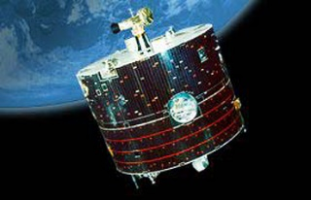
■ To Solve the Triggering Mechanism
What drives the substorm (auroral breakup)?
— When and where in the magnetotail does the first
change occur, associated with substorm onset?
3787 substorm events from
auroral breakups observed
by Polar and IMAGE
→ statistical analysis
(superposed epoch analysis)
using ~10 years of ion and
electric and magnetic field data
from Geotail, GOES, and Polar
？
Earth
Re: Earth’s radius
Miyashita et al. (2009)

Slide 38


■ The Geotail Satellite
The first satellite that has observed
Earth’s magnetotail thoroughly.
Launched on 24 July 1992 (30 years ago)
in collaboration with Japan (ISAS) and NASA.
Still observing the magnetosphere.
In situ observations of plasma (flow, pressure, etc.), electric and magnetic fields, and waves.
— characteristics of solar-terrestrial physics
(c) JAXA
lunar orbit (60 Re)
Earth
Geotail orbit
in view from
the north
← the sun
region of the present study
magnetotail
Re: Earth’s radius

Slide 39


■ Statistical Study
Vx
ΔBz
ΔPt
Magnetic reconnection
-16 > X > -20 Re
tailward edge of the thin CS
Dipolarization
-7 > X > -10 Re
2 min before onset.
Total pressure (Pi + Pb)
    largely decreases
at -10> X > -18 Re
(between NENL and CD)
increases at X > -10 Re
(dipolarization)
Bz>0 Vx>0
Auroral
Onset
Bz<0 Vx<0
-15
Y
15
Miyashita et al. (2009)
-5
X
-32
earthward tailward
increase decrease

Slide 40

■ Format of Panel
Equatorial plane
in view from the north
view from the dusk
-15
← Sun
Y
Time [min] from
substorm onset
(t=0: initial auroral brightening)
Earth
15
X
|Y|<15 Re, -5 > X > -32 Re
Re: Earth’s radius

Slide 41
■ Conclusions from Our Statistical Studies
A series of our statistical studies established the overall
morphological picture of magnetotail evolution and
energy transport associated with substorm onsets and
clarified that near-Earth reconnection plays an important
role in triggering a substorm, energy release, and
reconfiguration.
at X ~ -18 Re at t = -4 or -2 min
There is no
evidence that
current disruption causes reconnection.
at X ～ -8 Re at t = -2 min
→ Expands in all directions

Slide 42

■ Multi-Point Simultaneous Observations
Time History of Events and Macroscale Interactions during Substorms (THEMIS) mission (2007-, USA)
5 spacecraft in the magnetotail
+ ground-based auroral cameras and magnetometers
To solve the substorm triggering mechanism

Slide 43



■ Multi-Point Simultaneous Observations
Reconnection signatures, such as
plasmoid and fast earthward flow,
were observed before dipolarization.
Angelopoulos et al. (2008)

Slide 44




■ Stepwise Development of Onset Aurora
(1) fading
Mende et al. (2009)
(2) initial
brightening
(4) poleward
expansion
(3) enhancement of wave-like
(bead-like) structure
Most studies mark only one or two timings
and choose one as the substorm onset time.
Each step corresponds to tail substorm signatures.
→ It is important to determine these auroral steps, when
we discuss the timing issue and magnetotail changes.

Slide 45

■ Stepwise Development of Onset Aurora
Auroral arc
development
associated
with a
substorm
onset
observed by
a THEMIS
ground-based
camera
initial brightening
enhancement of
wave-like structure
Miyashita et al.
(2018)
poleward
expansion

Slide 46

■ Stepwise Development of Onset Aurora

Slide 47


■ Multi-Step Development of Substorm Onset
  Auroral breakup, AKR, Pi2/1,
  and geomagnetic negative bay
  develop in two steps.
AKR: low-freq.
high-freq.
initial brightening
poleward expansion
AKR: low-freq.
high-freq.
Pi1
Pi1
Pi2
Pi2
Morioka et al. (2010)
Morioka et al. (2014)

Slide 48

■ Pseudosubstorm
Pseudosubstorms (pseudobreakups)
are similar to substorms in
magnetotail processes and
the early stage of auroral onset
arc development.
However, they differ in the
subsequent auroral development.
For the pseudosubstorm,
the onset arc is suppressed without
progressing to poleward expansion.
Comparison between substorms
and pseudosubstorms helps us
understand the substorm triggering
mechanism.
Fukui, Miyashita
et al. (2020)

Slide 49


■ Pseudosubstorm
Pseudosubstorm
(Pseudobreakup)
Substorm
Fukui, Miyashita et al. (2020)

Slide 50

■ Simulation Studies (1)
Global magnetohydrodynamic (MHD) simulation
for understanding the global context
(c) NASA THEMIS

Slide 51

■ Simulation Studies (2)
Local particle (kinetic) simulation
for understanding the detailed mechanisms
Magnetic reconnection
Fujimoto & Sydora (2012)

Slide 52
■ Summary
The substorm is a process of energy release and dissipation in the magnetotail possibly triggered by magnetic reconnection.
It causes various plasma and electromagnetic disturbances in the magnetosphere and the ionosphere and on the ground, such as active auroral breakup and geomagnetic changes.
The triggering mechanism of substorms is still an open
question, although various models have been proposed.
To understand the mechanism, multi-point simultaneous observations by spacecraft and ground-based instruments are important.
Simulation studies are also needed to understand
the global context and the detailed mechanisms.
Substorms at other planets and the solar flare would be helpful for understanding the mechanisms.

