Slide 1
RV Fitting Sirinrat Sithajan 25th April 2019 NARIT School on Exoplanet and Astrobiology Chiang Mai, Thailand

Slide 2
Part I
RV data
RV fitting: principle
RV fitting: tools
Part II
Practice session: discover a planet by yourself!

Slide 3
RV Data

Slide 4
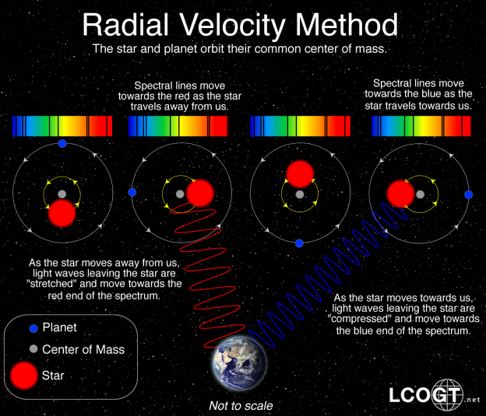

Slide 5
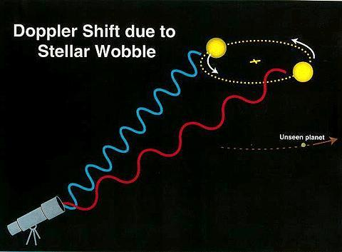
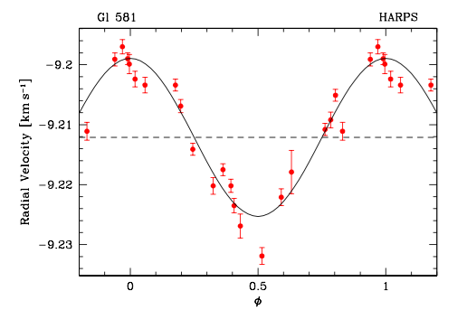
Observed spectra
Data reduction pipeline: measures magnitude and direction of the spectral line shift, and calculate RV
1 observation gives 1 RV data point
RV fitting: orbital and physical parameters e.g.
P, M_{p} sin i, e
Red-observed
Black-predicted
Bonfils et al. (2005)

Slide 6
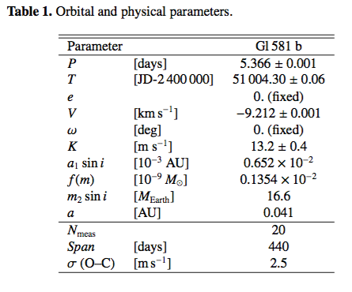
Exoplanet Discovery
Give RV curve fit best to the data
Red-observed
Black-predicted
Bonfils et al. (2005)

Slide 7
RV Fitting: Principle

Slide 8
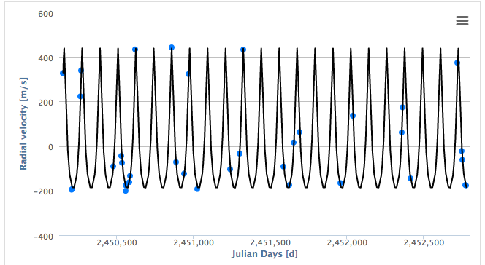
Goals
Find the Keplerian orbit to fit the data
And decide how much we can trust our result

Slide 9
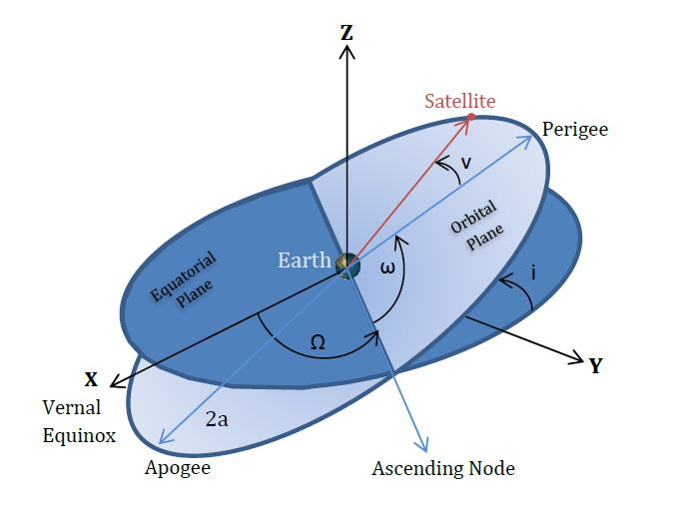
The radial velocity curve = a superposition of N Keplerian orbits of fixed orbital elements
K = RV semi-amplitude,
ν = true anomaly
e = eccentricity
ϖ = argument of periastron
Μ* = stellar mass
Μ = Planet mass

Slide 10
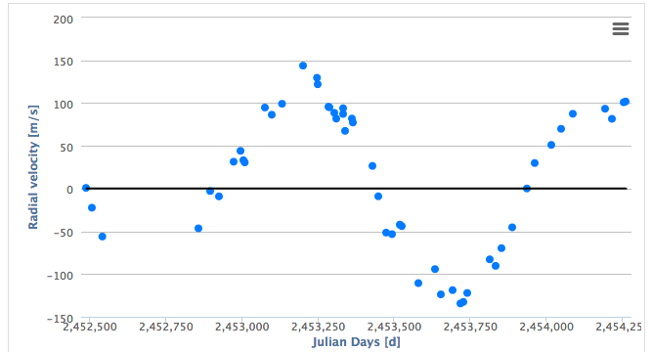
What is P?
996

Slide 11
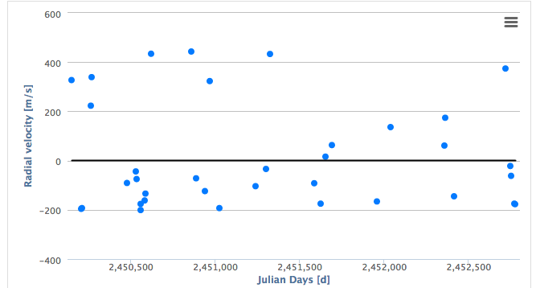
What is P?
116

Slide 12
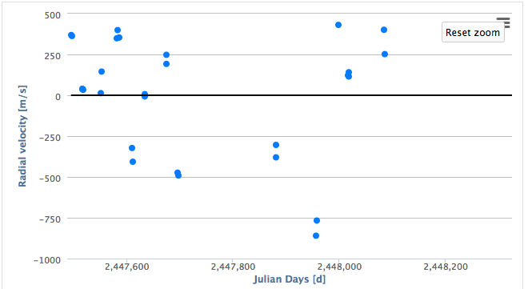
What is P?
84

Slide 13
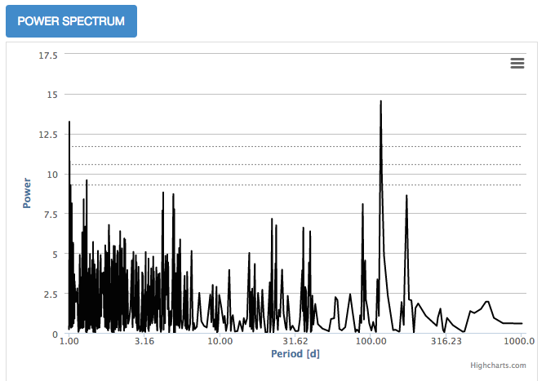
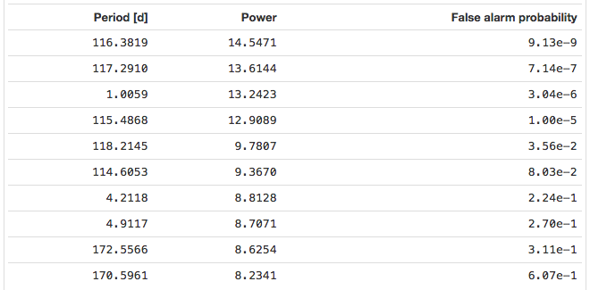
Lomb-Scargle (LS) Periodogram & false alarm probability (FAP)
116
LS Periodogram
Analysis of unevenly spaced data
Identifying periodic signals in the data
If a sinusoidal signal of period P exists in the data set, the value of power at P will be large
Higher power value indicate that the periodicity is more strongly represented in the data
FAP
The probability that the period found is not true. It just have arisen by chance.
Lower is better

Slide 14
Aliasing
Spurious periodicities
Periods that are of integer ratios of the planet’s signal can be represented in the data
Which one is the actual P!?
Vary sampling rates are usually sufficient to eliminate the aliases

Slide 15
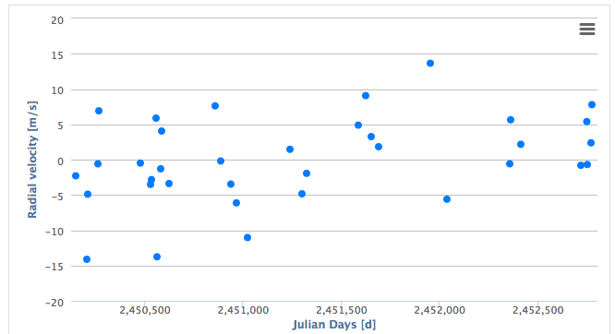
Goodness of Fit
Reduced X²
Search for the best-fit orbital parameters by minimizing reduced X² value
“Good” fit => X²~1
This rule is not exact, and should be applied with caution!
RMS (compared to K)
Residuals

Slide 16
Take home
Observed RVs
RVs predicted by a (best-fit) planet model
Lomb-Scargle Periodogram P
False alarm probability
Aliasing
Goodness of fit
Reduced X²
RMS

Slide 17
RV Fitting: Tools

Slide 18
RV fitting tools
For this class: Systemic Live
Pros: Web interface with no local installation, easy to use
Cons: Less fitting options
For publications:
Systemic 2 (shown by Rob on Tuesday)
RedVel (shown by Rob on Tuesday)
EXOFAST
RVLIN
Pros: More fitting options, publication quality
Cons: Complex installation, need to be familiar with the written language

Slide 19
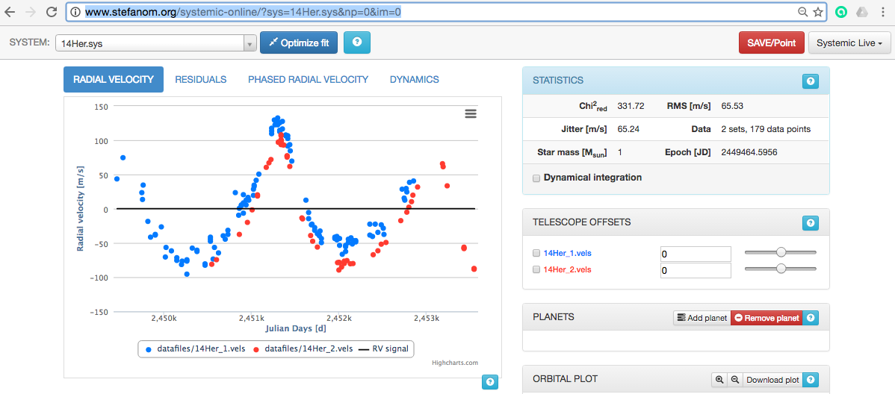
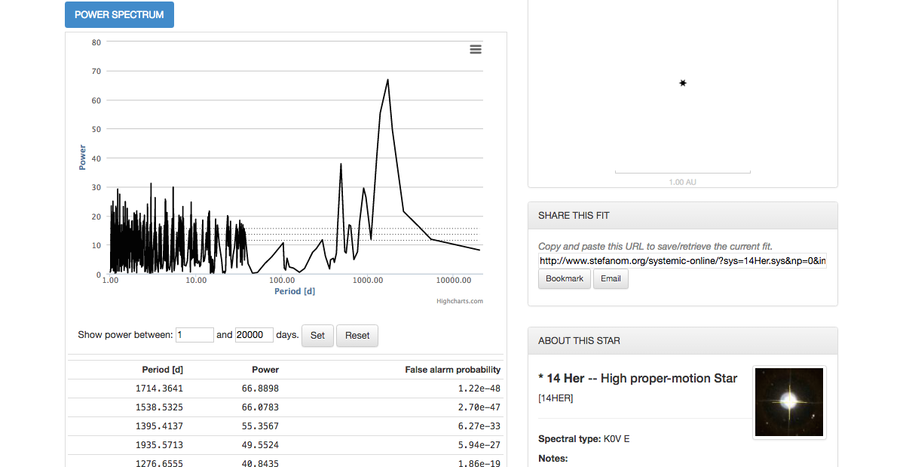
Systemic Live
http://www.stefanom.org/systemic-online/

Slide 20
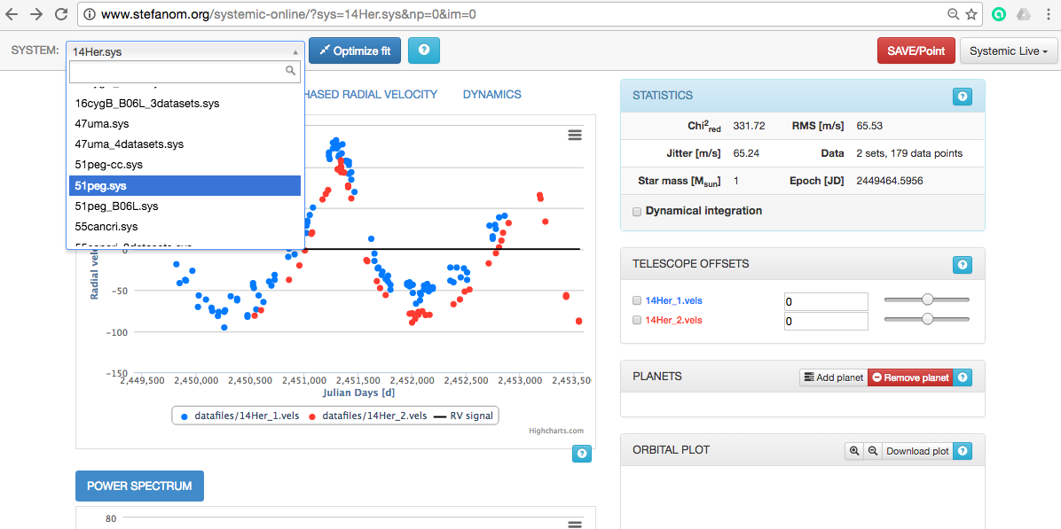
1. Select an RV data set

Slide 21
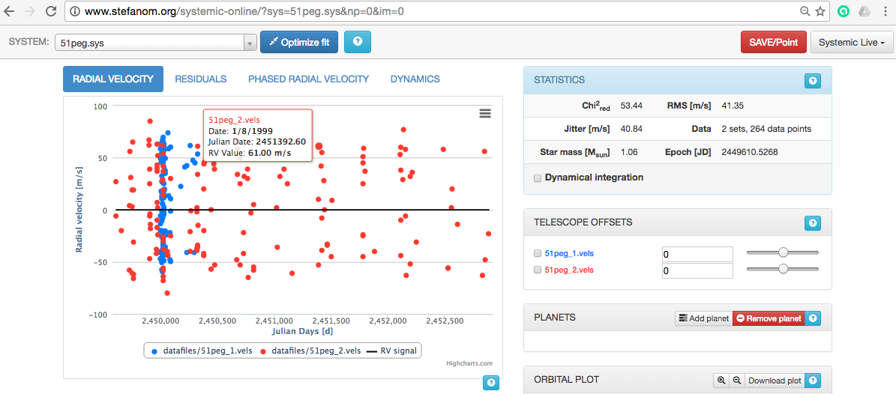

Slide 22
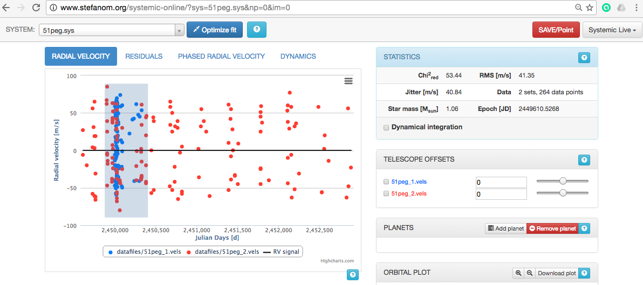
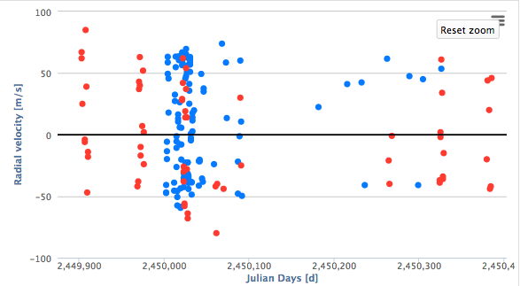

Slide 23
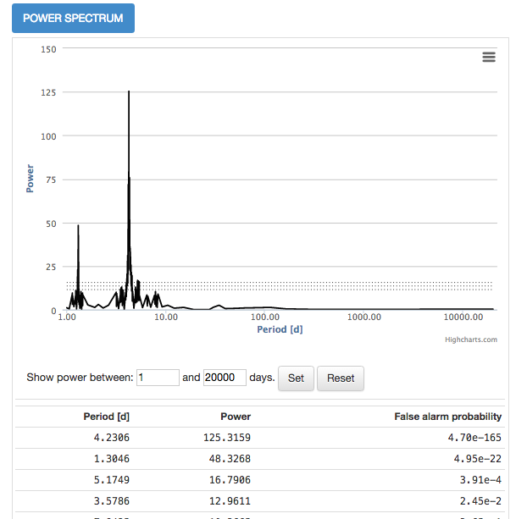
2. Find P
The Lomb-Scargle power spectrum shows the most prominent periodicities in the data.

Slide 24
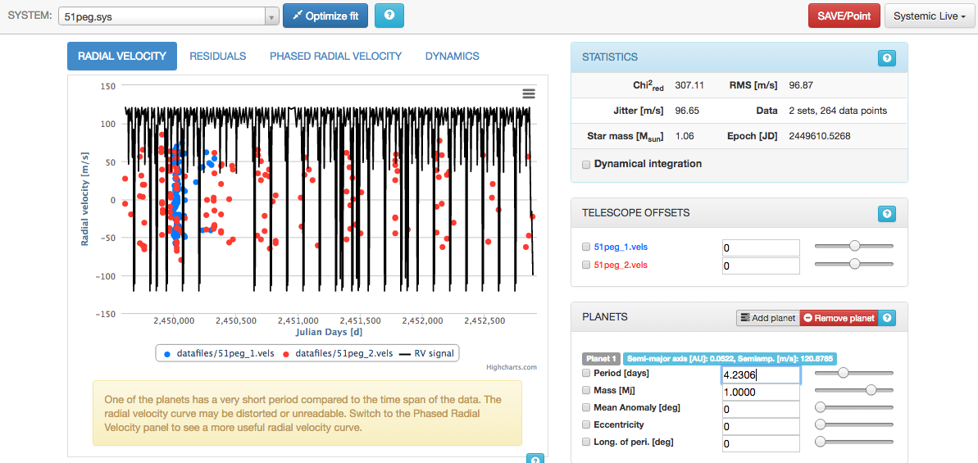
3. Add a planet at P

Slide 25
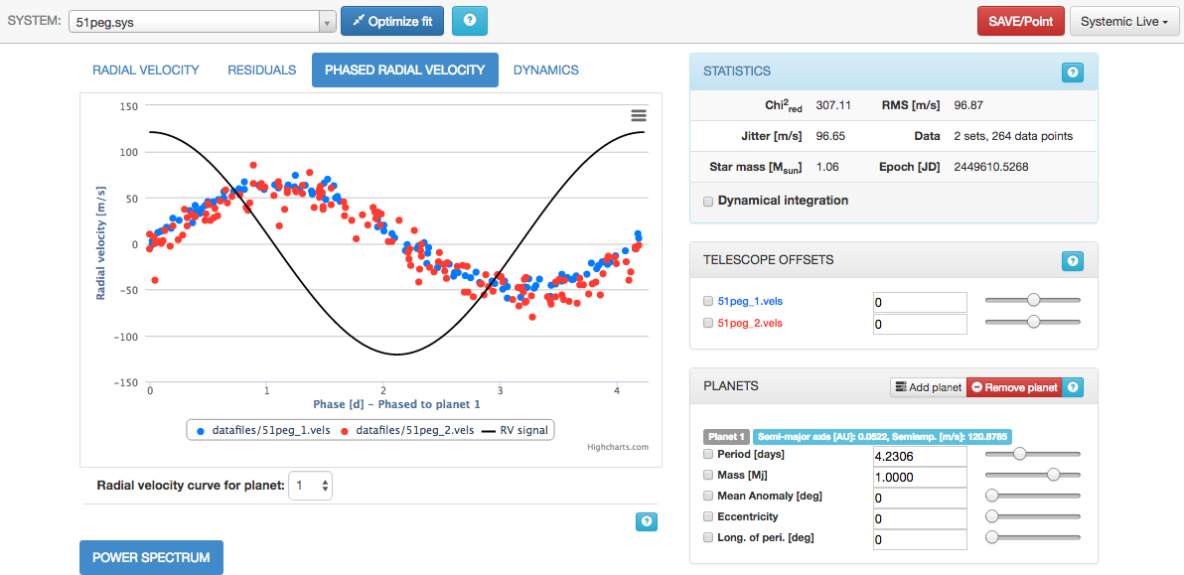
The radial velocity points are “folded” to the period of the planet
Mean Anomaly is the phase of the planet at the time of the first radial velocity observation.

Slide 26
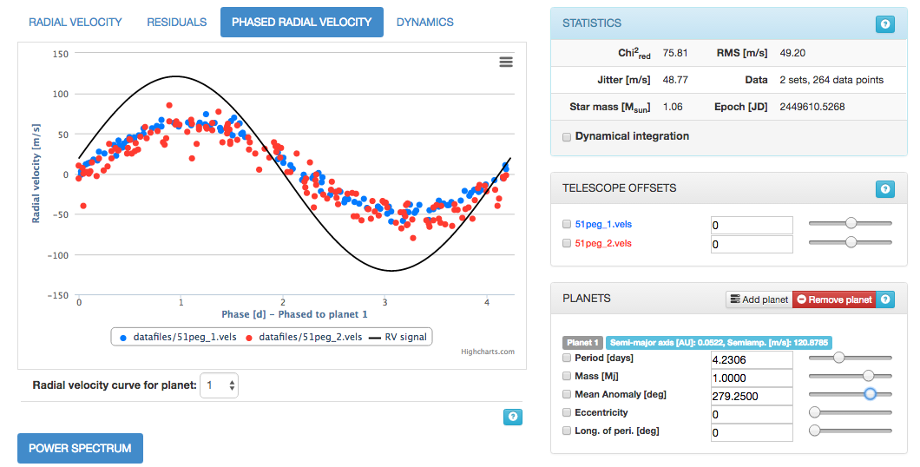
4. Finding the planet parameters
Keep your eyes on reduced X² and RMS values

Slide 27
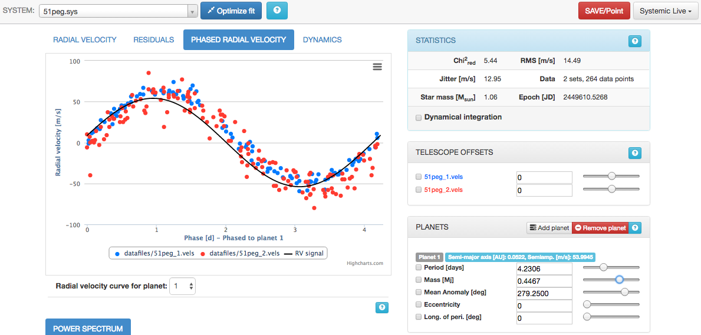

Slide 28
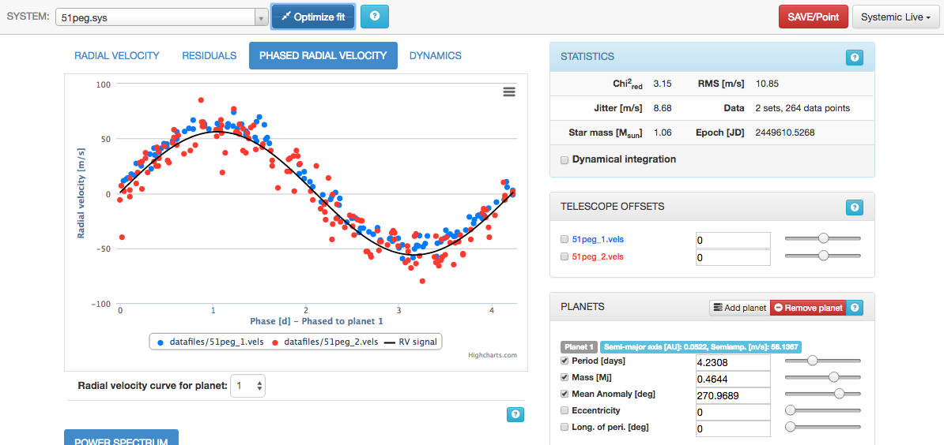
Improve the match between the model fit and the RV data by varying the values of the planetary parameters

Slide 29
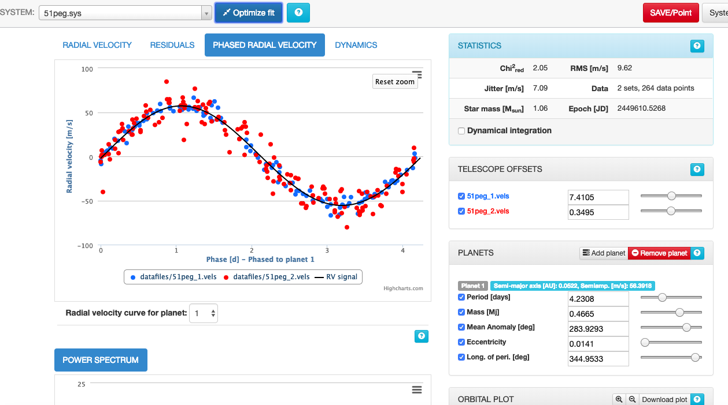

Slide 30
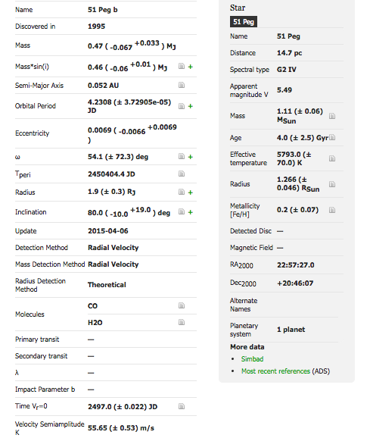
http://exoplanet.eu/

Slide 31
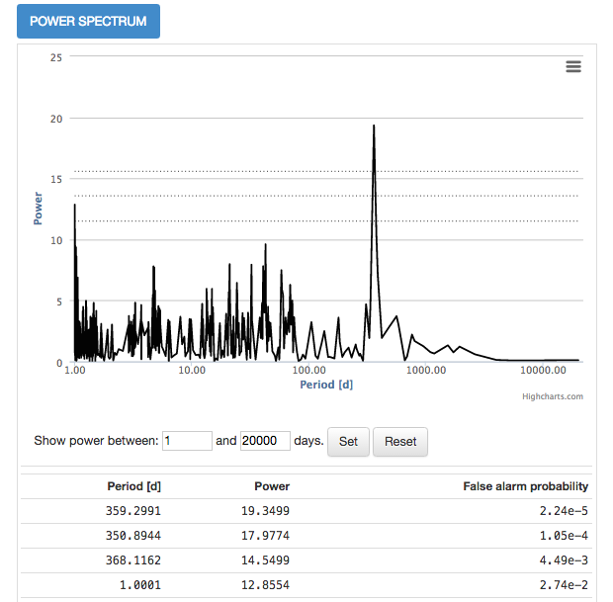
More planets?
Real? Alias?
The period is very close to the Earth’s orbital period (about 365.25 days)!!!

Slide 32
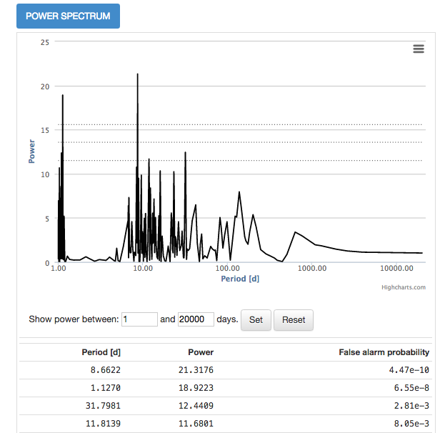
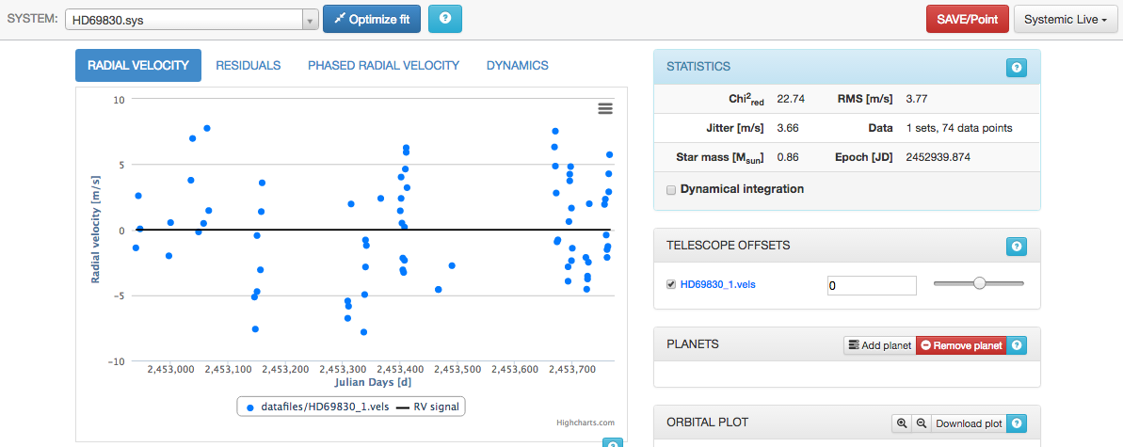
Multi-Planet Systems

Slide 33
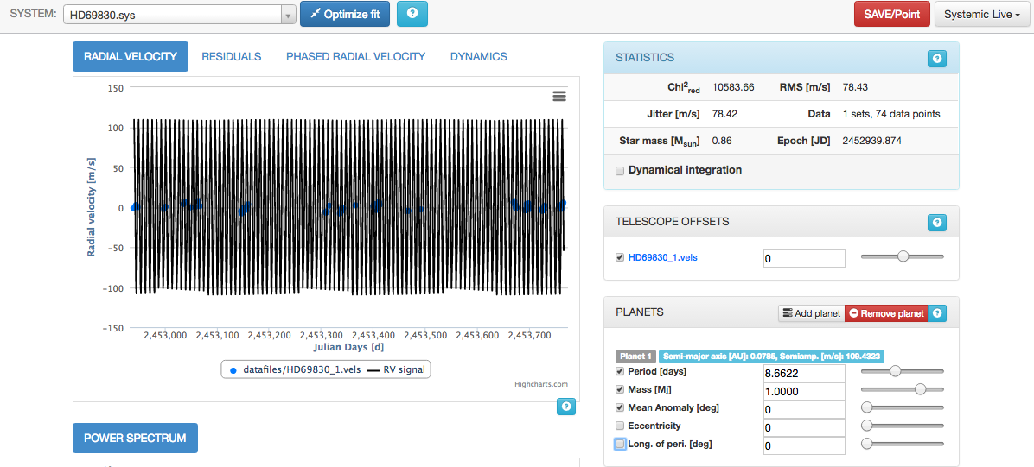

Slide 34
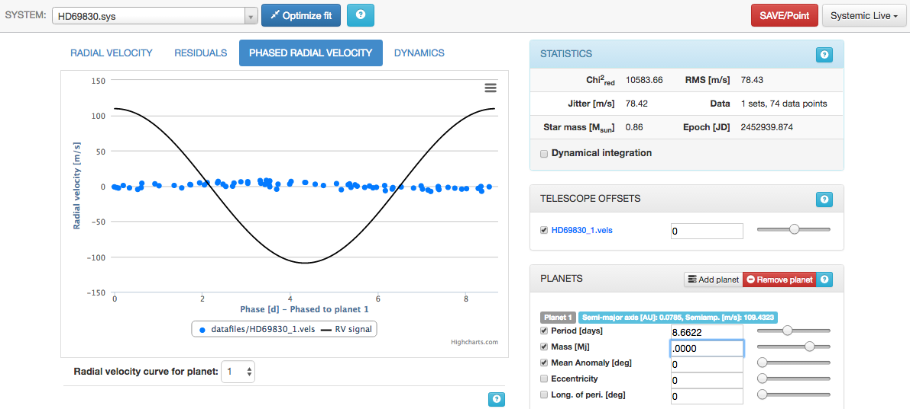

Slide 35
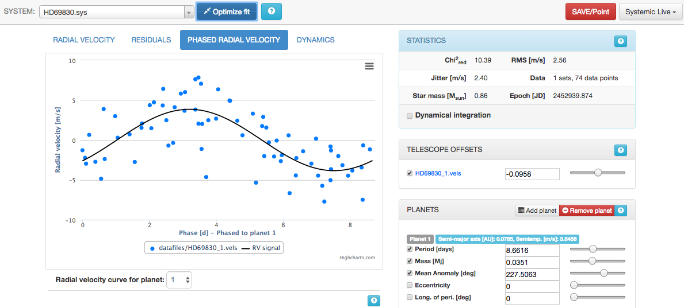

Slide 36
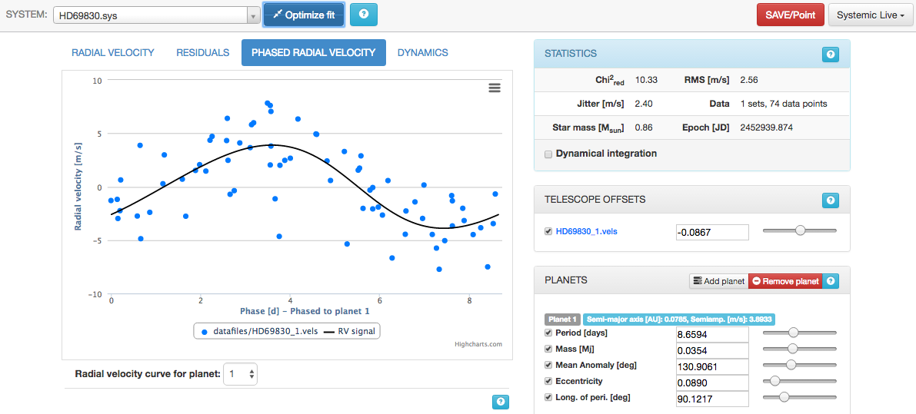

Slide 37
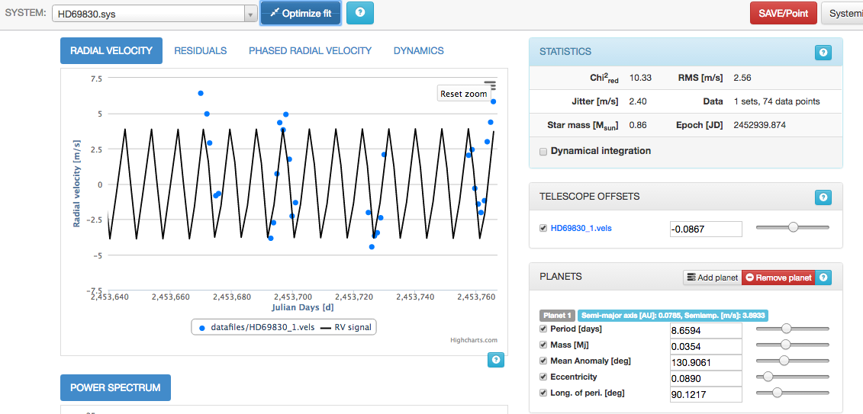

Slide 38
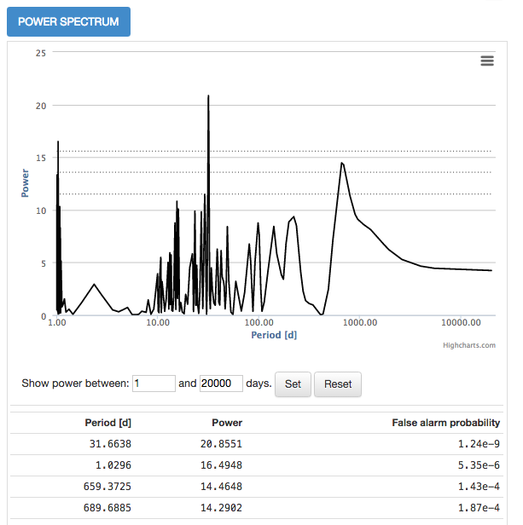
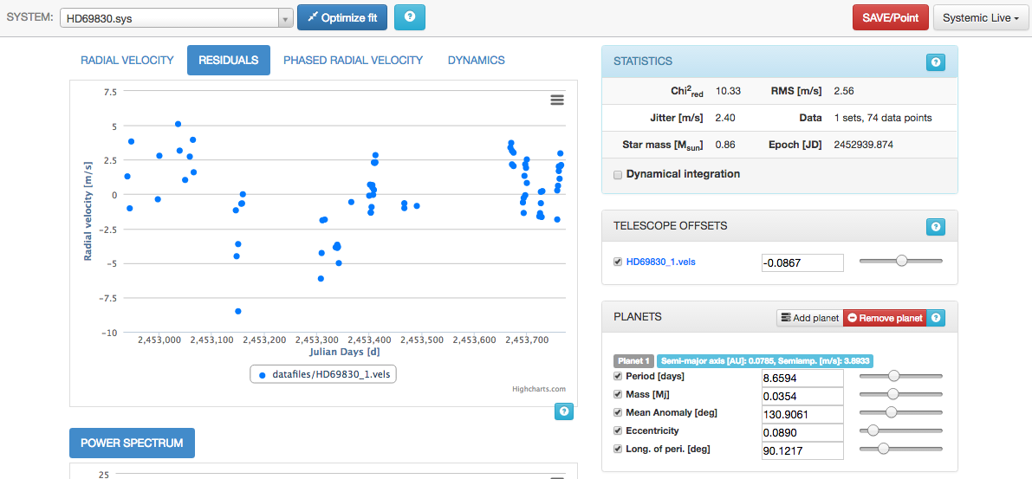
More planet?

Slide 39
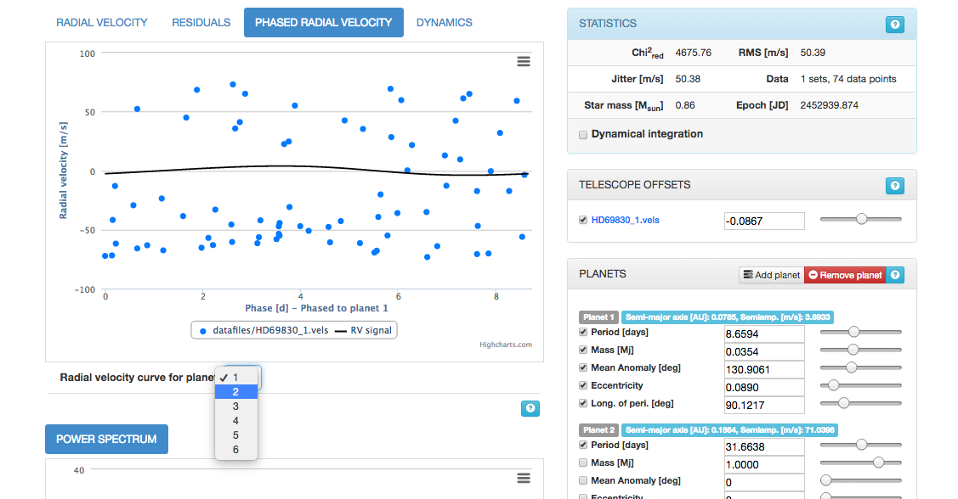
Notes:
Add 1 more planet

Slide 40
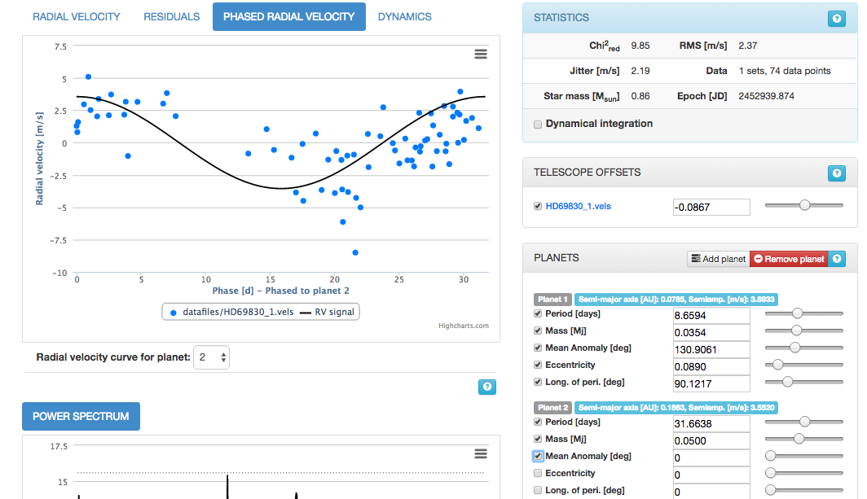
Notes:
Adjust P,M,Mean anomaly

Slide 41
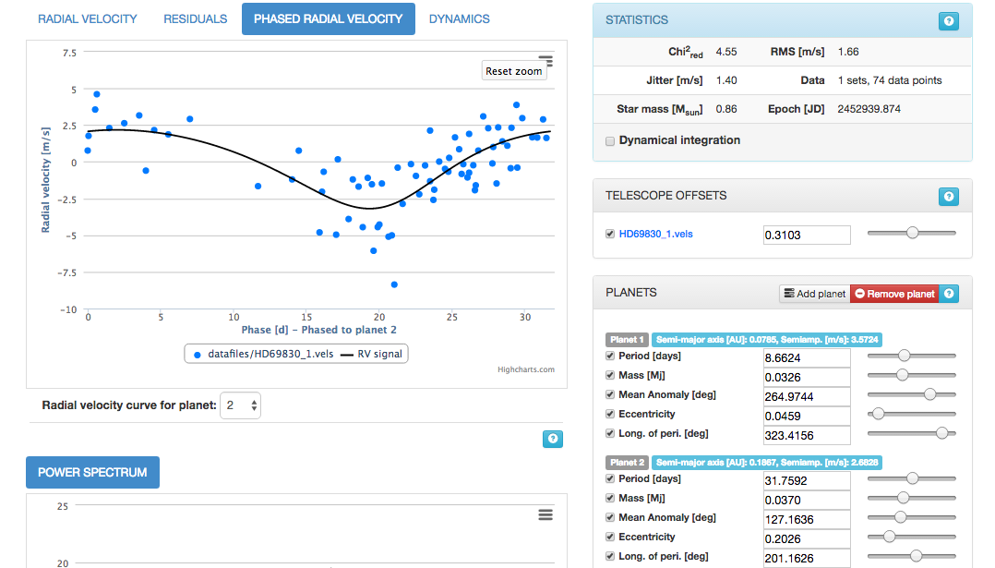
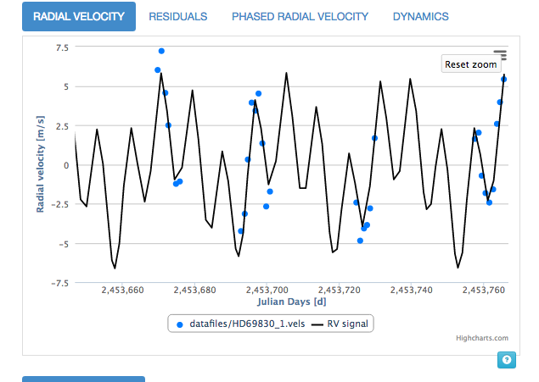
Notes:
Optimize fit all

Slide 42
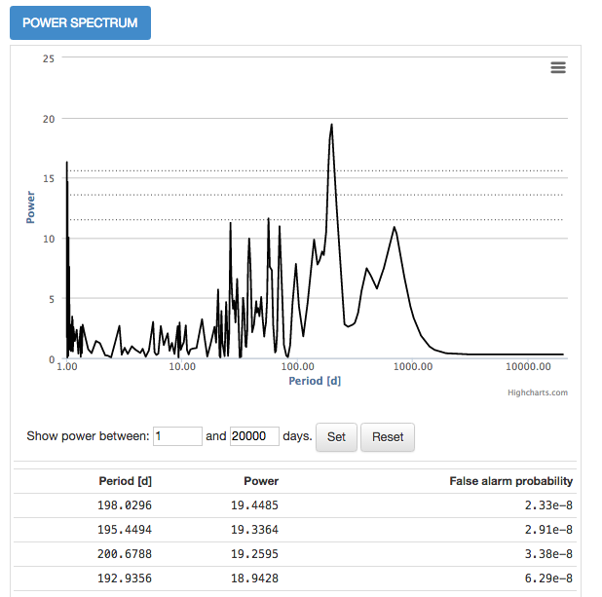
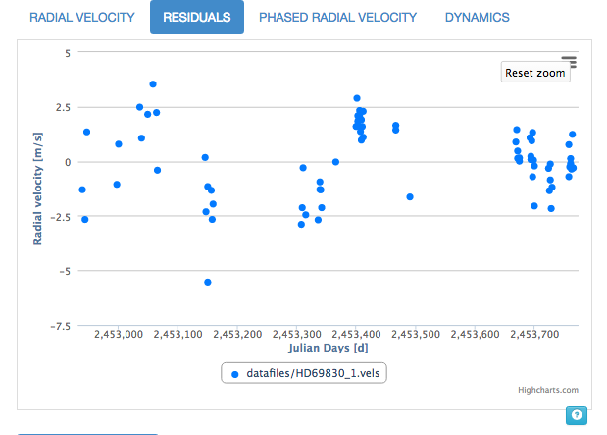
More planet?

Slide 43
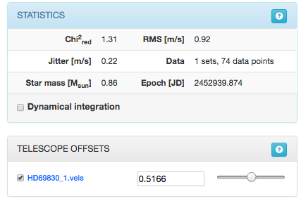
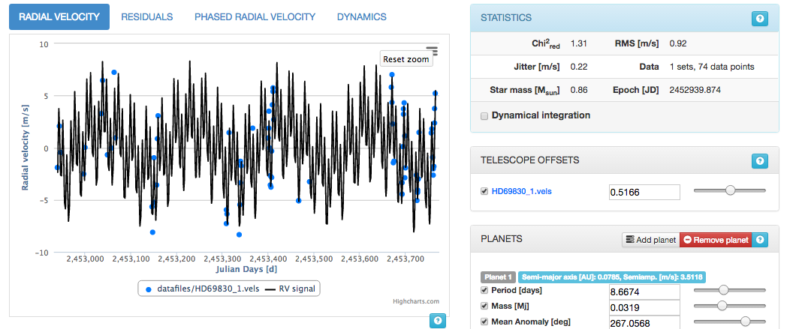
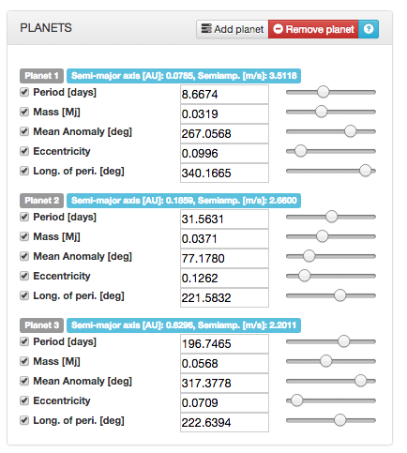
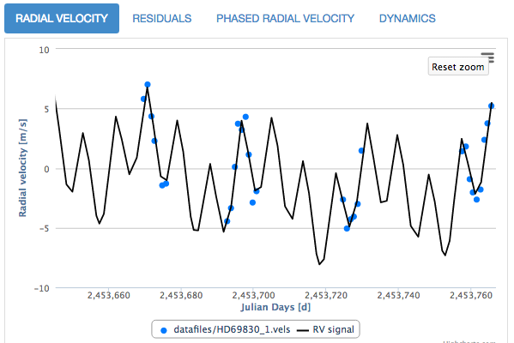

Slide 44
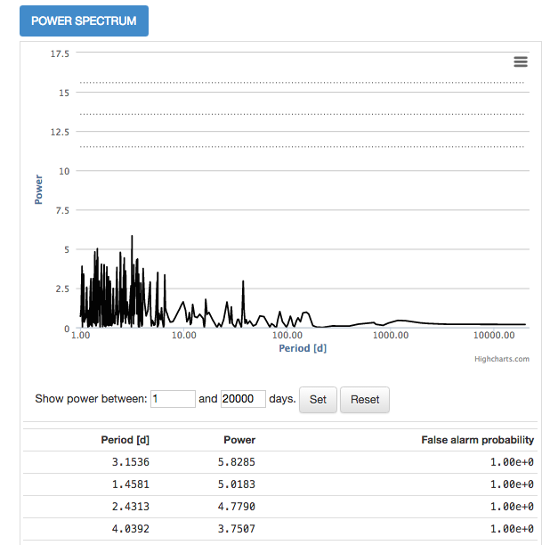
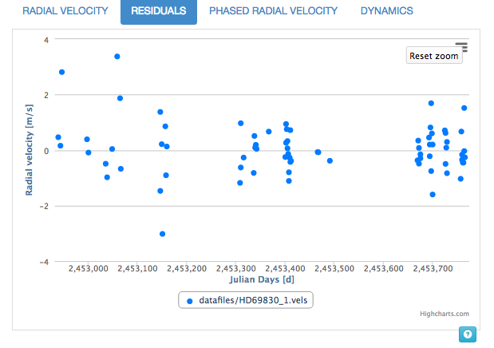
More planet?

Slide 45
Lovis et al. (2006)
Notes:
Compare the result with publication

Slide 46
Practice session: discover a planet by yourself!
Go to Systemic Live: http://www.stefanom.org/systemic-online/
Do your best at fitting the following data:
GJ3021
HD 118203
HD 117207
HD 115617
Provide the period and mass for the planet(s) in each system which you find convincing

