Slide 1
Exoplanet atmosphere
Supachai Awiphan
National Astronomical Research Institute of Thailand (NARIT), Thailand
Supachai Awiphan
Exoplanet atmosphere
24 April 2019 Chiang Mai, Thailand

Slide 2
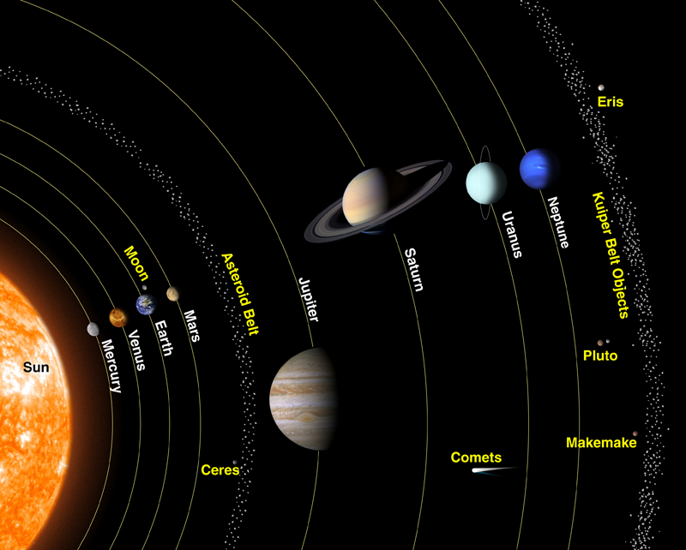
Planets
Credit: NASA
Supachai Awiphan
Exoplanet atmosphere
24 April 2019 Chiang Mai, Thailand

Slide 3
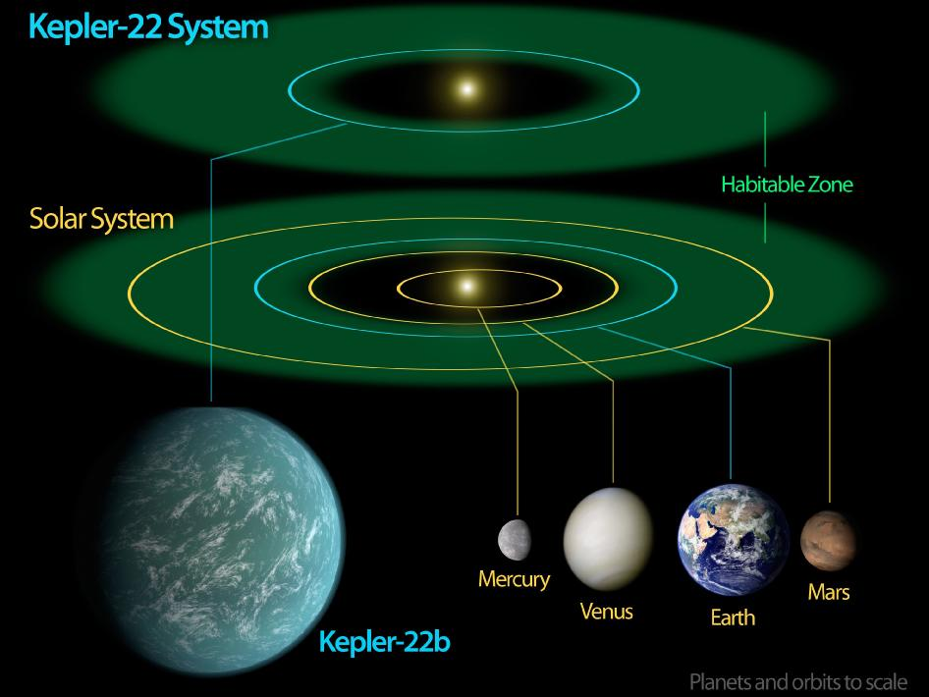
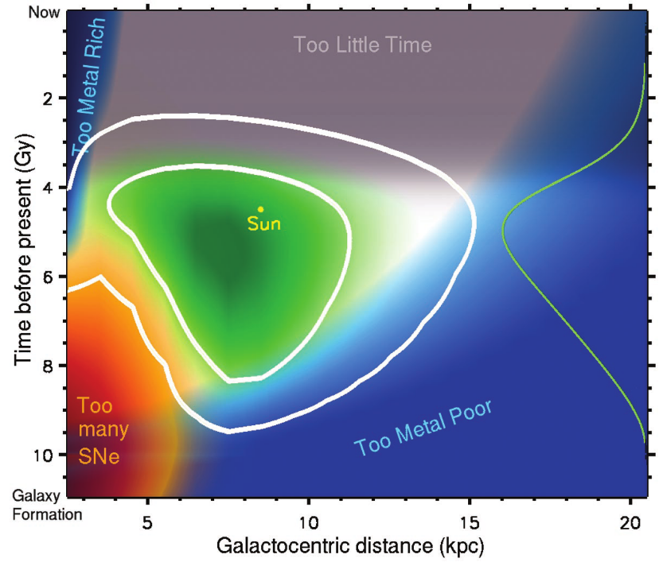
Habitable zone
An annulus around a star where a terrestrial planet with an atmosphere can sustain large amounts of liquid water on its surface (a condition necessary for photosynthesis?)
Chemical cycles or the greenhouse effect problem
Continuously habitable zone (>1 Gyr?)
Galactic habitable zone (7-9 kpc from the galactic centre?)
Credit: NASA Kepler
Lineweaver et al. 2004
Supachai Awiphan
Exoplanet atmosphere
24 April 2019 Chiang Mai, Thailand
Page 3

Slide 4
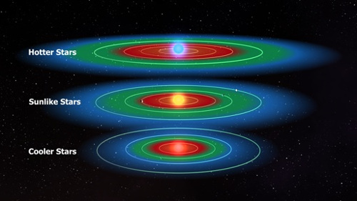
Habitable zone
Host star
High mass star Large HZ, but have far ultraviolet (FUV)
Solar mass star Best candidate, but planets in HZ have long orbital period
Low mass star Easy to find, but have magnetic activity in early age + tidally locked
Credit: NASA Kepler
Supachai Awiphan
Exoplanet atmosphere
24 April 2019 Chiang Mai, Thailand
Page 4

Slide 5
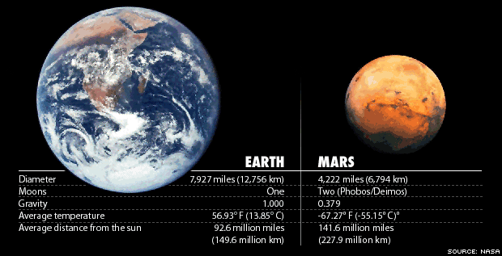
Mars
Supachai Awiphan
Exoplanet atmosphere
24 April 2019 Chiang Mai, Thailand

Slide 6
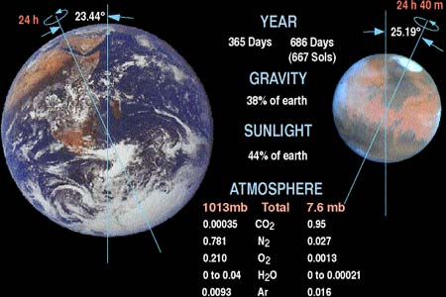
Mars
Supachai Awiphan
Exoplanet atmosphere
24 April 2019 Chiang Mai, Thailand

Slide 7
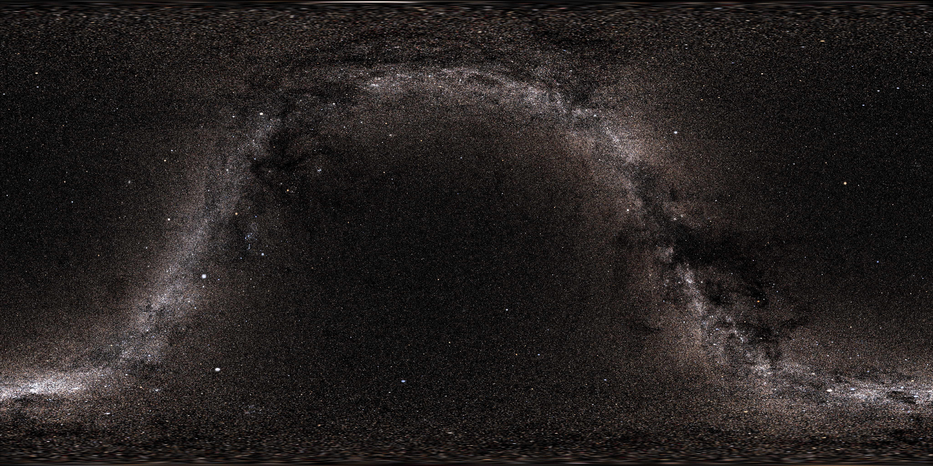
Milky way Galaxy
Tycho star catalog with threshold magnitude 5.0 Credit: NASA
Supachai Awiphan
Exoplanet atmosphere
24 April 2019 Chiang Mai, Thailand
Notes:
- Stars in Milky way Galaxy 100-400 billion

Slide 8
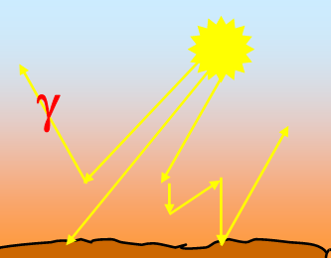
How to probe an exoplanet atmosphere?
Photons reflected by the planet (VIS-NIR)
Credit: Tinetti
Supachai Awiphan
Exoplanet atmosphere
24 April 2019 Chiang Mai, Thailand
Page 8

Slide 9
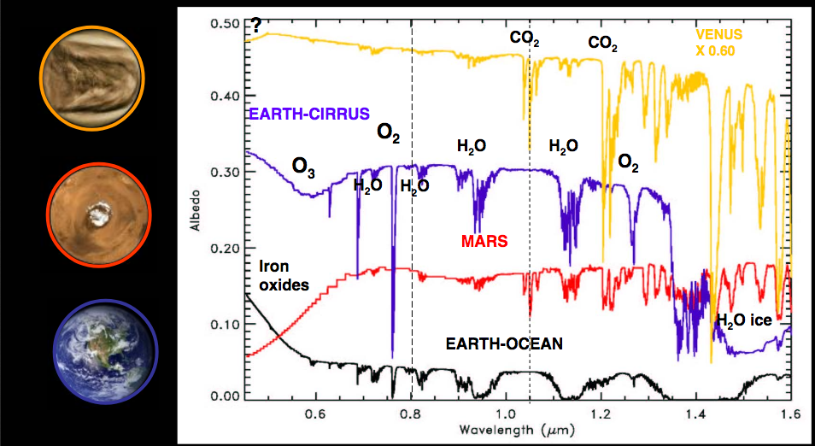
Albedo
Credit: Tinetti
Supachai Awiphan
Exoplanet atmosphere
24 April 2019 Chiang Mai, Thailand
Page 9

Slide 10
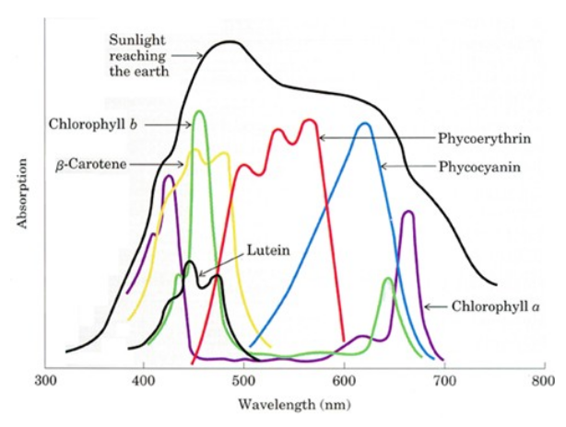
Vegetation
Credit: Nelson & Cox (2000)
Supachai Awiphan
Exoplanet atmosphere
24 April 2019 Chiang Mai, Thailand
Page 10

Slide 11
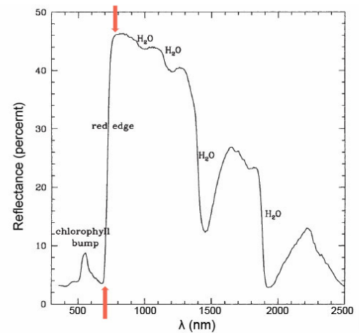
Red edge
The region of rapid change in reflectance of vegetation in the near infrared.
Chlorophyll contained in vegetation absorbs most of the light in the visible, but becomes almost transparent at wavelengths greater than 700 nm.
Infrared light to be reflected because each cell acts something like an elementary corner reflector.
From 5% to 50% reflectance going from 680 nm to 730 nm.
Avoiding overheating during photosynthesis.
Credit: Arnold et al. (2002), Seager et al. (2005)
Supachai Awiphan
Exoplanet atmosphere
24 April 2019 Chiang Mai, Thailand
Page 11

Slide 12
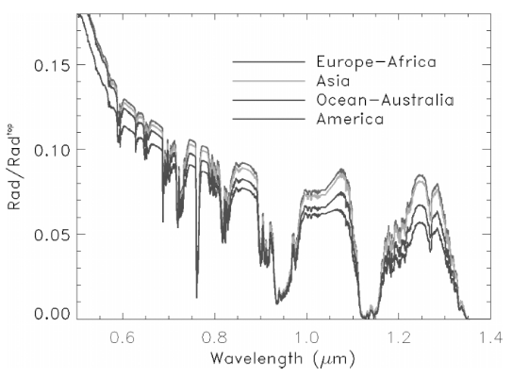
Red edge
Credit:Tinetti et al. (2006)
Supachai Awiphan
Exoplanet atmosphere
24 April 2019 Chiang Mai, Thailand
Page 12

Slide 13
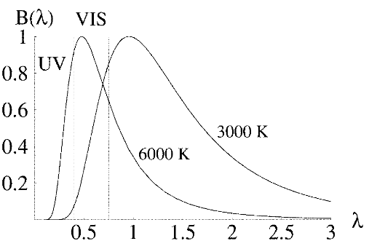
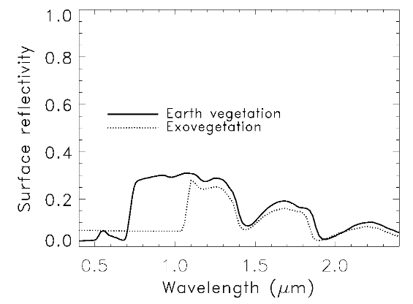
Exovegetation
Credit:Tinetti et al. (2006)
Supachai Awiphan
Exoplanet atmosphere
24 April 2019 Chiang Mai, Thailand
Page 13

Slide 14
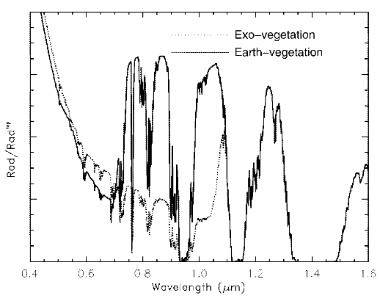
Exovegetation
Credit:Tinetti et al. (2006)
Supachai Awiphan
Exoplanet atmosphere
24 April 2019 Chiang Mai, Thailand
Page 14

Slide 15
How to probe an exoplanet atmosphere?
Photons reflected by the planet (VIS-NIR)
Photons emitted by the planet (MIR)
Credit: Tinetti
Supachai Awiphan
Exoplanet atmosphere
24 April 2019 Chiang Mai, Thailand
Page 15

Slide 16
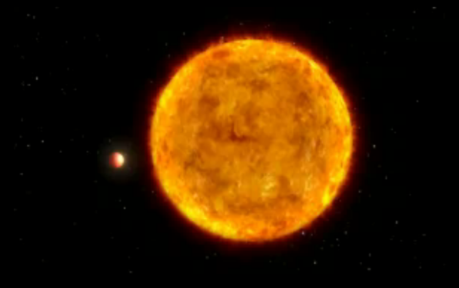
Day-Night temperature variation
Credit: NASA/ESA/ G.Bacon/ Spitzer Space Telescope
Supachai Awiphan
Exoplanet atmosphere
24 April 2019 Chiang Mai, Thailand
Page 16

Slide 17
Day-Night temperature variation
Credit: NASA Kepler
Supachai Awiphan
Exoplanet atmosphere
24 April 2019 Chiang Mai, Thailand

Slide 18
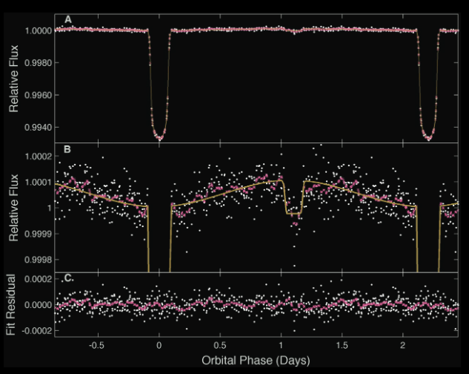
Day-Night temperature variation
HAT-P-7b
Credit: Borucki et al. (2009)
Supachai Awiphan
Exoplanet atmosphere
24 April 2019 Chiang Mai, Thailand
Page 18

Slide 19
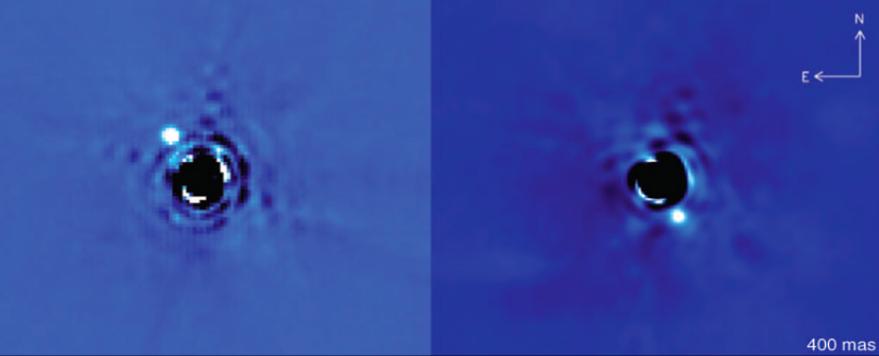
Direct imaging spectroscopy
Credit: Lagrange et al. (2010)
Supachai Awiphan
Exoplanet atmosphere
24 April 2019 Chiang Mai, Thailand
Page 19

Slide 20
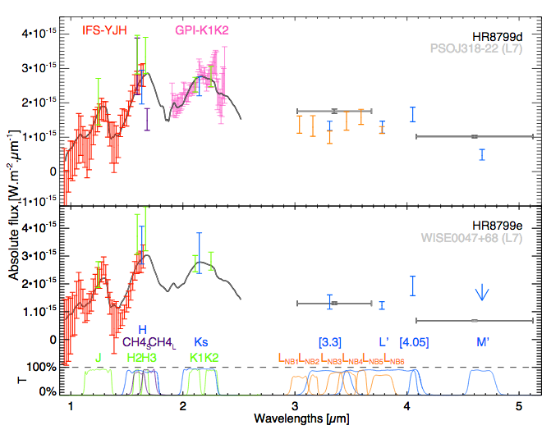
Direct imaging spectroscopy
HR8799d and HR8799e
Credit: Biller and Bonnefoy (2019)
Supachai Awiphan
Exoplanet atmosphere
24 April 2019 Chiang Mai, Thailand
Page 20

Slide 21
How to probe an exoplanet atmosphere?
Photons reflected by the planet (VIS-NIR)
Photons emitted by the planet (MIR)
Photons transmitted by the planet
Credit: Tinetti
Supachai Awiphan
Exoplanet atmosphere
24 April 2019 Chiang Mai, Thailand
Page 21

Slide 22
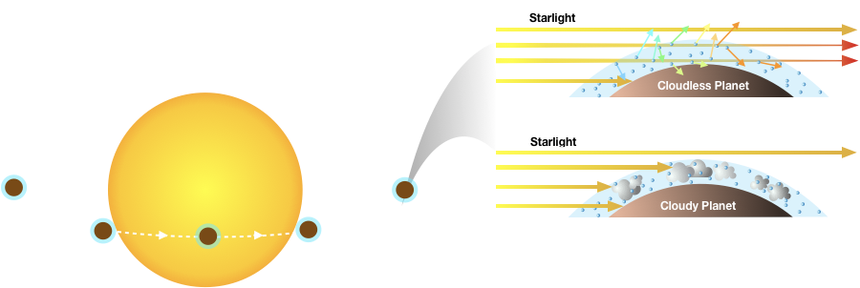
Transmission spectroscopy
Supachai Awiphan
Exoplanet atmosphere
24 April 2019 Chiang Mai, Thailand

Slide 23
Transmission spectroscopy
Credit: NASA
Supachai Awiphan
Exoplanet atmosphere
24 April 2019 Chiang Mai, Thailand

Slide 24
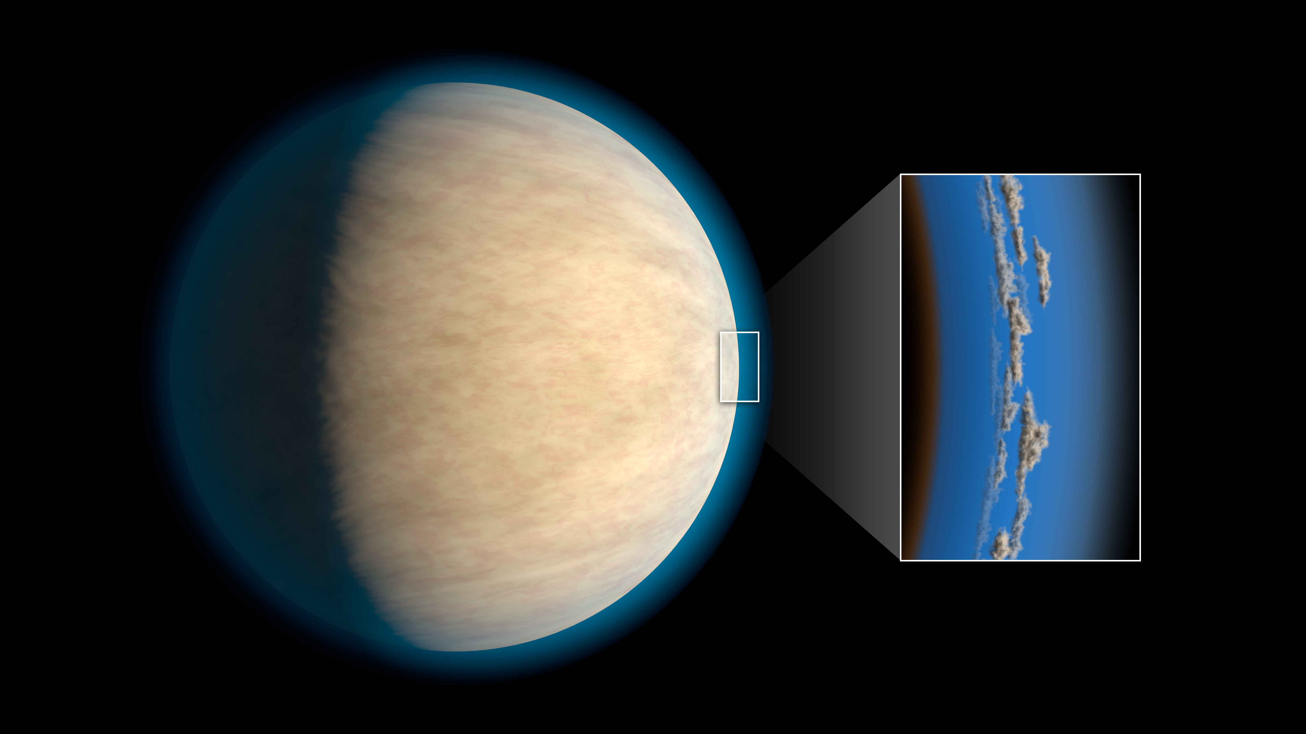
Transmission spectroscopy
Credit: NASA
HD 209458b light curves in 10 bandpasses (290-1030 nm)
(Knutson et al. 2009)
Supachai Awiphan
Exoplanet atmosphere
24 April 2019 Chiang Mai, Thailand
Page 24

Slide 25
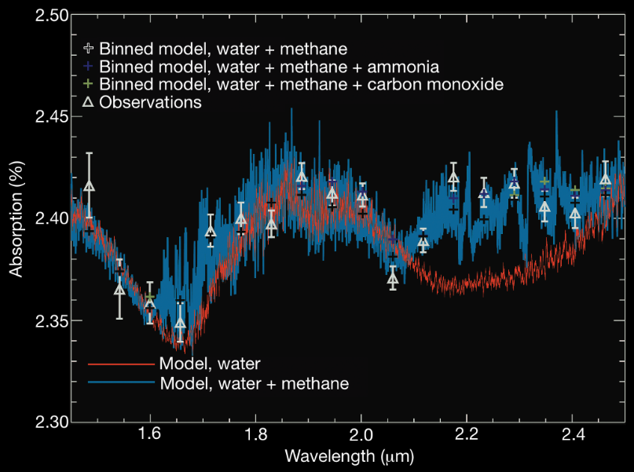
Transmission spectroscopy
Identification of atoms and molecules
HD 189733b
H₂O and CH₄ in transmission from HST
Credit: Swain et al. (2008) and Grillmair et al. (2008)
Supachai Awiphan
Exoplanet atmosphere
24 April 2019 Chiang Mai, Thailand
Page 25

Slide 26
Transmission spectroscopy
Credit: Tinetti et al. (2013)
Supachai Awiphan
Exoplanet atmosphere
24 April 2019 Chiang Mai, Thailand
Page 26

Slide 27
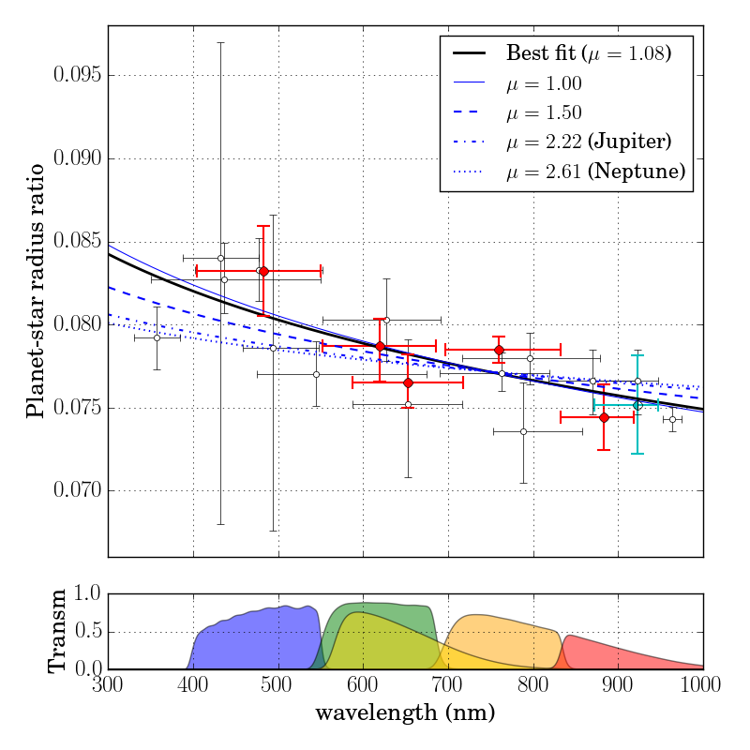
Transmission spectroscopy
Rayleigh scattering
GJ 3470b
Observation with TNT
Credit: Awiphan et al. (2016)
Supachai Awiphan
Exoplanet atmosphere
24 April 2019 Chiang Mai, Thailand
Page 27

Slide 28
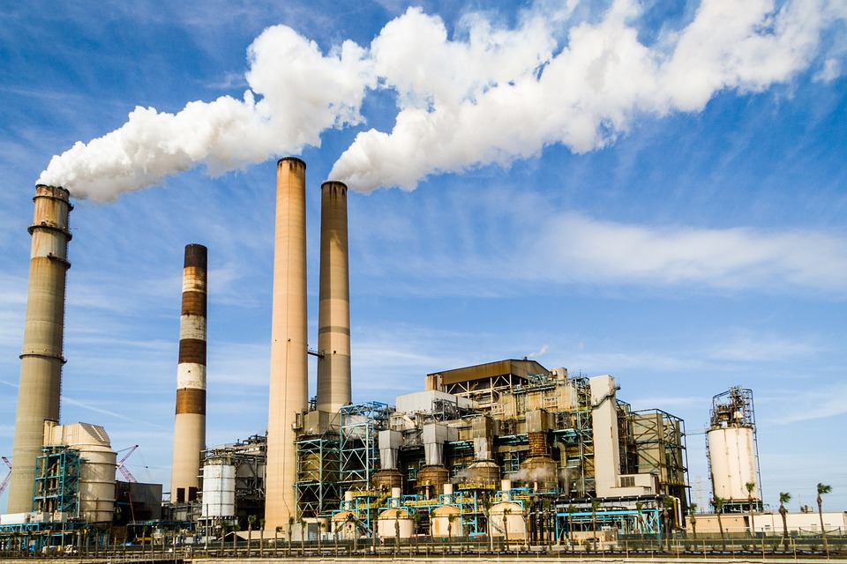
Transmission spectroscopy
Credit: cwizner/pixabay
With even better sensitivity in the future we can look for chemicals like CFCs- ie evidence for industrial activity
Supachai Awiphan
Exoplanet atmosphere
24 April 2019 Chiang Mai, Thailand
Page 28

Slide 29
Thank you
Supachai Awiphan
Exoplanet atmosphere
24 April 2019 Chiang Mai, Thailand
Page 29

