Slide 1
Transit
Supachai Awiphan
National Astronomical Research Institute of Thailand

Slide 2
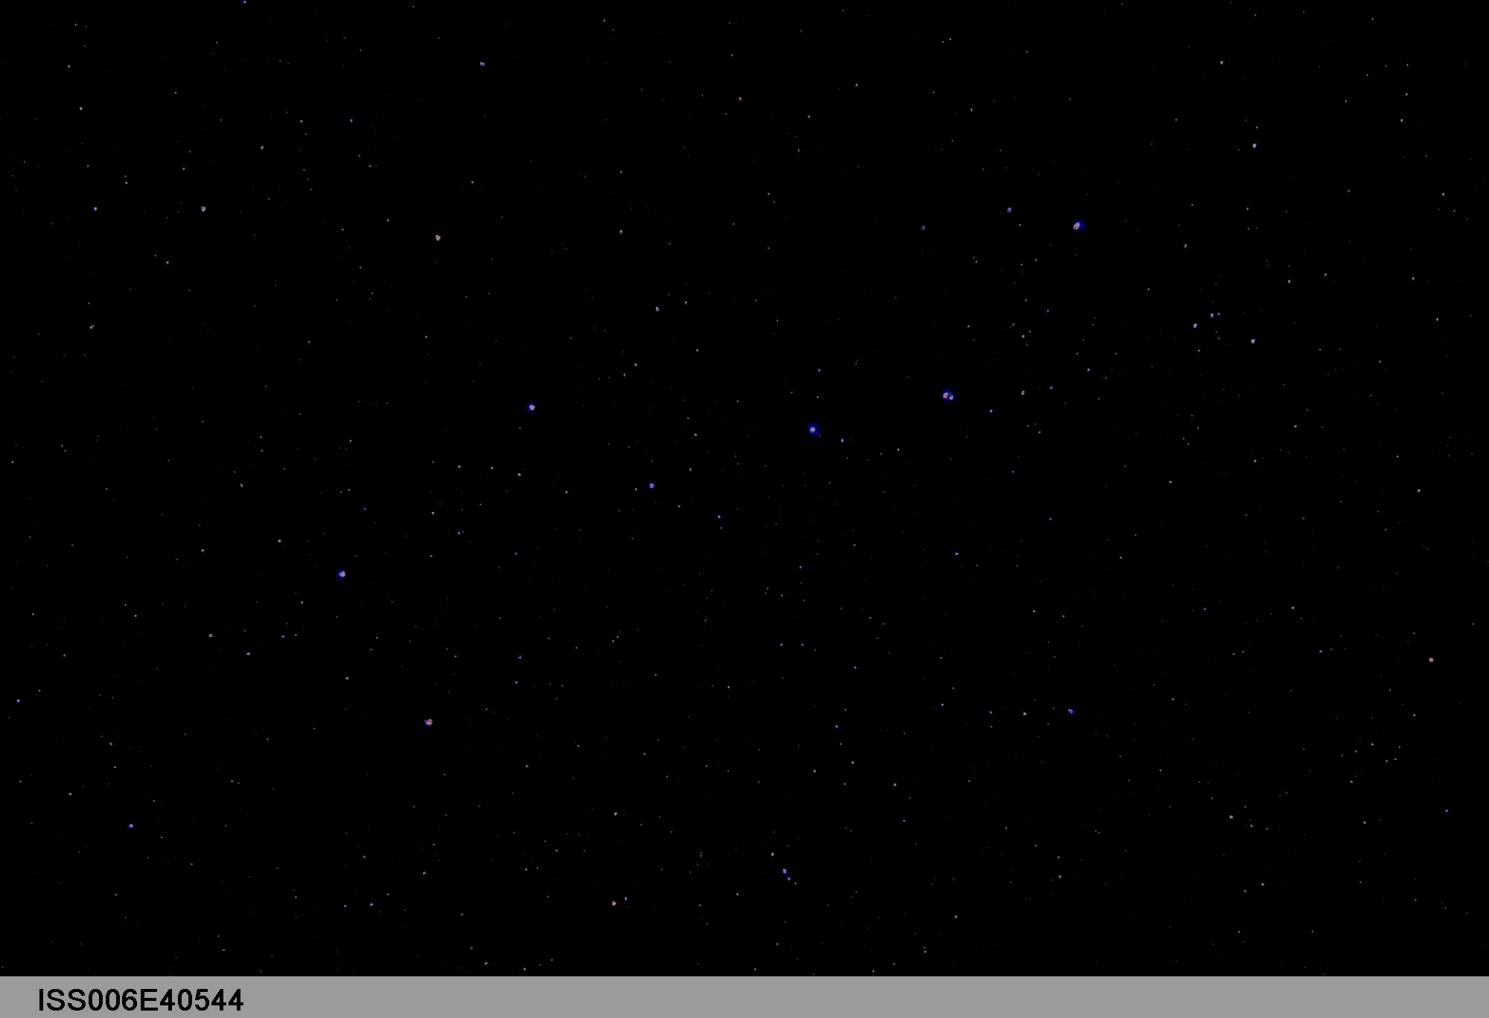
Page 2
Credit: NASA

Slide 3
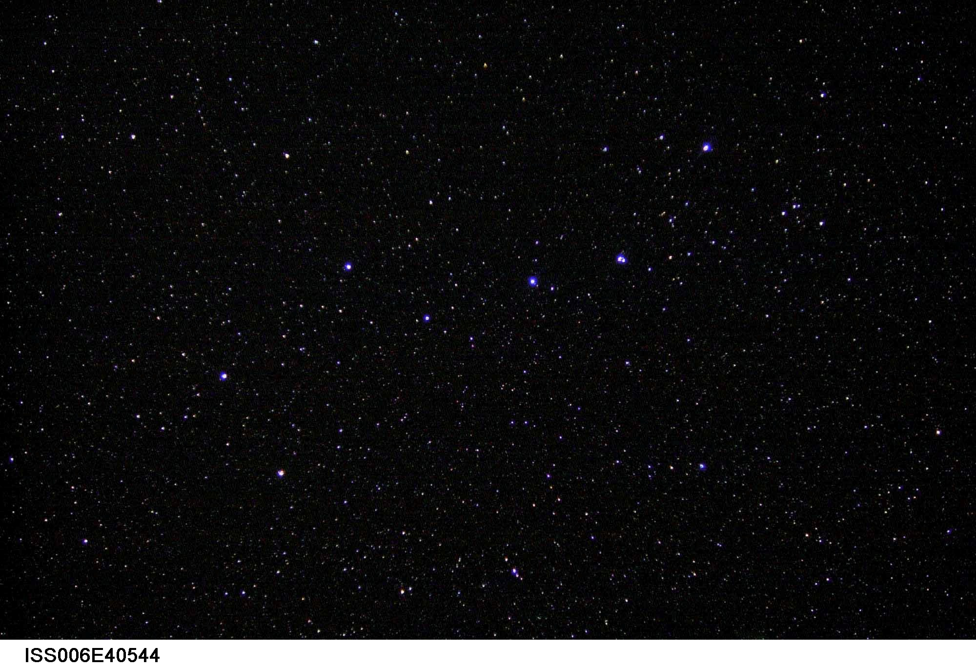
Page 3
Credit: NASA

Slide 4
Astronomical detector
Before camera Naked eyes, Pen & paper
Stars of magnitude 6 which means about 1000 photons per second
To 1839 Camera and photographic plate
QE improved by a factor of 100 during late part of 19th and first two-thirds of 20th)
Nonlinear, nonuniform, and cannot be calibrated
To 1940s Photomultiplier tube
More efficient , but one or several stars can be recorded one time
QE approaching 20 percent in the blue and a few percent in the red
To 1969 CCD (Charge-coupled device)
Stars in the field of view and high efficiency
Star of magnitude 24, which means about 15 photons per second on a 4 meter telescope (for your eye this would be 5e-5 photons per second).
Page 4

Slide 5
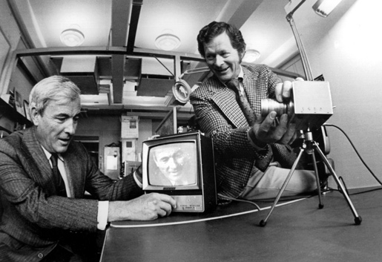
2009 Nobel Prize in Physics awarded to the inventors of the CCD
In 1969, Willard S. Boyle and George E. Smith invented the first successful imaging technology using a digital sensor, a CCD (charge-coupled device).
Bell Labs researchers Willard Boyle (left) and George Smith (right) with the charge-coupled device.
Photo taken in 1974, Photo credit: Alcatel-Lucent/Bell Labs.
Page 5

Slide 6
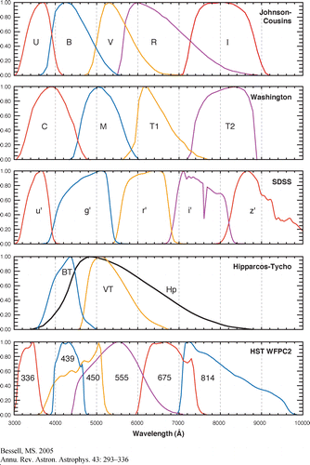
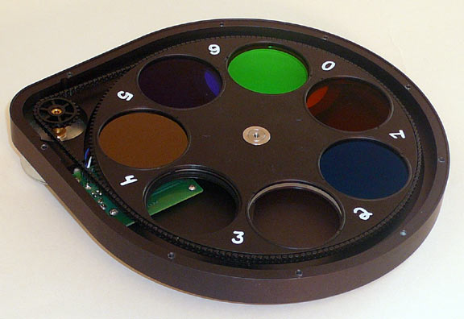
Filter
Blocking a specific part of the color spectrum above and below a bandpass
Increase signal to noise in specific bandpass
Colour information
Credit: http://www.customscientific.com
Page 6

Slide 7
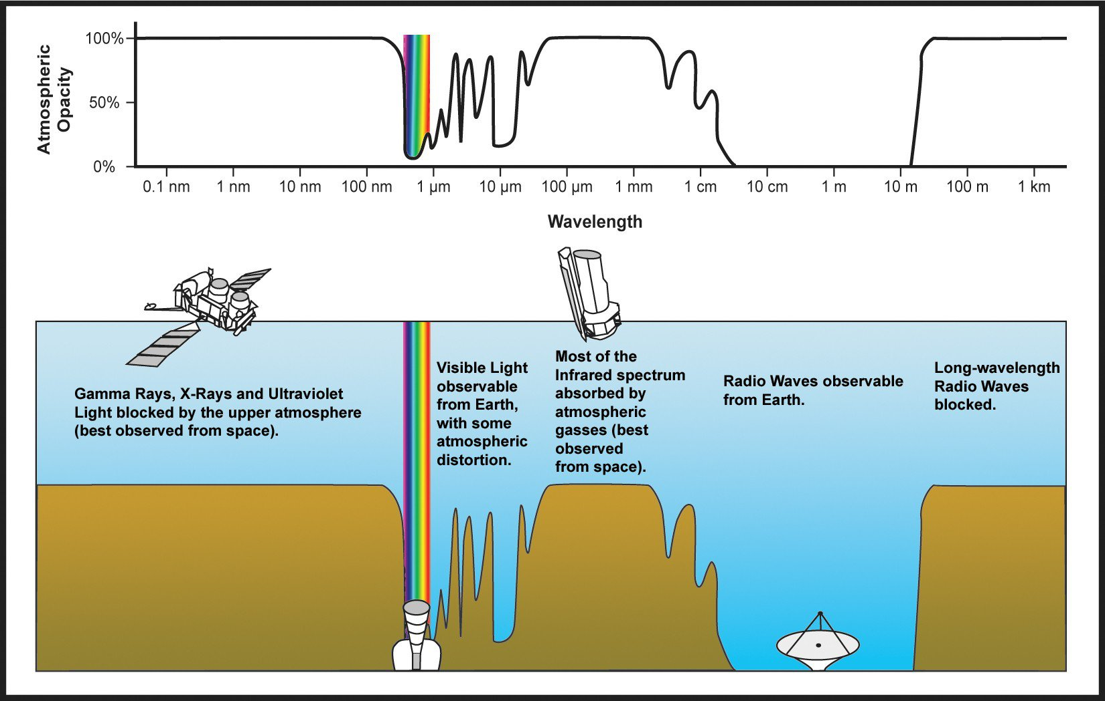
Atmospheric transmission window
Credit: NASA
Page 7

Slide 8
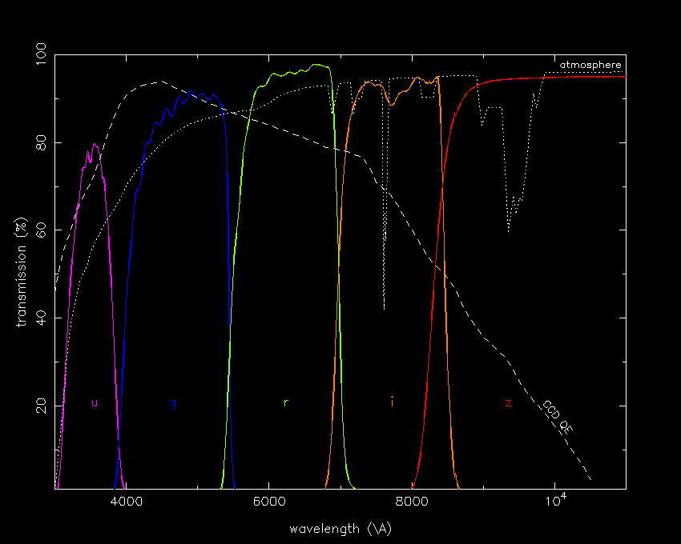
CCD Quantum efficiency
The effectiveness of an imager to produce electronic charge from incident photons
Page 8

Slide 9
CCD noise
Random (Statistical) Noise
“Poisson” or “shot” or “statistical” noise associated with counting statistics (appropriate to counting the number of photons that arrive each time interval).
where N is the number of detected events.
Readout noise
The readout noise is the noise of the on-chip amplifier which converts the charge (i.e the electrons) into a change in analogue voltage.
Dark current
Even in the absence of light, thermally generated electrons will be collected in the CCD and will contribute to the overall signal measured.
$$σ=\sqrt{N}$$
Page 9

Slide 10
Signal to noise
Signal to noise
$$S/N=\frac{S_{∗}×t}{\sqrt{{(S}_{∗}×t)+\left(S_{sky}×A×t\right)+\left(N_{read−out}×A\right)+(N_{Dark}×A×t)}}$$
$$m+σ=C−2.5\log{(S±N)}$$
$$m+σ=C−2.5\log\left[S\left(1±\frac{N}{S}\right)\right]$$
$$m+σ=C−2.5\log{S}−2.5\log\left(1±\frac{N}{S}\right)$$
$$σ=±2.5\log\left(1±\frac{1}{S/N}\right)$$
Page 10

Slide 11
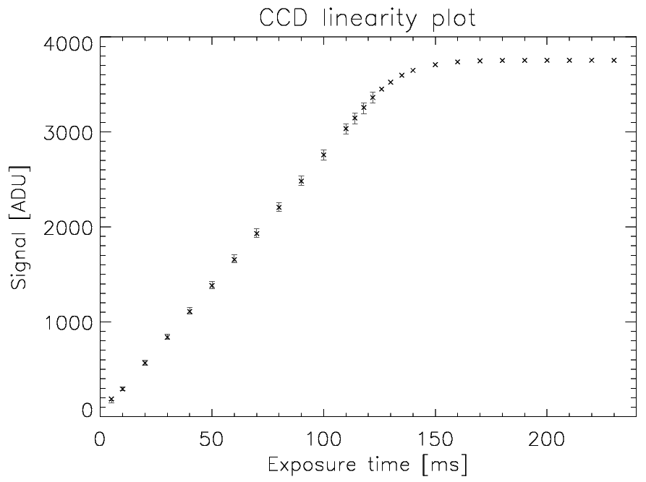
Saturation level and CCD linearity
Gain is the ratio of between number of electron and count (Analog-to-Digital Units, ADU)
Saturation level
CCD is designed to hold only so many electrons within a pixel before they start to leak outwards to other pixels.
This maximum size of a charge packet on the chip is called the full well depth.
There is also a "maximum possible number" in the Analog-to-Digital converter.
Most CCDs use 14-bit, 15-bit, or 16-bit A/D units: the corresponding maximum pixel values are:
2^14 = 16384
2^15 = 32768
2^16 = 65536
Page 11

Slide 12
Magnitude, position and time
Magnitude
Position (RA, Dec)
Time
Local time
Coordinated Universal Time: UTC
Julian Date: JD
Heliocentric Julian Date: HJD
Barycentric Julian Date: BJD
$$m_{1}−m_{2}=−2.5\log{\frac{I_{1}}{I_{2}}}$$
Page 12

Slide 13
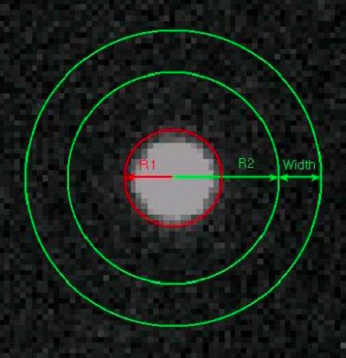
Aperture photometry
R₁ Star radius
R₂ Inner sky radius
Width Sky background width
$${Signal}_{star}={Signal}_{in R_{1}}−\overline{{Signal}_{in width}}×\frac{A_{in R_{1}}}{A_{in width}}$$
Page 13

Slide 14
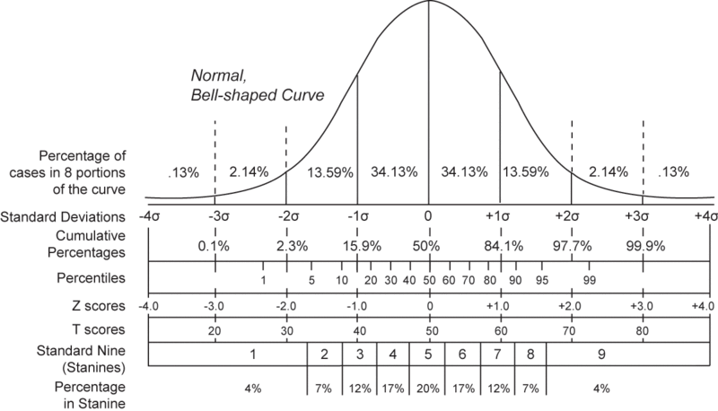
Aperture photometry
$$f\left(x\right)=\frac{1}{\sqrt{2πσ^{2}}}e^{\left(− \frac{{(x−μ)}^{2}}{2σ^{2}}\right)}$$
$$FWHM=2σ\sqrt{2\ln{2} }≈2.35σ$$
Two dimensional Gaussian function
$$f\left(x,y\right)=\frac{1}{{2πσ}_{x}^{2}σ_{y}^{2}}e^{\left(− \frac{x^{2}}{2σ_{x}^{2}}\right)}e^{\left(− \frac{y^{2}}{2σ_{y}^{2}}\right)}$$
$${\left.e^{\left(− \frac{r^{2}}{2σ^{2}}\right)}\right|}_{0}^{σ}=0.3935$$
$${\left.e^{\left(− \frac{r^{2}}{2σ^{2}}\right)}\right|}_{0}^{2σ}=0.8647$$
$${\left.e^{\left(− \frac{r^{2}}{2σ^{2}}\right)}\right|}_{0}^{4σ}=0.9889$$
$${\left.e^{\left(− \frac{r^{2}}{2σ^{2}}\right)}\right|}_{0}^{5σ}=0.999996$$
Credit: http://exoplanet.as.arizona.edu
Page 14

