Slide 1
Rv planet detection
2019 April 23
Rob wittenmyer

Slide 2
Outline
Early efforts
Gas absorption cells
Iodine cell technique
When it goes well: tools and analysis principles
Dynamical interactions matter
Warning! Stellar activity!
A graveyard of killed planets
Tools for dealing with messy stars

Slide 3
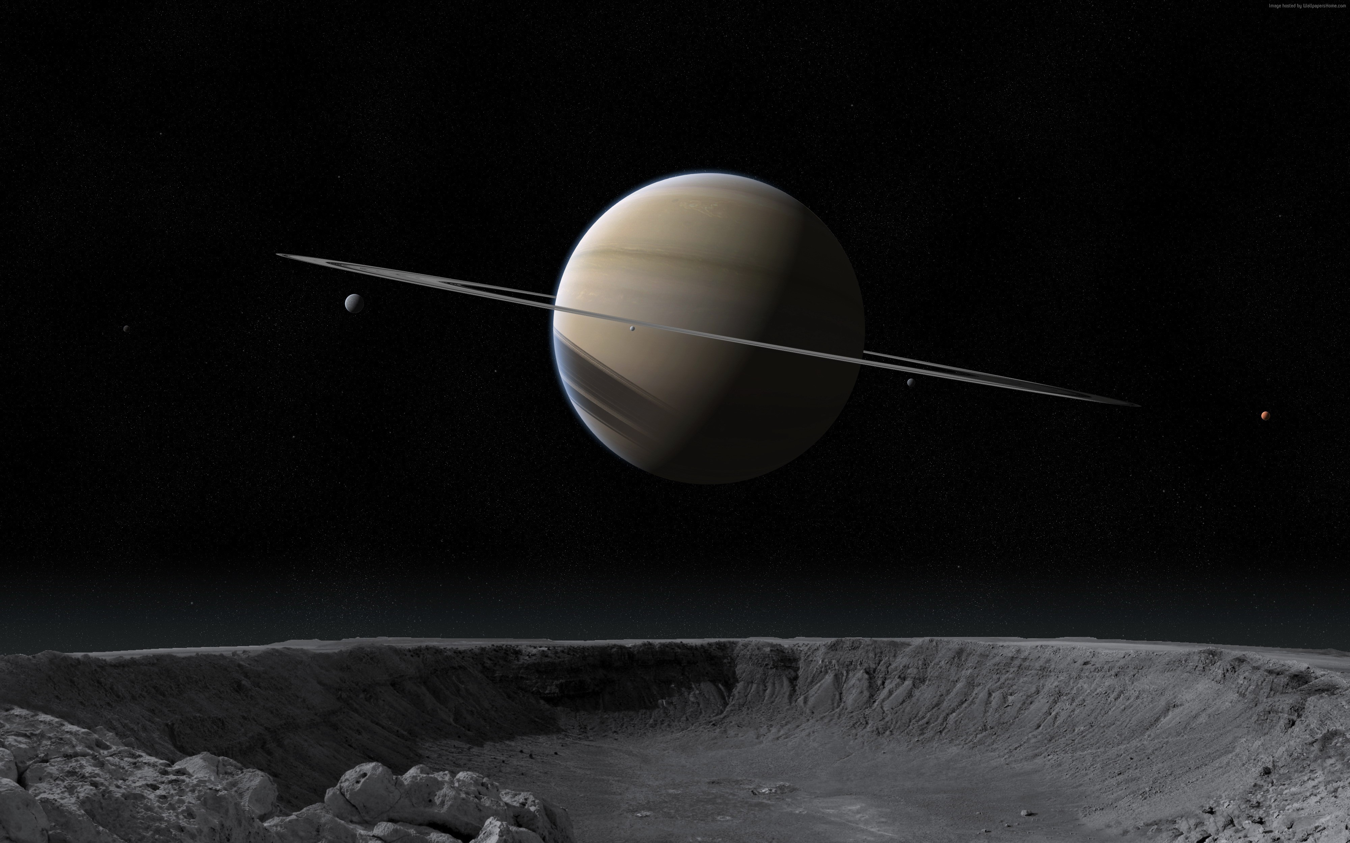
Observing strategies
Pick the right stars: Lines = Doppler information
Hot stars: neutral metal are ionised so very few lines left. Main-sequence O-B-A stars are bad.
M stars are hard because most flux is too red for iodine region.
Iodine-based RV surveys focus on F,G,K stars (“solar type”)

Slide 4
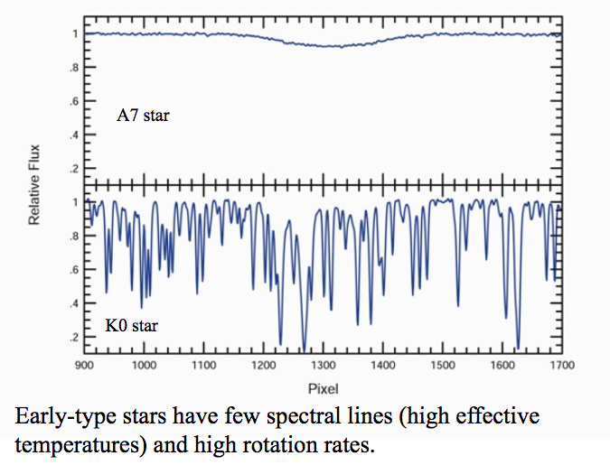
Observing strategies: rotation matters
https://slideplayer.com/slide/7474039/
Reiners+ 2010

Slide 5
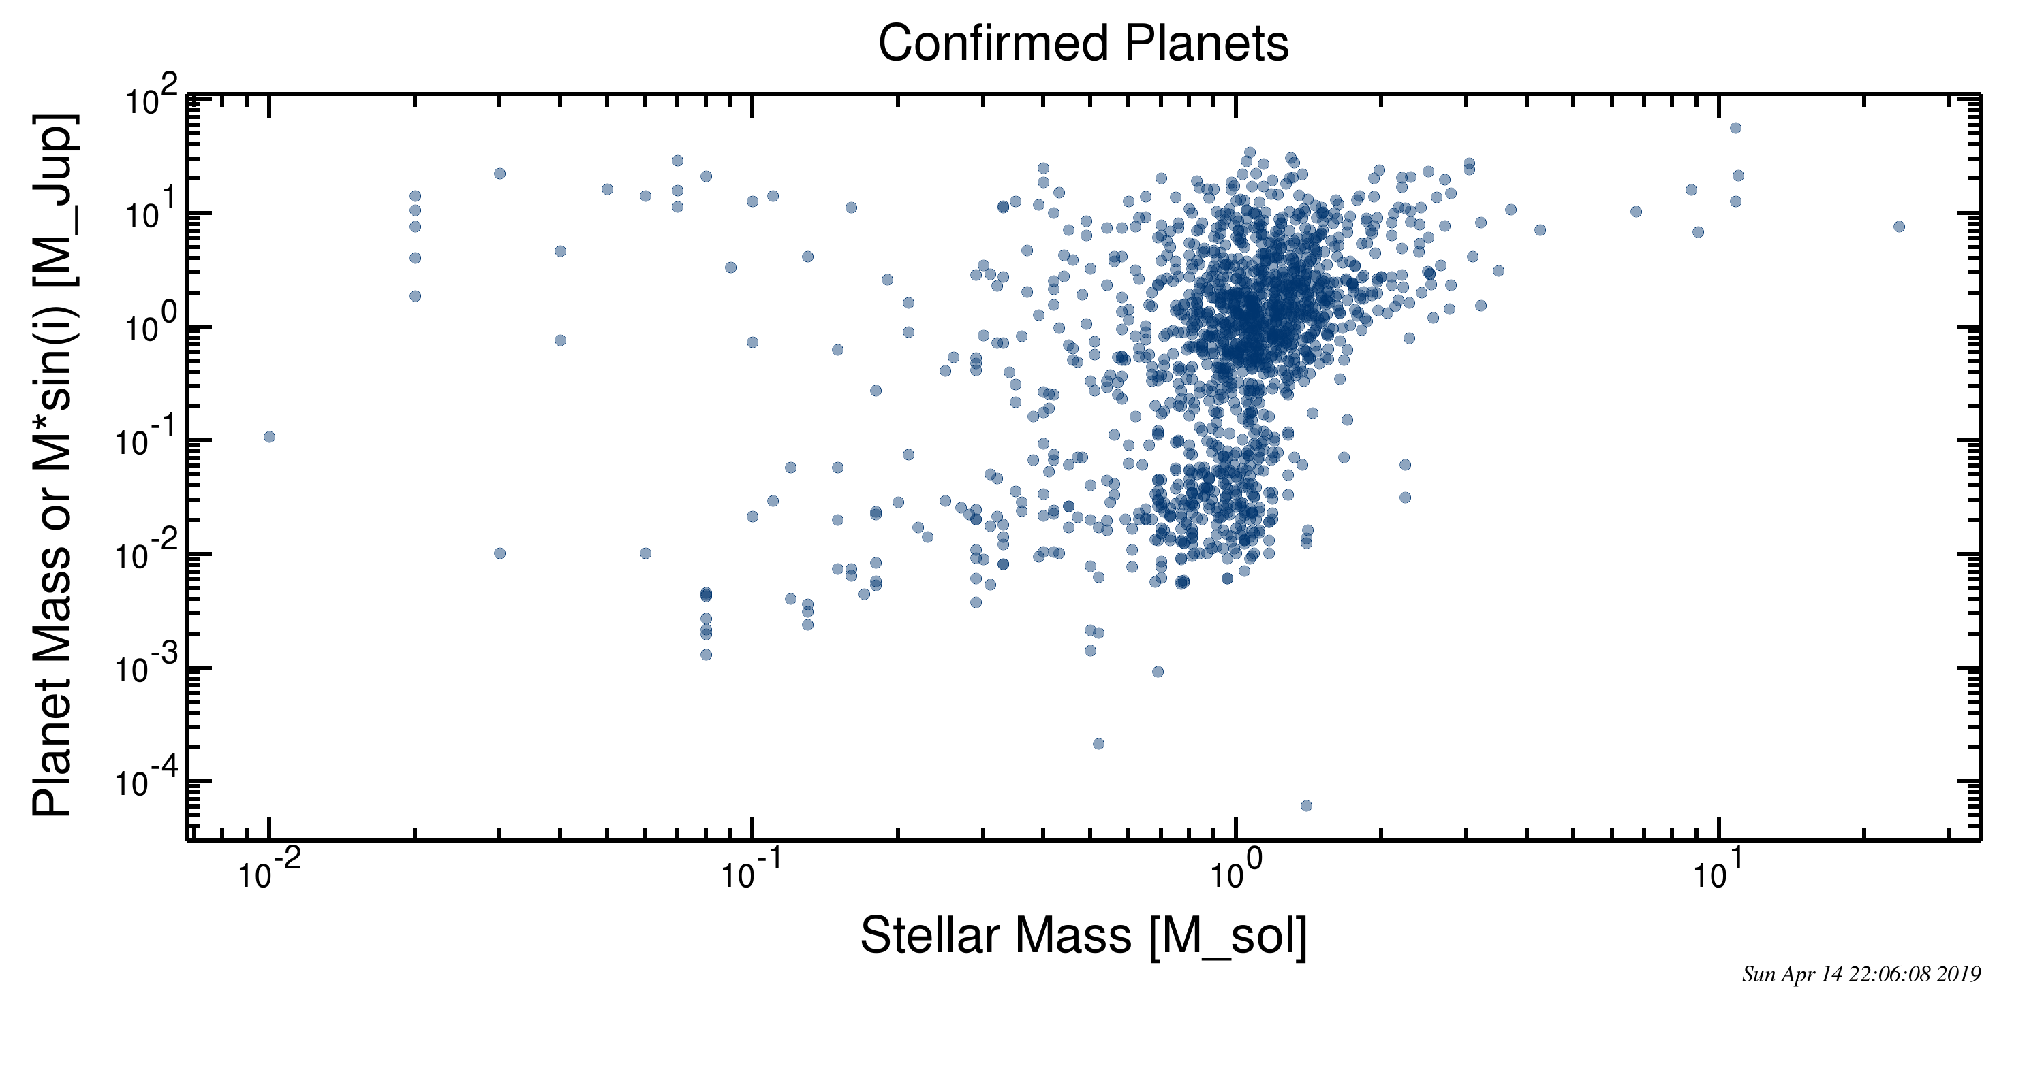
See the bias?

Slide 6
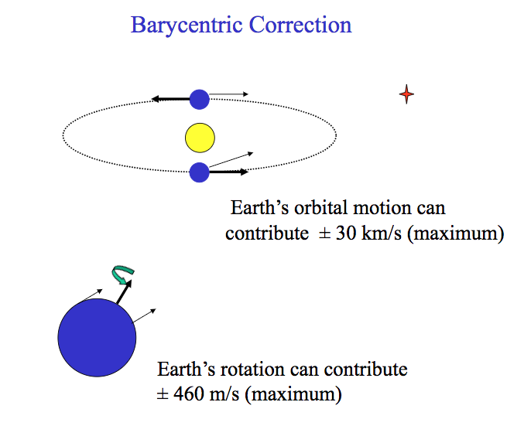
Observing strategies
https://slideplayer.com/slide/7474039/

Slide 7
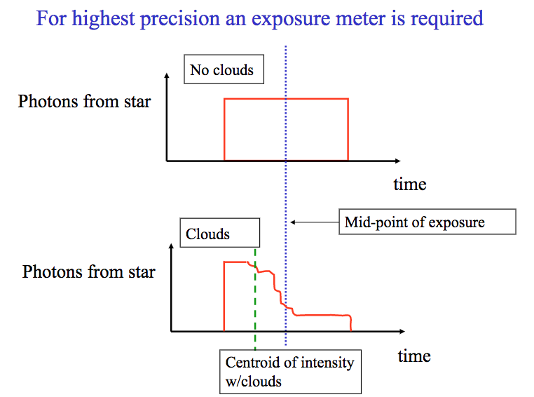
Observing strategies
https://slideplayer.com/slide/7474039/

Slide 8
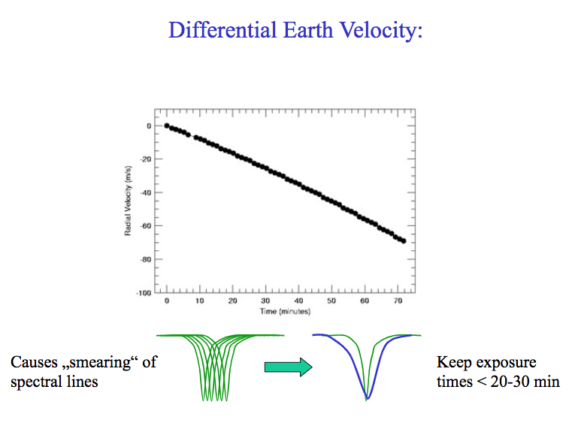
Observing strategies
https://slideplayer.com/slide/7474039/

Slide 9
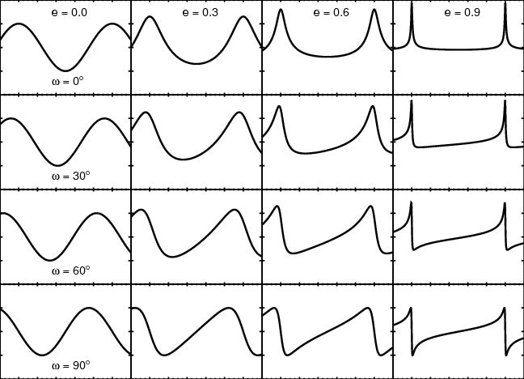
Observing strategies: sampling
Eccentricity matters!
If you miss the “interesting” part of the orbit, you miss the planet or get it wrong!

Slide 10
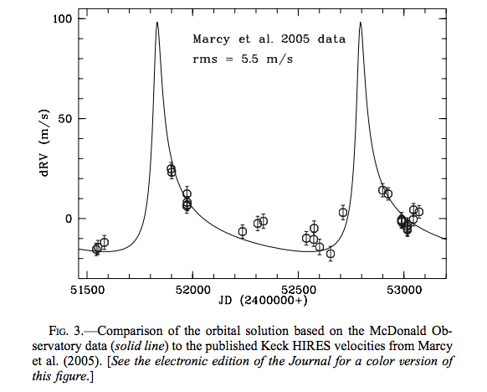
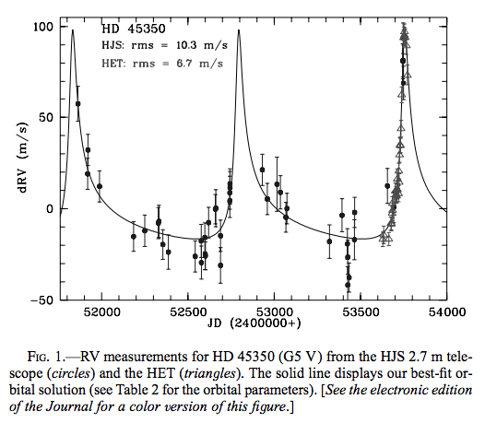
Observing strategies: sampling
Example: HD 45350 – discovery paper missed the large RV excursion.
Intensive observation caught the periastron passage.
Endl+ 2005

Slide 11
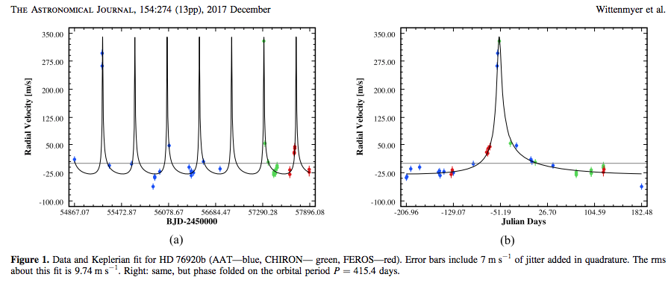
Observing strategies: sampling
HD 76920: Got lucky!
Wittenmyer+ 2017

Slide 12
Observing strategies: sampling
Multi-telescope campaign Jan 2018: Nailed it!
Bergmann+ 2019

Slide 13
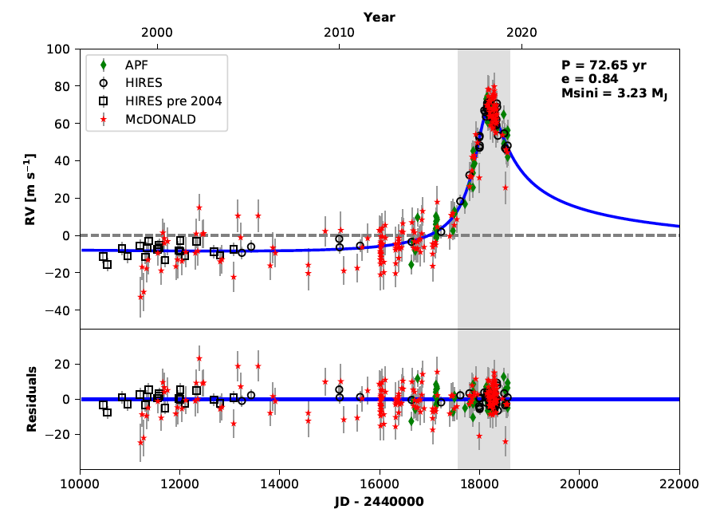
Observing strategies: sampling
Patience is key! 73 year orbit constrained by the information-rich eccentric bit
Blunt+ 2019, submitted

Slide 14
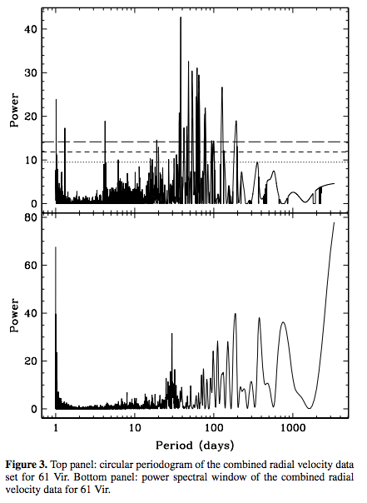
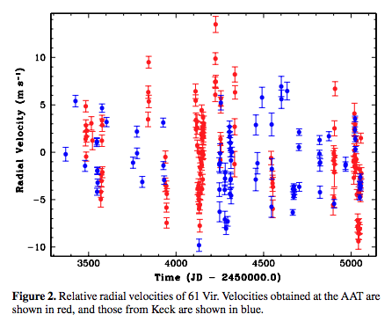
When it goes right
Vogt+ 2010
Get some RVs and look for periodicities with a Generalised Lomb-Scargle periodogram (error-weighted).
“Pre-whitening”: Fit for a planet at the highest peak, repeat until nothing significant remains.
Notes:
“uncomplicated” RV data analysis, periodograms, “pre-whitening”, stacked periodograms, tools e.g. Systemic, RadVel, and Agatha
use of dynamics as an observable – the “best” is not always the best…

Slide 15
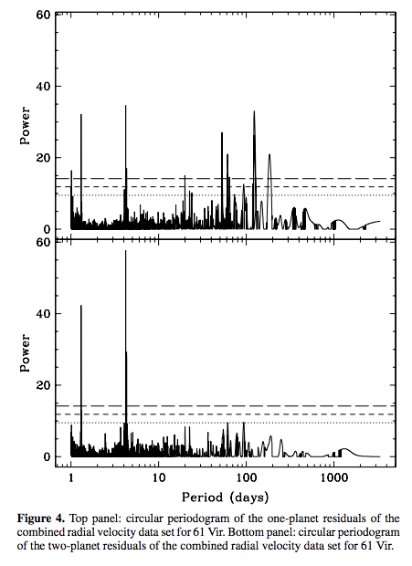
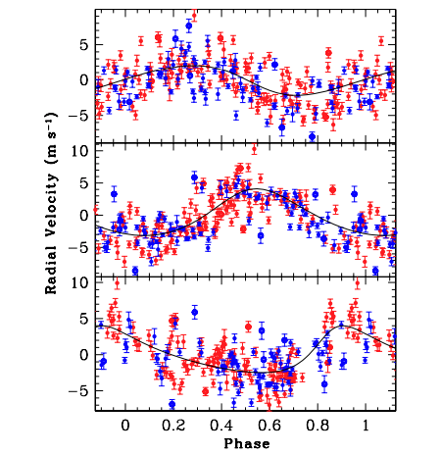
When it goes right
61 Vir: 3-planet system
38, 123, and 4.2 days
Vogt+ 2010
Notes:
“uncomplicated” RV data analysis, periodograms, “pre-whitening”, stacked periodograms, tools e.g. Systemic, RadVel, and Agatha
use of dynamics as an observable – the “best” is not always the best…

Slide 16
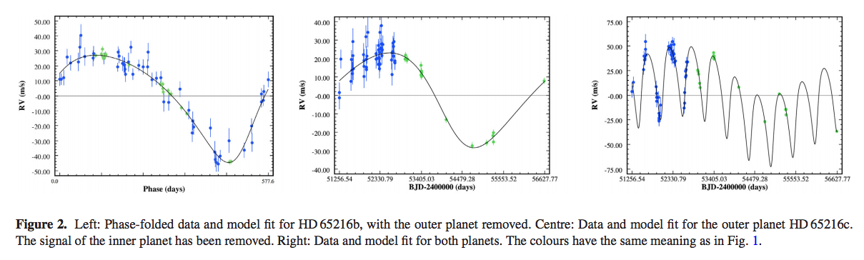
Sometimes it is bleeding obvious
HD 65216b: previously known from HARPS result (Mayor+ 2004). P=578 days
Outer planet “Jupiter analog” P=5370 days (14.7 years)
Blue and green are both HARPS RVs – green is “post-fix” after a fibre-feed upgrade in 2015. This causes an RV offset and must be treated as a separate instrument in the fitting process.
Wittenmyer+ 2019a
Notes:
“uncomplicated” RV data analysis, periodograms, “pre-whitening”, stacked periodograms, tools e.g. Systemic, RadVel, and Agatha
use of dynamics as an observable – the “best” is not always the best…

Slide 17
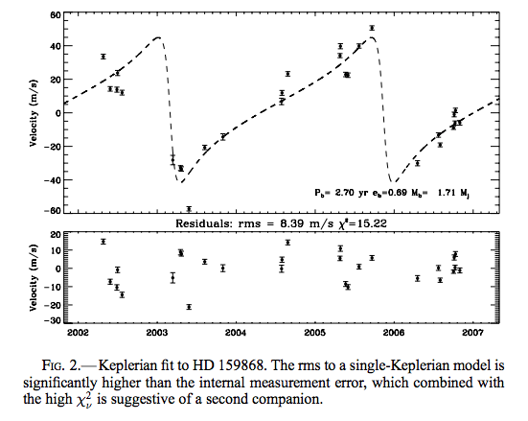
New data, new insights
HD 159868b in 2007
Single, eccentric e=0.69
But high scatter…
O’Toole+ 2007

Slide 18
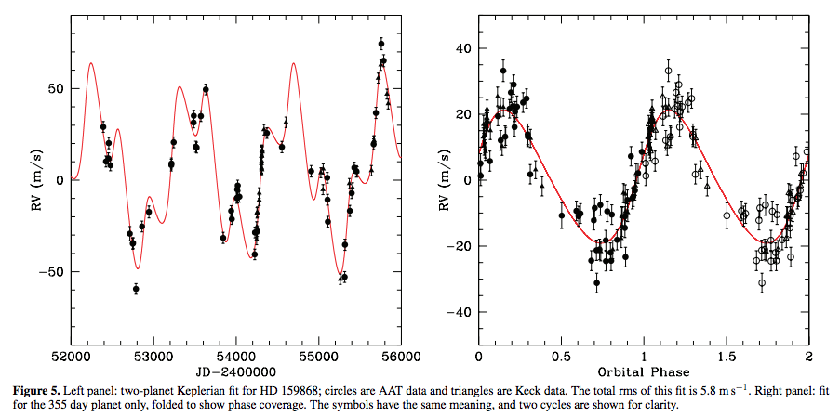
New data, new insights
Wittenmyer+ 2012
More data shows a second planet at 352 days, e=0.15
Initial planet now e=0.01
Second signal was showing up as “extra” eccentricity

Slide 19
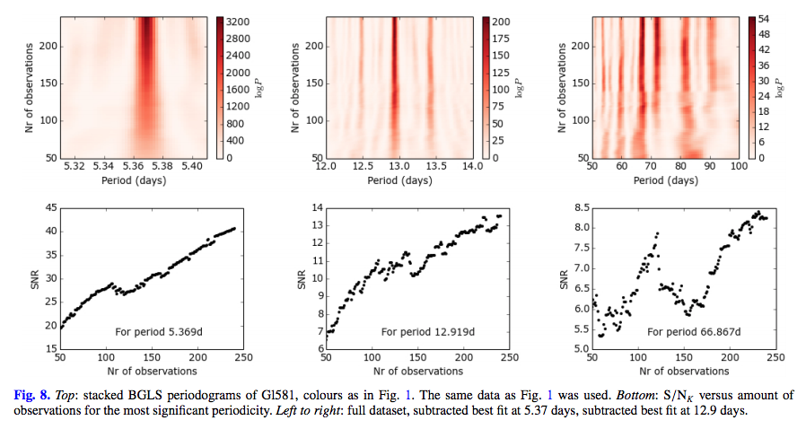
Making sure it is a real signal
Mortier & Collier Cameron 2017
“Stacked periodograms” show how significance of a signal evolves with time. You want this to steadily increase.
GJ 581 system: Two of these three are planets.

Slide 20
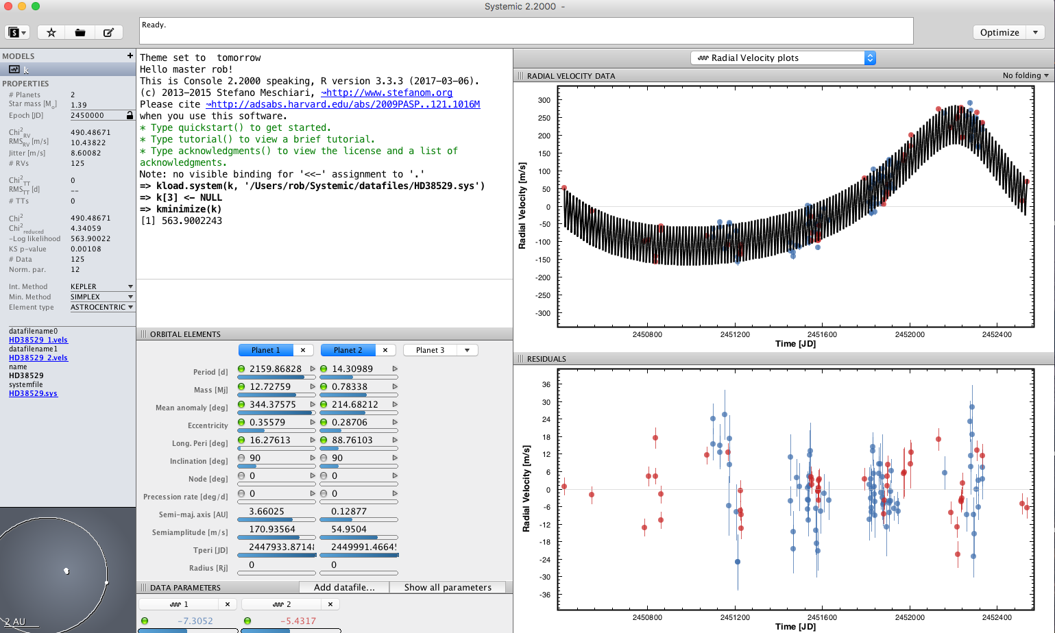
Some tools for fitting rv data
Systemic Console: Relatively user-friendly interface for Keplerian orbit fitting. *Version 2.0 only “sometimes” can be installed….
Good for quick looks and frequentist statistical analysis.

Slide 21
Some tools for fitting rv data
Switch over to Systemic window for a demo.
Good for “straightforward” data sets.
More tools to be demonstrated shortly for more complex situations.

Slide 22
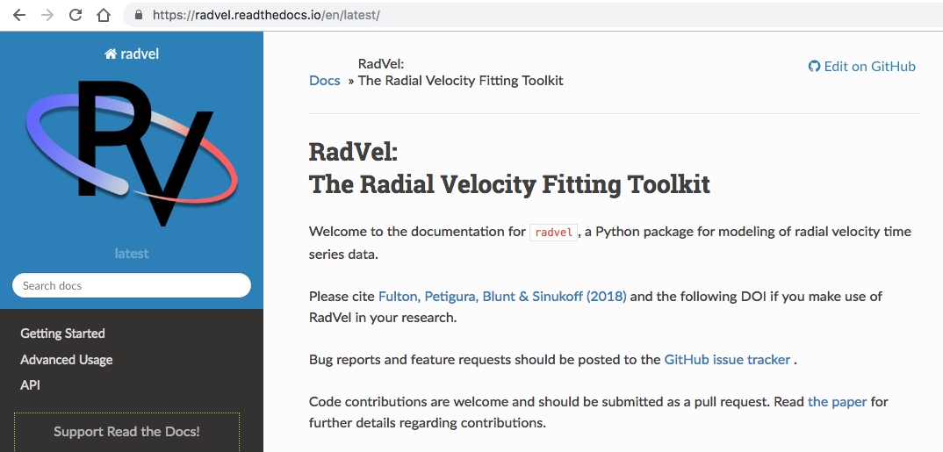
Some tools for fitting rv data
RadVel: a Python-based RV fitting routine including Bayesian analysis
Fulton+ 2018 PASP, 130, 504.
Also produces publication-ready plots and tables!

Slide 23
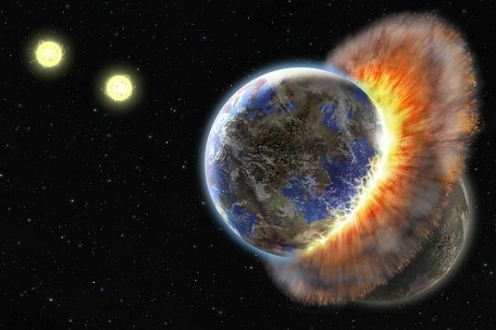
So you think you found some planets?
Multiple planet systems interact with each other!
“Best fit” to RVs may not be physically meaningful.

Slide 24

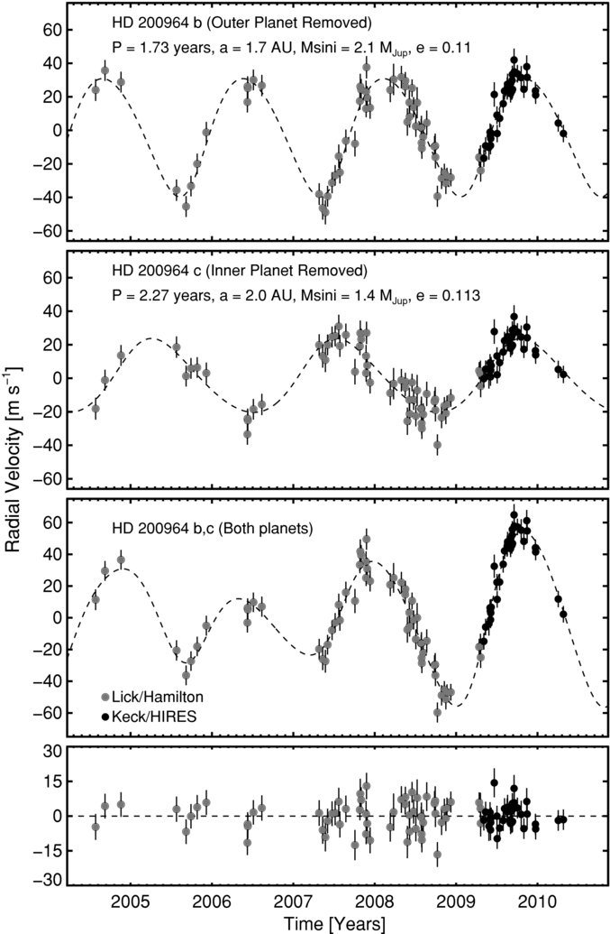
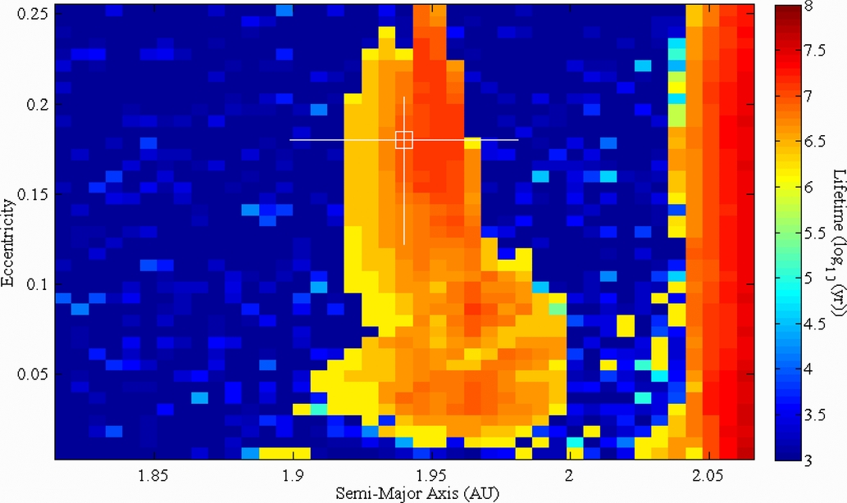
Step 1: Are the planets all they seem to be?
Wittenmyer et al., 2012, ApJ, 761, 165
HD 200964 4:3 resonant system
Johnson et al. (2011)
Notes:
24
Each coloured square represents the mean lifetime of 75 values of mean anomaly and periastron argument, within a +/- 3 sigma range.

Slide 25
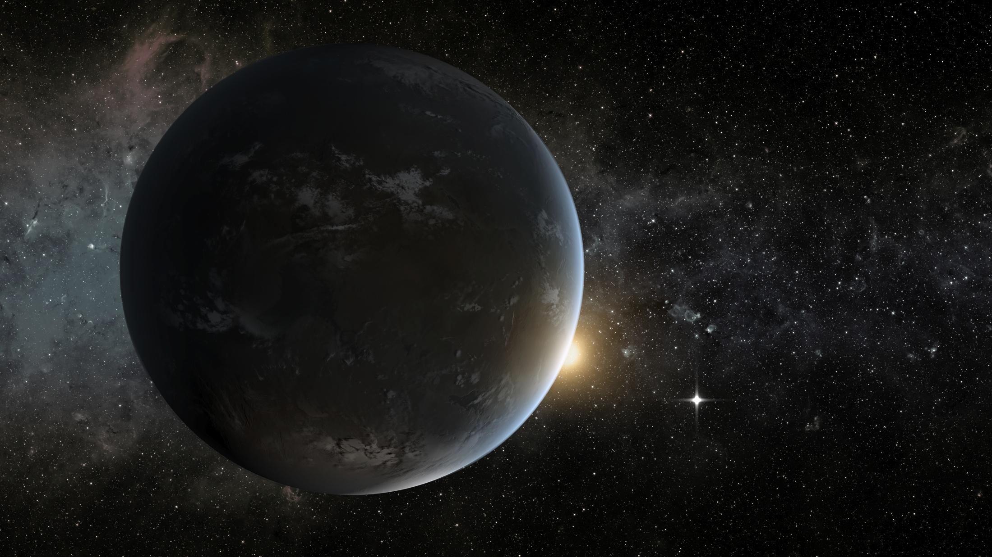
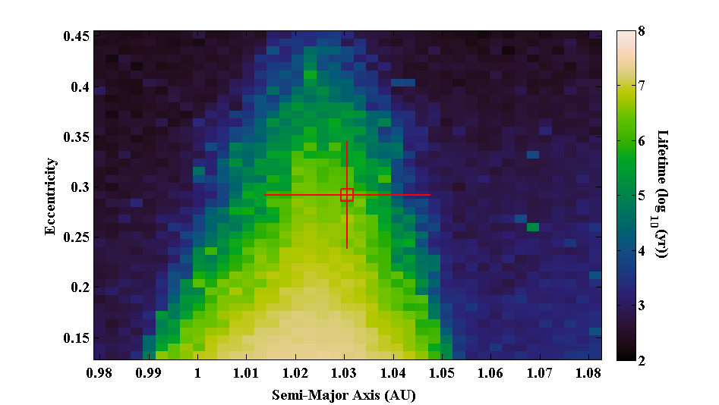
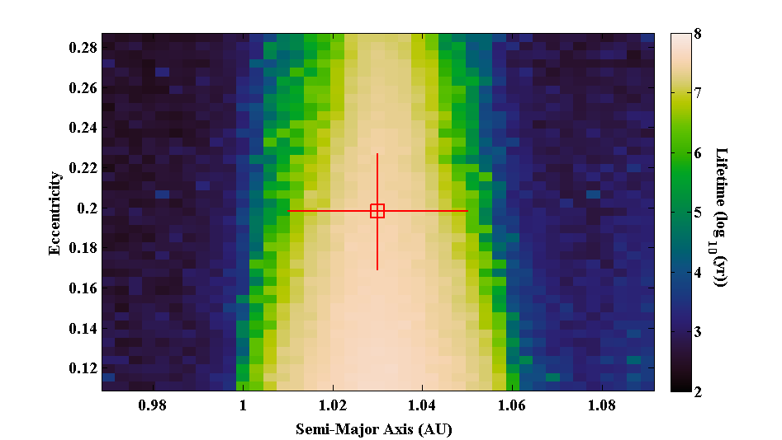
An improved fit for a 2:1 resonant system…
HD73526: Wittenmyer, Tan, Lee, Horner et al., 2014, ApJ, 780, 140
Notes:
25
(1). Best fit Keplerian parameters. → (2) Dynamical fit better!

Slide 26
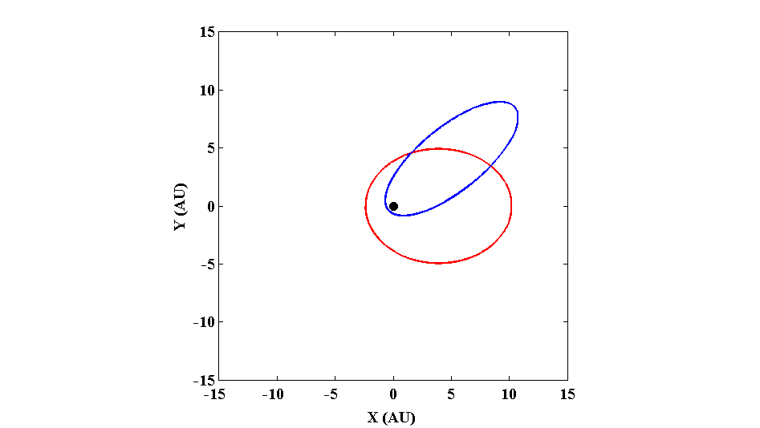
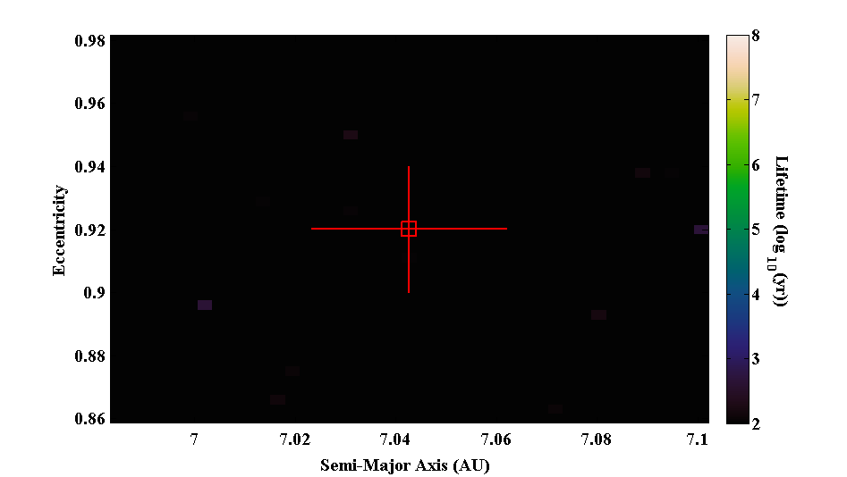
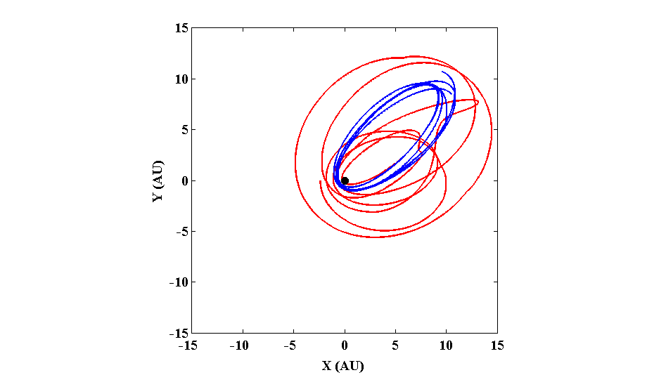
Smashing Planets – the horror of QS Virginis
Horner et al., 2013, MNRAS, 435, 2033
Notes:
26

Slide 27
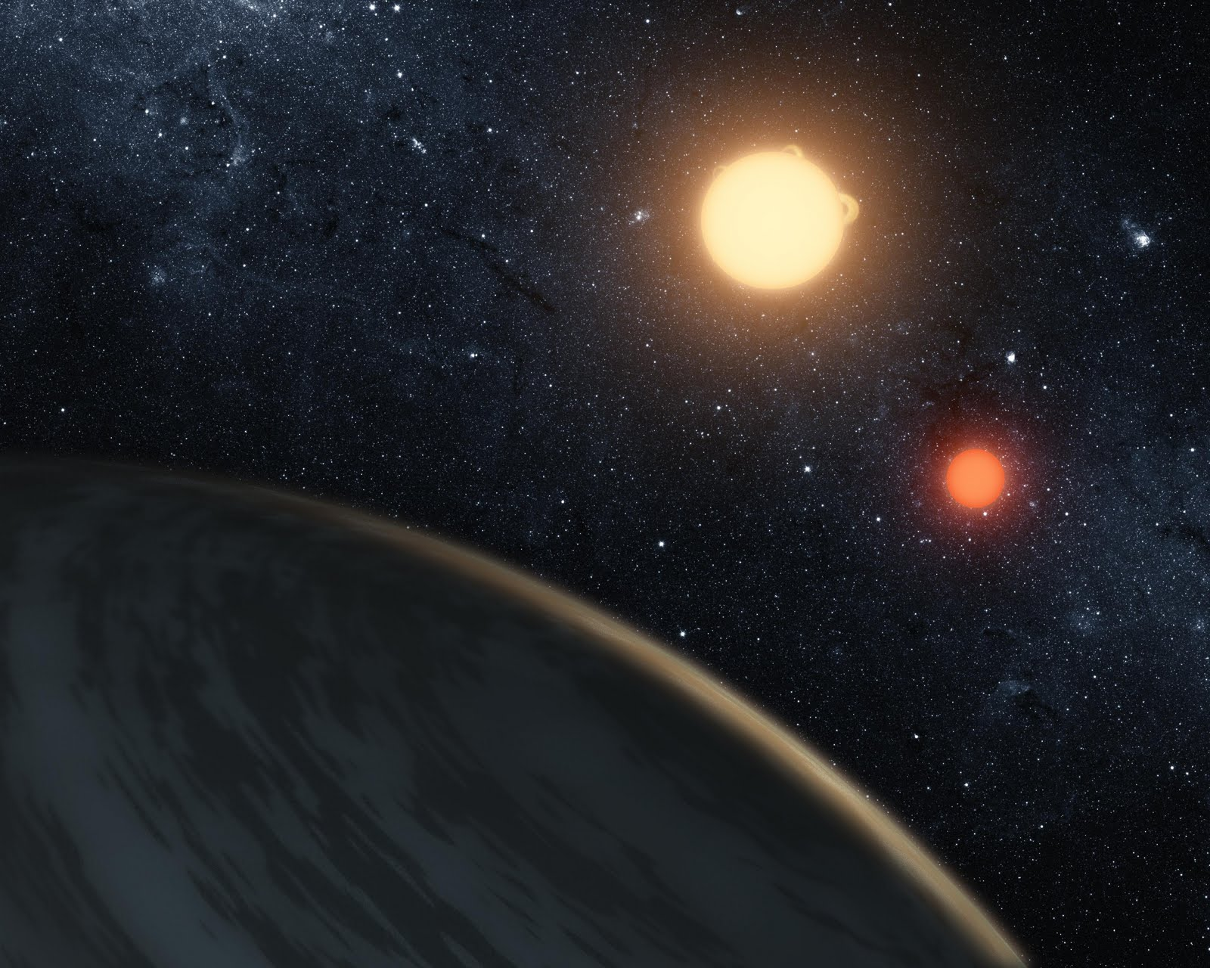
A summary of our dynamical mapping results
Circumbinary “planets” detected by eclipse timing
HW Vir – Horner et al. 2012b, MNRAS 427, 2812
NN Ser – Horner et al. 2012a, MNRAS 425: 749
HU Aqr – Horner et al. 2011, MNRAS 416: L11
– Wittenmyer et al. 2012a, MNRAS 419: 3258
NSVS 14256825 – Wittenmyer et al. 2013, MNRAS 431: 2150
– Hinse et al. 2014, MNRAS 438: 207
QS Vir – Horner et al. 2013, MNRAS 435: 2033

Slide 28
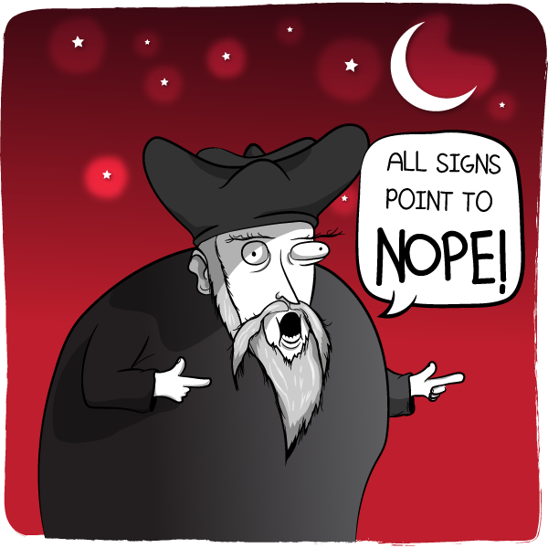


A summary of our dynamical mapping results
Circumbinary “planets” detected by eclipse timing
HW Vir – Horner et al. 2012b, MNRAS 427, 2812
NN Ser – Horner et al. 2012a, MNRAS 425: 749
HU Aqr – Horner et al. 2011, MNRAS 416: L11
– Wittenmyer et al. 2012a, MNRAS 419: 3258
NSVS 14256825 – Wittenmyer et al. 2013, MNRAS 431: 2150
– Hinse et al. 2014, MNRAS 438: 207
QS Vir – Horner et al. 2013, MNRAS 435: 2033

Slide 29
A summary of our dynamical mapping results
Radial-velocity planets
HD 155358 – Robertson et al. 2012, ApJ 749: 39
HD 159868 – Wittenmyer et al. 2012b, ApJ 753: 169
HD 200964 & 24 Sex – Wittenmyer et al. 2012c, ApJ 761: 165
BD+20 2457 – Horner et al. 2014, MNRAS 439: 1176
HD 33844 – Wittenmyer et al. 2016b, ApJ 818: 35
HD 30177 – Wittenmyer et al. 2017, AJ 153: 167

Slide 30

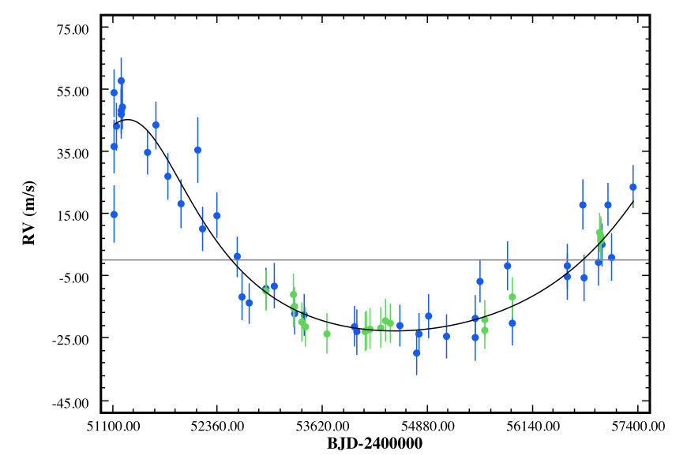
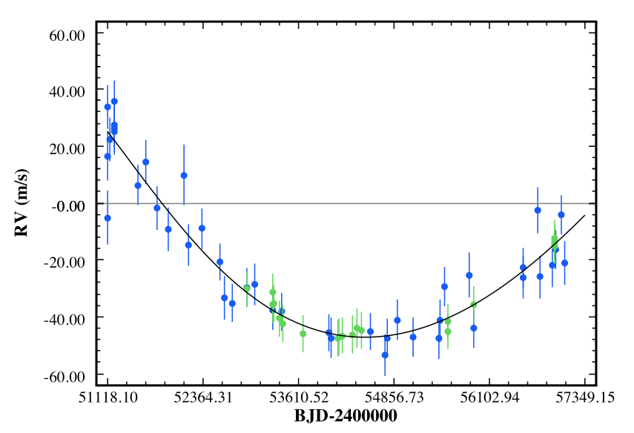
HD 30177c: A Saturn Analog*
*(In the sense of orbiting around 10ish AU – not a Saturn-mass planet)
Short period “best fit”
P = 19.0 ± 1.7 yr
a = 7.0 ± 0.4 AU
M sin i = 3.0 ± 0.3 M_{jup}
Long period “almost as good”
P = 31.9 ± 6.7 yr
a = 9.9 ± 1.4 AU
M sin i = 6.4 ± 3.3 M_{jup}
Wittenmyer et al. (2017)

Slide 31
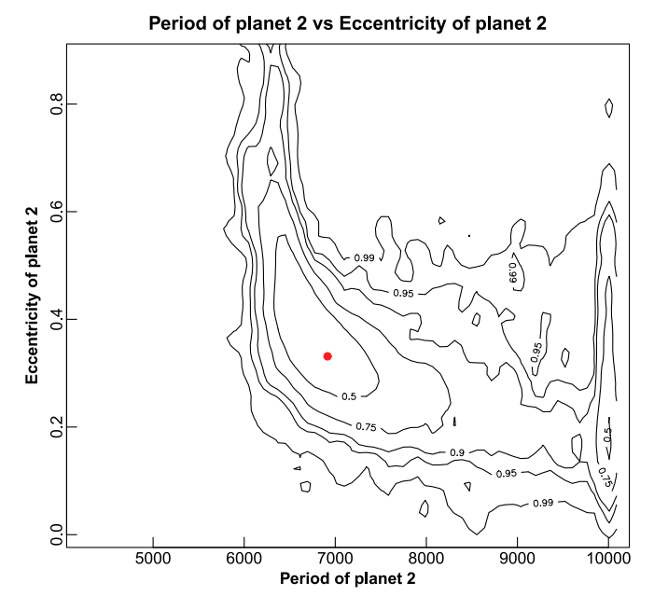
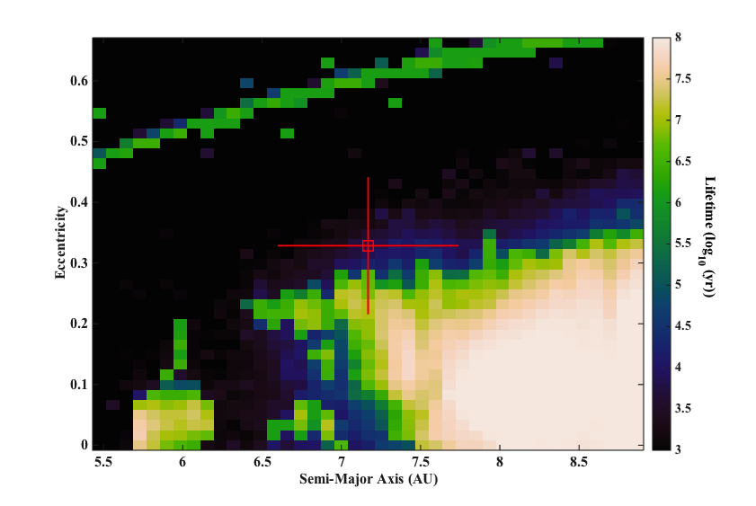
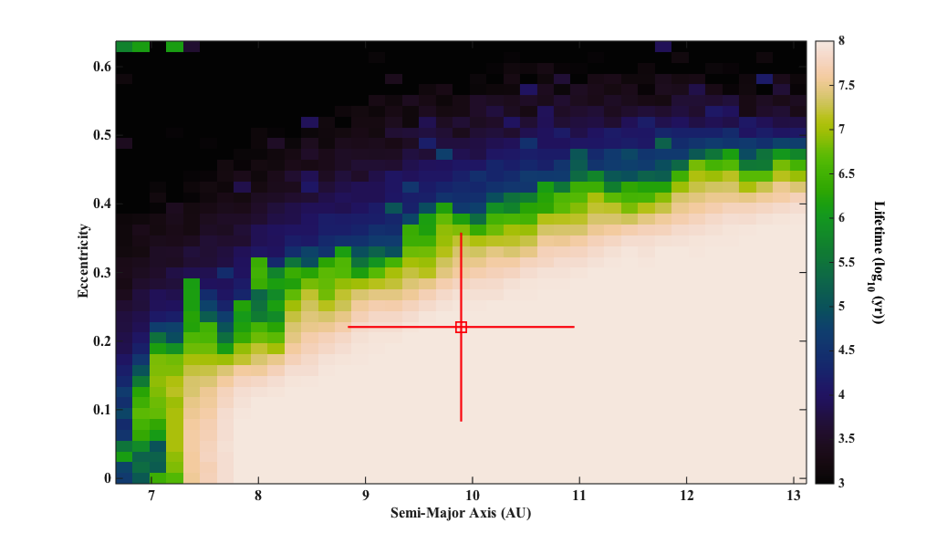
HD 30177c: A Saturn Analog
Short period: Unstable
Long period: Stable
Two solutions – Dynamical stability
shows that shorter period “best fit”
is disfavoured.
Wittenmyer et al. (2017)

Slide 32
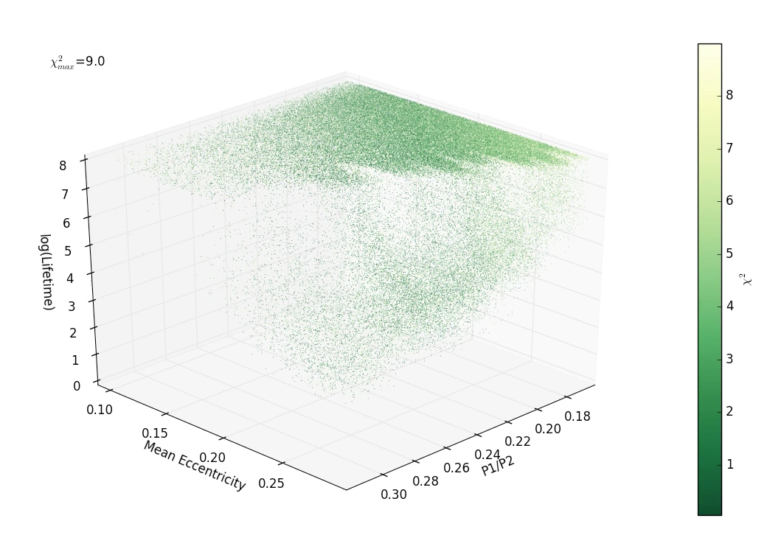
How well do the tested configurations fit the data?
Long-period solution
Video credit:
Matthew Mengel (USQ)
Lifetime as function of mean eccentricity of the two planets,
and period ratios. Darker colours are better fits.
Wittenmyer et al. (2016f)
Notes:
Short period

Slide 33
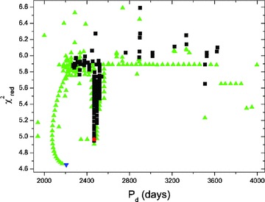
We’re not the only ones doing this
HD 181433 system (Campanella 2011, MNRAS 418, 1028)
Best fit dynamically unstable. (blue triangle)
Stable fits (black squares) centred on 5:2 MMR
Notes:
Right: edge-on coplanar χ 2 red grid with jitter included. The eccentricities of both planets are varied in the range from 0.001 to 0.251 with steps of 0.005, while the other orbital parameters and the zero-point offset were fitted until the χ 2 red minimum is achieved. The solid black contours indicate the stable fits, while the dashed contours indicate fits where the system survives the dynamical tests, but with chaotic scattering behavior. While the best dynamical fit is unstable (white star), we found two stability islands where long-term (108 yr) stability is achieved. With a moderate eb, at the 1σ border (blue contours), a stable 2:1 MMR region exists, and at lower eccentricities a broad stability region can be seen at more than 3σ from the best fit, without showing any signs of a low-order MMR. Left: higher resolution zoom of the stable 2:1 resonant region.

Slide 34
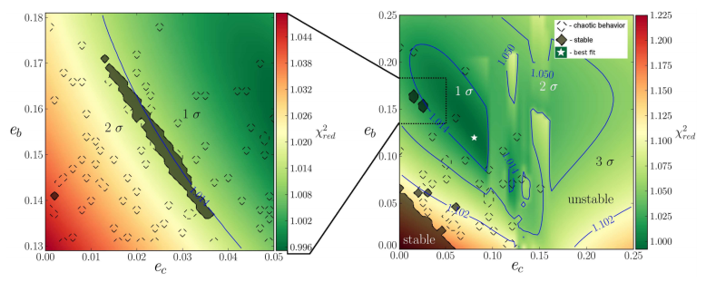
We’re not the only ones doing this
Eta Ceti candidate 2:1 resonant system (Trifonov+ 2014)
Combining dynamical stability tests with goodness of fit.
Best fit to radial velocity data is unstable.
But stable fits are found ~1 sigma away (grey regions)
Notes:
Right: edge-on coplanar χ 2 red grid with jitter included. The eccentricities of both planets are varied in the range from 0.001 to 0.251 with steps of 0.005, while the other orbital parameters and the zero-point offset were fitted until the χ 2 red minimum is achieved. The solid black contours indicate the stable fits, while the dashed contours indicate fits where the system survives the dynamical tests, but with chaotic scattering behavior. While the best dynamical fit is unstable (white star), we found two stability islands where long-term (108 yr) stability is achieved. With a moderate eb, at the 1σ border (blue contours), a stable 2:1 MMR region exists, and at lower eccentricities a broad stability region can be seen at more than 3σ from the best fit, without showing any signs of a low-order MMR. Left: higher resolution zoom of the stable 2:1 resonant region.

Slide 35
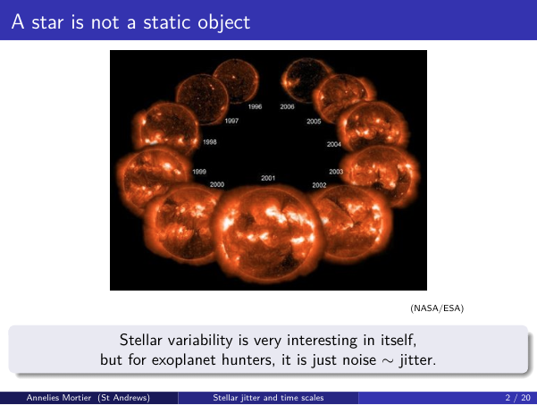
Stars are messy
Credit: Annelies Mortier

Slide 36
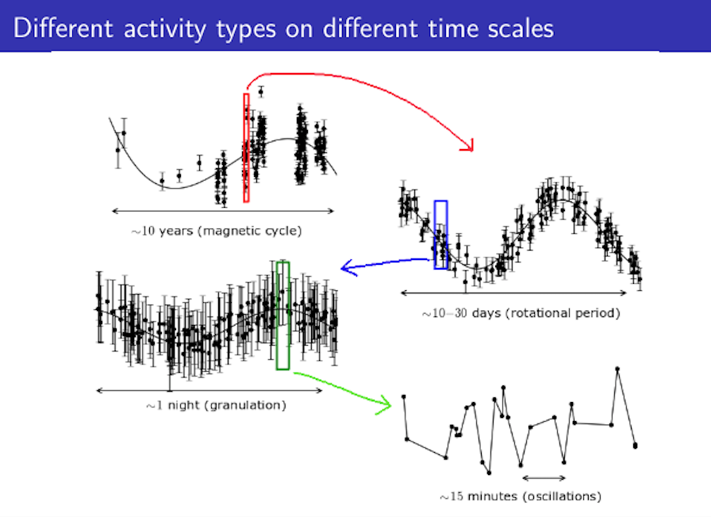
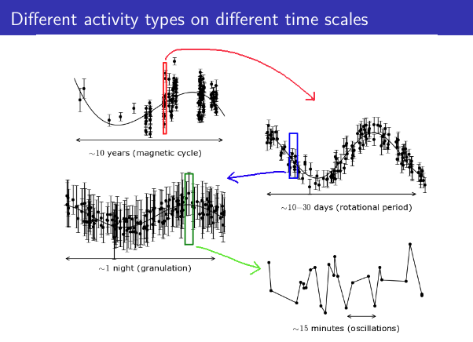
Stars are messy
Credit: Annelies Mortier

Slide 37
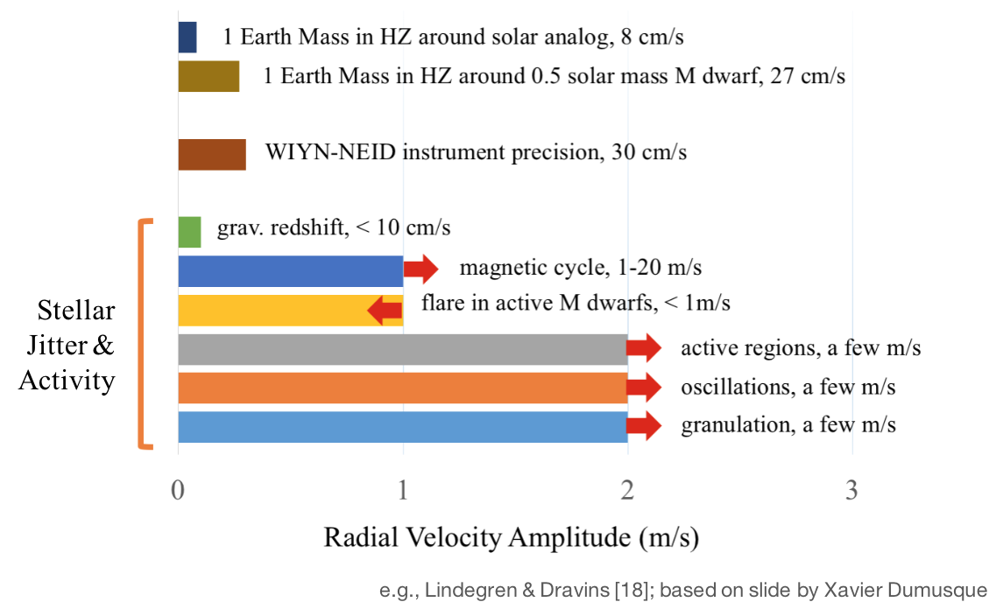
Stars are messy: rv “jitter”
Credit: Sharon Wang

Slide 38
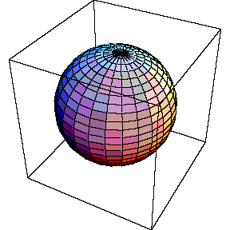
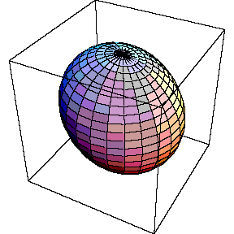
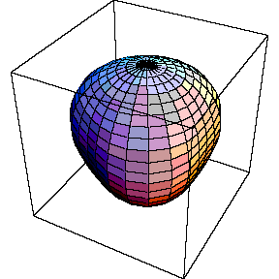
Stars are messy
Oscillations – noise for me, signal for the
Seismology people

Slide 39
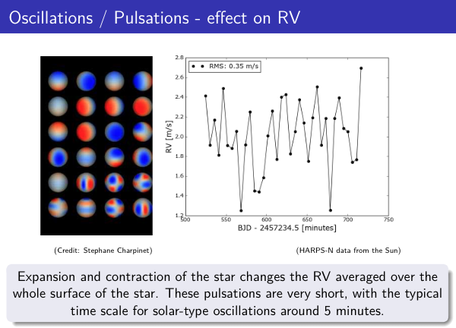
Stars are messy: oscillations
Credit: Annelies Mortier

Slide 40
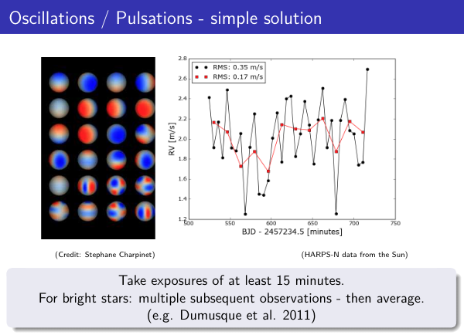
Stars are messy: oscillations
Credit: Annelies Mortier

Slide 41
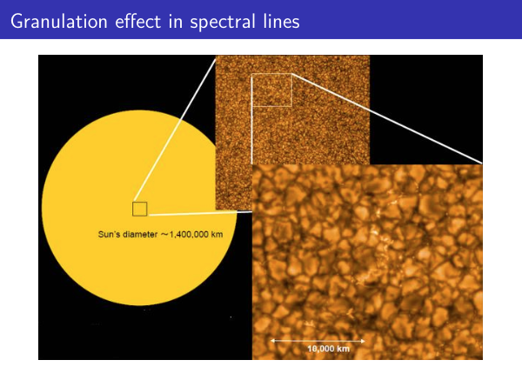
Stars are messy: granulation
Credit: Annelies Mortier

Slide 42

Stars are messy: granulation
Timescales: Hours. Solution? Average multiple observations per night
(But this reduces sensitivity to very short-period planets)
Credit: Annelies Mortier

Slide 43

Stars are messy: spots
Credit: Annelies Mortier

Slide 44

Stars are messy: granulation
Credit: Annelies Mortier

Slide 45

Stars are messy: magnetic cycles
Credit: Annelies Mortier

Slide 46

Stars are messy: magnetic cycles
Credit: Annelies Mortier

Slide 47

Stars are messy: magnetic cycles
Timescales: Years – 5-15 years with amplitudes of a few to 10+ m/s.
Scary! Jupiter = 12 m/s over 12 years.
Credit: Annelies Mortier

Slide 48


Magnetic cycles != planets
HD 85390: almost fooled us into thinking there is an outer planet!
Checking the CCF FWHM showed a correlation with the RVs. P=18.3 yr, ”K”=3.4 m/s
Wittenmyer+ 2019a

Slide 49




Stellar activity kills planets
Looks like a planet! Let’s see the Calcium II chromospheric emission line…
Queloz+ 2001
Notes:
We don’t want emission!

Slide 50

Spots, not a planet
“Bisector” = measure of the spectral line’s distortion.
For a real planet, the Doppler signal does NOT distort the line, it is only a shift.
If bisectors correlate with your radial velocity, that is a bad thing.
Queloz+ 2001

Slide 51

Activity indicators
Calcium II “H and K lines” are good indicators of activity. (If your spectrograph goes that blue)
Shown: Controversial planet HD 41248, where activity signal parallels the RVs.
Santos+ 2014: No planets!
More to come on this one….
Santos+ 2014

Slide 52

Activity indicators
You can do this with H-alpha as well. Works best for M dwarfs
The saga of the GJ 581 system
Santos+ 2014
Credit: Johanna Teske

Slide 53

Activity indicators
Traces RVs well in M dwarfs.
The saga of the GJ 581 system
Santos+ 2014
Credit: Johanna Teske

Slide 54

Activity indicators
Not very definitive for FGK stars though…
Credit: Johanna Teske

Slide 55


Colours matter
Spot contrast is smaller in the red. So, to reduce the impact of spots on your spectral lines (RVs), look in the red!
TW Hya planet? Optical spectrograph
Setiawan+ 2008
Same target using CRIRES (red-optimised spectrograph)
Huelamo+ 2008

Slide 56


Activity levels change
Alpha Cen Bb: claimed 3.24 day planet (Dumusque+ 2012)
Tiny signal hidden under many activity signals!

Slide 57

Activity levels change
Planet or not?
Life is tough when the signal is smaller than the noise.

Slide 58


Bye bye b b
Rajpaul+ (2016) showed that the “planet” signal was an unfortunate artefact of incompletely removing the activity signals.

Slide 59










Gj 581: a real mess
Credit: Stephen Kane
Notes:
This is 8 slides…

Slide 60

Killing planets
GJ 581 d “habitable zone planet” very controversial.
Shown to be activity signal by correlation with H-alpha (Robertson+ 2014)
Significance of “planet d” signal does NOT increase steadily. This is much like the stacked periodograms we saw before.
Increases more at times of high activity.
RVs trace the H-alpha activity (lower panel)

Slide 61

Killing planets
Planets b, c, e are securely there.
Planet “d” vanishes when RVs are corrected for activity.
Robertson+ 2014

Slide 62

Red noise
Noise (star or instrument) is often corrrelated in time. This is called “red noise” and can mask or mimic planetary signals.
MA models = Moving Average used to model the red noise in RV data.
Case study: HD 41248 system, where the 2 planets at 18 and 25 days were dismissed as activity. (RVs tracked the Ca II indicators)
Jenkins and Tuomi 2014

Slide 63

Jenkins and Tuomi 2014

Slide 64

Tracing and removing stellar activity
Credit: Sharon Wang

Slide 65

Simultaneous Photometry can help
Ground based photometry
At same time as RV observations
Photometry informs the Gaussian Process model to detrend the RVs.
Dai+ 2017

Slide 66

Simultaneous Photometry can help
RVxK2.com

Slide 67

Tools for dealing with activity
“Agatha” https://phillippro.shinyapps.io/Agatha/
Useful if you have noise proxies e.g. Ca II, Bisectors, CCF FWHM, etc.
Also useful for quick and easy checking for impact of red noise using MA components.
Demo of GJ 628 data and Agatha.
Feng+ 2017

Slide 68

Tools for dealing with activity
“Agatha” https://phillippro.shinyapps.io/Agatha/
Useful if you have noise proxies e.g. Ca II, Bisectors, CCF FWHM, etc.
Also useful for quick and easy checking for impact of red noise using MA components.
Demo of GJ 628 data and Agatha.
Feng+ 2017

Slide 69

Tools for dealing with activity
“Agatha” https://phillippro.shinyapps.io/Agatha/
Useful if you have noise proxies e.g. Ca II, Bisectors, CCF FWHM, etc.
Also useful for quick and easy checking for impact of red noise using MA components.
Demo of GJ 628 data and Agatha.
Feng+ 2017

