Slide 1
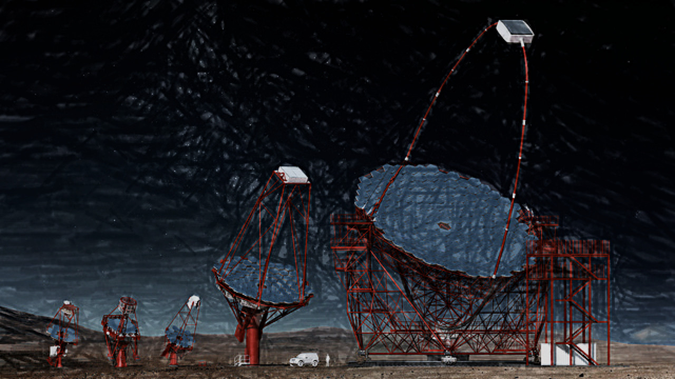



CTA Dark Matter & Exotic Physics WG
[and how Thai scientists could participate]
Miguel A. Sánchez-Conde
Instituto de Física Teórica IFT UAM/CSIC & Departamento de Física Teórica
Universidad Autónoma de Madrid
miguel.sanchezconde@uam.es
1st Thai-CTA workshop on Astroparticle Physics
Chiangmai, Thailand, February 18-22 2019

Slide 2
Science working groups (SWGs)
[PHYS coordinators: Stefan Funk, Jamie Holder and Emma de Oña Willhelmi]
Galactic Science
  Andrea Giuliani and Luigi Tibaldo -- Web link
Cosmic Rays
  Elena Amato and Daniele Gaggero -- Web Link
Extragalactic Science
  Johnatan Biteau and Josefa Becerra -- Web Link
Transients
  Fabian Schuessler and Francesco Longo -- Web Link
Dark Matter and Exotic Physics
  Miguel A. Sánchez-Conde and Gabrijela Zaharijas-- Web Link
Intensity Interferometry
  Dave Kieda and Nolan Matthews -- Web Link
For new CTA users: https://portal.cta-observatory.org/help/SitePages/Home.aspx

Slide 3
Summary of main CTA science opportunities:
Key science projects (KSPs)
KSPs the starting point of more detailed ongoing studies within the SWGs
KSP reassessment to be done!
arXiv: 1709.07997

Slide 4
CTA publications
CTA CONSORTIUM PUBLICATIONS
  They should define state‐of‐the‐art and be a significant step forward from what is in the “Science with CTA” document.
  Journal papers making use of unpublished information or internal CTA tools, simulations, or techniques
OTHERS
  Journal papers describing CTA science expectations using published information only
Recommendation: always submit your CTA-related paper to the CTA Speaker’s and Publications Office (SAPO). The instructions can be found here.

Slide 5
Data Challenge 1 (DC-1)
[Coordinated by Stefan Funk]
Data set distributed at the end of August 2017.
Several analysis done with both ctools and Gammapy
DC-1 close-out document under preparation by S. Funk.
Working towards understanding the capabilities of the analysis tools

Slide 8
Dark Matter and Exotic Physics WG
Conveners:
Miguel A. Sánchez-Conde (miguel.sanchezconde@uam.es)
Gabrijela Zaharijas (gabrijela.zaharijas@ung.si)
Webpage: link
Mailing list: sign up!
Meetings:
Goal is one per month. Last one on January 31st.
Brief updates of ongoing work. Brainstorming welcome too!
Agenda circulated within the WG in advance. Latest one here.
Strong synergies with other WGs: Galactic, Extragalactic, Cosmic Rays.
Conventions document to be adopted in all DMEP studies.

Slide 9
Main DMEP WG ongoing activities
Ongoing consortium publications:
  GALACTIC CENTER (with Galactic SWG)
  DWARF SPHEROIDAL GALAXIES (DM only)
  LARGE MAGELLANIC CLOUD (with Galactic SWG)
  GALAXY CLUSTERS (with CR SWG)
  AXION-LIKE PARTICLES (with g-ray propagation task force)
  SPECTRAL LINES (?)
Ongoing non-consortium publications:
  Paper led by N. Hiroshima on dwarf DM profiles
DC-1:
  DC-1 closeout document just circulated by Stefan Funk. DMEP contributions in section 6.
  More work on simulation data still possible!
IRF needs of the DMEP WG: the ASWG may put a dedicated effort on it.

Slide 10
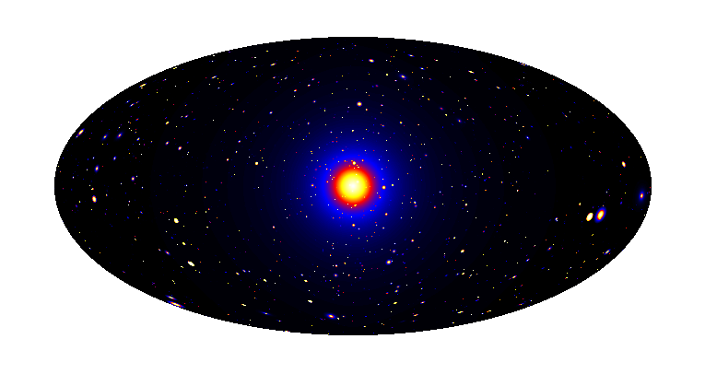
WIMP search strategies/targets
Galactic Center
Milky Way Halo
Dark satellites
Nearby galaxies
Dwarf satellites
Galaxy Clusters
extragalactic background
+ Spectral Lines
Dark Matter simulation:
Pieri+(2009) arXiv:0908.0195
Notes:
Tal vez antes de poner esto estaría bien introducir el tipo de plot sv vs mass

Slide 11
CTA DMEP preliminary studies
Galactic Center
DWARFS
LMC
Galaxy Clusters
arXiv: 1709.07997

Slide 12
CTA DMEP preliminary studies
Galactic Center
DWARFS
LMC
Galaxy Clusters
arXiv: 1709.07997

Slide 13
Now the real work started…
Example: Galactic center
CTA DMEP Galactic center Task Force KSP, in prep.
[Plots courtesy of G. Zaharijas]

Slide 14
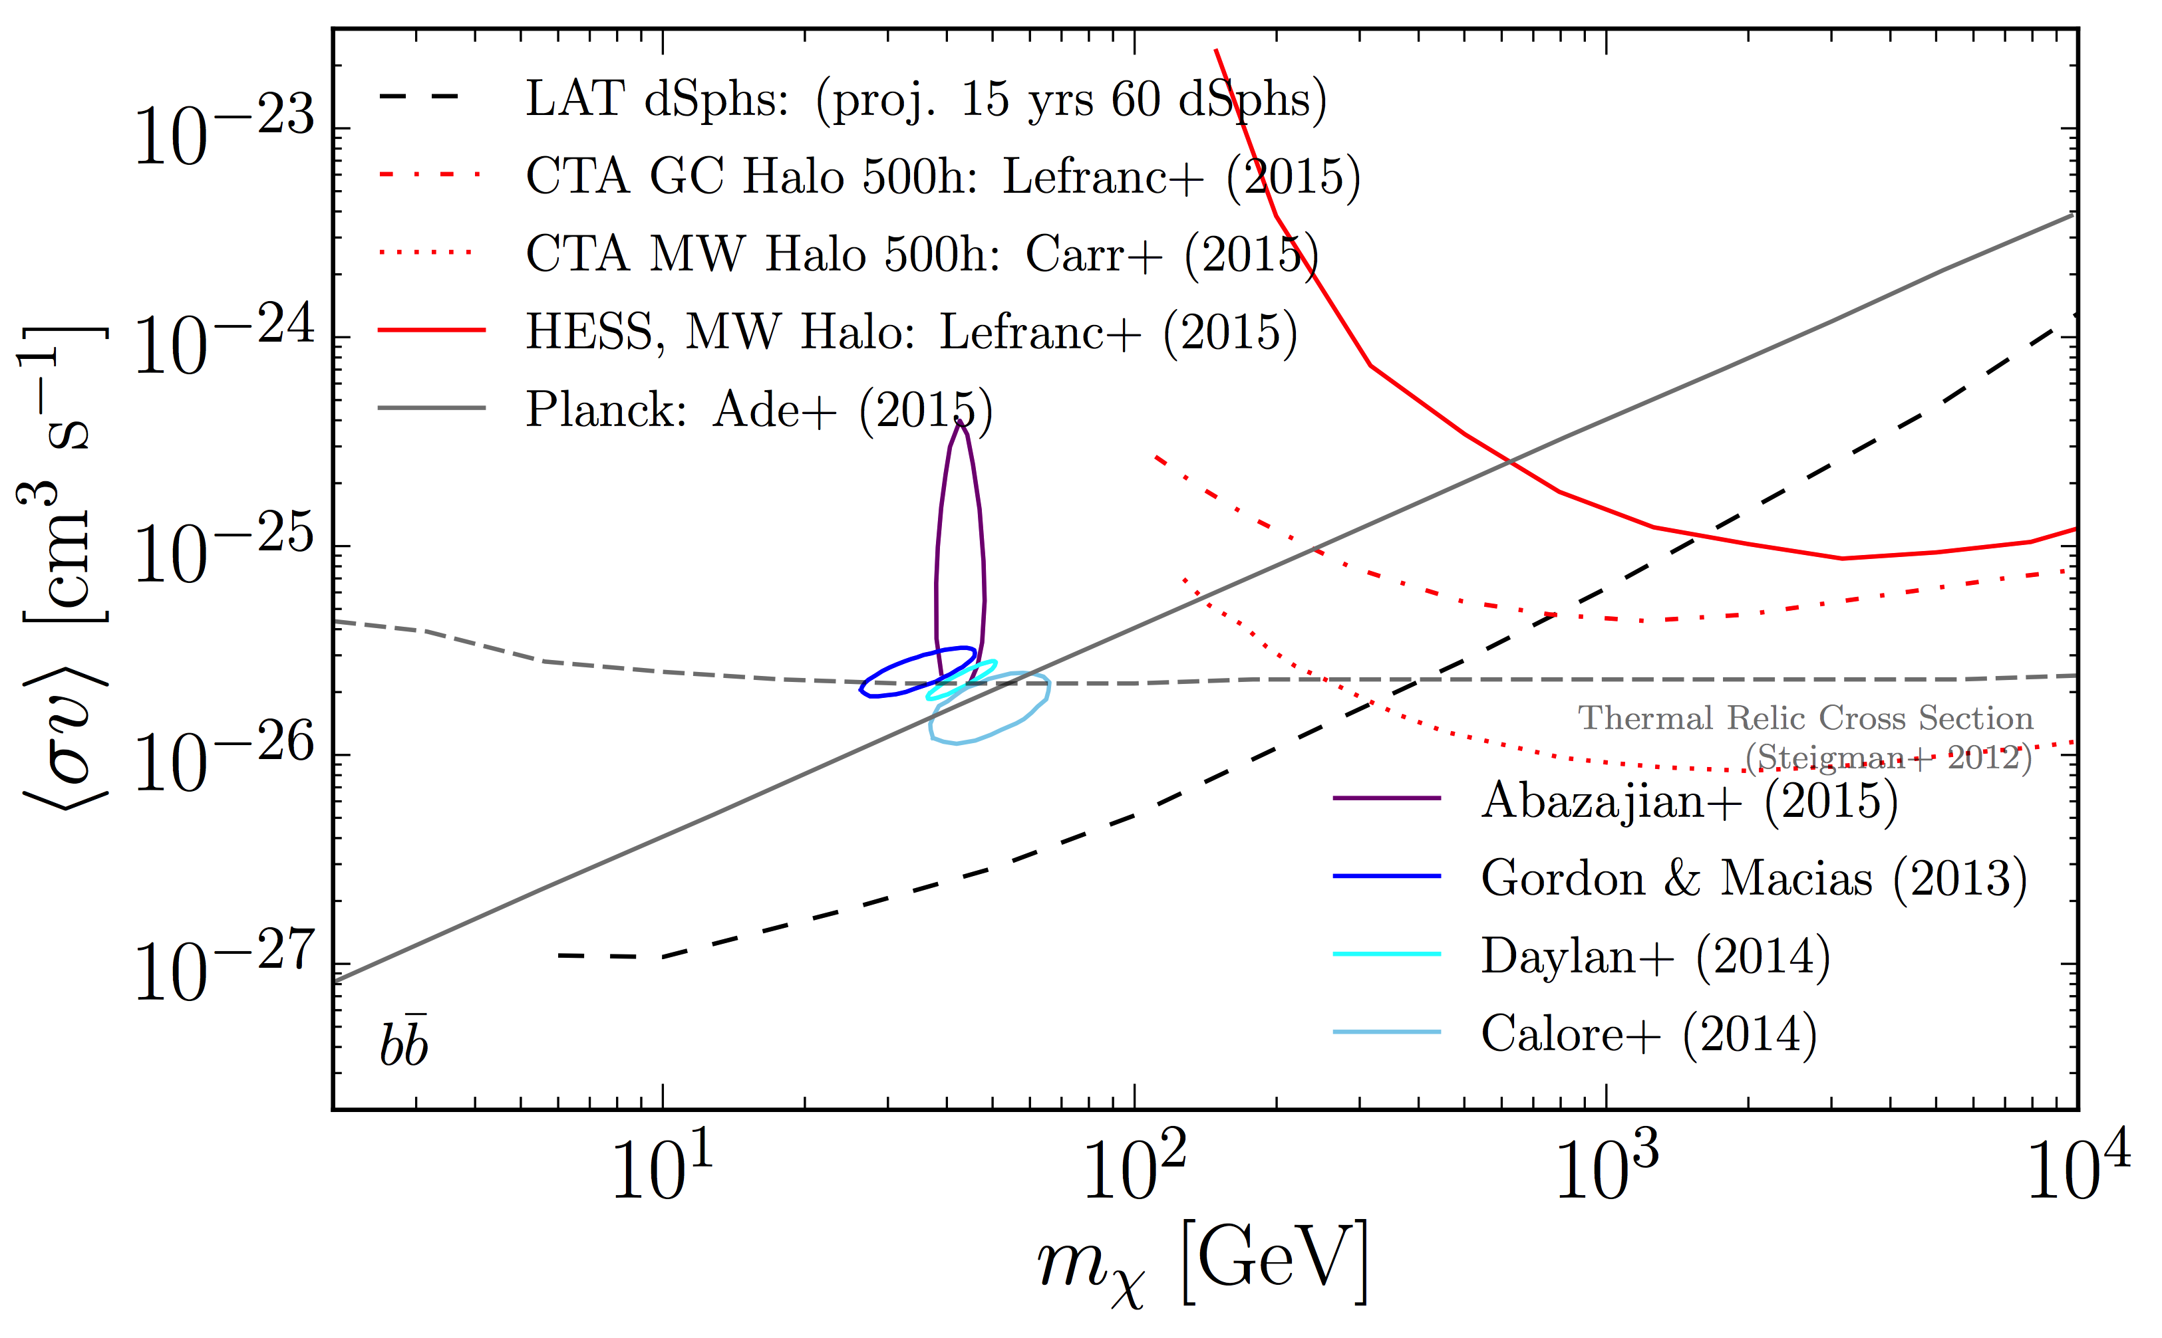
(γ-ray) WIMP DM searches: tomorrow
Charles, MASC, et al.,
Physics Reports [1605.02016]
Discovery of new dwarfs the best tool to improve upon the current DM limits.
Fermi + CTA may (fully?) test the WIMP miracle (by ~2025?)
Critical to keep the diversity of astrophysical targets, experiments, messengers, DM particle candidates.

Slide 15
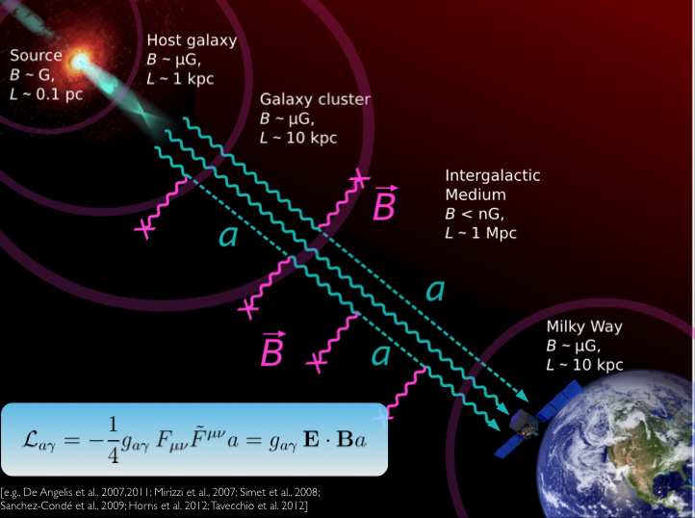
Beyond WIMPs: axion-like particles
Figure courtesy of M. Meyer

Slide 16
Always welcome to join an ongoing effort!
(or to start a new one)
Just drop me and Gabi an email anytime.

Slide 17
CTA-PHYS meetings
GENERAL MEETING (Lugano, 3-7 June 19)
Two general CTA meetings / year.
Dedicated F2F SWG meeetings from time to time.
From time to time, general calls.
If you are planning to attend and want to join the DMEP session, please leave your name in this page.

Slide 18
I want to get involved…
What should I do now?
Check out the webpage of the SWG you are interested in.
Subscribe to the SWG mailing list.
Identify the work you want to get involved in, and let the conveners know.
If a new project, let the conveners know.
Remember: if your project is KSP-related, you will need to work within the corresponding “task force”.
Ask any questions to the conveners.
Attend SWG meetings and enjoy interacting with the rest of the team!

Slide 19
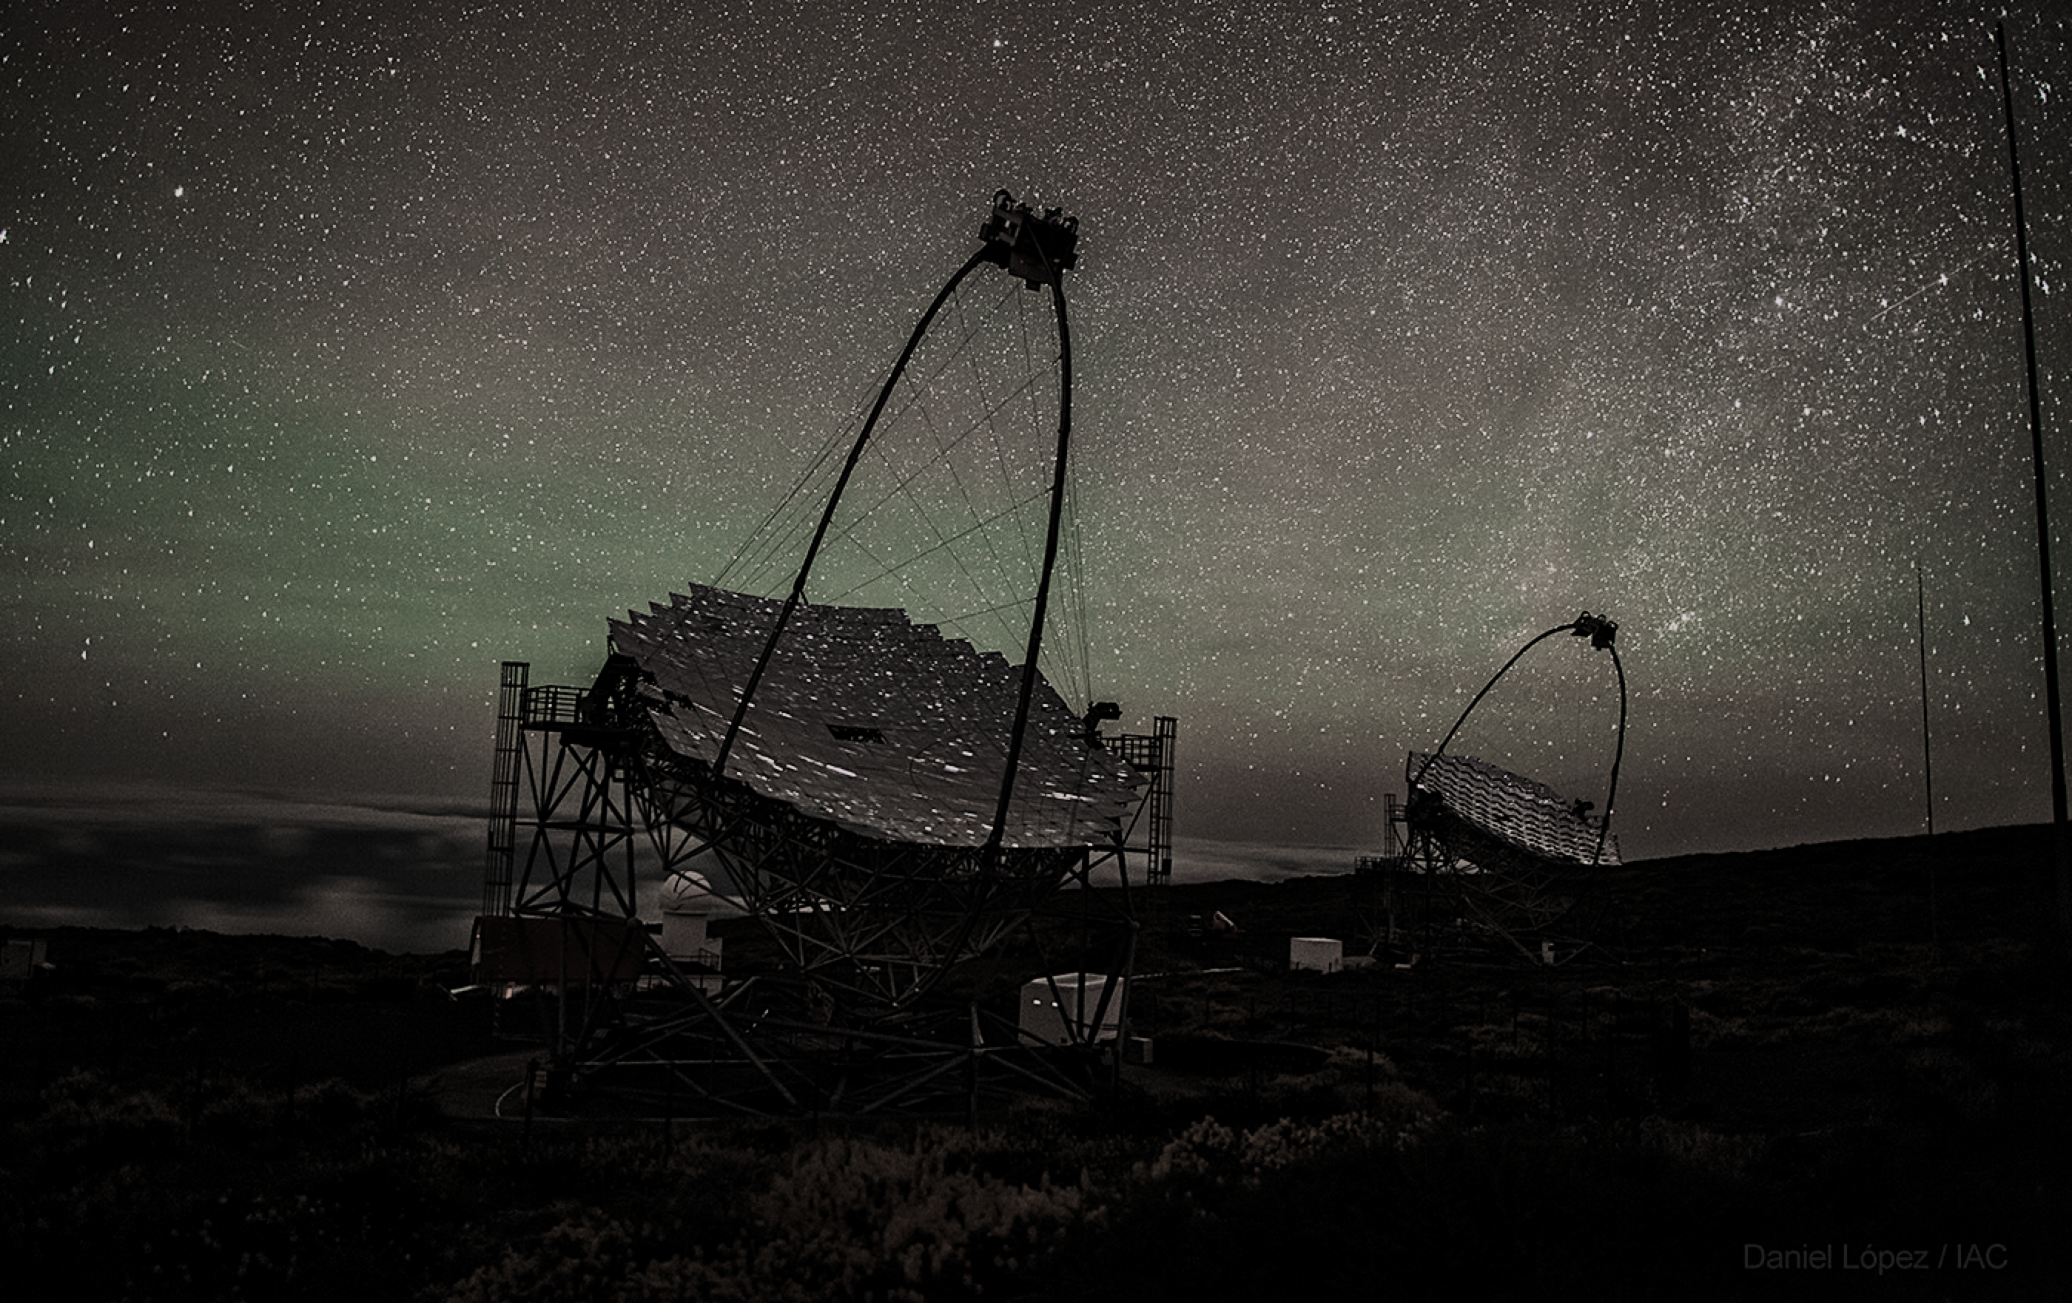
Looking forward
to your participation!
Miguel A. Sánchez-Conde
miguel.sanchezconde@uam.es
www.miguelsanchezconde.com
https://projects.ift.uam-csic.es/damasco/

