Slide 1
Early Results of Fast HI-galaxy Mock Catalogue Clustering Analysis from ViMala
Ittipat Promnorakid
Chaichalit Srisawat
Utane Sawangwit

Slide 2
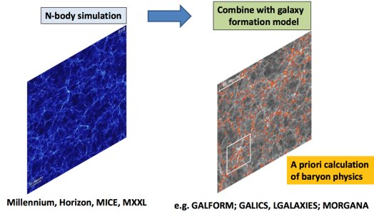
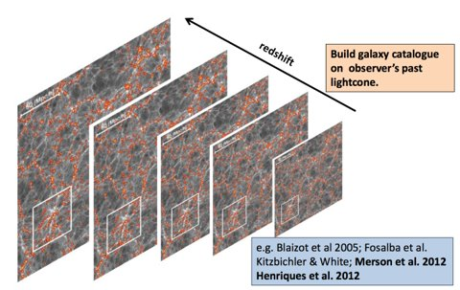
ViMala: The Virtual Observatory from Mock Galaxy Catalogues
$$h=67.3$$
$$Ω_{M}=0.315$$
$$Ω_{Λ}=0.685$$
This part has been done by Chaichalit Srisawat

Slide 3
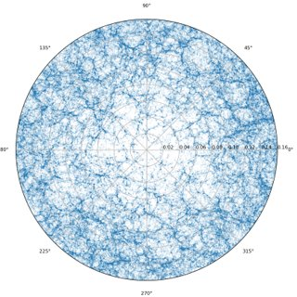
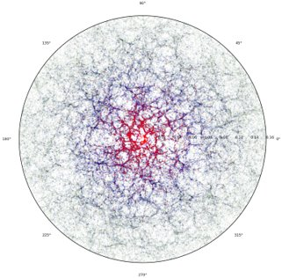
ViMala: The Virtual Observatory from Mock Galaxy Catalogues
Apply Semi-analytics model (SAM):
Position, Velocity
Cold gas, Hot gas
Stellar mass, black hole, metallicity, etc.
FAST: HI Galaxy survey
21-cm hydrogen line
Observed frequency ~1.23 - 1.42 GHz

Slide 4
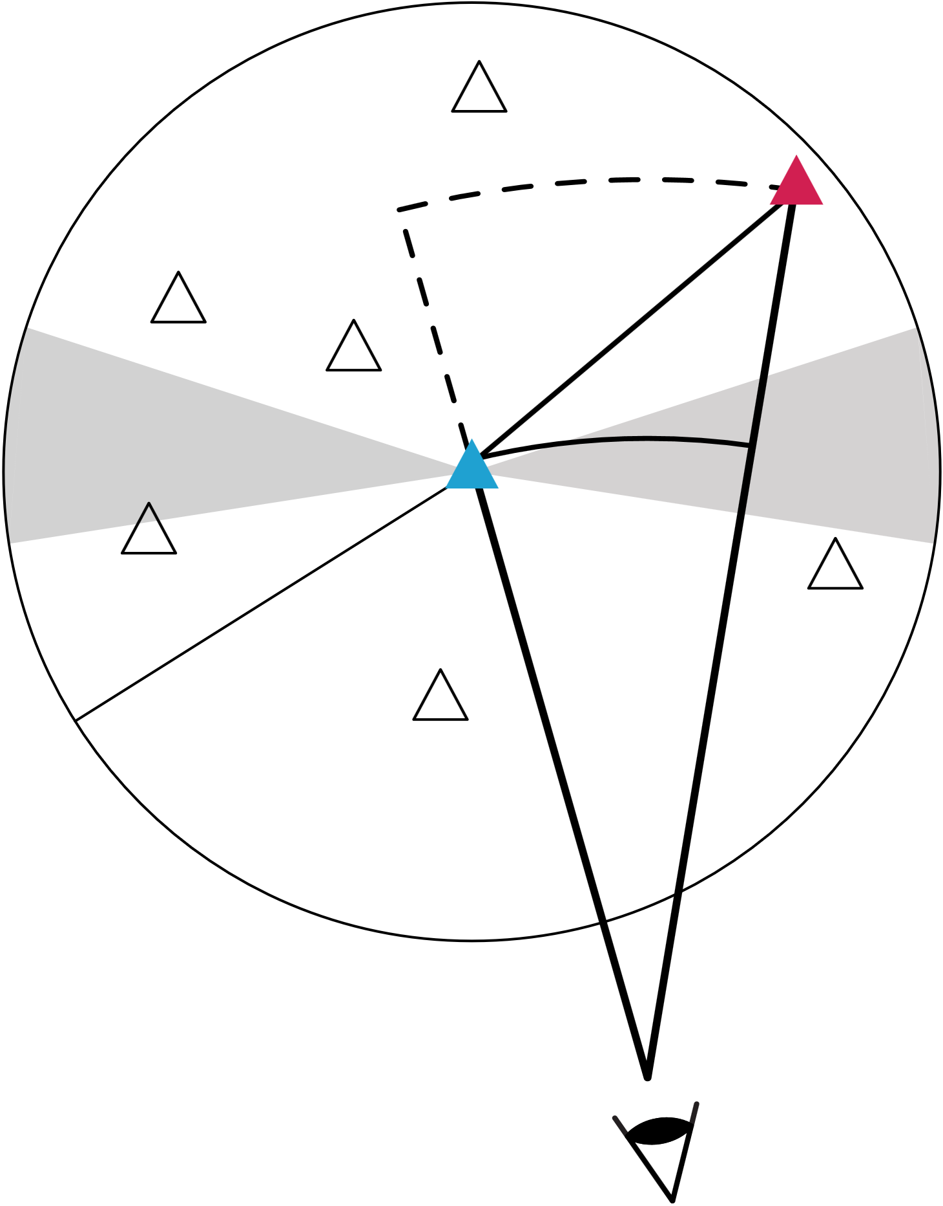
The two-point correlation function
$ξ\left(r\right)$ measure the excess probability of finding a pair of objects separated by distance $r$ relative to that expected from a randomly distributed process.
$$δP\left(r\right)=n^{2}\left[1+ξ\left(r\right)\right]δV_{1}δV_{2}$$
The $ξ\left(r\right)$ is computed using the Landy-Szalay estimator (1993).
$$ξ_{LS}\left(r\right)=1+{\left(\frac{N_{rd}}{N}\right)}^{2}\frac{DD\left(r\right)}{RR(r)}−2\left(\frac{N_{rd}}{N}\right)\frac{DR\left(r\right)}{RR\left(r\right)}$$
Another $w\left(r\right)$ is computed, Hamilton estimator (1993), as cross-check since it doesn’t require normalization factor.
$ξ_{H}=\frac{DD\left(r\right) ×RR\left(r\right)}{DR{\left(r\right)}^{2}}−1$
$$r_{⊥}, r_{p}$$
$$r_{||}, π$$
$$r^{′}$$
$$r$$

Slide 5
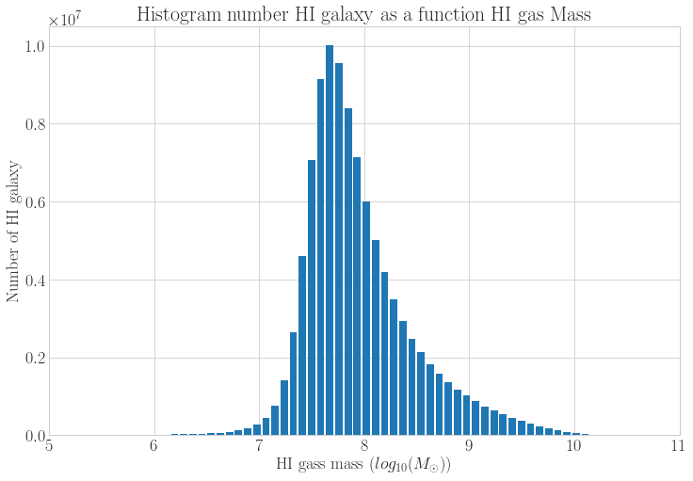
The two-point correlation function
Galaxies contain no neutral hydrogen have been dropped off
Number of random particle needed for counting
HI mass bin​ | $$Mass ​$$ $$\left({10}^{6} M_{⊙}\right)$$ | Particles$\left({10}^{6}\right)$ | Random Particles $\left({10}^{6}\right)$
bin1​ | 6 - 7.4​ | 7.6 | 100
bin2​ | 7.4 - 7.9​ | 48.5 | 500
bin3​ | 7.9 - 8.7​ | 35.0 | 500
bin4​ | 8.7 - 10.4​ | 9.29 | 500
Estimate time for each pair type counting
Mass Bin | Pair Count | Time
1 and 4 | DD | 2 minutes
 | DR | 1 hour 30 mins
 | RR | 3 days
2 and 3 | DD | 1 hour 30 mins
 | DR | 3 days
 | RR | 3 weeks
We use Corrfunc python package for counting each pair

Slide 6
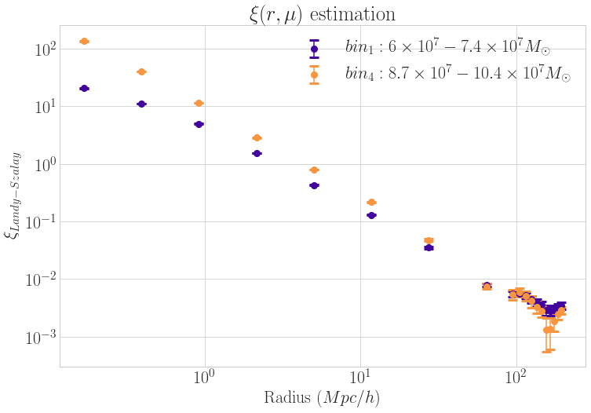
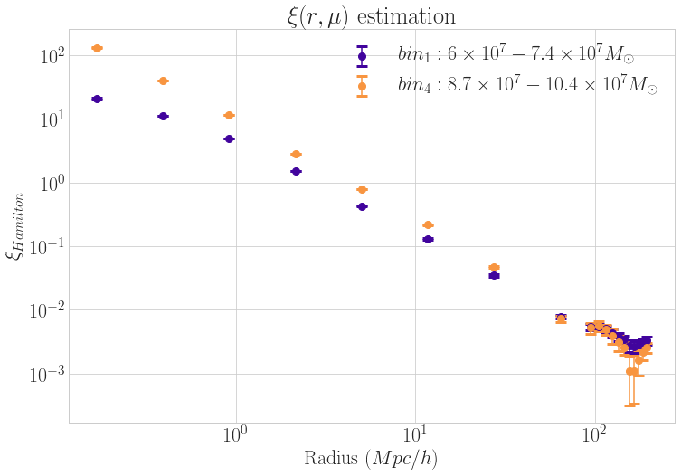
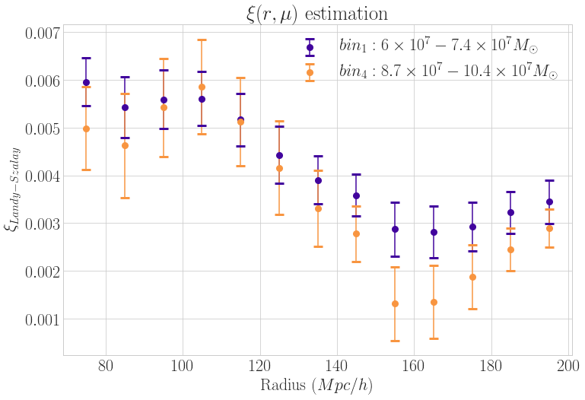
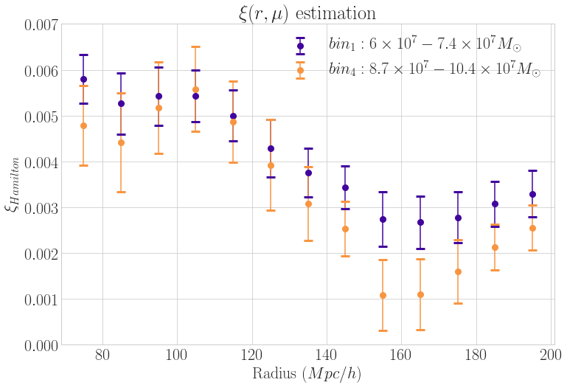
Landy-Szalay estimation
Hamilton estimation

Slide 7
Thank you very much

