Slide 1
NARIT Cosmology & High-Energy Astrophysics Research Kick-Off meeting
Utane Sawangwit
NARIT Extragalactic astrophysics and Cosmology Group
5 October 2018, AstroPark, Chiang Mai

Slide 2
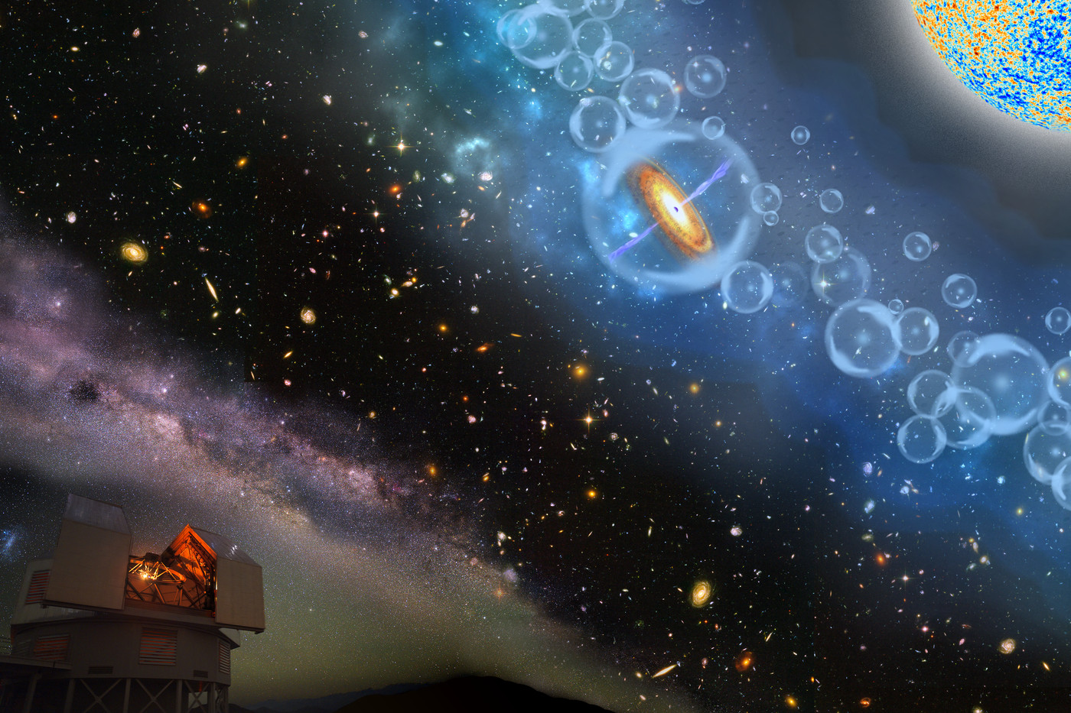
Thank you all for joining
& Welcome to NARIT

Slide 3
Let’s have a kick-off meeting
Expanded Research network (NARIT + Universities)
26 People (13 PhDs) now involved in various projects (from 7 institutes)
Staffs
NARIT: 3 Researchers, 1 Post-doc, 2 RAs (2 more starting in Nov.)
External: 6 Lecturers (KU, SWU, KKU, MFU, SUT)
3 Student Advisors @ Universities (CMU, SUT)
Students (most are/will be funded as NARIT Student research fellowship)
1 PhD
10 Masters

Slide 4
Goals of this Kick-off
Introduce & Familiarize ourselves to one another
Share what you are doing and learning your collaborators expertise’s & Strengths
Facilitate further collaborations and strengthen our research network
Updates on the activities planned for this year
Help to advertise, prepare to participate & help out with needed man-power with various tasks
Doing Research alone is kind of boring and may not be as productive as you may think

Slide 5
HIgh-energy astrophysics and COsmology Research Network (HICORN)
The 2nd meeting of the HIgh-energy astrophysics and COsmology Research Network (HICORN) meeting. The first meeting was organized in Jan. 2018 at Srinakharinwirot University, Bangkok. (see https://indico.narit.or.th/e/HICORN2 for talks’ slides)
Current Members (Chaired by Prof. Boonrucksar)
Aj.Dr. Maneenate Wechakama, Kasetsart University (KU)
Aj.Dr. Patipan Uttayarat, Srinakharinwirot University (SWU)
Aj.Dr. Chakrit Pongkitivanichkul, Khon Khaen University (KKU)
Aj.Dr. Anant Eungwanichayapant, Mae Fah Luang University (MFU)
Aj.Dr. Wasutep Luangtip, Srinakharinwirot University (SWU)
Aj.Dr. Poemwai Chainakun, Suranaree University of Technology (SUT)
Dr. Utane Sawangwit, NARIT
Dr. Apimook Watcharangkool, NARIT
Dr. Siraprapa Sanpa-arsa, NARIT

Slide 6
Goals of HICORN
National Joint research on High-Energy astrophysics and Cosmology
Organising a concerted effort in applying for funding from the NRCT next fiscal year → Grouped research grant proposal (c.f. individual grant proposal we’ve been doing for many years)
Planning of future (if any) and better utilisation of current and up-coming National facilities and NARIT involvement in major international projects in HE astrophysics and cosmology → Multi-Wavelength & Multi-Messenger (MW/MM)

Slide 7
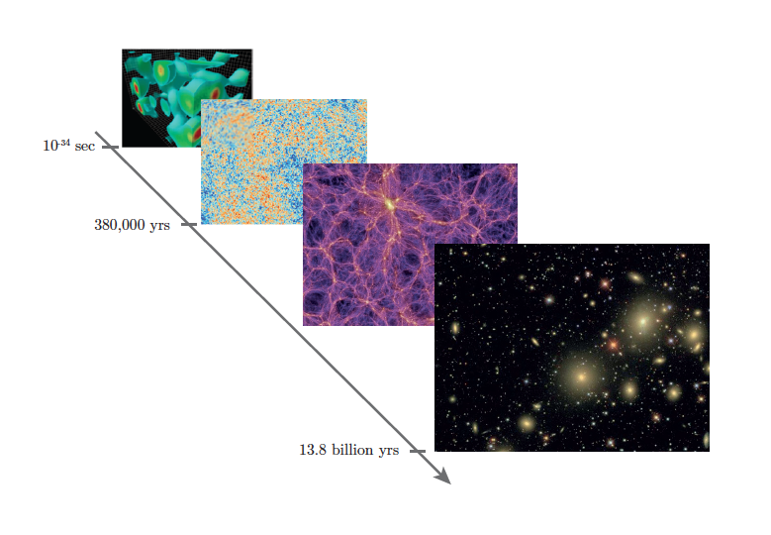
Current issues in Cosmology & HE Astro
What is the underlying physical framework of the universe? (Gravity Theory)
What is the Dark Energy & Dark Matter?
How does the large-scale structures (galaxy, clusters etc.) form and evolve, what re-ionize the universe?
What is the exact mechanism of accreting onto compact objects and feedback mechanism?
...

Slide 8
How do we plan tackle them?
Theory
Simulations
Observations, especially MW & MM if we are to get the full picture
Advanced computational techniques, Machine Learning

Slide 9
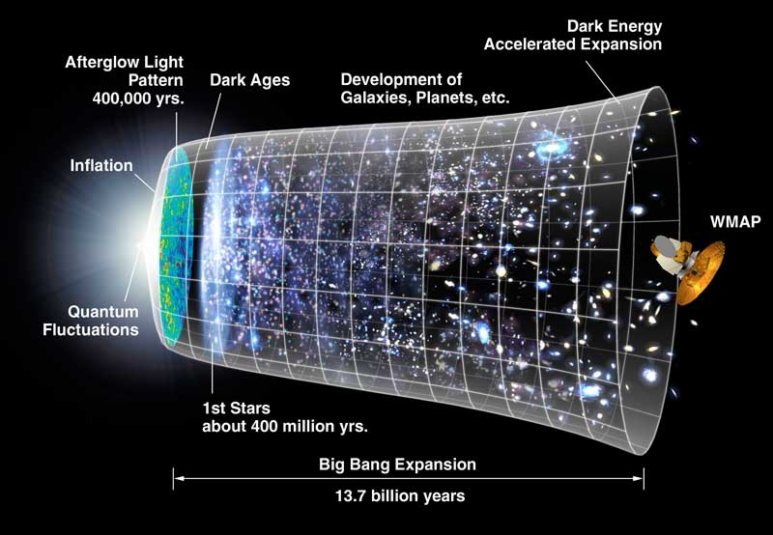
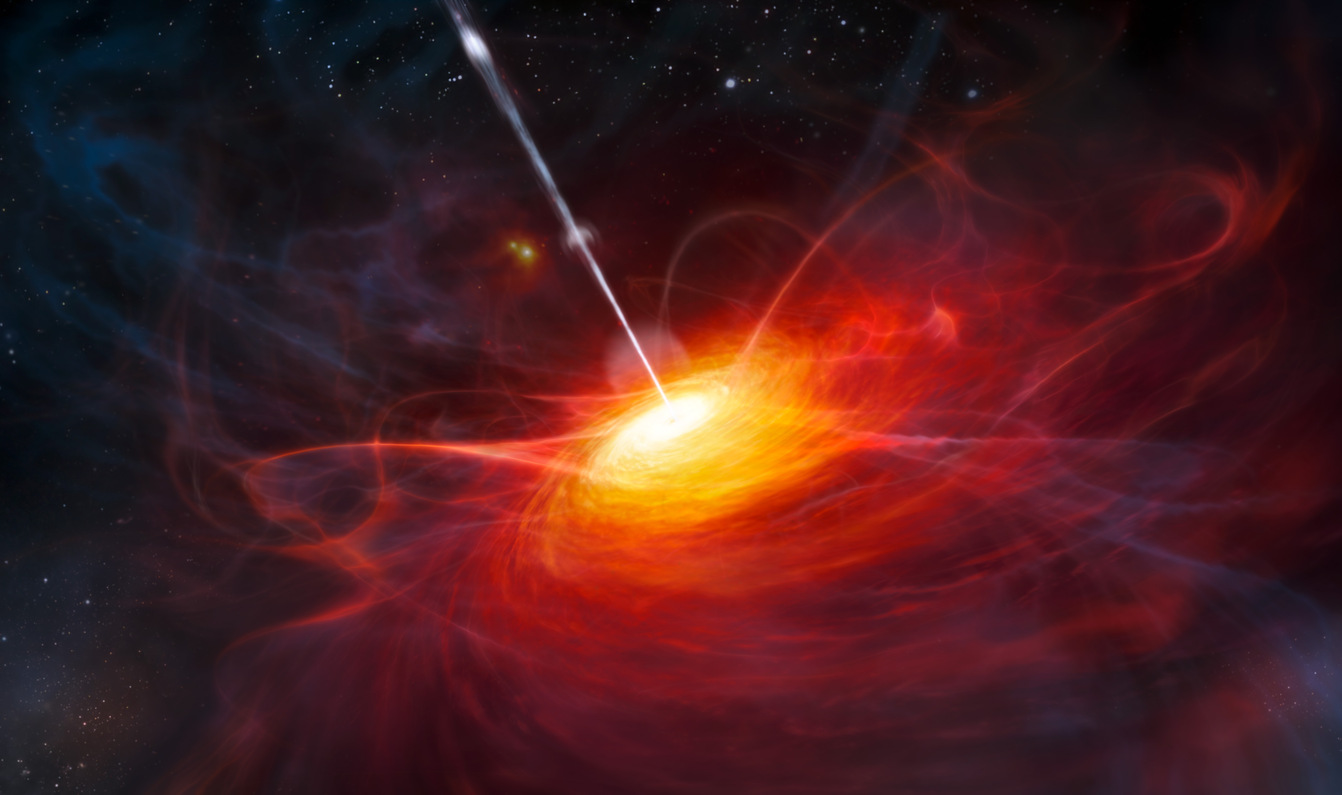
Research themes within the network
Cosmology
Dark Matter detection and models (DM)
Cosmic Microwave Background (CMB)
Epoch of Re-ionization (EoR)
Large Scales Structures (LSS)
High-Energy Astrophysics Phenomena
AGN variability & feedback mechanism
Compact Objects and accretion physics
Gravitational Waves (GW)

Slide 10
Research projects within the network
Funding for “Research Program” will be
submitted to TRF for 3-year projects (2020 - 2022)
Cosmology
DM: Indirect Detection (JUNO, CTA)
CMB: ISW & Weak Lensing
EoR: High-z quasars and neutral HI
LSS: Weak Lensing (Voids & Clusters), HI galaxy survey (FAST)
High-Energy Astrophysics Phenomena
AGN: MW variability, coronal gas modeling, pair-haloes
CompObj&Accre: ULXs, binary pulsar
GW: Quantum Detector, Stochastic background(?)

Slide 11
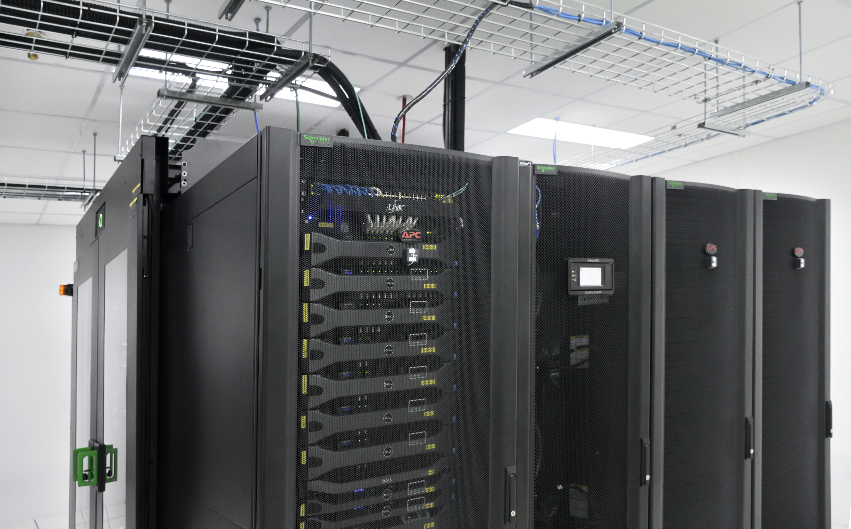
Large experiments & Infrastructures
GW
Neutrino
X-ray + UV
𝞬-ray
Radio
Microwave
Optical+IR
MW/MM
HPC

Slide 12
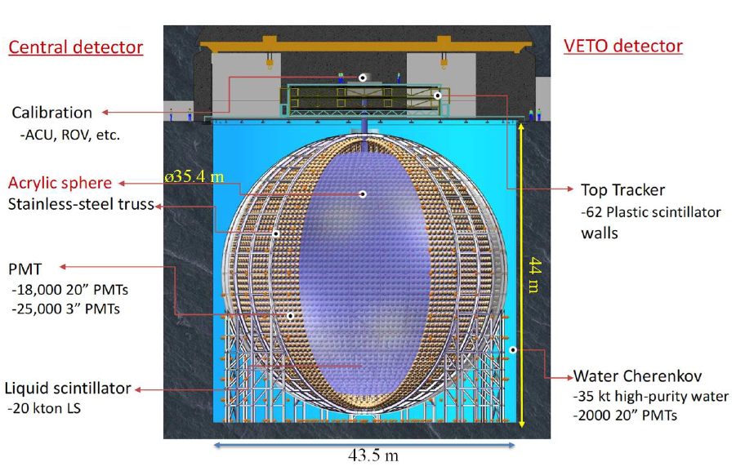
MWL/MM High-energy astrophy. & Cosmology
Indirect Dark Matter search
Neutrino: JUNO
Gamma-ray: CTA
Multi-wavelength AGN variability
Optical
X-ray
Gamma-ray
Radio
Start taking data 2021/2022
Full CTA Array config 2025/2026
First LST, first light Oct/Nov 2018
4 LSTs in

Slide 13
Strategy for building up manpower
More Cosmology & HE Astrophysics Lecture Courses at universities
NAIT Student Research Fellowship program
Recruiting via Thai CERN – DESY program (need more exchange programs perhaps via large experiments involvement)
Regular Schools & Workshops (Feb 18 -22, NARIT-CTA Astro-particle School, see also Tukky’s school and workshop lists for 2019)

Slide 14
“Twinkle, twinkle, quasi-star
Biggest puzzle from afar
How unlike the other ones
Brighter than a billion Suns
Twinkle, twinkle, quasi-star
How I wonder what you are”
George Gamow, “Quasar”, 1964

